Slide 1
Thinh Nguyen
Material Manipulation Using the Leap Motion
Osaka University
July 10, 2013

Slide 2
Current Progress
Deformed lathe object using height maps, didn’t quite get the effect that I wanted. Now doing deformations with other techniques/not as rigid of a technique.
Researching/experimenting with various techniques to do so. Created gestures to customize beginning mesh (size/width gestures).

Slide 3
Next Week
Deform geometry using various techniques. Try out CSGs, Marching Cubes algorithm, per vertex intersections.

Slide 4
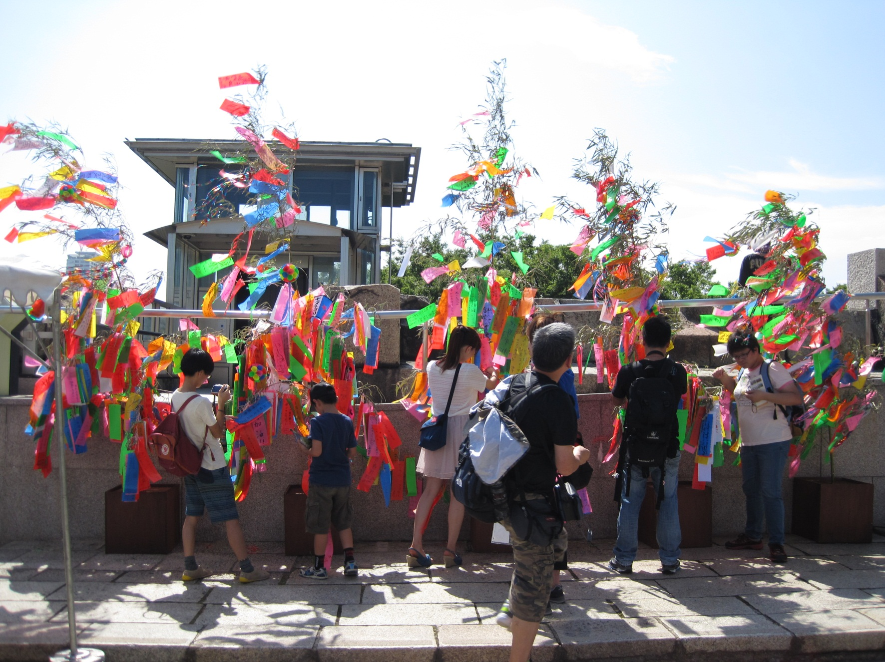
Wishing Trees at Osaka Castle

Slide 5

Kids playing at a local festival

Slide 6
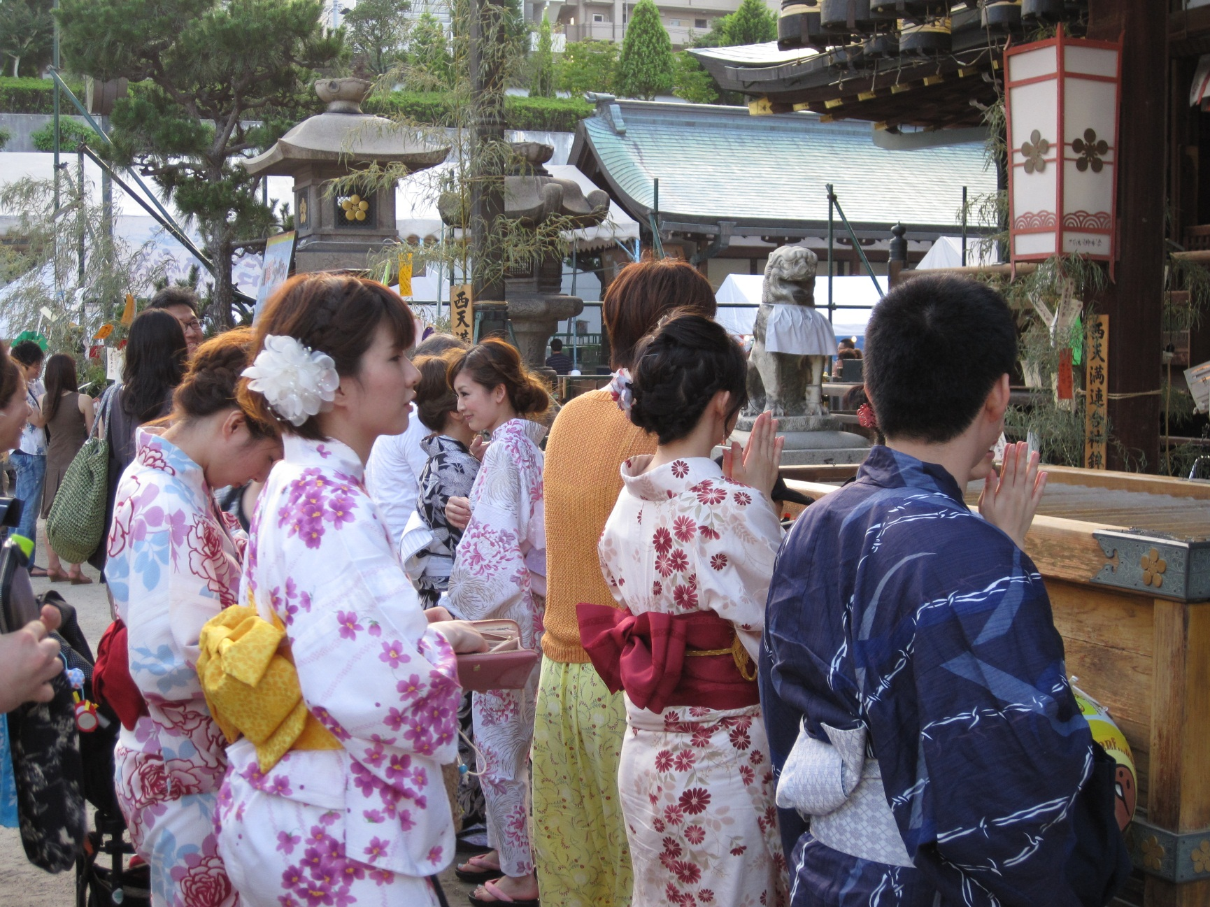
Near Offering Box At Local Temple

