Slide 1
Thinh Nguyen
Material Manipulation Using the Leap Motion
Osaka University
July 24, 2013

Slide 2
Current Progress
Skewed geometry inwards using raycasted techniques, runtime quite slow with >5 rays.
Worked on coupling adjacent face surfaces (nearby neighbor faces of the mesh also getting gradual changes and not just the one the raycaster selected).
Optimizations to rendering loop when finger objects are too far away from mesh object

Slide 3
Current Progress Continued.
Geometry moves both inward and outward now.
Slight bug when moving inwards too fast, once raycaster is already past the surface mesh the raycasted technique does not work anymore until the finger ray is outside again.
Read a variety of VR sculpting papers to see what types of techniques and problems they were having.

Slide 4
Next Week
Come up with a way to actually add/subtract vertices to the existing mesh.
Finish up coding the face coupling in the mesh class. Solve the “Finger moving in the mesh too fast” problem.
Work on camera rotations and movements to work with mesh manipulation.

Slide 5
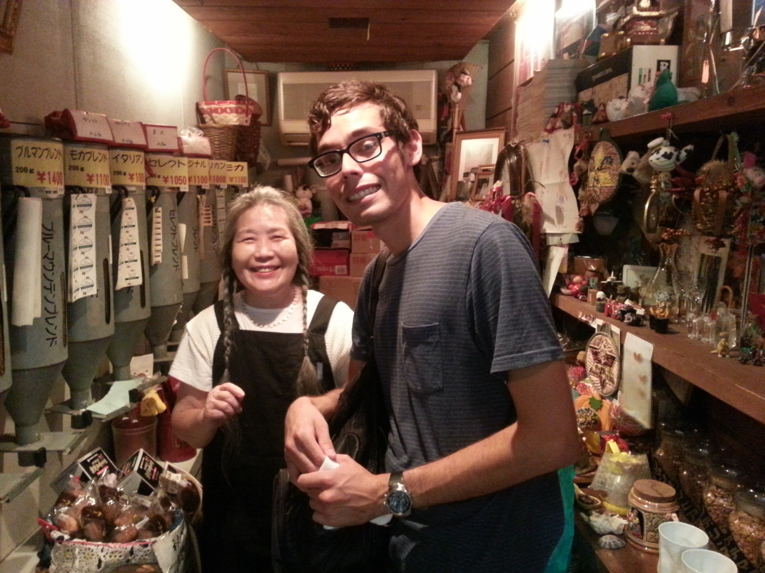
Local coffee shop (she gave us a bunch of free stuff!)

Slide 6


Slide 7
Special Thanks to:
Jurgen Schulze – UCSD Mentor
Kiyoshi Kiwokawa – Osaka Mentor
Gabriele Wienhausen, Peter Arzberger, Teri Simas, Jason Haga, Prime Staff
Ledell Family

