Slide 1
Informatics Tools for Biodiversity Data Conversion
Kittinan Ponkaew
VisLab, Osaka
8/7/2013

Slide 2
Week 6 Progress
Finished mammals data conversion process. Tested it with Specify and resolved errors.
Finished birds data conversion. Had difficulties dealing with different formats. Resolved corrupted data issues.
Started setting up attachment interface and reading the documentation of Specify 6.5.

Slide 3
Plans for Week 7
Retry converting Herps database. There was a problem with conversion process
Work on Paleo data sets and test them.
Write up documentation for different data.

Slide 4
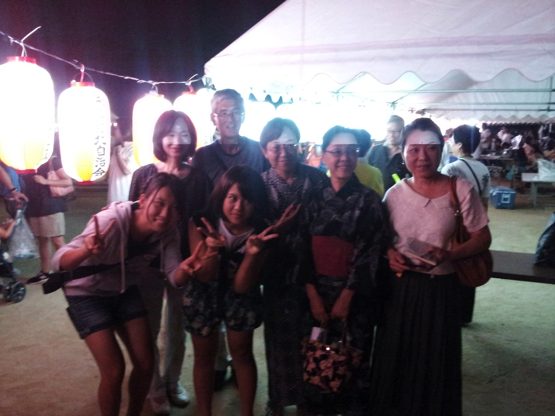
Cultural Exploration

Slide 5
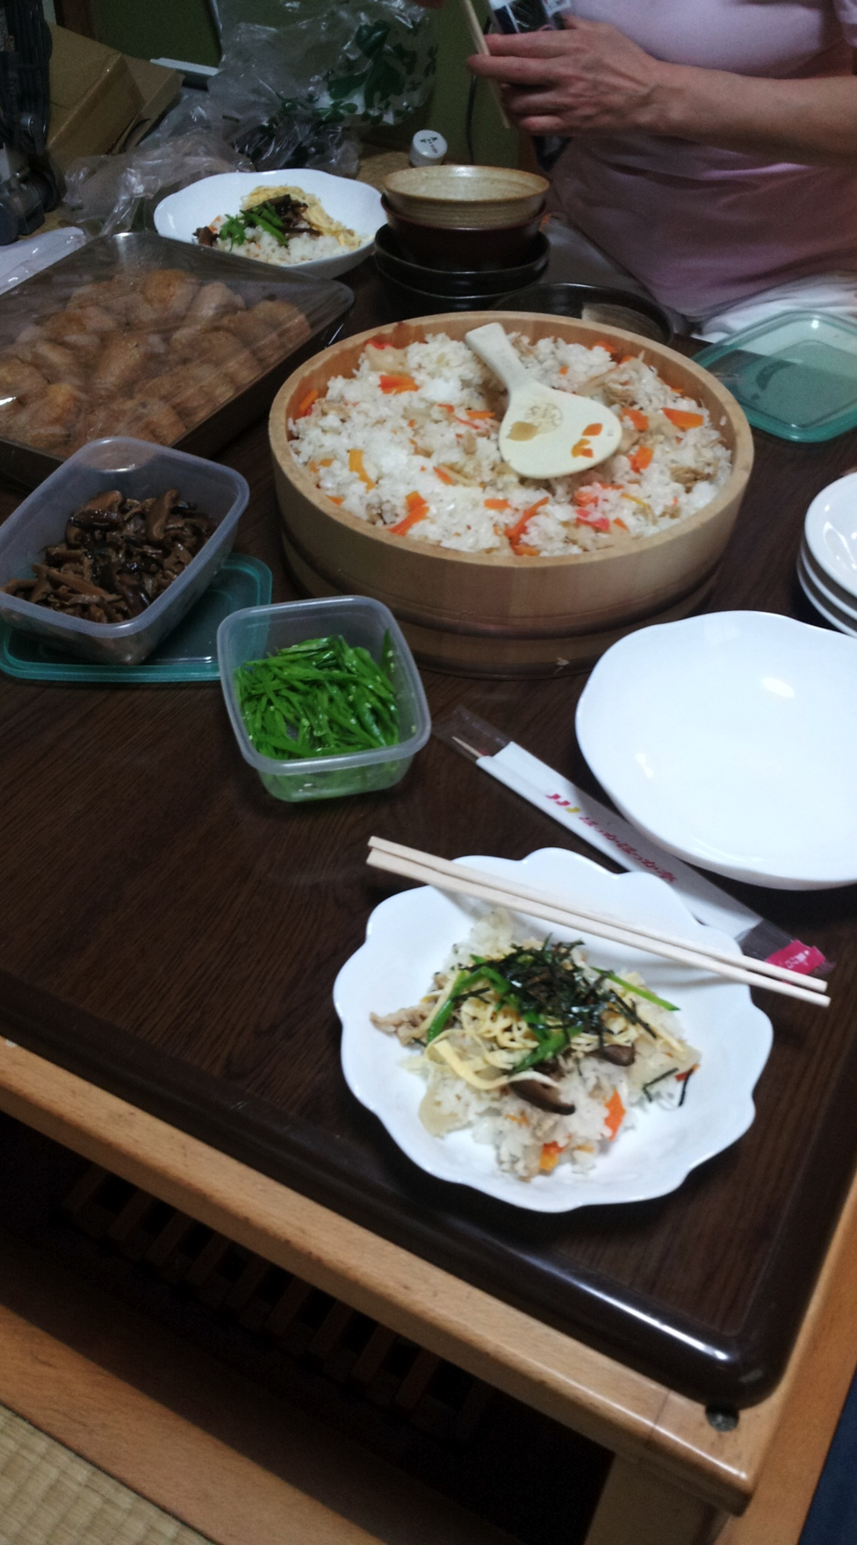
Cultural Exploration 2
Food prepared by the friendly neighbors,
after we have established contact, and
they understood that we came in peace.

Slide 6
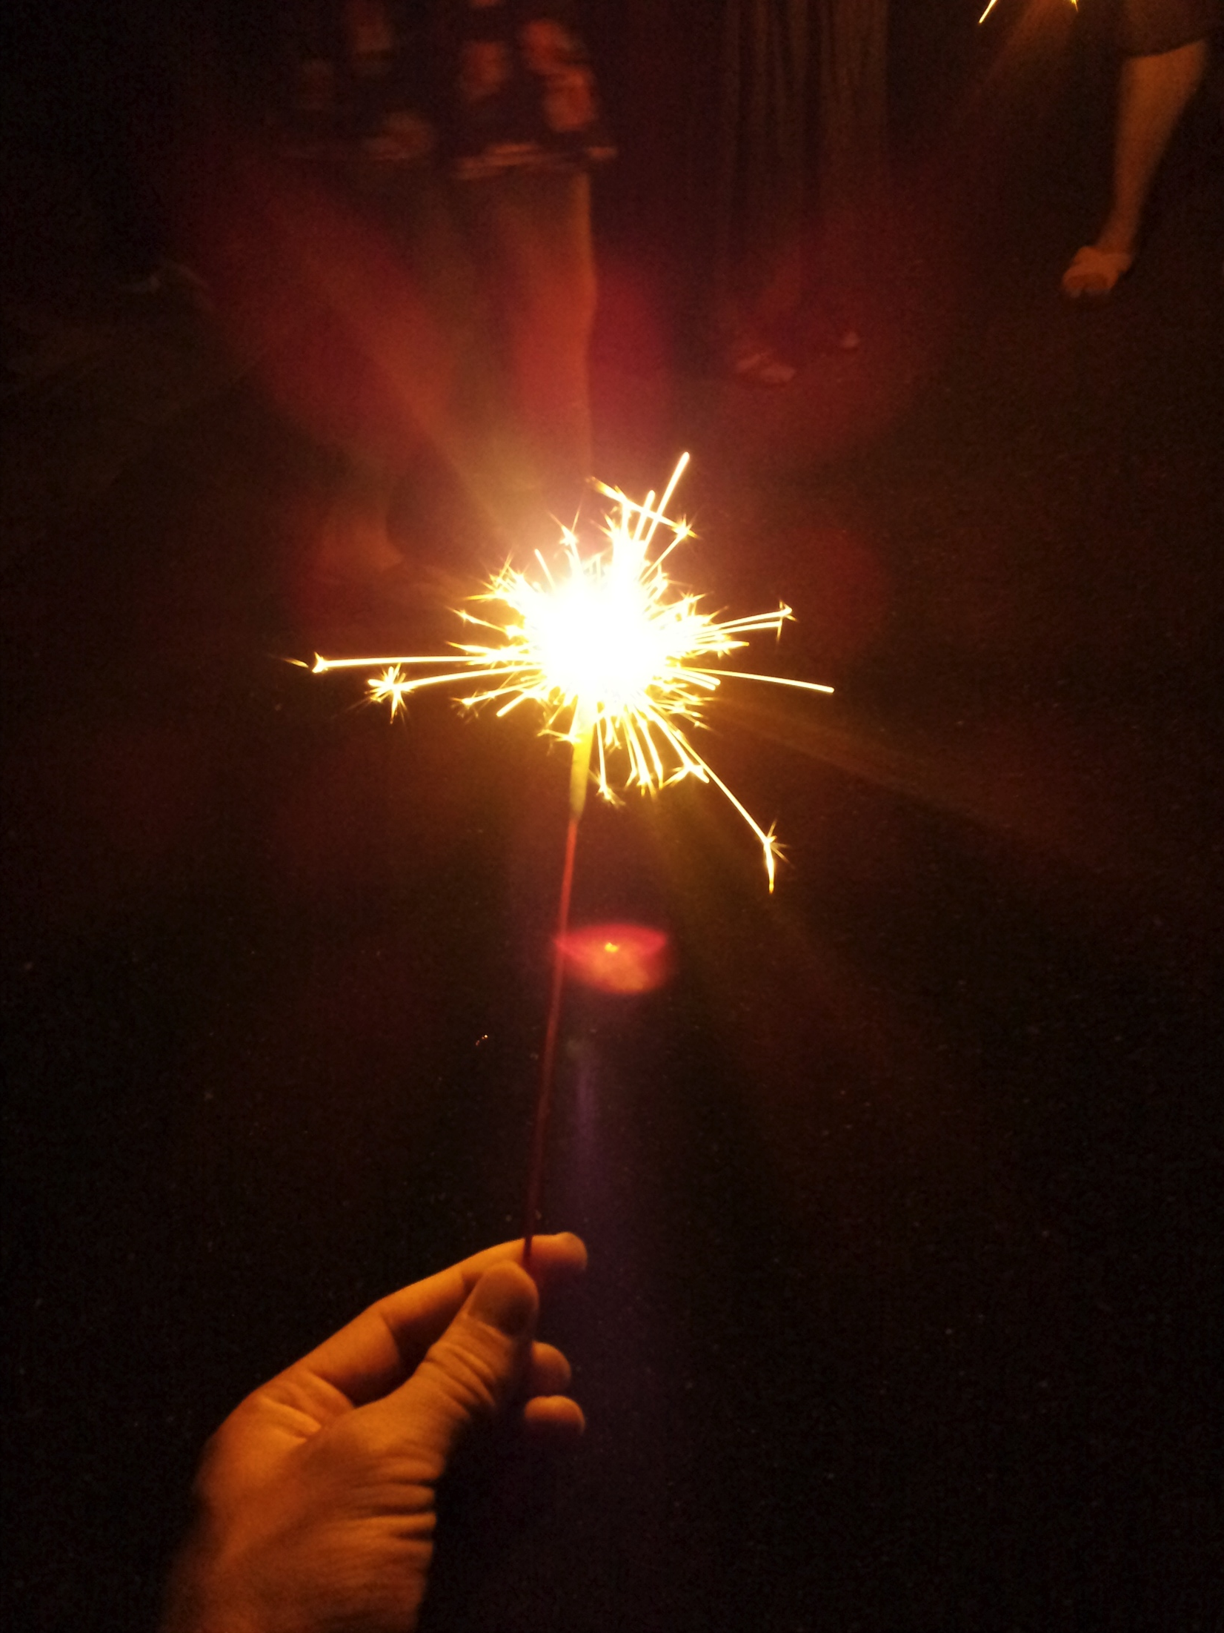
Cultural Exploration 3
After-party fireworks party.

Slide 7
Acknowledgement
Dr. Jason Haga
Dr. Shinji Shimojo
PRIME
NICT
Balboa Park Online Collaboration
PRIME alumna Haley Hunter-Zinck
NSF

