Slide 1
Jesus Rios
Japanese Friendship Garden Mobile Tour
7/3/2013
VisLab Osaka, Japan

Slide 2
Research Project
Android smart-phone application that uses a new location based technology, PlaceSticker, to serve as an interactive guide for the Japanese Friendship Garden in Balboa Park.
The app will contain detailed information about plant collections (e.g. description, place of origin, history), galleries and include a riddle activities for visitors to enjoy and explore the garden

Slide 3
Progress Update
Set up work environment
Set up git repository
Implemented Android action bar
Adapted GridView (Android) to work with multiple items on screen
Create custom version of GridView to force home screen to scroll as a whole (instead of GridView using its separate scroll bar)

Slide 4
Next week’s plan
Implement action bar using ActionBar Sherlock
Change app from using Activity’s to Fragments (Android) for better UI flexibility
Implement swiping in between screens
Abstract certain code for easier reuse
Save application data in between sessions

Slide 5
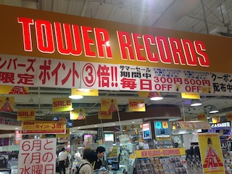
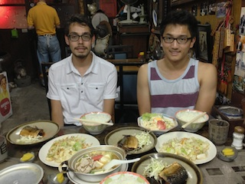
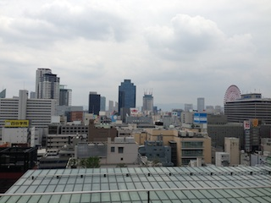
Record store in Japan
Traditional Japanese dinner
View from outside the
VisLab office

Slide 6
Acknowledgements
University of California, San Diego (UCSD)
Dr. Jason Haga
Dr. Peter Arzberger
Dr. Gabriele Wienhausen
Teri Simas
Jim Galvin
Tricia Taylor
National Institute of Information and Technology (NICT)
Dr. Shinji Shimojo
Takata Tomoaki
Balboa Park Online Collaborative (BPOC)
Vivian Haga
Christina DePaolo
Japanese Friendship Garden
Marisa Espinosa
Luanne Kanzawa
Information Services International – Densu Ltd. (iSiD)
PRIME alumna Haley Hunter-Zinck
National Science Foundation (NSF)

