Slide 1
Jesus Rios
Japanese Friendship Garden Mobile Tour
7/10/2013
VisLab Osaka, Japan

Slide 2
Progress Update
Implemented ActionBar Sherlock
Tweaked app UI Home Screen (Made it prettier)
Switched from using Android Activity to Fragments (UI flexibility)
Implemented swipe gestures to move between screens

Slide 3
Next week’s plan
Tweak UI Riddle Screen (Make it prettier)
Add detailed information screen for each Riddle
Implement ‘Up’ button navigation in Android

Slide 4
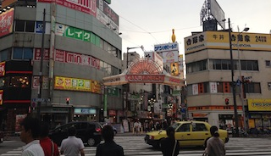
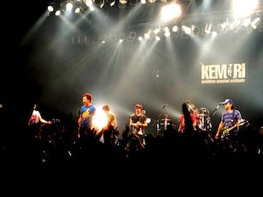
Juuso, train stop on the way back home
KEMURI live show in Namba! It was amazing

Slide 5
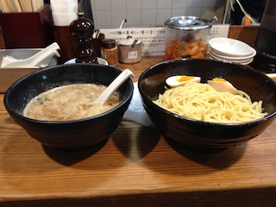
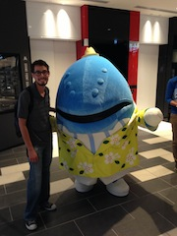
Delicious dipping noodles!
Me and my fish friend

Slide 6
Acknowledgements
University of California, San Diego (UCSD)
Dr. Jason Haga
Dr. Peter Arzberger
Dr. Gabriele Wienhausen
Teri Simas
National Institute of Information and Technology (NICT)
Dr. Shinji Shimojo
Takata Tomoaki
Balboa Park Online Collaborative (BPOC)
Vivian Haga
Christina DePaolo
Japanese Friendship Garden
Marisa Espinosa
Luanne Kanzawa
Information Services International – Densu Ltd. (iSiD)
PRIME alumna Haley Hunter-Zinck
National Science Foundation (NSF)

