Slide 1
Jesus Rios
Japanese Friendship Garden Mobile Tour
8/1/2013
VisLab Osaka, Japan

Slide 2
Progress Update
Created “Credits” page and added info
Added a new map icon
Tested more screen sizes but had trouble adjusting to one screen size without breaking another, more testing required…
Changed the background theme to a brighter white color

Slide 3
Next week’s plan
More screen size testing and UI adjustments
Add garden map to the app
Add “unlock” content for when a user solves a Riddle
Set up mock-up application in the lab
Investigate and implement dynamic fragment UI updates

Slide 4
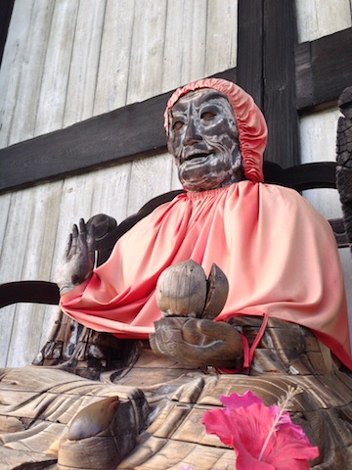
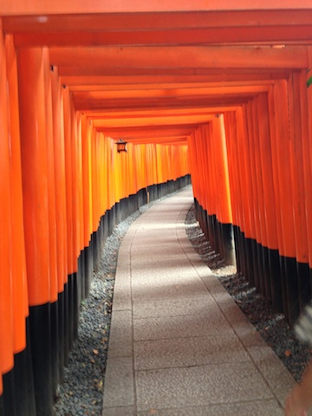

Slide 5
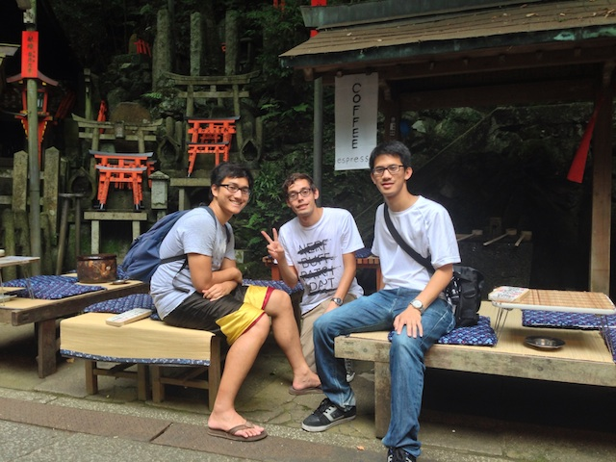
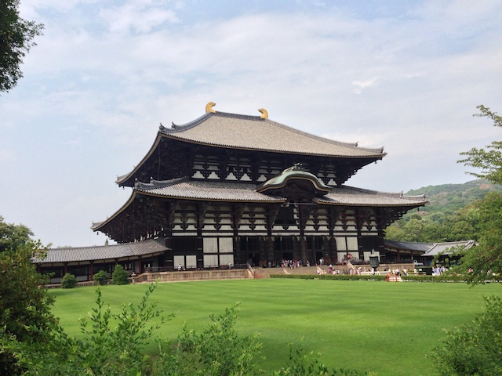

Slide 6
Acknowledgements
University of California, San Diego (UCSD)
Dr. Jason Haga
Dr. Peter Arzberger
Dr. Gabriele Wienhausen
Teri Simas
National Institute of Information and Technology (NICT)
Dr. Shinji Shimojo
Takata Tomoaki
Balboa Park Online Collaborative (BPOC)
Vivian Haga
Christina DePaolo
Japanese Friendship Garden
Marisa Espinosa
Marisa Takeuchi
Luanne Kanzawa
Information Services International – Densu Ltd. (iSiD)
PRIME alumna Haley Hunter-Zinck
National Science Foundation (NSF)

