Slide 1
Configuration and Deployment of a scalable virtual machine cluster for molecular docking
Nara Institute of Science and technology, Nara Prefecture, Japan
Karen Rodriguez
7/3/2013

Slide 2
Overview
Virtual machines (VMs) have been observed to yield molecular docking results that are far more consistent than those obtained from a grid configuration.
Inhomogeneous results obtained from a grid are thought to be due to physical differences in the cluster’s components. This is eliminated by creating and networking cloned VMs.
This study’s objectives consist of constructing a clustered VM environment that is scalable according to job demand and which yields consistent dock results.
This system is to be tested, packaged, and deployed on the PRAGMA grid. This will provide sufficient computing resources to perform a full-scale docking project of large protein databases.

Slide 3
Week 1:
Kevin Lam and I arrived at Nara Institute for Science and Technology (NAIST) June 23,2013. Met Ichikawa-sensei and received a brief tour of the laboratory and living accommodations.
Began installation of software necessary for VM creation and management (Debian OS, LVM configuration, and Xen) upon suggestion of Wen-wai Yim, a previous PRIME student familiar with virtual clusters.
Further discussion with Dr. Haga and Ichikawa-sensei helped us determine that it would be more beneficial to utilize CentOS 6 with KVM and work from there since the Rocks/KVM platform is the most advanced to date.
Installed CentOS 6 and the necessary VM packages on a lab computer (HP Z400 Workstation). Updated software, configured host bridges.
Created first VM with CentOS 6 and installed docking software, cloned thrice.

Slide 4
Future Plans
Network VM’s into a single cluster.
Perform a small-scale docking test on the virtual cluster.
If results are satisfactory, will expand virtual cluster in terms of size.
Create an environment of layered clusters.
Investigate Amazon Elastic Cloud applicability in this project and how to implement.
Amazon Elastic Cloud (EC2) is a web service that permits automated resizing of the cluster depending on host demand. It would theoretically be capable of spawning and destroying virtual machines to adjust computing capacity.
If tests yield satisfactory results, will acquire necessary account and requirements for its execution.
Also will investigate VM packaging and preparation measures for migration and deployment.

Slide 5
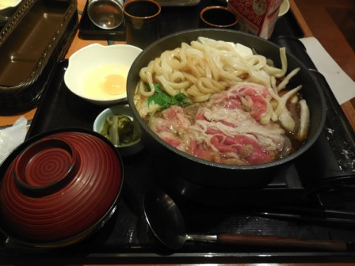










The Japan Experience

