Slide 1
Configuration and Deployment of a scalable virtual machine cluster for molecular docking
Nara Institute of Science and Technology, Nara Prefecture, Japan
Karen Rodriguez
7/17/2013

Slide 2
Overview
Virtual machines (VMs) have been observed to yield molecular docking results that are far more consistent than those obtained from a grid configuration.
Inhomogeneous results obtained from a grid are thought to be due to physical differences in the cluster’s components. This is eliminated by creating and networking cloned VMs.
This study’s objectives consist of constructing a clustered VM environment that is scalable according to job demand and which yields consistent dock results.
This system is to be tested, packaged, and deployed on the PRAGMA grid. This will provide sufficient computing resources to perform a full-scale docking project of large protein databases.

Slide 3
Week 3:
Tested dock using test suite and compared results. We are close yet there is some discrepancy.
Resolved dock+MPI run issues such that jobs are sent to all machines and energy score results are consistent across the cluster (both for grid- and amber-based docking).
Tried compiling several input ligand files into one and running against a single receptor, results seem ok.
There are occasional firewall issues that cause MPI to not send jobs to all nodes
Experienced some problems with files changing back to default on their own.

Slide 4
Future Plans
Find a permanent solution to firewall issues (firewall is turned off now, but need a long-term solution once it’s in the cluster).
Fix scripts to prevent defaulting dock input files whenever an error occurs.
Determine if energy score discrepancies are significant and if they can be easily dealt with (i.e., is it an offset?). If not, look into other types of compilers to use with dock.
Open MPI currently sends all jobs to all nodes. Although this has been useful as a test for result consistency on the cluster, we need to find a way to distribute jobs to nodes according to available processing power.

Slide 5
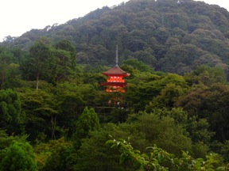

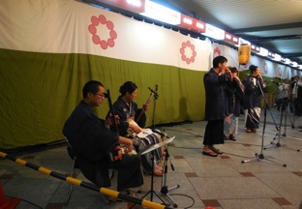


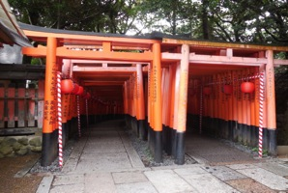

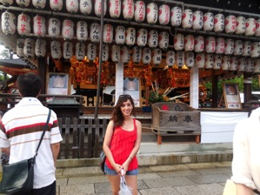
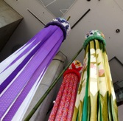

This Week: Kyoto!

Slide 6
Acknowledgments
Mentors
Dr. Jason Haga, UC San Diego Bioengineering
Dr. Kohei Ichikawa, Nara Institute of Science and Technology
UCSD PRIME Program
Teri Simas
Jim Galvin
Dr. Gabrielle Wienhausen
Dr. Peter Arzberger
Tricia Taylor
Funding
NAIST
Japanese Student Services Organization (JASSO)
PRIME
PRIME alumna Haley Hunter-Zinck
National Science Foundation

