Slide 1
Configuration and Deployment of a scalable virtual machine cluster for molecular docking
Nara Institute of Science and Technology, Nara Prefecture, Japan
Karen Rodriguez
7/31/2013

Slide 2
Overview
Virtual machines (VMs) have been observed to yield molecular docking results that are far more consistent than those obtained from a grid configuration.
Inhomogeneous results obtained from a grid are thought to be due to physical differences in the cluster’s components. This is eliminated by creating and networking cloned VMs.
This study’s objectives consist of constructing a clustered VM environment that is scalable according to job demand and which yields consistent dock results.
This system is to be tested, packaged, and deployed on the PRAGMA grid. This will provide sufficient computing resources to perform a full-scale docking project of large protein databases.

Slide 3
Week 5:
Created a new VM with CentOS 5.9 (gcc version 4.2.1). Installed MPICH and Dock 6.2 on it and cloned a slave.
The purpose of this was to see if this older gcc version can improve scores.
Tested Dock against data from a previous PRIME student (Wen-wai Yim) and Dock Test suite. Results match her physical cluster results and some of her virtual cluster testing.
Contacted PRAGMA administration for help with a VM-deploying test (using one of the older VM’s with CentOS 6.4, Dock 6.6, gcc 4.7.7) before deploying the ones we are currently testing and will be using (with CentOS 5.9, Dock 6.2, gcc 4.1.2).
Details are to be discussed over a Skype meeting to be scheduled.
Investigated use of Virtual Private Network (VPN) and n2n applications for virtual networking (to be used once the virtual machines have been deployed on PRAGMA).

Slide 4
Future Plans
Deploy test VM on PRAGMA. A slave VM image is to be distributed to PRAGMA clusters enabled to support KVM-based machines while a master VM will be sent only to the Rocks cluster.
Need to write VM deployment, installation and configuration instructions for administrators of clusters that will receive these VMs.
Each machine will require network configuration to optimize its operation in its respective environment. Virtual networking will also be configured later through VPN applications.
An MPICH+Dock run will be tested on this setup to verify that it works and to troubleshoot any issues that may arise.
Remove the deployed test machines and deploy the working VM’s (with downgraded OS and gcc) to PRAGMA. Configure addresses according to environment and virtual networking.
Begin implementation of elastic cloud options.

Slide 5





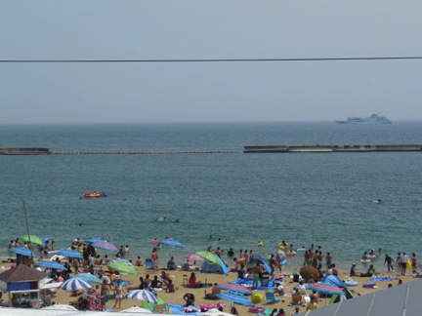

Kobe

Slide 6
Acknowledgments
Mentors
Dr. Jason Haga, UC San Diego Bioengineering
Dr. Kohei Ichikawa, Nara Institute of Science and Technology
UCSD PRIME Program
Teri Simas
Jim Galvin
Dr. Gabrielle Wienhausen
Dr. Peter Arzberger
Tricia Taylor
Funding
NAIST
Japanese Student Services Organization (JASSO)
PRIME
PRIME alumna Haley Hunter-Zinck
National Science Foundation

