Slide 1
Configuration and Deployment of a scalable virtual machine cluster for molecular docking
Nara Institute of Science and Technology, Nara Prefecture, Japan
Karen Rodriguez
8/21/2013

Slide 2
Overview
Virtual machines (VMs) have been observed to yield molecular docking results that are far more consistent than those obtained from a grid configuration.
Inhomogeneous results obtained from a grid are thought to be due to physical differences in the cluster’s components. This is eliminated by creating and networking cloned VMs.
This study’s objectives consist of constructing a clustered VM environment that is scalable according to job demand and which yields consistent dock results.
This system is to be tested, packaged, and deployed on the PRAGMA grid. This will provide sufficient computing resources to perform a full-scale docking project of large protein databases.

Slide 3
Week 8:
The machines were uploaded to rocks for testing once again. Parallel processing of Dock worked fine, but some adjustments needed to be made.
The user account of Slavenode1 was erroneously granted root privileges, and this needed to be reverted.
Some network scripts also required changing.
Nadya requested that we create one flat partition for the VM instead of the current LVM setup. This is in progress.
Nadya notified us that the VMs have been compromised and that someone accessed them and created an admin account. She said this was likely with malicious intent, as a result the machines were shut down and we are investigating how this happened.
The original images on the host have this admin account as well, we believe that this means that the admin account was created there and not once the machines were uploaded to rocks.

Slide 4
Future Plans
Find out how could the machines have been compromised and fix this problem to prevent it in the future. Then remove the admin account and verify that the machine still works as intended.
Create a single flat partition in the VMs.
Upload the compressed image to my Rocks account where Nadya can retrieve the image and finally upload it to Gfarm. The deployment process in remote clusters will be mostly done by other administrators. Helping them and Nadya with this step is a step we hope we can finish soon so that we may use N2N to network the VMs together.
Finish final presentation by Monday Aug. 26.

Slide 5
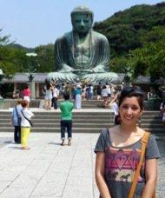
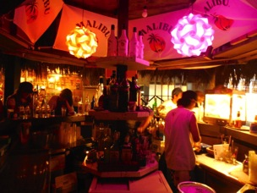


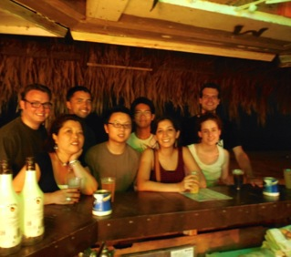
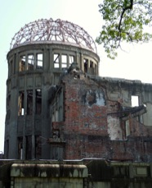

Obon! Kamakura, Nagoya, Hiroshima, Miyajima, and Tokyo!

Slide 6
Acknowledgments
Mentors
Dr. Jason Haga, UC San Diego Bioengineering
Dr. Kohei Ichikawa, Nara Institute of Science and Technology
UCSD PRIME Program
Dr. Gabrielle Wienhausen
Dr. Peter Arzberger
Teri Simas
Jim Galvin
Tricia Taylor
Funding
NAIST
Japanese Student Services Organization (JASSO)
PRIME
PRIME alumna Haley Hunter-Zinck
National Science Foundation
Special Thanks to Nadya Williams, Olivia Yang and Josh Wei.l

