Slide 1
Sensor Pod Configuration at TFRI with PRIME Week 8
Thaddeus Trinh
August 21, 2013

Slide 2
Proposed Research
To work with TFRI to help integrate new sensors into their Android sensor pod network and to deploy and test the new sensors in the field
Fuel Moisture Sensor
Solar Irradiation Sensor
Soil Moisture Sensor
Soil Drainage Gauge

Slide 3
Current Progress
Solar Irradiation sensor, Soil Moisture Sensor, and CTD sensors have been completed
FTS FS-3 Fuel Stick Moisture Sensor software is complete, hardware is still a work in progress
Final Report

Slide 4
FTS Fuel Stick
The Fuel Stick Moisture is measured using an algorithm that required the Humidity and Temperature of the Stick
The Fuel Stick Humidity is easily measured since it outputs an analog voltage
Fuel Stick Temperature is measured with a thermistor so we are in the process of figuring out the best method for measuring the resistance and converting it to a voltage that can be read by the IOIO Board since the IOIO pins are only for voltages

Slide 5
Plans for Next Week
Complete and Present Final Report
Fly Home!

Slide 6

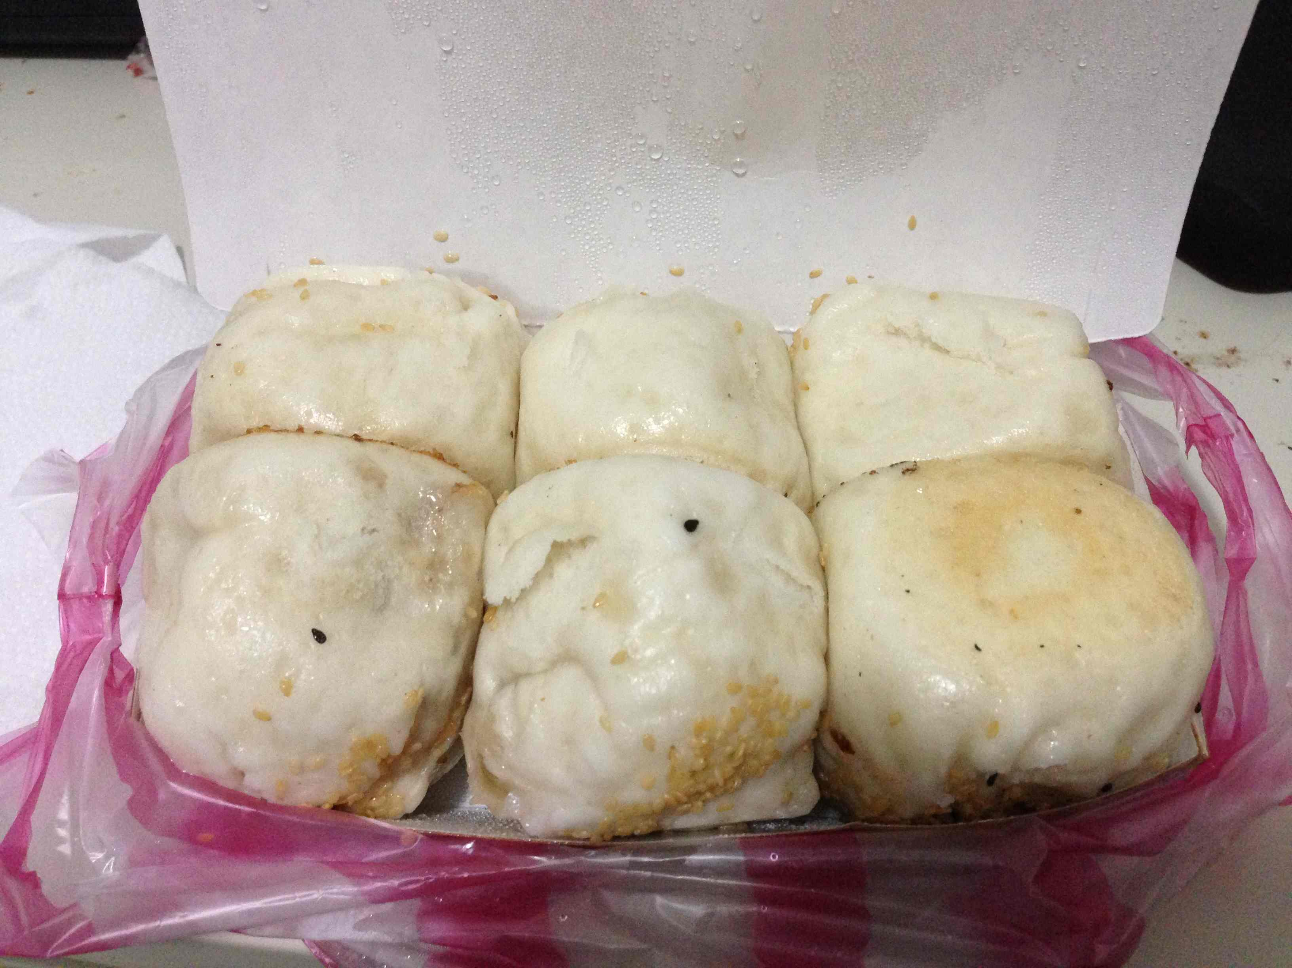
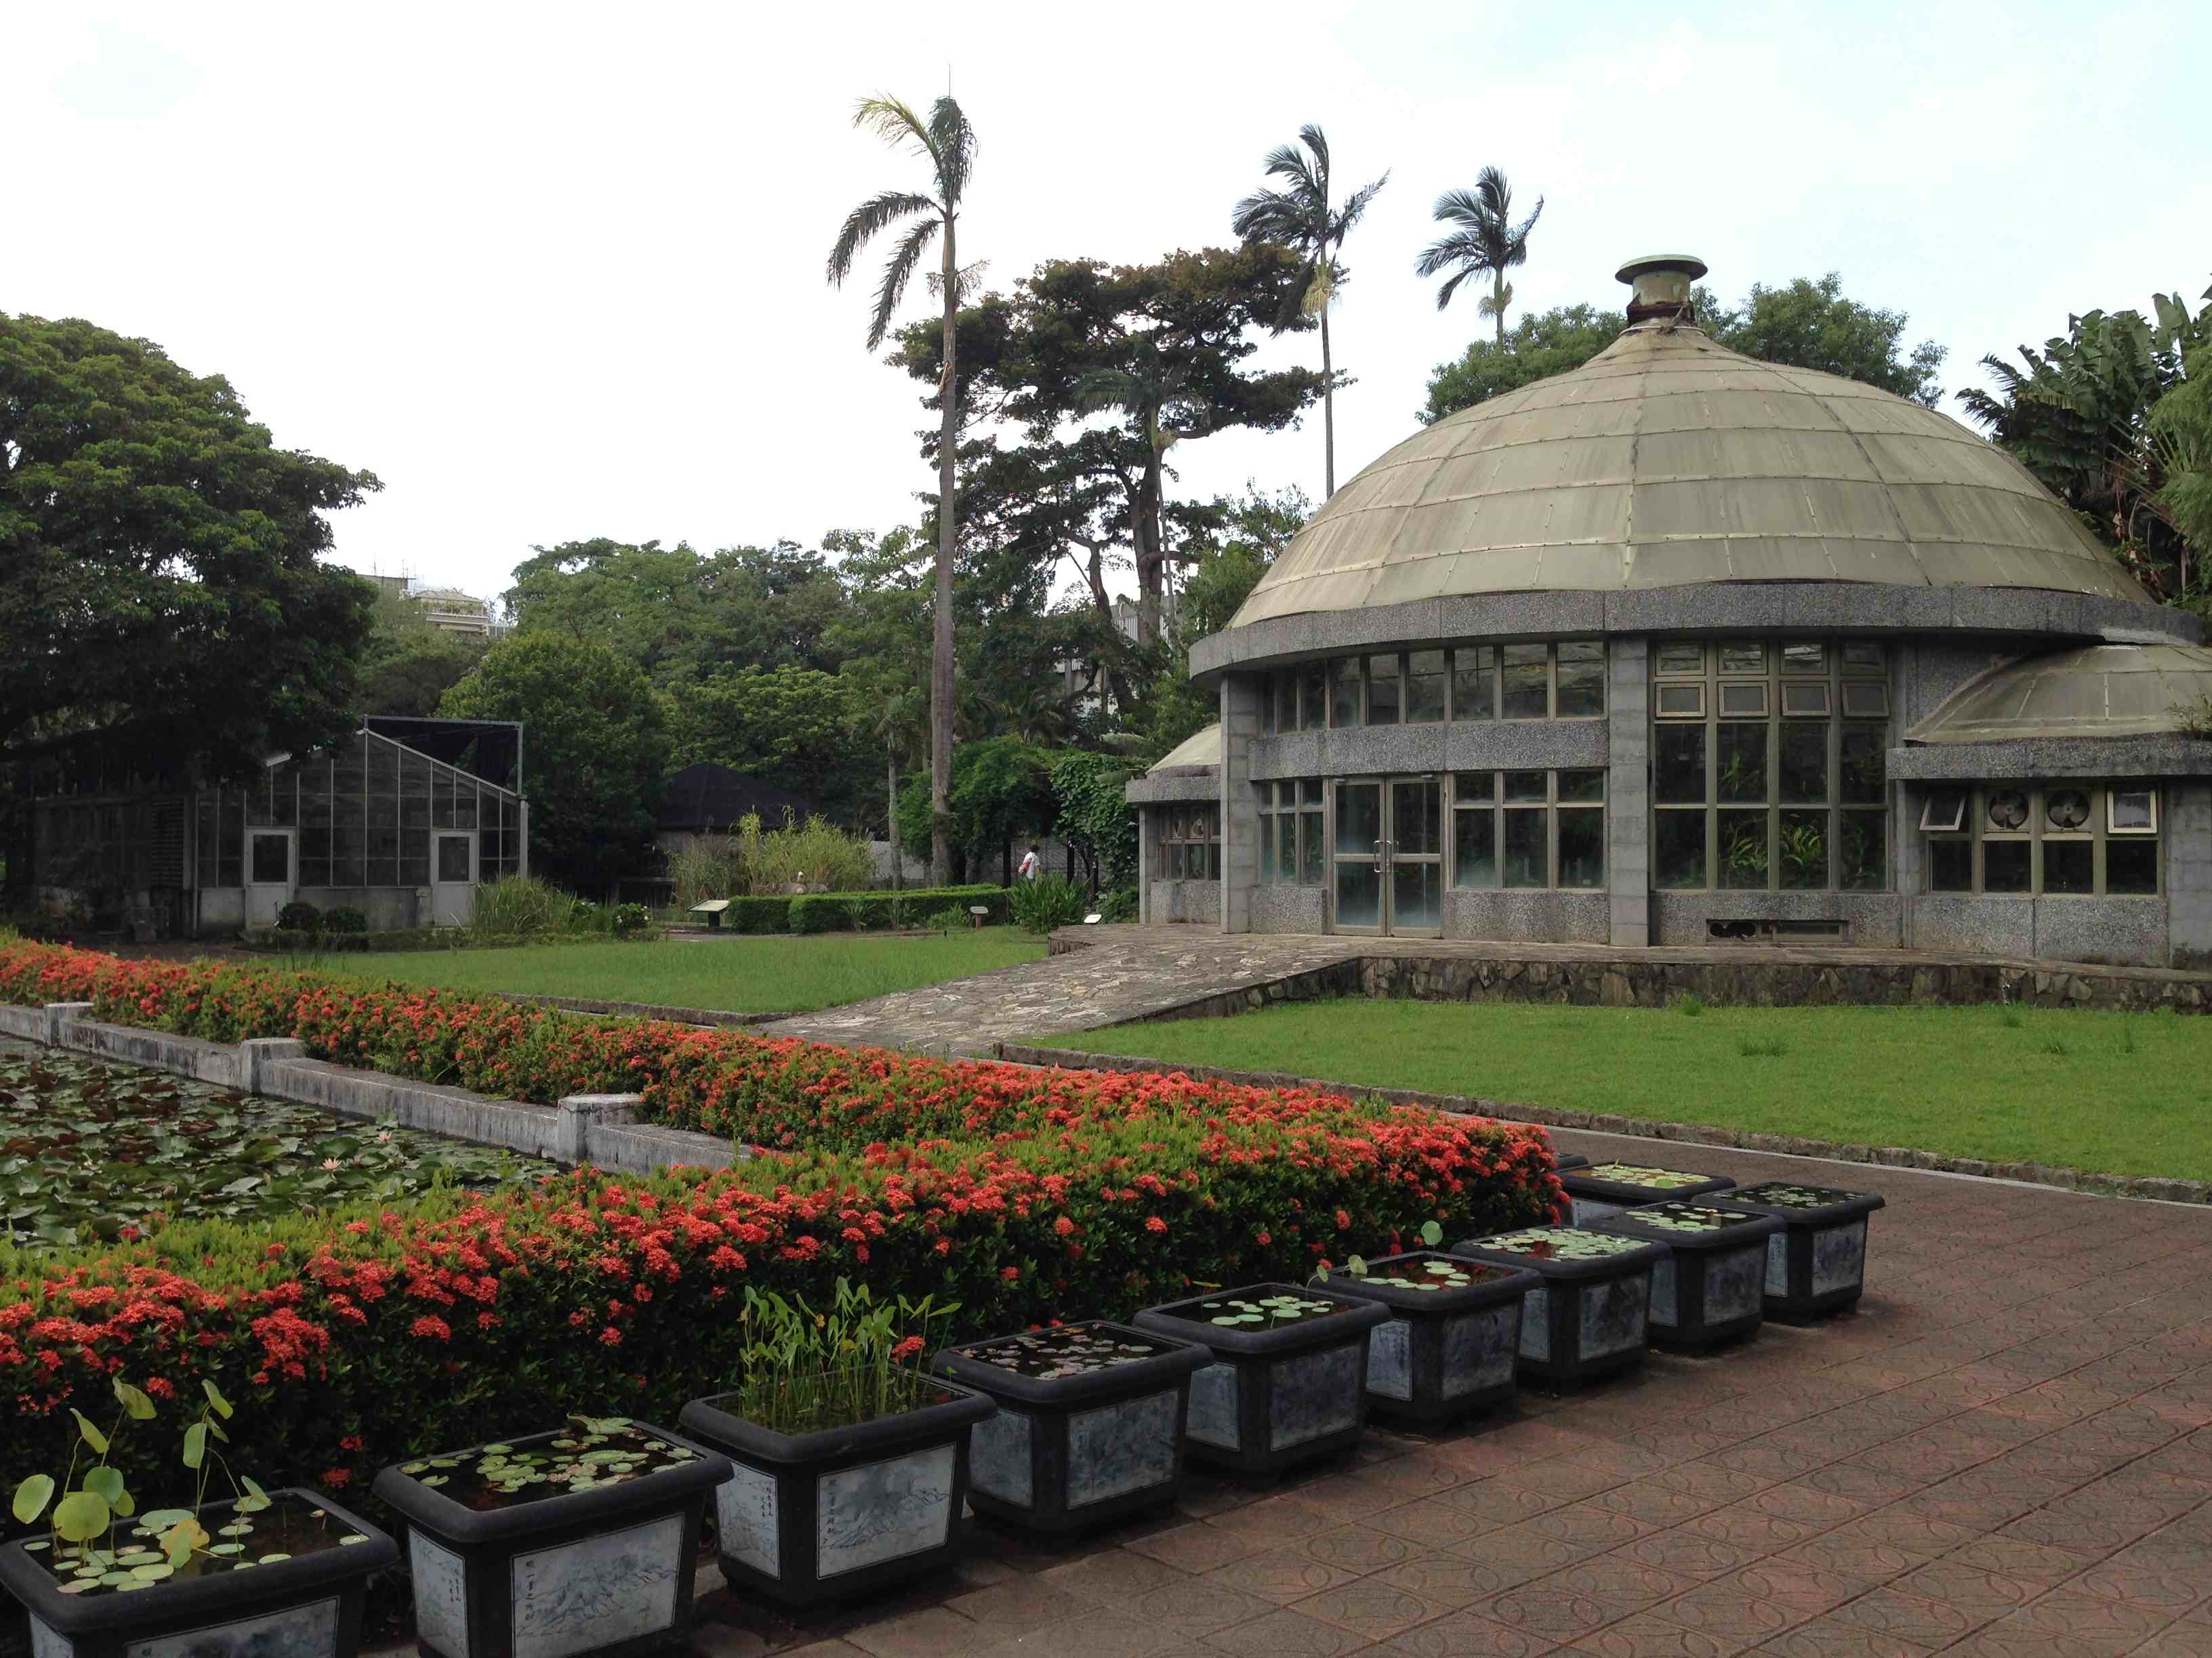
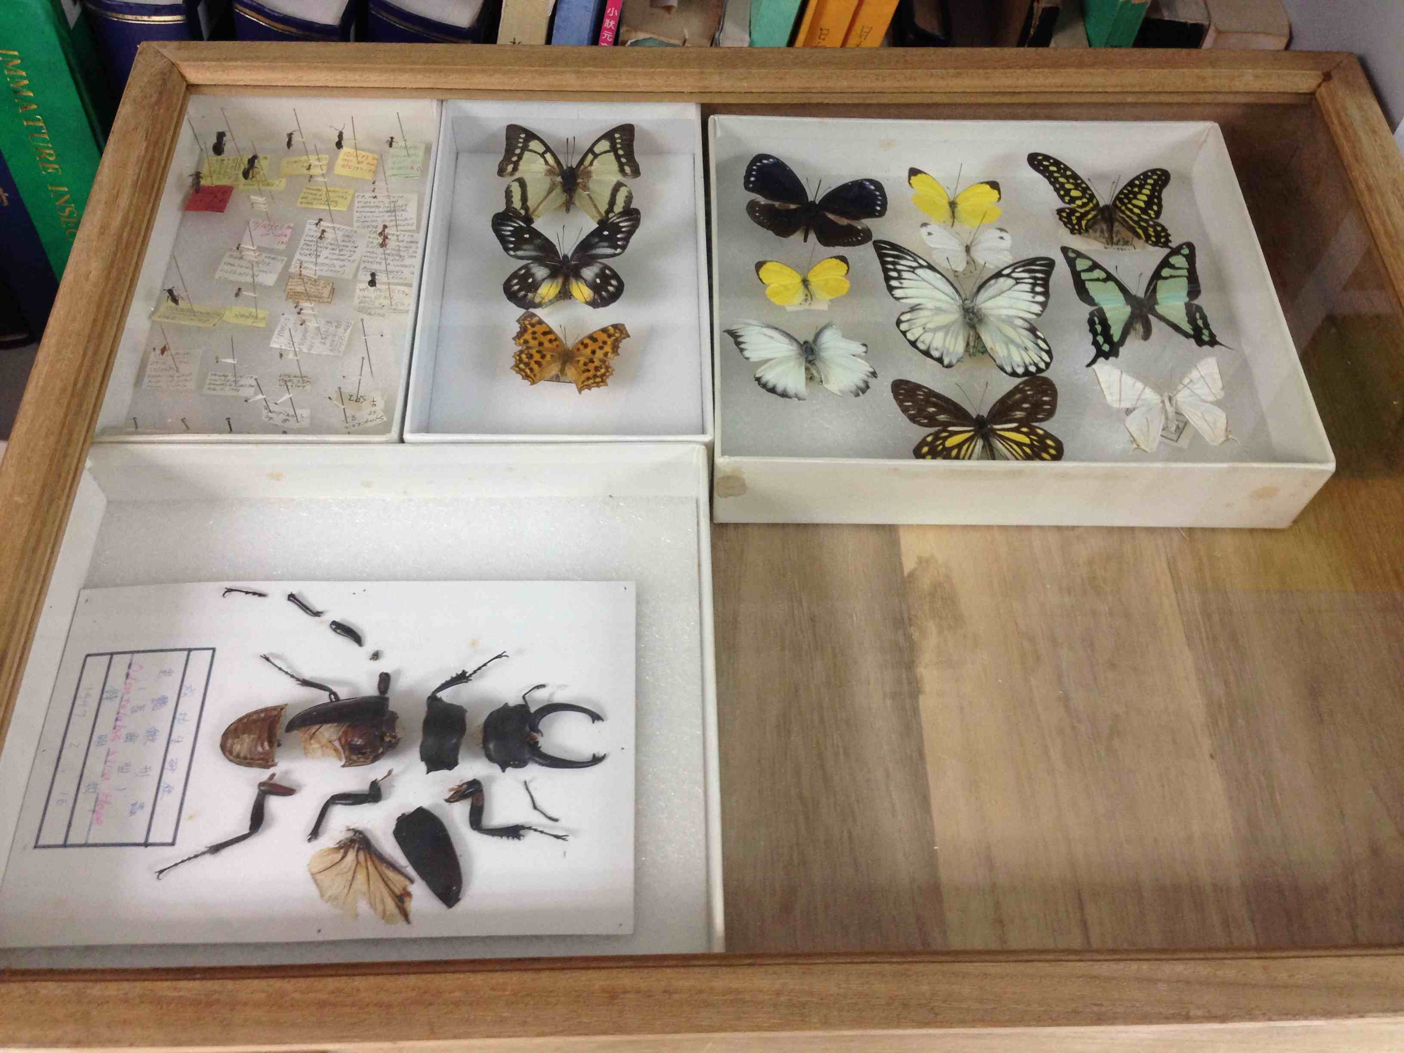
Culture
Huge meat buns, Taiwan MOCA, Botanical Garden, TFRI labs

Slide 7
Acknowledgements
PRIME
Gabriele Wienhausen
Peter Arzberger
Teri Simas
Tricia Taylor
Mentors
Tony Fountain (CALIT2)
Chau Chin Lin (TFRI)
Sheng-Shan Lu (TFRI)
Yu-Huang Wang (TFRI)
Peter Shin (CALIT2)

