Slide 1
Chronic Chagas Disease and Potential Natural Products
National Taiwan University
Hanne Inez Wolff
July 17th, 2013

Slide 2
Progress to Date
Have docked over 200 compounds to protein: 1S0J.
Some promising results:
(Excerpt from RankConformations.txt)
---------------------------------------------------------------------------------------------------------
Rank File/Compound Name Binding Affinity kcal/mol
---------------------------------------------------------------------------------------------------------
1 Bisisodiospyrin -12.7
2 188_Amentoflavone_pg19 -12.2
3 186_Heveaflavone_pg19 -11.8
4 187_PodocarpusflavoneA_pg19 -11.8
5 154_TaiwanhomoflavoneB_pg16 -11.7
6 189_dimethoxyAmentoflavone_pg19 -11.7
7 178_SapindosideB_pg18 -11.1
8 151_TaiwanhomoflavoneA_pg16 -10.9
9 130_Salvianolic_acidA_pg13 -10.8
10 177_SaponinA_pg18 -10.7

Slide 3
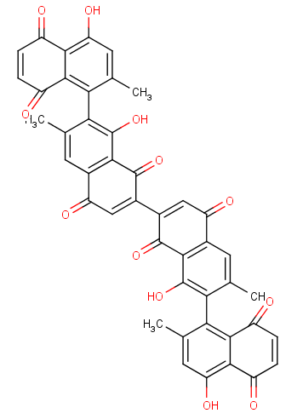
Rank1: Bisisodiospyrin
Fairly non-polar molecule.
Binding Affinity (Vina):
-12.7 kcal/mol
Binding Affinity(AutoDock4):
-15.43 kcal/mol
Inhibition constant Ki:
4.87 pM (picomolar)
RMSD from reference structure = 6.853 A

Slide 4
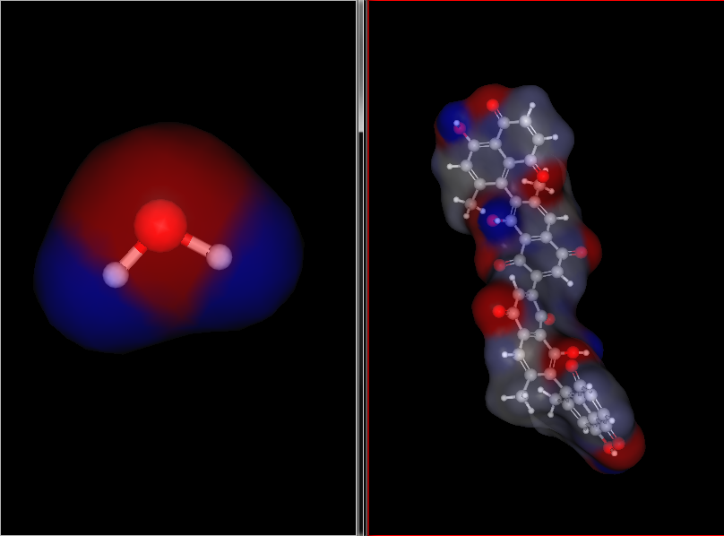
Comparison to H₂O (Polar)
Fairly non-polar molecule.

Slide 5
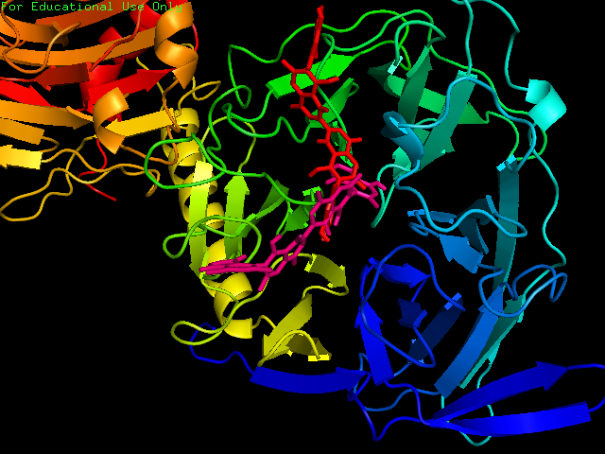
Ligand and Protein Interaction
KEY
Red: Vina Prediction
Pink: AutoDock4 Prediction

Slide 6
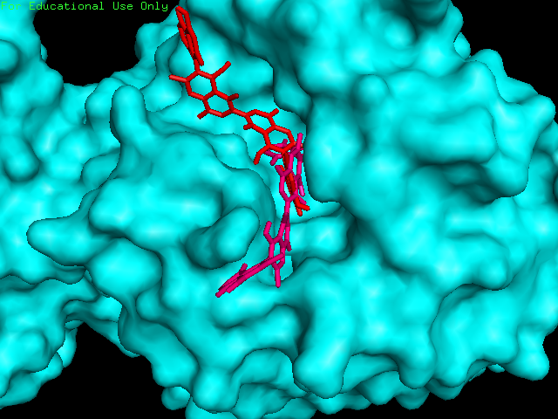
KEY
Red: Vina Prediction
Pink: AutoDock4 Prediction

Slide 7
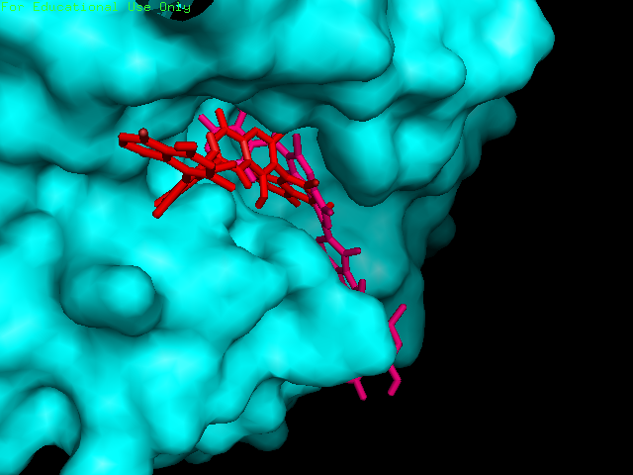
KEY
Red: Vina Prediction
Pink: AutoDock4 Prediction

Slide 8
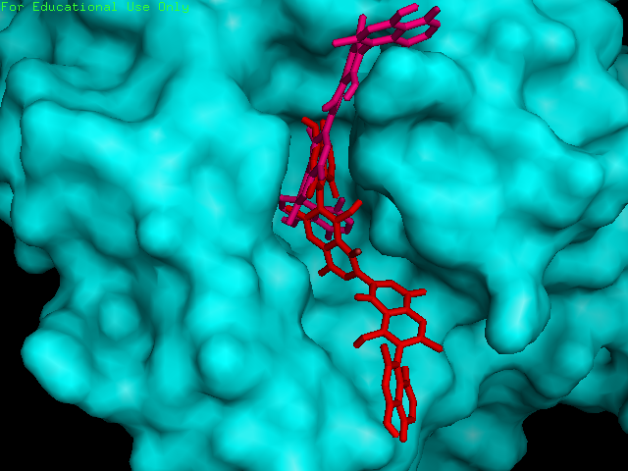
KEY
Red: Vina Prediction
Pink: AutoDock4 Prediction

Slide 9
Note on Polarity
Bisisodiospyrin seems to create stacking interactions with Try312 and Tyr119 – which are both non-polar amino acids.
A reliable result, considering that Bisisodiospyrin is a fairly non-polar molecule.
These stacking interactions are mentioned in Amaya (2004) paper “Structural Insight into the Catalytic Mechanism of Trypanosoma cruzi trans-Sialidase”. However, with a different ligand, MuNANA.
Bisisodiospyrin, also interacts with Asp96 which is a “key binding interaction”, according to Amaya (2004)

Slide 10
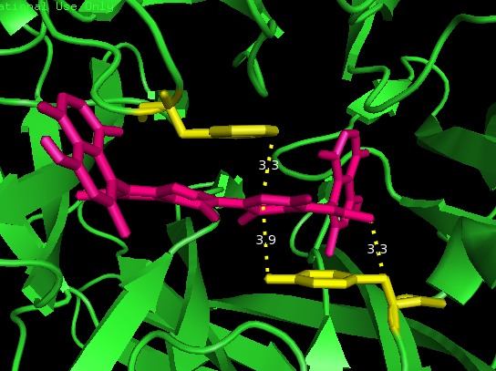
Stacking Interaction
Note:
The measurements are merely present to show distances, not molecular interactions

Slide 11
Next Week Goals
Continue to dock Natural Products to ligand 1S0J

Slide 12
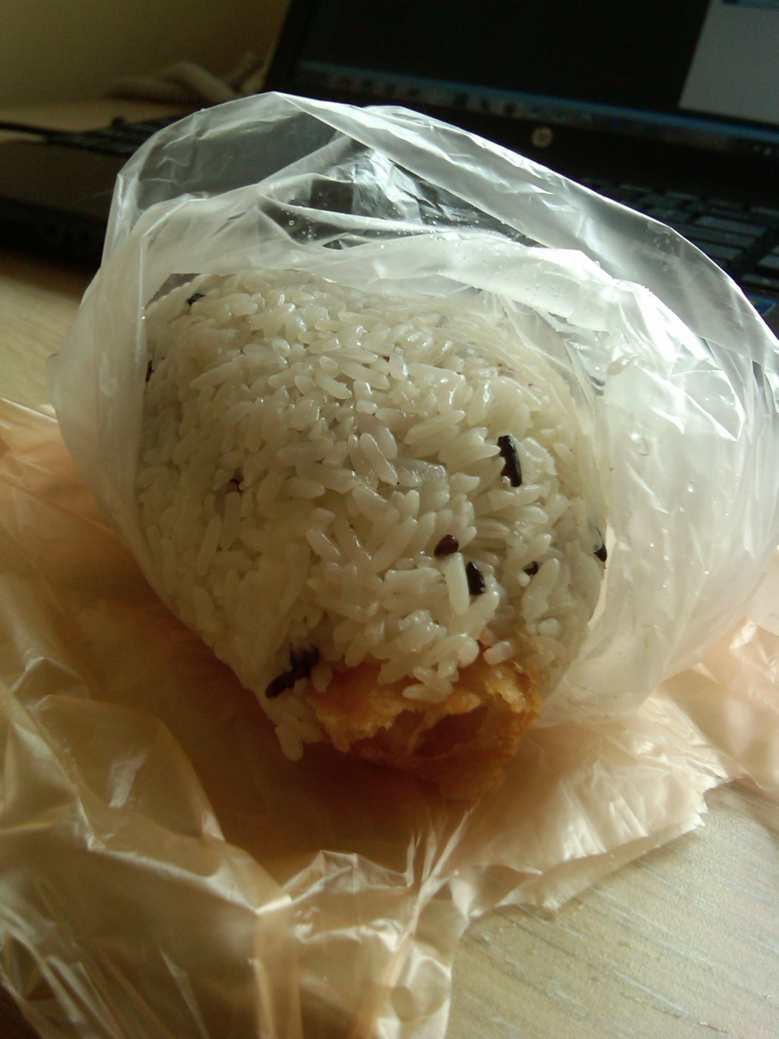
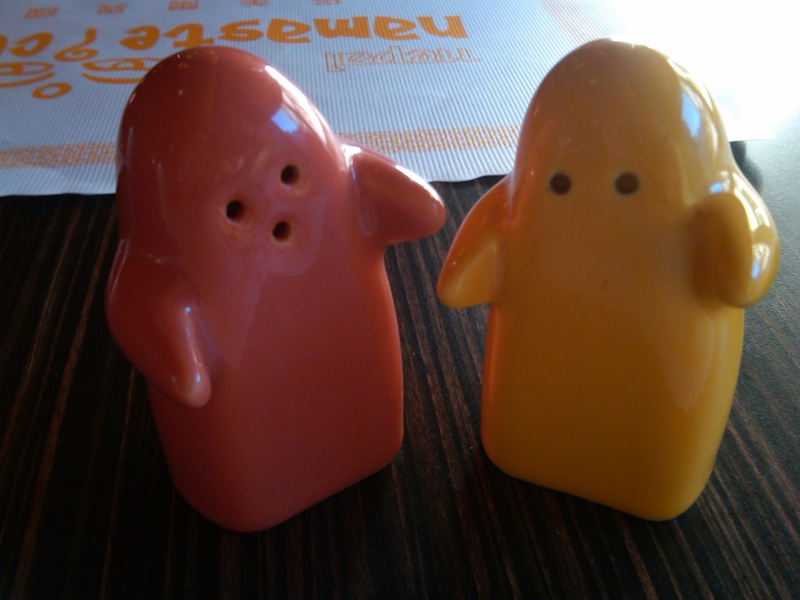
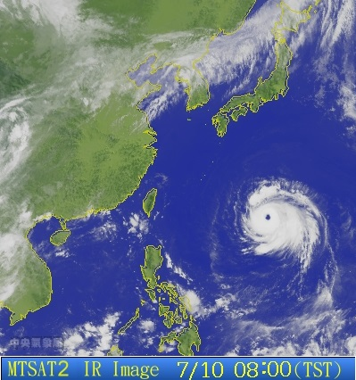
Cultural Aspect

Slide 13
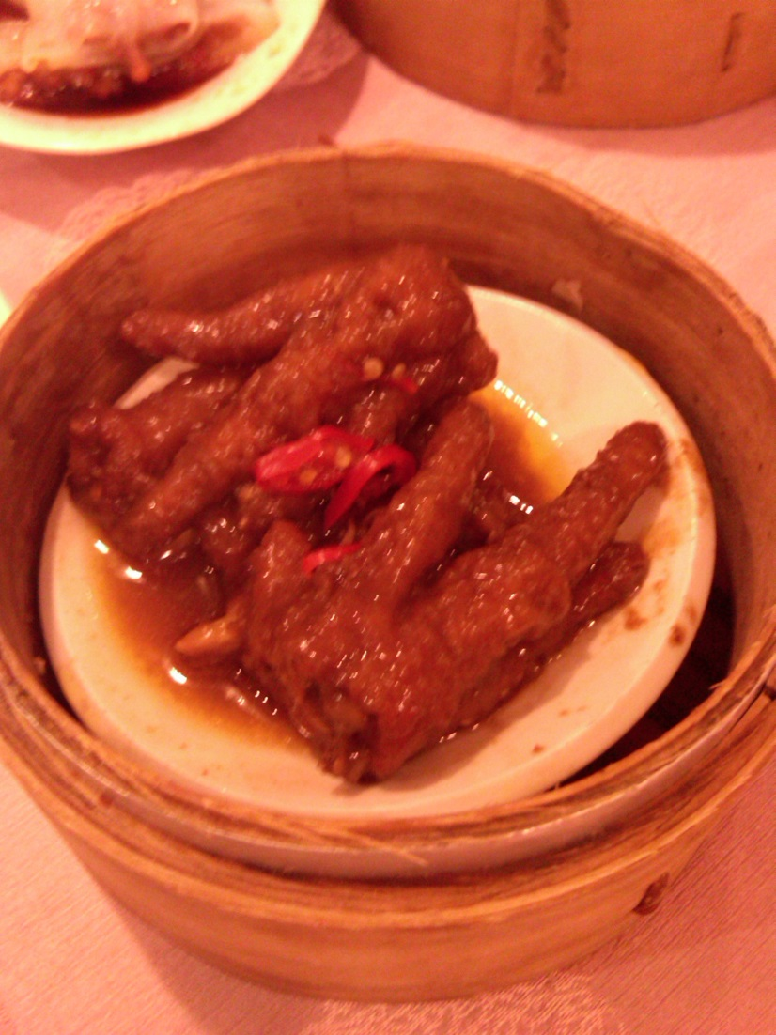
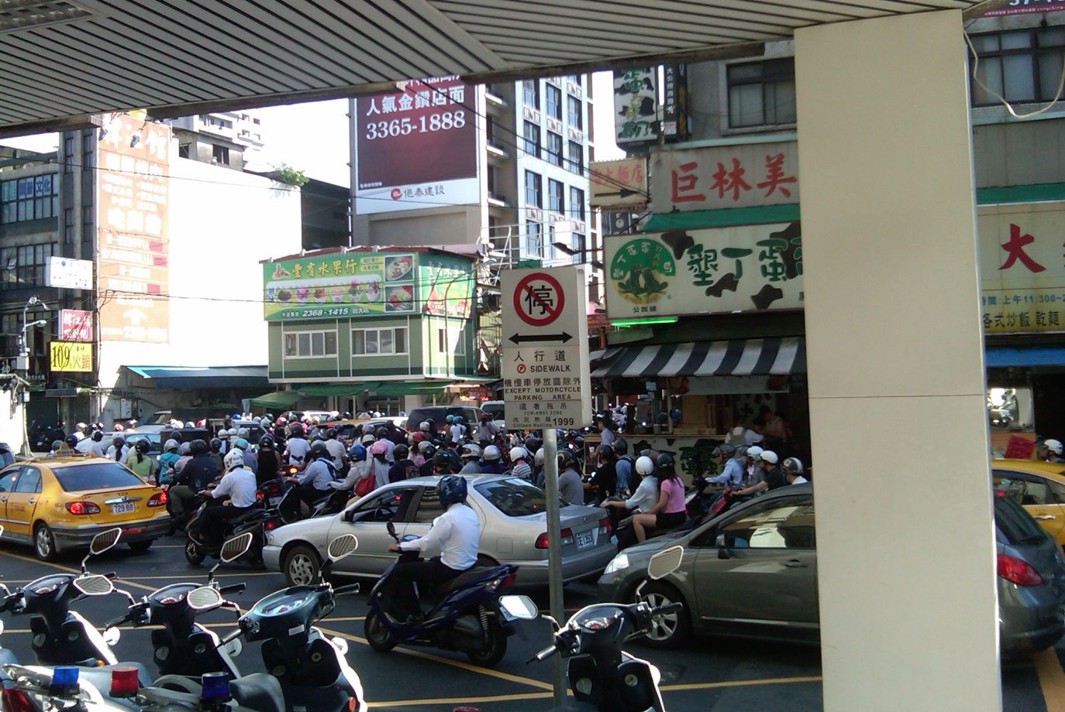
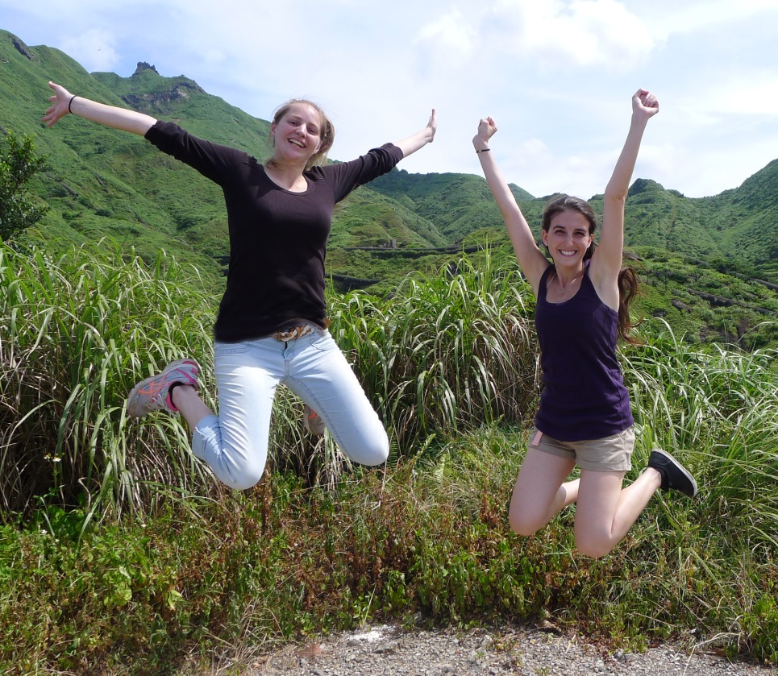

Cultural Aspect

Slide 14

Thanks to...
I would like to extend a thanks to..
Gabriele Wienhausen
Peter Arzberger
Dr. Phil Bourne
Dr. Jung-Hsin Lin
Chirag Krishna
Dr. Jung-Hsin Lin’s lab, and finally
Tosh Nomura Eureka! Foundation for making this trip possible

