Slide 1
Chronic Chagas Disease and Potential Natural Products
National Taiwan University
Hanne Inez Wolff
July 17th, 2013

Slide 2
Progress to Date
Have docked over one fourth of the Natural Product Database to 1S0J.
Some promising results to date:
(Excerpt from RankConformations.txt)
----------------------------------------------------------------------------------------------------------------
Rank File Name Binding Affinity (kcal/mol)
----------------------------------------------------------------------------------------------------------------
1 bisisodiospyrin_pg3_out.pdbqt -12.7
2 346_diacetoxy_pg35_out.pdbqt -12.6
3 188_Amentoflavone_pg19_out.pdbqt -12.2
4 186_Heveaflavone_pg19_out.pdbqt -11.8
5 187_PodocarpusflavoneA_pg19_out.pdbqt -11.8
6 154_TaiwanhomoflavoneB_pg16_out.pdbqt -11.7
7 189_dimethoxyAmentoflavone_pg19_out.pdbqt -11.7
8 425_22epiHippuristan11one_pg43_out.pdbqt -11.3
9 178_SapindosideB_pg18_out.pdbqt -11.1
10 238_TransScirpusinA_pg24_out.pdbqt -11.1

Slide 3
Next Week Goals
Continue to dock natural products to ligand 1S0J

Slide 4
Major Successes & Road Blocks
Major Successes
Have been docking compounds successfully.
Created two programs to help analyze and speed up the process.
Road Blocks
Currently I was informed that some compound in the database might have been not accurate.
I will talk to the database manager about what compounds were effected.

Slide 5

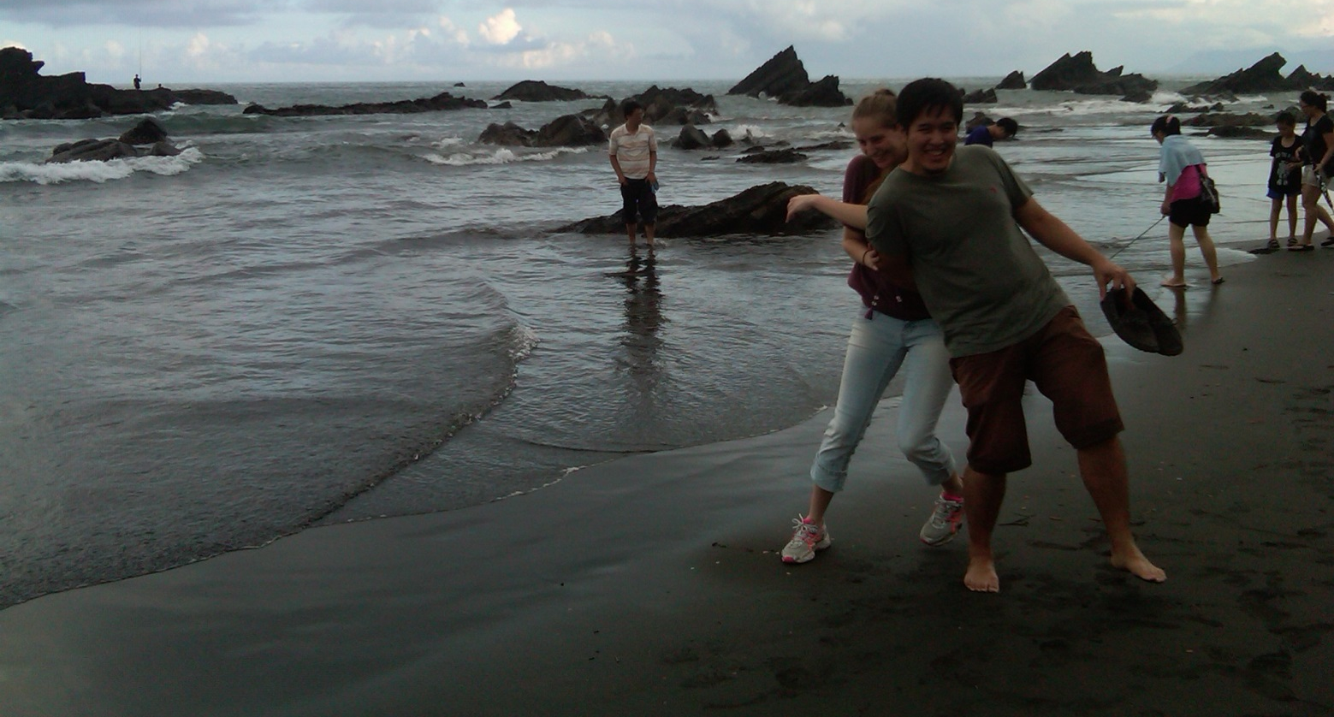
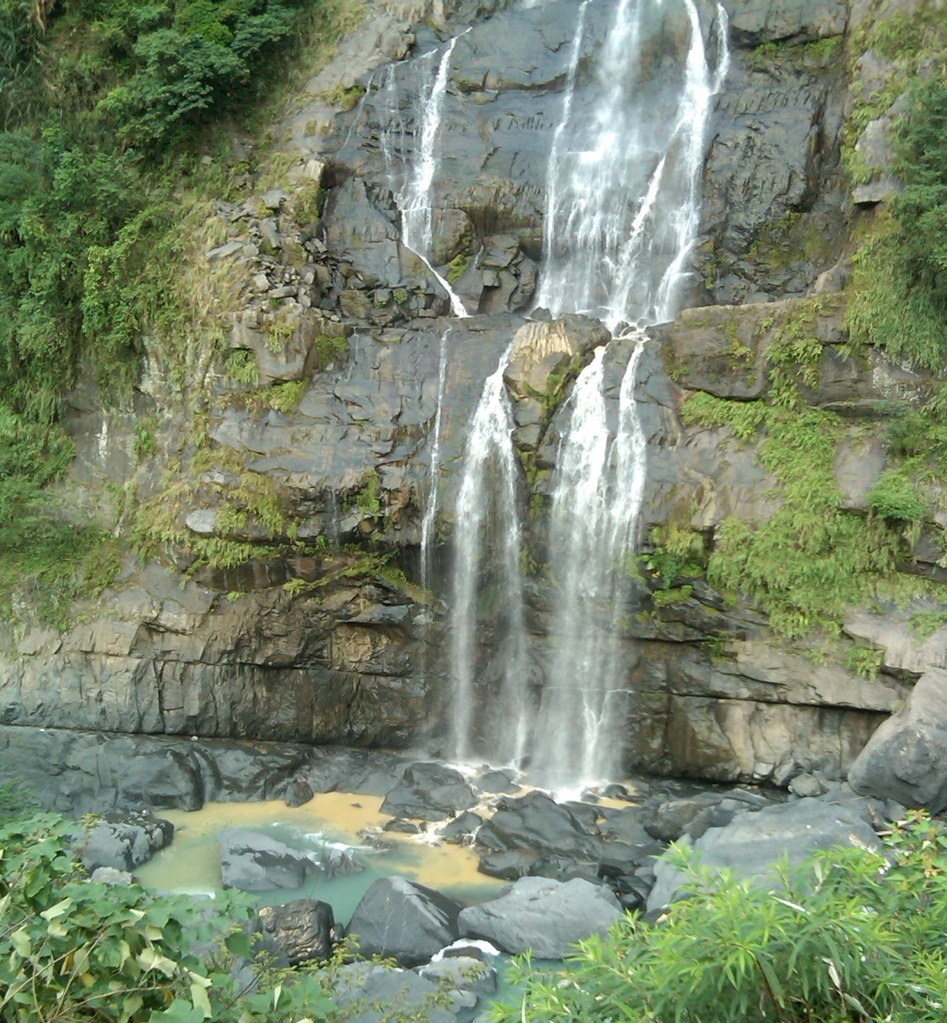
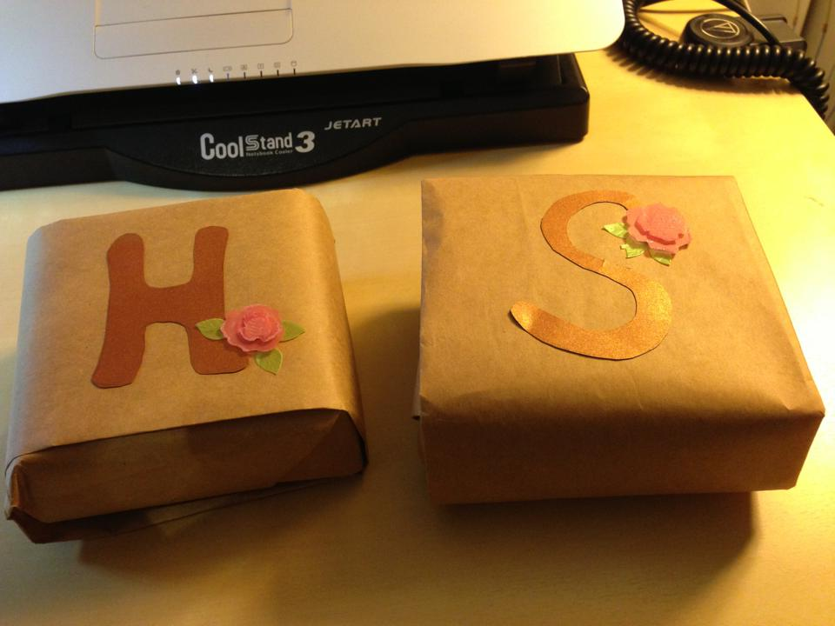
Cultural Aspect

Slide 6
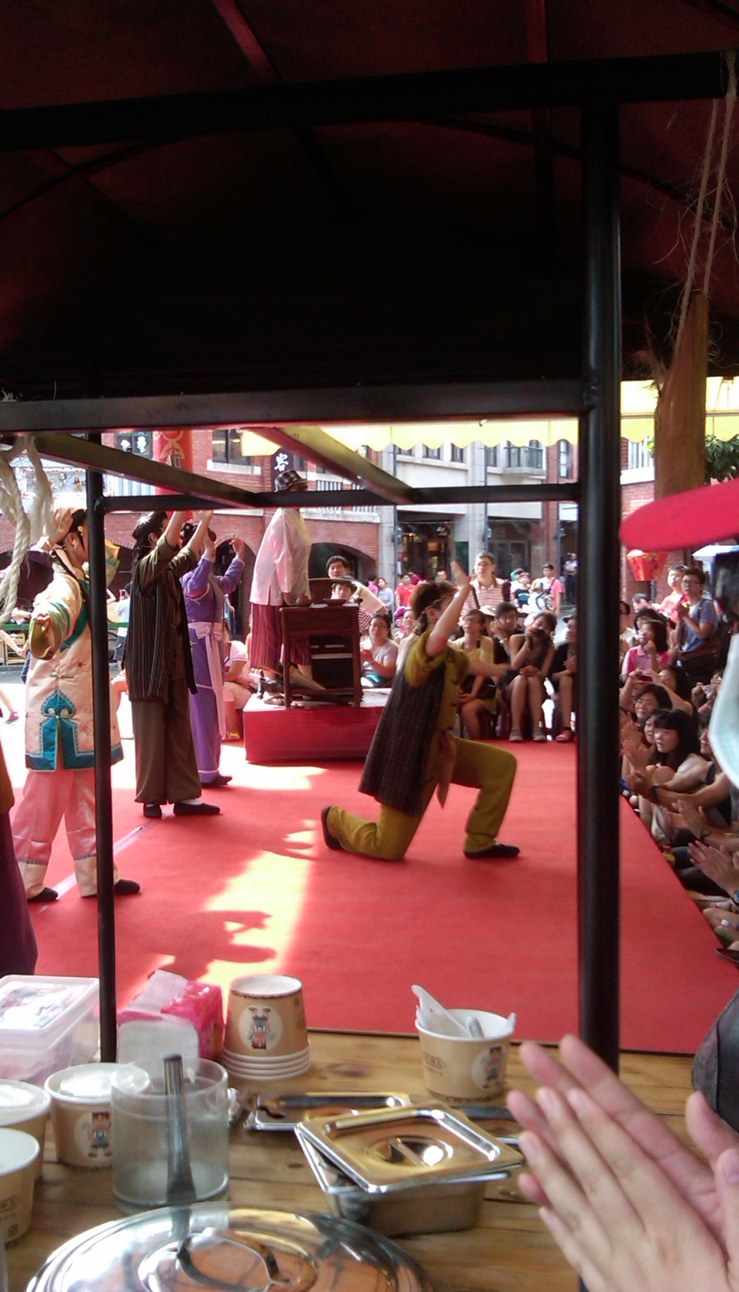
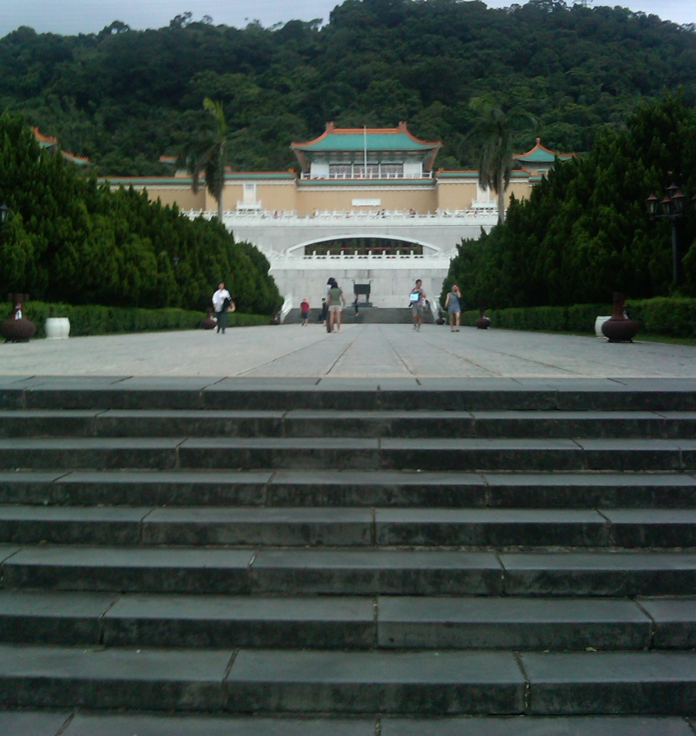
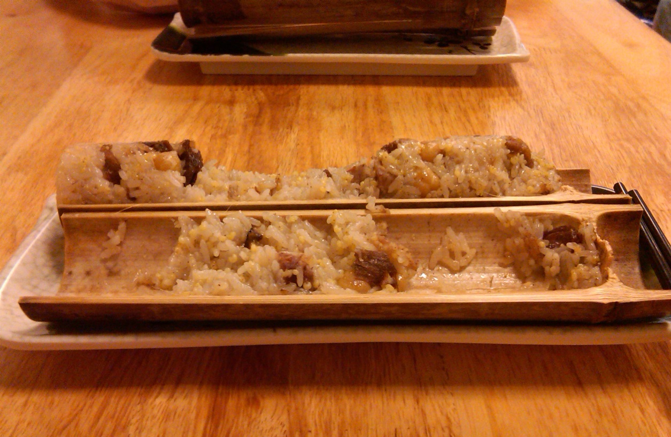
Cultural Aspect

Slide 7
Thanks to...
I would like to extend a thanks to..
Gabriele Wienhausen
Peter Arzberger
Dr. Phil Bourne
Dr. Jung-Hsin Lin
Chirag Krishna
Dr. Jung-Hsin Lin’s lab, and finally
Tosh Nomura Eureka! Foundation for making this trip possible

