Slide 1

Detection of troll-bot accounts in VK based on profile and comment data
Report completed by: Aidar Galin, Stanislav Chumakov, Yura Umnov
Saint Petersburg
2022

Slide 2
Goal and objectives of the course project
Objectives:
Data collection
Uploading of the data to HDFS
Data Processing and analysis
Goal:
Use of technologies and methods for processing and analysis large amount of data

Slide 3
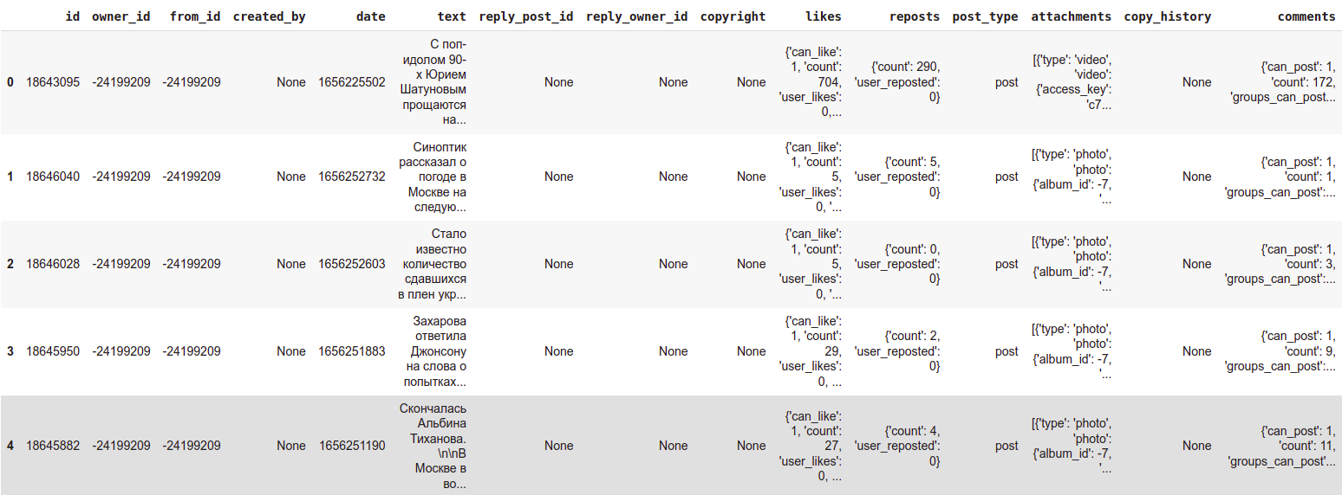
Scraping and parsing of data
Collecting data of the VKontakte posts
Method API.wall.get returns a list of posts from the user's or community's wall.

Slide 4
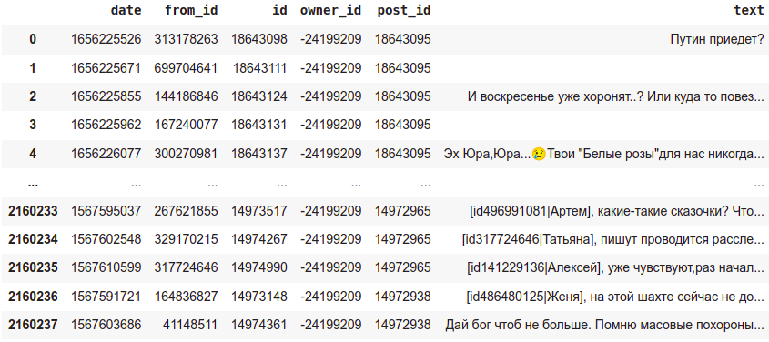
Scraping and parsing of data
Collecting data of the VKontakte comments
Method API.wall.getComments returns a list of comments to an entry on the wall.

Slide 5
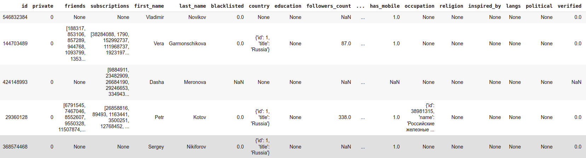
Scraping and parsing of data
Collecting data of the VKontakte users
API.users.get returns extended user information.
API.users.getSubscriptions returns a list of user IDs and public pages that are included in the list of user subscriptions.
API.friends.get returns a list of the user's friend IDs or extended information about the user's friends

Slide 6
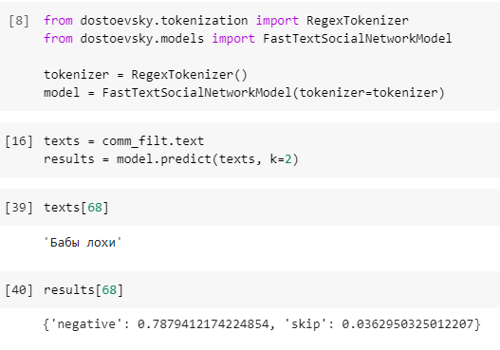
Sentinent analysis
Rating the comments: positive, neutral, negative
Dostoevsky library, FastText model pre-trained on RuSentiment dataset was used

Slide 7
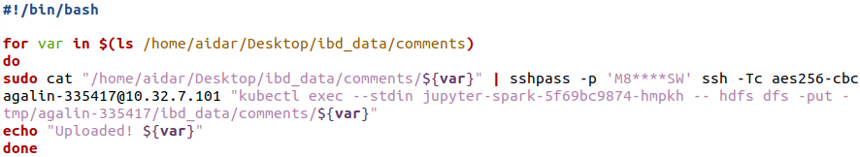
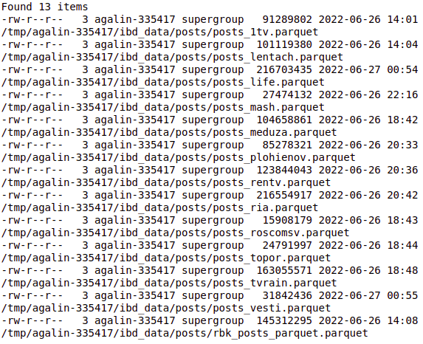
Uploading data
Script for uploading data from local machine to cluster
Total amount of collected data is 7.8Gb,
containing full history of 13 news groups

Slide 8
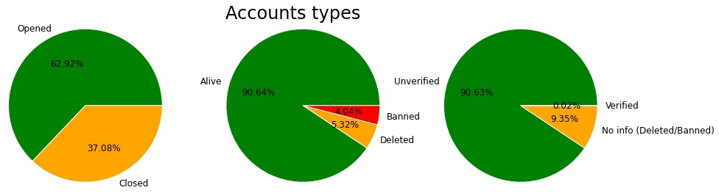
Data Processing and analysis
Total number of harmful accounts = 129569 Share of such accounts = 8.5 %

Slide 9
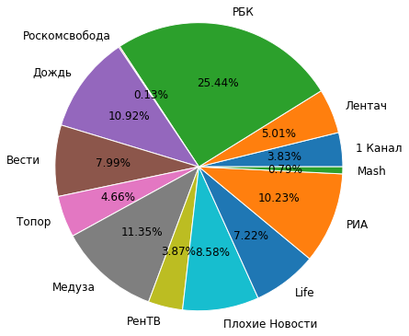
Data Processing and analysis
The share of each group in the total amount of spam

Slide 10
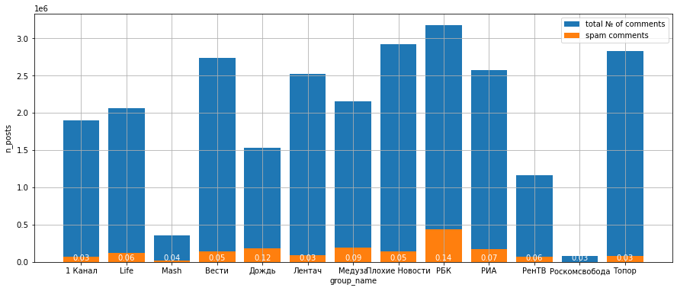
Data Processing and analysis
The share of each group in the total amount of spam

Slide 11
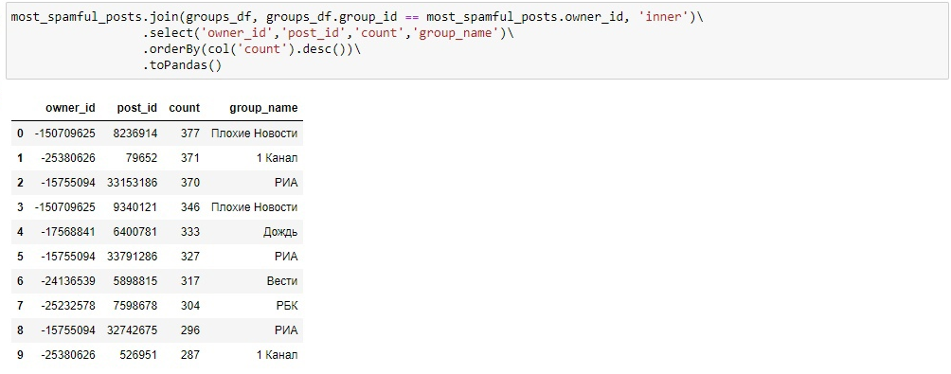
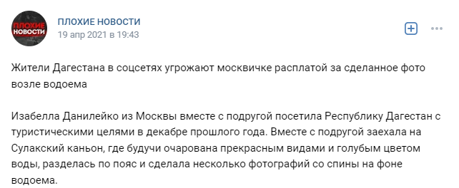
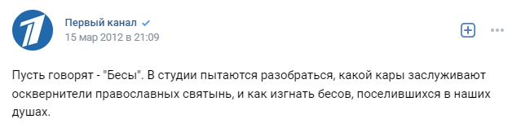
Data Processing and analysis
Top 10 posts with the most number of spam comments
#1:
#2:

Slide 12

Thank you for your attention!

