Slide 1
Netflix Stock profile
By: Sampath Ramawickrama

Slide 2
List of Visualizations
The Following is the list of visualizations that I made using seaborn, I used Pandas to read the CSV files containing the raw data for Netflix stocks, DOW jones, and Netflix stock by quarter. All of this data was for 2017. Then I plotted them on different types of graphs in order to portray the information in a readable fashion.
Distribution of 2017 Netflix Stock Prices by Quarter – This take in the Netflix quarterly data and outputs it into a violin graph in order to show the distribution of Netflix stock by quarter.
Earnings per share in cents- This takes in raw inputs graphing the estimate Yahoo projected for the Quarter compared to the actual earnings for that quarters
How are earnings and Revenue Related? – This takes in a raw input of earnings and revenue to visualize the earnings and revenue reported by Netflix by mapping two bars side-by-side
Netflix vs Dow jones – This compares Netflix stock to the Dow Jones Industrial Average in 2017, by plotting two line charts side by side.

Slide 3
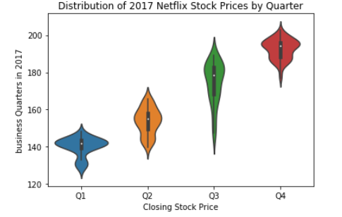
Distribution of 2017 Netflix stock prices by Quarter

Slide 4
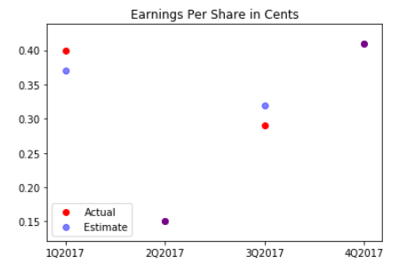
Earning per share in cents

Slide 5
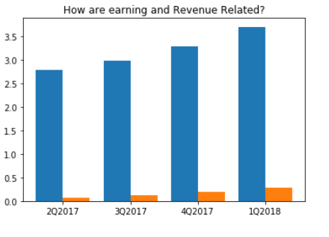
How are earnings an revenue Related?

Slide 6
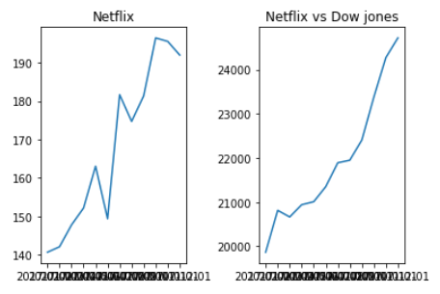
Comparing Netflix Stock to the Dow Jones Industrial Average

