Slide 1



AWS, Certifications, & Docker
Presentation for Intern

Slide 2
AWS
z

Slide 3

Cloud unsafe? A myth or reality
Security of the Cloud
Security in the Cloud
vs
Cloud Service Provider
Cloud Customer

Slide 4
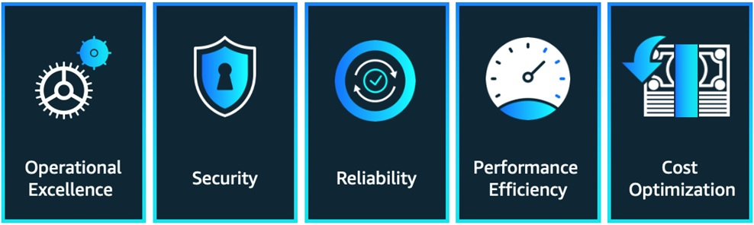
Challenges in Cloud Computing
Trading-off between five pillars of Well-Architected Framework
Strict data border-cross controls

Slide 5
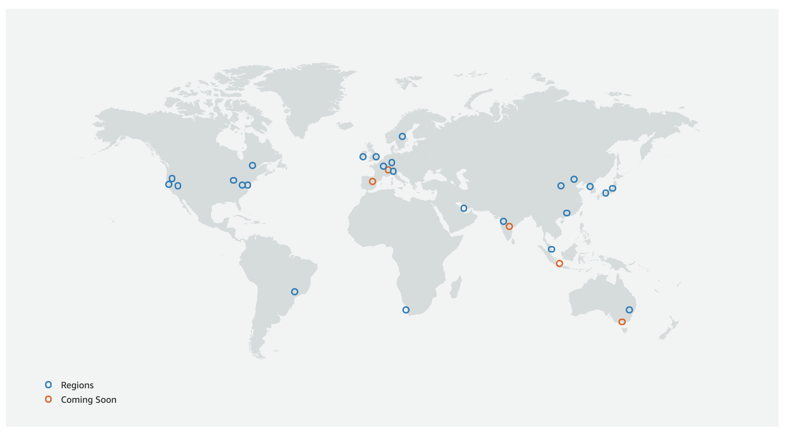
AWS Infrastructure Basics
25 Regions
80 Availability Zones
218+ Edge Locations
Encryption Keys
Source : https://aws.amazon.com/about-aws/global-infrastructure/

Slide 6
Most Common AWS Services used by SRE-7
Service | Category | Features | Example usage
S3 | Storage | Object storage Immutable | Terraform state files
EC2 | Compute | Windows, Linux, & Mac instances Different sizes | Bastion
DynamoDB | Storage | Key-value Datastore | Environment variables
VPC | Network | VPC Subnets NAT/Internet Gateways Security groups | Multi-AZ deployments
KMS | Security | Key encryption | Encryption keys
RDS | Database | Aurora, SQL, Oracle Multi-Region replication | Database, backup and restore
ECS | Container Service | Fargate EC2 | Microservices
ECR | Image repo | Tagging Vulnerability detection | Container images

Slide 7
Certifications
z

Slide 8
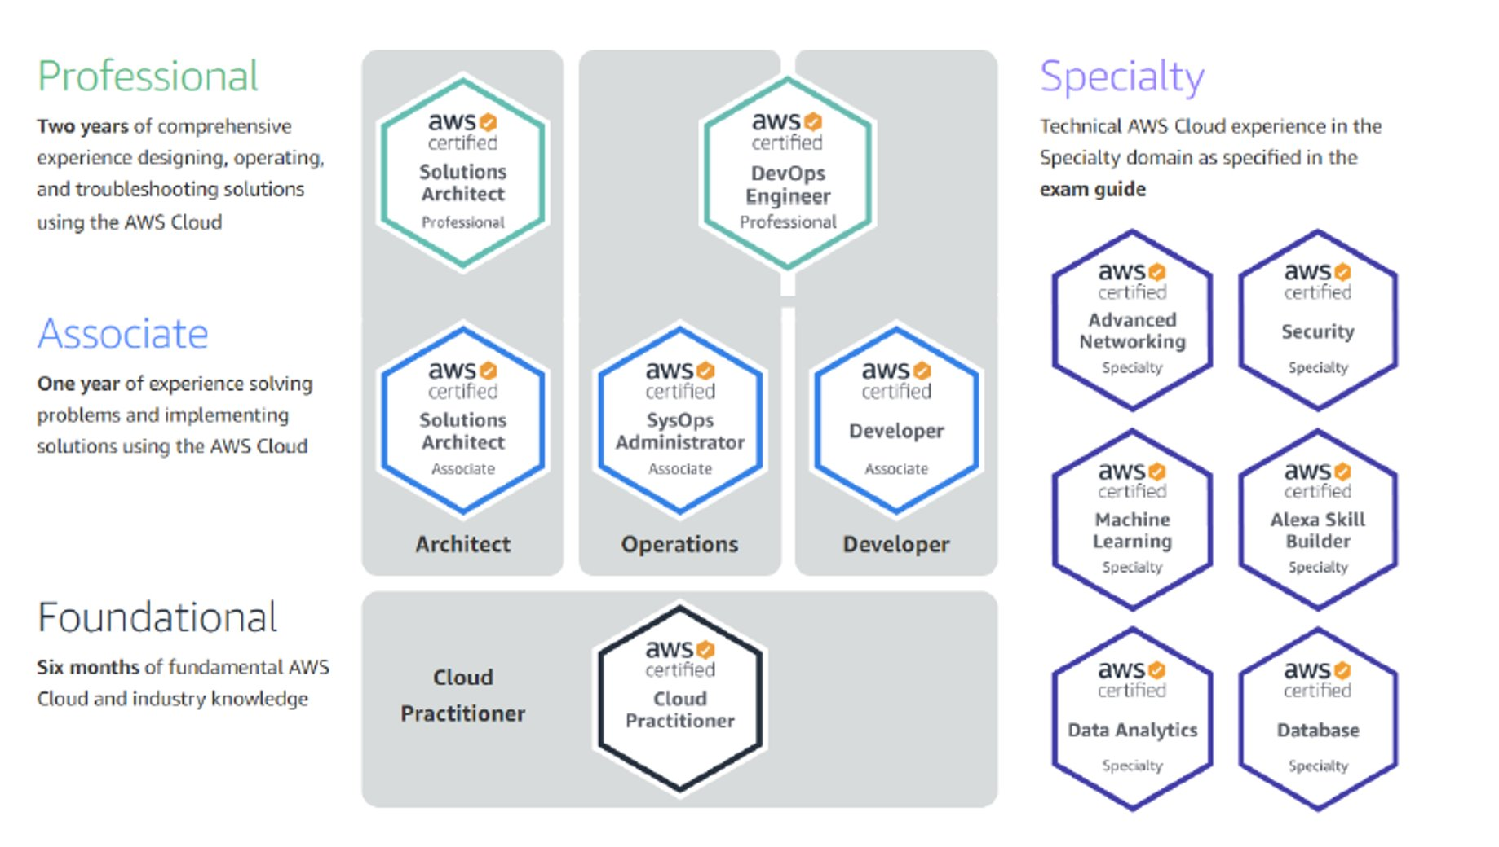
AWS Certification Paths

Slide 9
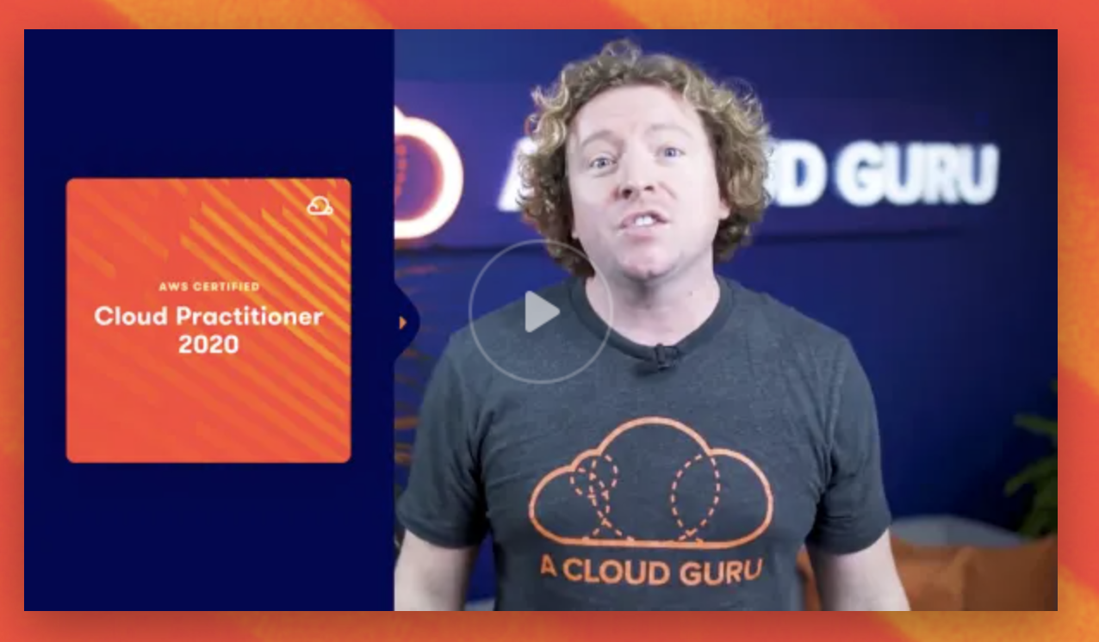
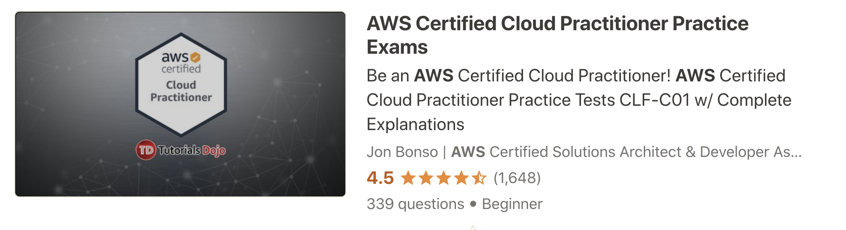
Certification resources
A Cloud Guru
Practice Exams

Slide 10
Docker

Slide 11
Pre-Docker era
Monolithic Applications
One BIG thing
Difficult to change
Difficult to expand
High vulnerability

Slide 12
Microservices era
Microservices
An architectural and organizational approach to software development where software is composed of small, independent services that communicate over well-defined APIs

Slide 13
Containers & Docker
Containers
A standardized unit with everything the software needs to run ex: libraries, system tools, code, and runtime
Either Docker containers for Linux workloads or Windows containers for Windows workloads
Container
Container
Container
Code
Code
Code
Libraries
Libraries
Libraries
Virtual Kernel
Virtual Kernel
Virtual Kernel
Docker
Operating System

Slide 14
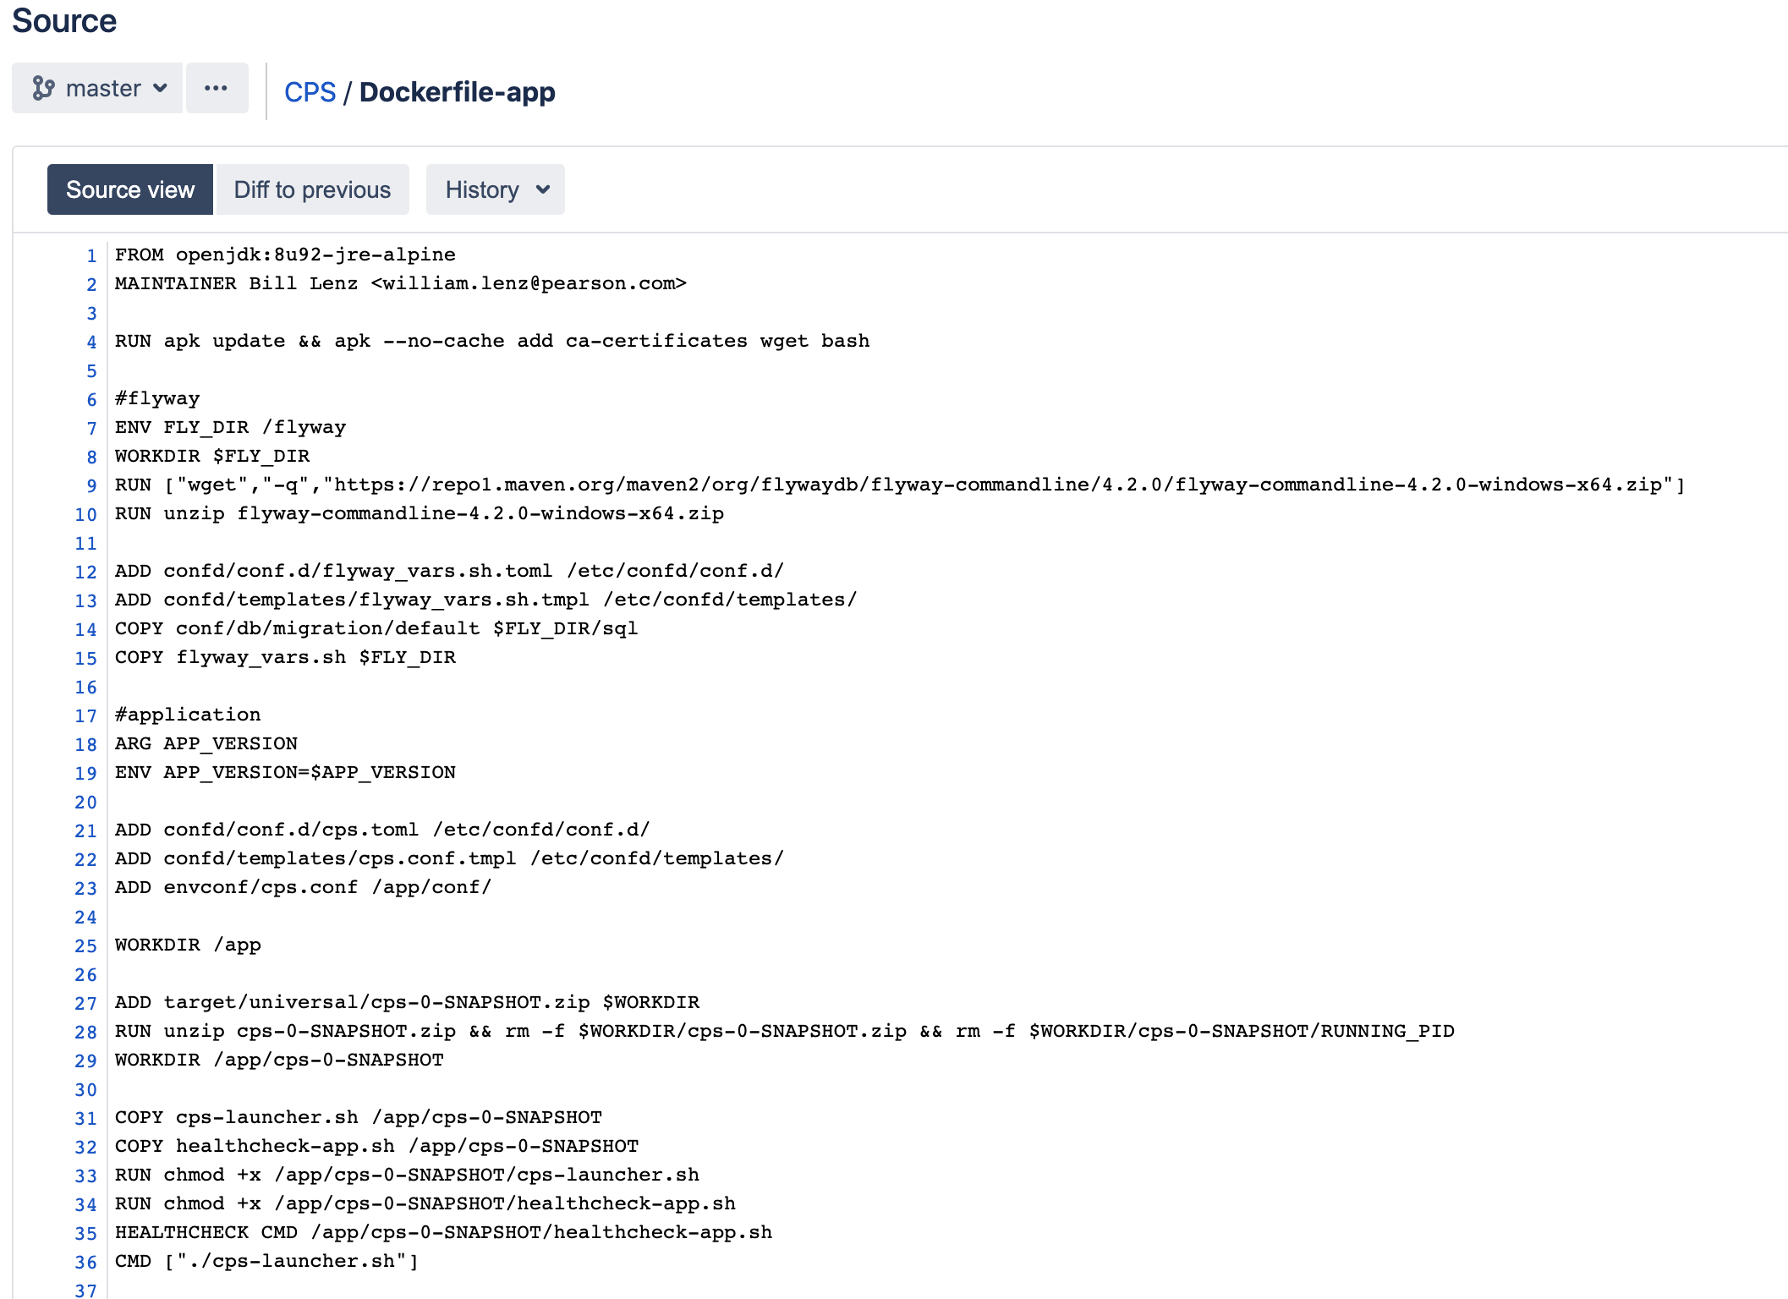
Sample Docker File
Located in the root of the project folder
Default name(Dockerfile) can be customized

Slide 15
ECS
A container orchestration service that supports both Docker and Windows containers
Serverful - EC2
Serverless - Fargate
ECS Architecture
ECS Cluster-Dev
Service 1
Task 1
Task 2
Service 2
ECS Cluster-Prd

Slide 16
Study Docker?
Docker Quick Start at ACloudGuru
https://acloud.guru/overview/da6947b1-0901-4f60-a045-c15ec895a3d9?_ga=2.263461452.1395653366.1624542933-665135405.1622144927

