Slide 1
Layer-specificity in the effects of attention and working memory on activity in primary visual cortex
Timo van Kerkoerle, Matthew W. Self, & Pieter R. Roelfsema

Slide 2
Introduction
Selective attention and working memory are essential in daily life. While attention serves to select relevant stimuli, working memory retains the information when the stimulus has disappeared.
It is generally believed that visual memories consist of a number of phases that differ in their stability.
1st Phase -> Iconic Memory: High Capacity Snapshot; Fragile (100ms); Decaying activity that follows the response elicited by the stimulus in low-level areas of visual cortex.
2nd Phase -> Visual Working Memory: Small Capacity Store; Robust (Several Seconds); Occurs in higher areas of the visual, parietal, and frontal cortex where neurons exhibit persistent firing, even after the stimulus has disappeared.

Slide 3
Introduction Continued
The role of low level areas in maintenance of relevant visual information is under debate. Some fMRI studies suggest that low level visual areas are involved in working memory.
It is unknown if V1 neurons exhibit persistent activity when there is no stimulus in the receptive field (RF), and how feedback from higher visual areas is involved in the process.
The purpose of the experiment is to fill in the above mentioned knowledge gap.

Slide 4
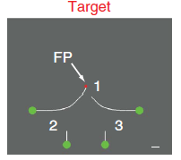
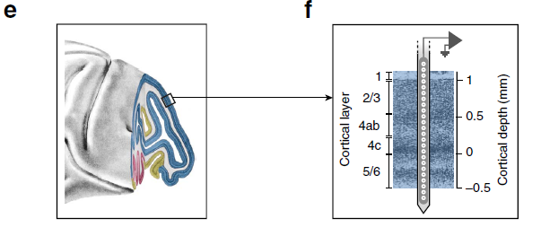
Setup Overview
Trained monkeys to perform curve tracing task, which requires and analysis of the location and orientation of multiple contour elements that are represented at a high resolution in the lower areas of the visual cortex. The monkey’s task was to determine the green circle that connected to the fixation point by a target curve, and to make an eye movement [saccade] to this circle after delay.
A laminar electrode was used to record the activity of neurons in the different layers of V1.

Slide 5
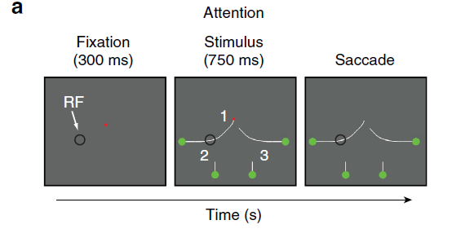
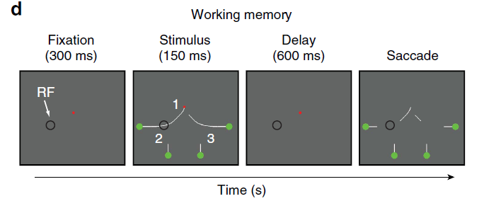
Setup Overview Continued
Two types of tasks: attention & working memory.
Stimulus is presented for complete duration of the trial.
Stimulus is briefly presented.

Slide 6
Questions & Goals
1) Can monkeys trace briefly presented curves? If so, do V1 neurons exhibit persistent activity that depends on the relevance of previously presented contour elements?
2) Compare the putative V1 memory signal to the additional response modulation when the curves remain visible.
3) Measure the influence of visual mask on activity in area V1 because masking interferes with the more fragile iconic memory, but not working memory.
4) Compare the different V1 layers, which might contribute differentially to attention and working memory.

Slide 7
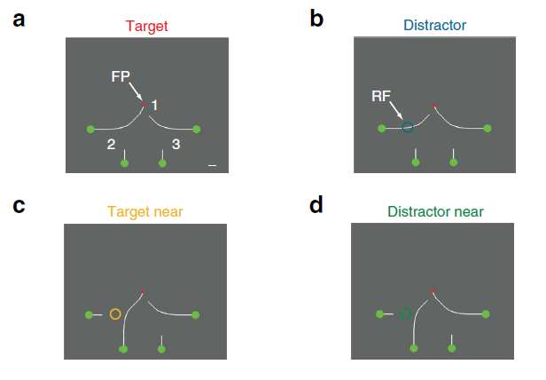
Results: Layer Specific Activity in V1 during the curve tracing task.
Recorded multi-unit activity (MUA) and local field potentials (LFPs) in the different layers of monkey V1. Also computed the current-source density (CSD) profile to determine the putative location of synaptic inputs.
Used a total of 8 stimuli configurations (conditions). Each condition was presented as an attention and a working memory task. Performed in blocks of 100 trials per condition.

Slide 8
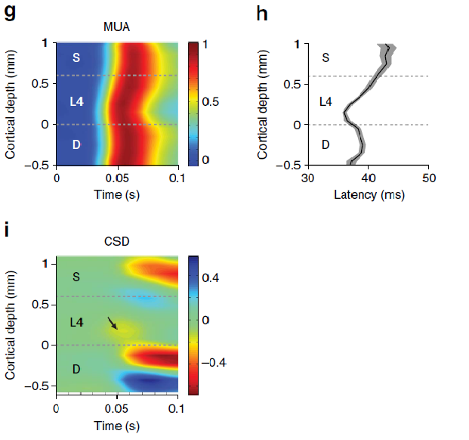
Results Continued: Layer Specific Activity in V1 during the curve tracing task (Attention)
High Accuracy: 97% for monkey R & 94% for monkey E
The appearance of a contour segment in the RF elicited a feedforward MUA response in the different V1 layers, starting in layers 4C and 6 and then spreading into the superficial and deep layers
This laminar pattern is consistent with the projection from the lateral geniculate nucleus (LGN) to layer 4C which, in turn, targets the superficial and deep layers, although the later CSD profile presumably also includes contributions from horizontal and feedback connections

Slide 9
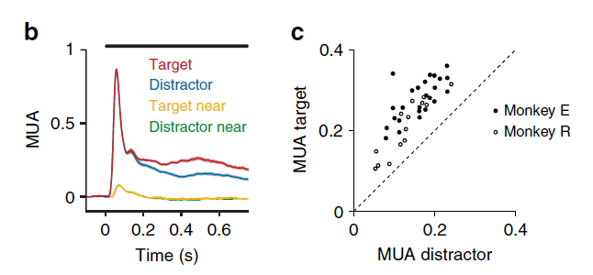
Results Continued: Layer Specific Activity in V1 during the curve tracing task (Attention)
Accordingly, the initial MUA response did not distinguish between the target and distractor curve (Fig. b). However, after a delay the representation of the target curve was enhanced over the representation of the distractor.
The reliability of the attentional modulation in V1 was high as it occurred in every penetration (Fig. c).
A target or distractor curve next to the RF elicited only a weak, response (Fig. b) that did not discriminate between target and distractor.

Slide 10
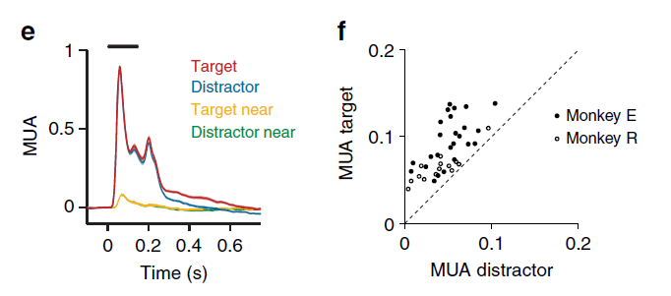
Results Continued: Layer Specific Activity in V1 during the curve tracing task (Memory)
High Accuracy: 97% for monkey R & 90% for monkey E
In this version of the task, the MUA exhibited an off-response and the activity then gradually decreased to baseline (Fig. e), a decrease in activity that presumably corresponds to the decay of iconic memory.
Modulation present in all penetrations (Fig. f).
No modulation of V1 activity occurred when the target or distractor curve was adjacent to the RF (P>0.05 for both monkeys), that the memory signal was either spatially highly specific or depended on the preceding brief stimulus in the neurons’ RF.

Slide 11
Results Continued: Layer Specific Activity in V1 during the curve tracing task (Memory)
Examined the LFP and observed that the target curve elicited more power in the gamma range (30–90 Hz) and less power in the alpha range (5–15 Hz) than the distractor curve, in both the attention and the working memory tasks. These results support previous findings that increases in spiking activity are usually associated with more gamma power and less power at lower frequencies in the LFP.

Slide 12
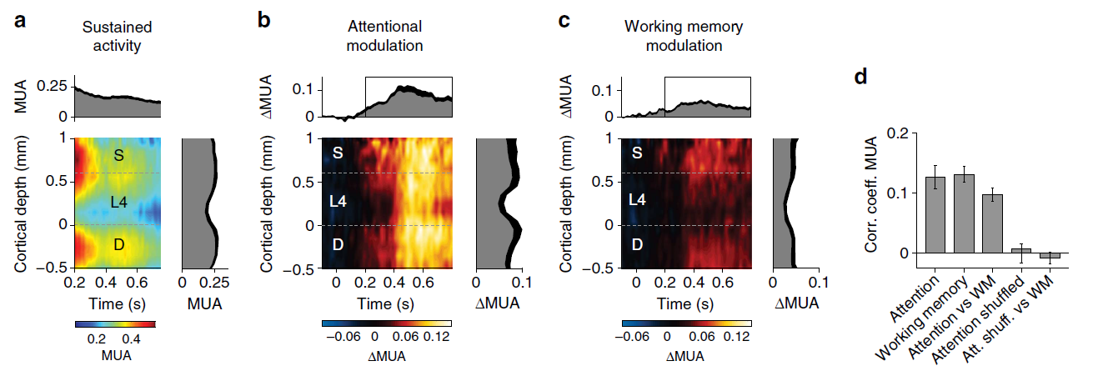
Results Continued: Layer Specific Activity in V1 during the curve tracing task (MUA)
There were differences between layers in the strength of the attentional
modulation, which was strongest in the superficial and deep layers and weaker in layer, in accordance with the anatomy of feedback connections to V1, which tend to avoid
layer 4.

Slide 13
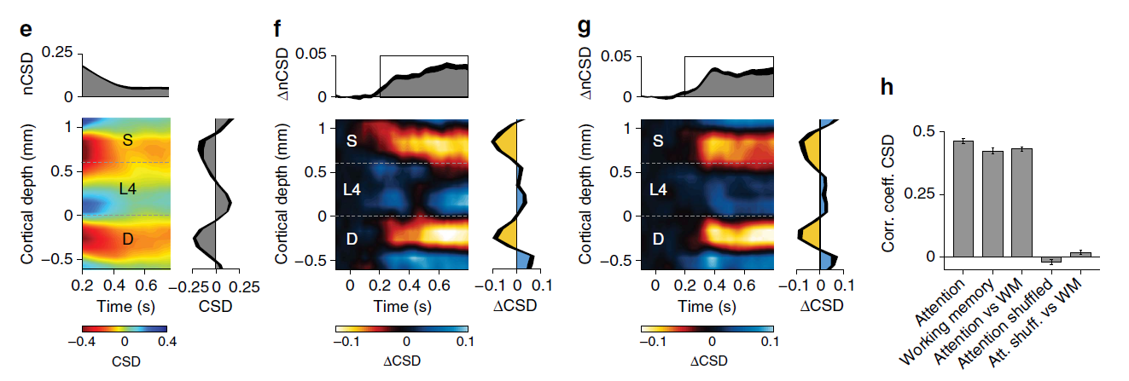
Results Continued: Layer Specific Activity in V1 during the curve tracing task (CSD)
Thus, both tasks gave rise to similar laminar patterns of spiking activity and synaptic
input, in accordance with the anatomy of feedback connections to V1.

Slide 14
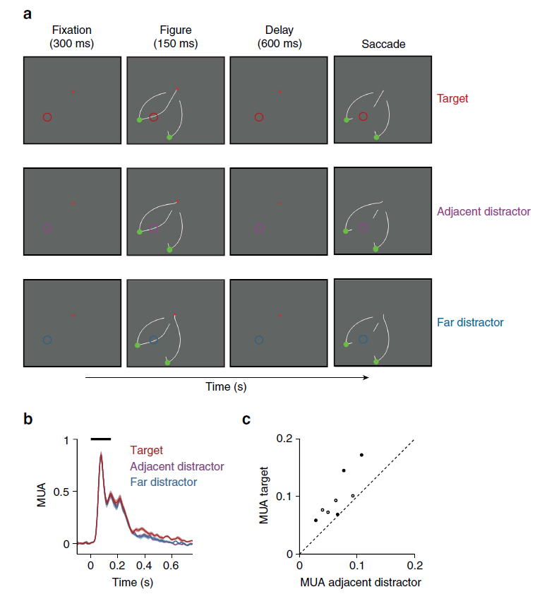
Dissociating the memory trace from the saccade plan
The average MUA response elicited by the memory of the target curve was stronger than that elicited by the near distractor and the far distractor (Fig. b,c). Thus, persistent activity was strongest for task-relevant parts of the memory representation and it was not due to eye movement preparation.

Slide 15
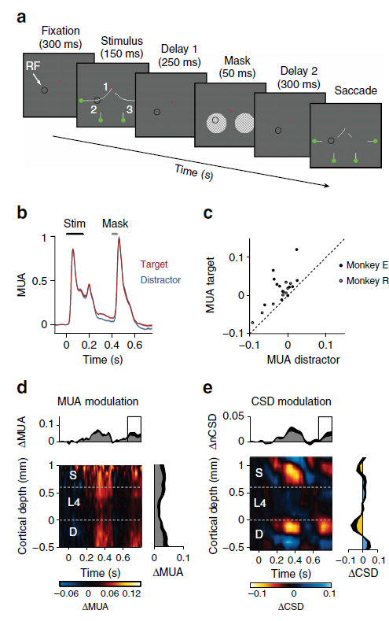
The influence of masking on persistent activity in V1
The monkeys’ accuracy in this task was lower than in the memory task without a mask (84% for monkey E and 95% for monkey R).
During the mask, V1 spiking activity does not store the memory of the stimulus but the modulation of spiking activity is restored later, presumably due to feedback from higher areas. The reappearance of the V1 modulation suggests that these putative higher areas enable a more stable form of memory, and it excludes the possibility that the modulation of the V1 response depends on iconic memory.

Slide 16
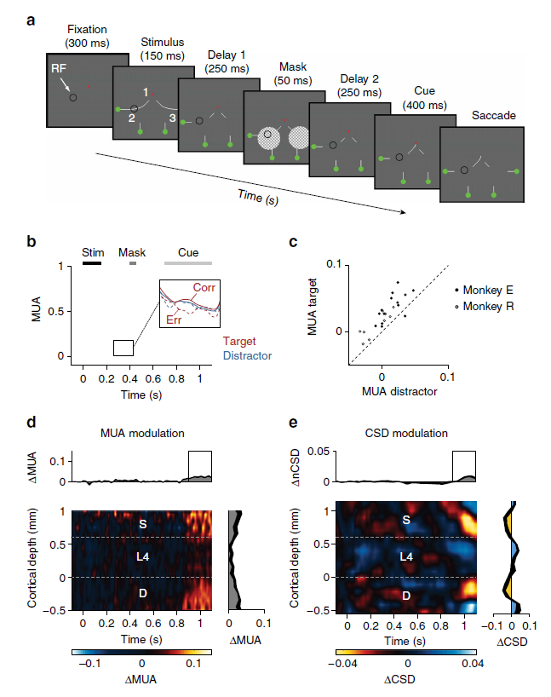
Working memory for curves has a limited capacity
We next investigated whether the monkey could maintain the configuration of two curves in memory by revealing the cue at location 1 only after the crucial segments at locations 2 and 3 had disappeared and been masked (Fig. a).
The accuracy was lower than in the task of Fig. 2d (74% for monkey E and 81% for monkey R) and close to 75%, as if the monkeys could hold only one of the masked segments in memory.
The monkeys’ accuracy suggested that they could memorize, on average, only one of the two masked configurations at locations 2 and 3.

Slide 17
Discussion
We found that monkeys are also able to trace curves that are only briefly shown to them, just like human observers.
The relevance of contour elements modulated the spiking activity of V1 neurons, during a phase in which they were no longer in view.
The direct comparison of the influence of selective attention and working memory on neuronal activity in the different layers of cortex revealed an almost identical CSD profile, suggesting that the mechanisms for selective attention overlap with those for working memory.

Slide 18
Discussion Continued
Theories about visual memory for briefly presented stimuli distinguish between an early iconic memory store with a rapid decay and a later working memory store that lasts longer. The transfer from iconic memory to working memory has to be selective because the capacity of working memory is much smaller than that of iconic memory.
First, the delays tested by us (up to 950 ms) exceed the persistence of iconic memory. Second, the memory recovered after a mask. Third, we found that the monkeys’ capacity to memorize contour configurations was limited and that V1 activity predicted the quality of the memory for the curve in the RF. Thus, the late modulation of V1 activity provides a neuronal correlate of working memory.

Slide 19
Discussion Continued
Many previous studies in monkeys performing working memory tasks focused on higher cortical areas where the persistent firing for items in working memory can be strong. It has remained less clear if working memory also relies on persistent activity in early visual cortical areas.
It seems more likely that the target curve was stored in higher cortical areas, which then fed back to restore the pattern of response modulation in V1. There are several candidate structures that could have acted as a source of these top-down signals. First, the inferotemporal cortex might store the shape of the target curve during the memory delay. Second, neurons in the parietal cortex have been shown to code for the configuration of image elements that are part of a perceptual group. Third, memory representations in the frontal cortex are relatively uninfluenced by intervening stimuli, that is, they resist masking.

Slide 20
Conclusion
Our findings thereby support the notion that attention and working memory modulate spiking activity in early visual areas through feedback input, although causal experiments would be required to provide conclusive evidence.

