Slide 1
>>> Python and GIS:
… Beyond ModelBuilder … and PythonWin
Chad Cooper
Southwestern Energy Company

Slide 2
>>> What we'll cover
> Lists, lists, lists
> Code examples
> 3rd party modules
> Editors/IDEs
> Python references
> This presentation/code online!
Code in orange
Pseudocode in blue
Output/results in green

Slide 3
>>> Love the list
> List: Array of object
references - Huh? or Ordered
collection of arbitrary objects
list1 = [0,1,2,3]
list2 = ['zero','one','two','three']
list3 = [0,'zero',1,'one',2,'two',3,'three']
> Ordered
list2.sort() list2.sort(reverse=True)
['one','three',...] ['zero','two',...]
> Mutable list1.append(4) list1.reverse()
[0,1,2,3,4] [4,3,2,1,0]

Slide 4
>>> Keep lovin' the list
> Iterable for l in list3
0
zero ...
> Membership 3 in list3 --> True
> Nestable - 2D array/matrix
list4 = [[0,1,2],
[3,4,5],
[6,7,8]]
> Access by index - zero-based
list4[1] list4[1][2]
[3,4,5] 5

Slide 5


>>> Process a text file
1 import csv, arcgisscripting
2 gp = arcgisscripting.create()
3 rows = gp.InsertCursor('C:/database.gdb/table')
4 fields = ['slat','slon','spud']
5 reader = csv.reader(open('C:/file.csv','rb'))
6 for line in reader:
7 t = 0
8 row = rows.NewRow()
9 for field in fields:
10 row.SetValue(field,line[t])
11 t = t + 1
12 rows.InsertRow(row)
CSV
GDB table

Slide 6
>>> Databases:
MS SqlServer
1 import ceODBC
2 db = ceODBC.connect('DSN=Wells')
3 c = db.cursor()
4 c.execute('SELECT wellname, slat, slon \
5 FROM wells WHERE wellid IN (1,2,3)')
6 for each in c.fetchall():
7 print each
[('DOE #1-18', 33.095599, -92.38563),
('SMITH #2-7', 35.10155, -91.48824),
('JOHN #11-13', 34.09130, -93.45256)]

Slide 7
>>> Databases:
IBM DB2
1 import ceODBC
2 db = ceODBC.connect('DSN=dsn;UID=uid;PWD=pwd')
3 c = db.cursor()
4 c.execute('SELECT wellname FROM wells')
5 for each in c.fetchmany(3):
6 print each
[('DOE #1-18', 33.095599, -92.38563),
('SMITH #2-7', 35.10155, -91.48824),
('JOHN #11-13', 34.09130, -93.45256)]

Slide 8
>>> Sending email
1 import smtplib
2 server = smtplib.SMTP(email_server_ip)
3 msg = 'Eat more spam and eggs!'
4 server.sendmail('from@me.com',
5 'to@you.com',
6 msg)
7 server.quit()
> Make sure port 25 is
unblocked!

Slide 9
>>> Download files
> GNU wget - free CLI program
> Retrieve using HTTP protocol
> Build a URL such as:
'http://www.archive.org/download/
usgs_drg_ar_36094_a1/
o36094a1.tif'
> Pass URL to wget, it fetches
Notes:
Jared Bendedict bought a set of all 24K USGS quads (56,000 images) and then raised the money to set them free, available to the public. See http://ransom.redjar.org/ for more info.

Slide 10
>>> Download files
1 import os, shutil
2 wgetDir = 'C:/Program Files/wget/o'
3 quads =
4 [['36094a1','ELKINS','ar'],['36094a2','FAYETTEVILLE','ar']]
5 exts = ['tif', 'tfw', 'fgd']
6 url = 'http://www.archive.org/download/'
7 home = 'C:/temp/quads/'
8 for quad in quads:
9 for ext in exts:
10 fullurl = url + 'usgs_drg_' + quad[2] + \
11 '_' + quad[0][:5] + '_' + quad[0][5:] + \
12 '/o' + quad[0] + '.' + ext
13 os.system('wget %s -o log.log' % (fullurl))
14 # Move and rename --> AR_ELKINS_o35094h3.tif
15 shutil.move(wgetDir + quad[0] + '.' + ext,
16 home + quad[2].upper() + '_' + \
17 quad[1].replace(' ','_') + \
18 '_' + 'o' + quad[0] + '.' + ext)

Slide 11
>>> DB records --> FC
1 connect(dsn)
2 db.cursor()
3 execute(sql)
4 results = fetchall()
5 fields = [f1,f2,...]
6 rows = InsertCursor(table)
7 for r in results:
8 row = rows.NewRow()
9 row.SetValue(fields[i], r[i]
10 ...
11 if point data:
12 MakeXyEventLayer(table,x,y,layer)
13 CopyFeatures(layer,featureclass)
14 else:
15 AddJoin(layer,layerfield,table,tablefield)
16 CopyFeatures(layer,featureclass)

Slide 12
>>> 3rd party modules
> pyExcelerator, xlrd - Excel
> ceODBC, MySQLdb - databases
> mxDateTime - date/time f(x)s
> csv* - read/write csv files
> geopy - geocode using 3rd party
geocoders (Google, Yahoo, VE)
> For fun: gdata (Google API),
Flickr, digital photos (EXIF)
* in standard library

Slide 13
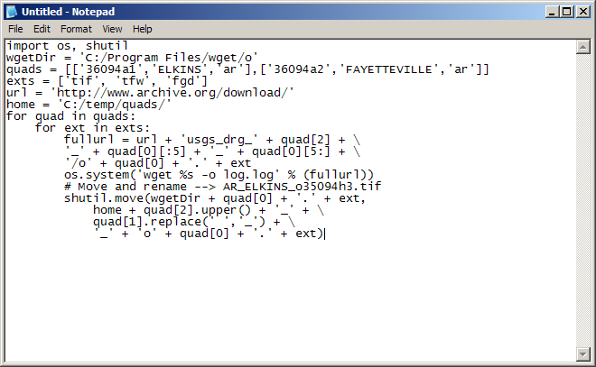
>>> Editors - Notepad
> Editor: Basic - you write code

Slide 14
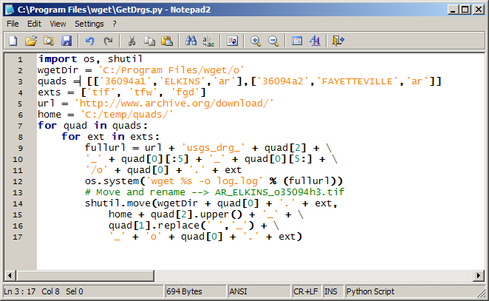
>>> Editors - Notepad2
> Editor: Basic - you write code

Slide 15
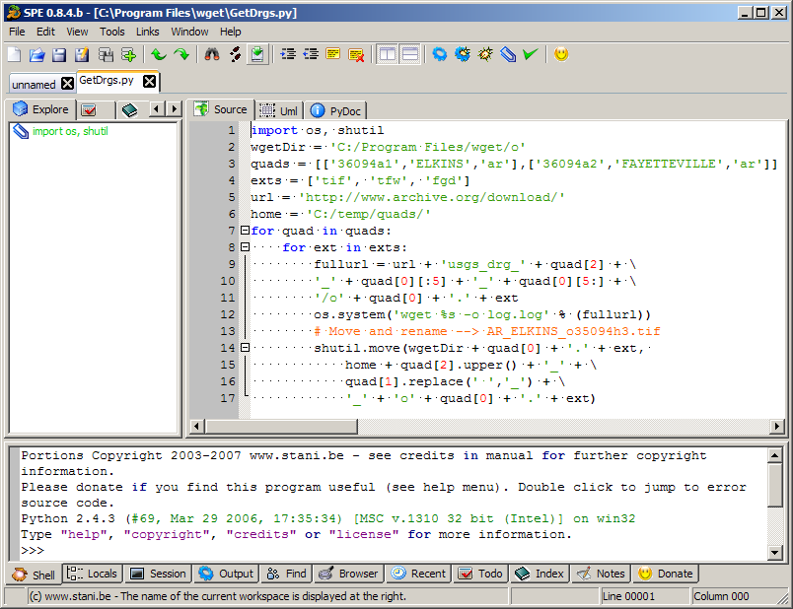
>>> IDEs - SPE
> IDE: Integrated development
environment
> Tools
> Debugger
> Shell

Slide 16
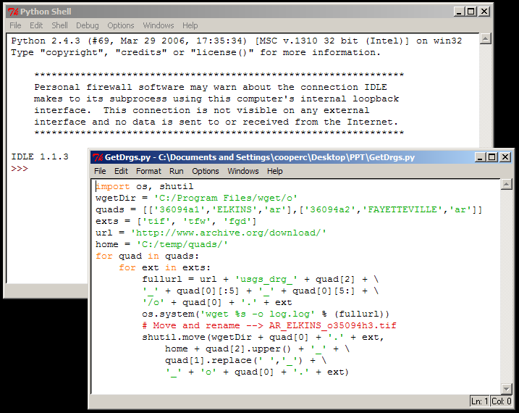
>>> IDEs - IDLE
> Ships with CPython distro

Slide 17
>>> Good references
> http://www.python.org/doc
> Module reference
> Google group: comp.lang.python
> Books:
> Python Cookbook (recipes online)
> How to Think Like a Computer
Scientist (online)
> ESRI gp scripting forum

Slide 18
>>> Further reading
> Python Magazine - online print
and pdf (for fee)
> The Python Papers - pdf free
online
> Dive Into Python - free online

Slide 19

chad_cooper@swn.com
Presentation available at:
http://tinyurl.com/36xj78
Code available at:
http://code.google.com/p/csvimporter

