Slide 1
Don’t waste your Health Record
Predicting Diabetes by machine learning on EHR
25 million people (8.3% of entire US population) have diabetes;
Diabetes is also associated heart disease, stroke, blindness and kidney disease;
Predicting who has diabetes lead to a better understanding of it and its comorbidities.

Slide 2
Data
The goal is to predict whether a patient has Diabetes(DMIndicator=1)
9948 patients in training. ﻿1904 have diabetes
Manually extracted features:
Age
Gender
US_Region(4 direction)
Diagnosis Description
is hyperlipidemia(fat),
is hypertension
Medicine
Lisinopril(high blood pressure and heart failure),
Lipitor(high cholesterol),
Simvastatin(high cholesterol),
Zithromax Z-Pak(various types of infections),
Xanax(anxiety))
LabTest Type
Bilirubin
Protein
Hemoglobin

Slide 3
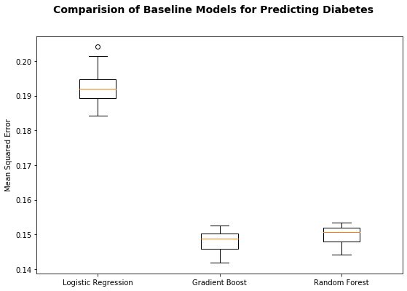
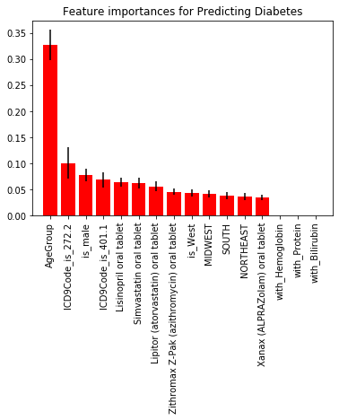

Slide 4
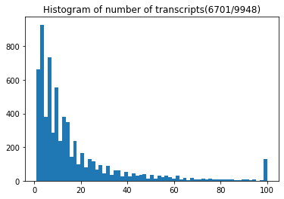
Transcripts Histories
Transcripts(EHR) sorted by VisitYear
Clinic information: weight, BMI, SystolicBP, DiastolicBP
Diagnosis information: ICD9Code, Acute(Chronic:0, Acute:1)
Future model: LSTM with sequence of transcripts data and transcripts independent data

