Slide 1
Week 5 Lecture 3
Test for a Single Mean: One Sample t-test
Jill VanderStoep Hope College – Holland, MI

Slide 2
Hypothesis Testing
Confidence Interval
Aim: Evaluate the strength of evidence against the null hypothesis
Steps:
Write null & alternative hypotheses
Test the null hypothesis (2 options)
Simulation based approach
Theory based approach
Get the null distribution
Find p-value and/or standardized statistic
Evaluate your evidence against the null/in favor of alternative hypothesis
Aim: Provide an estimation to an unknown parameter.
Steps:
Find the sample statistic
Compute margin of error
Provide your interval estimation

Slide 3
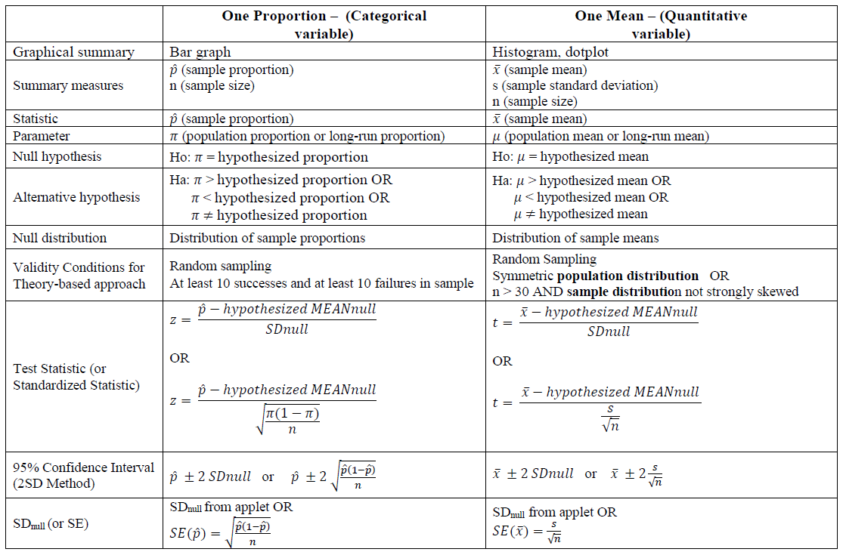

Slide 4

Backpack Weights

Slide 5

Backpack Weights
Carrying a heavy backpack can be a source of chronic, low-level trauma and can cause long-lasting shoulder, neck, and back pain.
The American Academy of Orthopedic Surgeons recommends that a backpack not weigh more than 10% to 15% of the wearer’s body weight.
College students at a public university in California (about 20,000 enrollment) wondered if college students at their university were following these backpack weight guidelines.

Slide 6
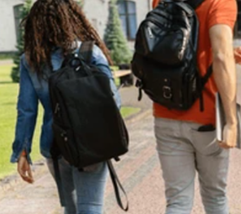
Backpack Weights
STEP 1: Ask a research question
Do university students carry backpacks that weigh on average something different than the recommended 10% of their body weight?
Let’s take a closer look at this study

Slide 7
Backpack Weights
STEP 2: Design a study and collect data
Each of 4 consecutive days, student researchers set up a scale at a different location on their campus. At each location, data was gathered on students who agreed to participate until they had data on 25 students at that location (100 total students).
Each student had their backpack weight recorded to the nearest pound.
Each student filled out a short survey that asked their weight in pounds, what college they were in, their major, their year in school, whether they were a graduate or undergraduate student, their total course units, and whether they experienced any back problems.

Slide 8
Backpack Weights
What are the observational units?
The observational units are the 100 students.
What measured variables are categorical?
College, major, year in school, back problems.
What measured variables are quantitative?
The backpack weight (lbs), the student weight (lbs), the number of course units.

Slide 9
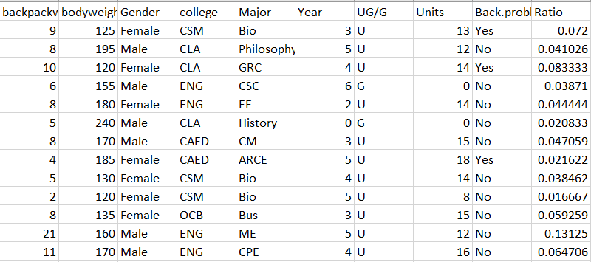
Backpack Weights
Other variables calculated
Percentage of student’s body weight the backpack is calculated as a ratio
Spread sheet/data sheet

Slide 10
Hypotheses
State the null and alternative hypotheses
Null hypothesis: The unknown long run mean ratio of backpack weight to body weight is 0.10
Alternative hypothesis: The unknown long run mean ratio of backpack weight to body weight is different from 0.10

Slide 11
Parameters
We can also use a symbol for the unknown parameter we are trying to estimate.
The parameter of interest is:
µ = the unknown long-run mean ratio of backpack weight to body weight

Slide 12
Hypotheses
Mu (µ) is the parameter for population mean ratio.
Using this symbol, we can rewrite the hypotheses as follows:
H₀: µ = 0.10
H_{a}:µ ≠ 0.10

Slide 13
Hypotheses
Remember
The hypotheses are about the parameter value in the population, not just for these 100 students.
Hypotheses are always about populations or processes, not the sample data.

Slide 14
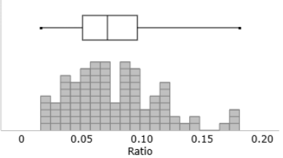
Step 3: Explore the data
 | Sample size | Mean | SD | Min. | First Quart. | Med. | Third Quart. | Max.
Ratio | 100 | 0.078 | 0.037 | 0.016 | 0.052 | 0.071 | 0.096 | 0.181

Slide 15
Results
The sample mean was different than 0.10
What are two possible explanations for why we observed a sample mean that was different from 0.10?
#1 The population mean ratio really is 0.10 and our sample mean of 0.078 from 100 students happened by random chance.
#2 The population mean ratio is different from 0.10 and that is why our sample mean ratio was different from 0.10.

Slide 16
Step 4: Draw inferences beyond the data
Is it possible to get a mean ratio of 0.078 even if in the population the ratio is 0.10?
Yes, it’s possible, how likely though?
Test statistic and p-value will tell how likely it is to get a mean ratio that different from 0.10.

Slide 17
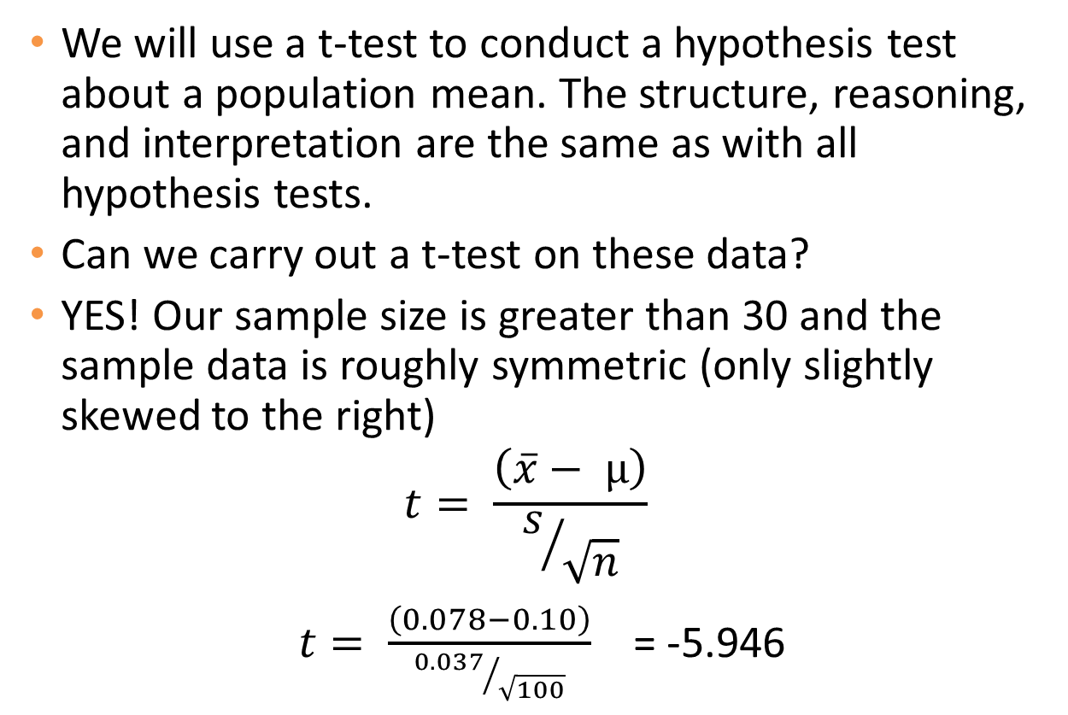
Test Statistic
We will use a t-test to conduct a hypothesis test about a population mean. The structure, reasoning, and interpretation are the same as with all hypothesis tests.
Can we carry out a t-test on these data?
YES! Our sample size is greater than 30 and the sample data is roughly symmetric (only slightly skewed to the right)
$$t= \frac{\left(\overline{x}− µ\right)}{s/{\sqrt{n}}}$$
$t= \frac{\left(0.078−0.10\right)}{{0.037}/{\sqrt{100}}}$ = -5.946

Slide 18
How to Find p-value?
Let’s use the applet to find the p-value.
Very small p-value. Reject Ho.

Slide 19
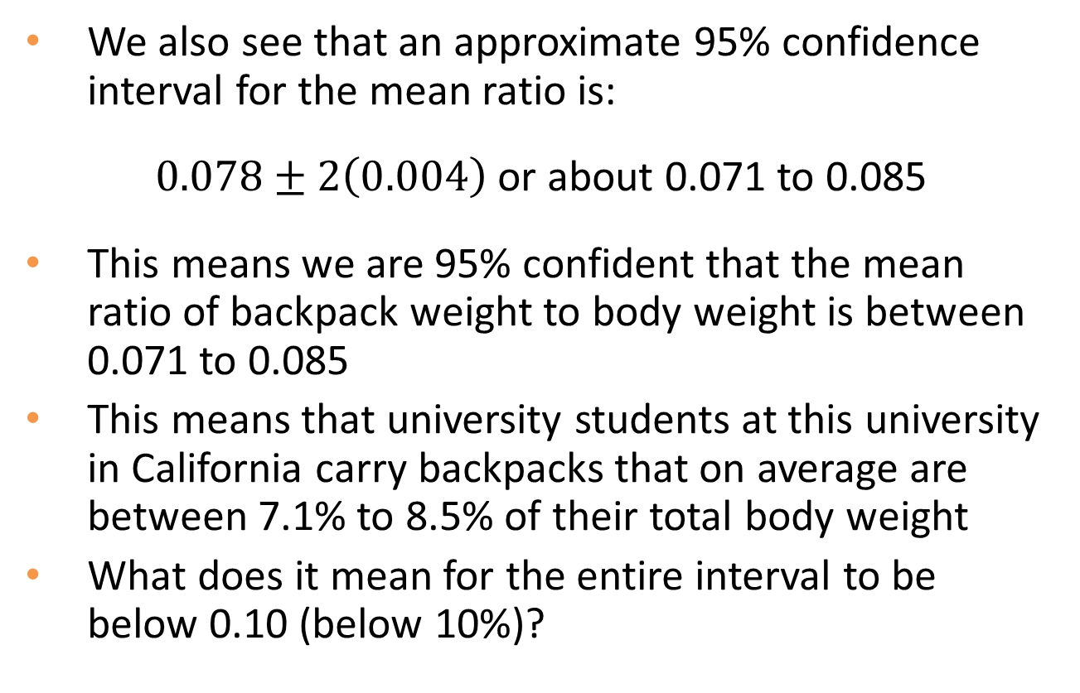
Confidence Interval
We also see that an approximate 95% confidence interval for the mean ratio is:
$0.078±2\left(0.004\right)$ or about 0.071 to 0.085
This means we are 95% confident that the mean ratio of backpack weight to body weight is between 0.071 to 0.085
This means that university students at this university in California carry backpacks that on average are between 7.1% to 8.5% of their total body weight
What does it mean for the entire interval to be below 0.10 (below 10%)?

Slide 20
Step 5: Formulate Conclusions
Was the sample randomly selected from a larger population?
No, the sample was not randomly sampled from a larger population of university students. However, if you believe that university students in California are not different in their body composition or the amount of weight they carry in their backpacks compared to other university/college students across the US, then we can generalize to all college/university students in the US.
Were the observational units randomly assigned to treatments?
No, there was no random assignment in this study, so we cannot make any causal conclusions.

Slide 21
Conclusions
While we have strong evidence that the mean ratio is different from 0.10 (10%), is the difference impressive?
Recall that for children in elementary school and secondary school, pediatric surgeons recommended that the ratio of backpack weight to body weight not exceed 10% to 15%.
The average ratio of 0.08 (7.8%) is well below this recommendation.
It does seem that college/university students are carrying more reasonable weights in their backpacks.

Slide 22
Step 6: Look back and ahead
Looking back: Did anything about the design and conclusions of this study concern you? In particular, are there things that could have been done to give a better chance finding strong evidence of a true difference between the two groups?
Always nice to have a larger sample size. A random sample. Researchers should try to replicate their results. These replicated studies could be at different colleges/universities across the U.S.
Looking ahead: What should the researchers’ next steps be to fix the limitations or build on this knowledge?
See if these results hold when other variables are looked at. For example do these ratios hold within subpopulations like males and females, or between different majors. Could backpack weights be decreasing due to e-books (all books on one laptop).

