Slide 1
Monte Carlo Analysis of Two Sample T test on Movie Data
Dan Agnew, Tyler Hempstead, Mars Alkindi

Slide 2
Project Goal
Perform analysis relevant to stat 400 by using data we had scrapped from IMDB
A question of interest is whether season 2 of tv shows tend to be better or worse than season 1
One way of testing this is with a two-sample t test for difference in population means, however we would be violating the assumption that our two samples are independent. We could also try a paired t test.
Use Monte Carlo analysis to determine the effectiveness of a two-sample t test and paired t test for a difference in population means between season 1 and season 2 of tv shows when different assumptions are applied

Slide 3
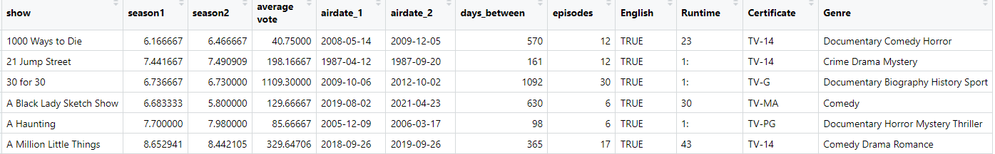
Data
226 observations of season 1 and season 2 data on TV shows
Data Sampled from top 5000 most voted on TV shows on IMDB

Slide 4
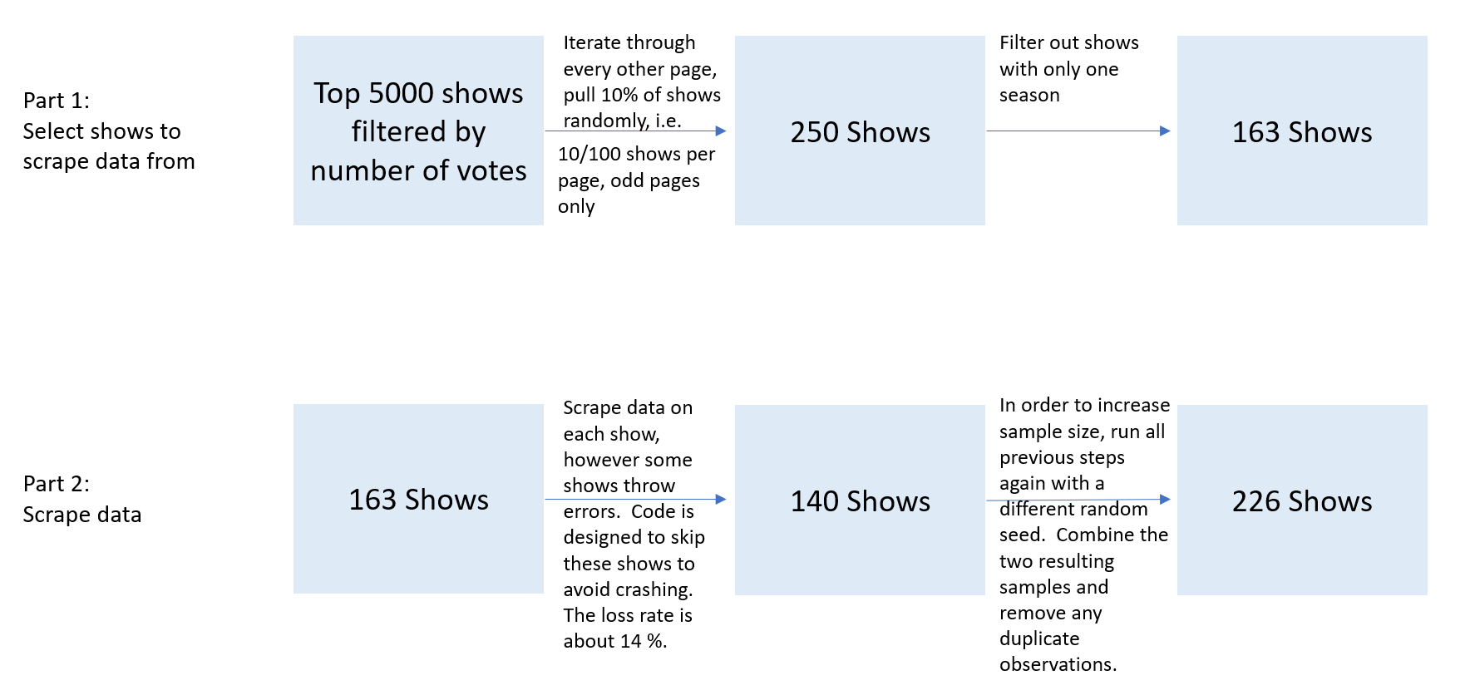

Slide 5
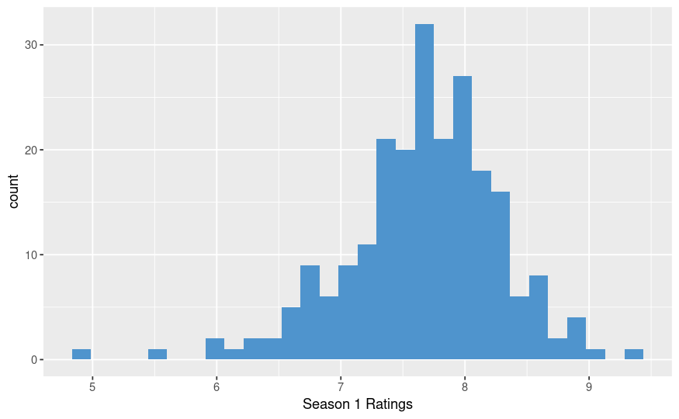
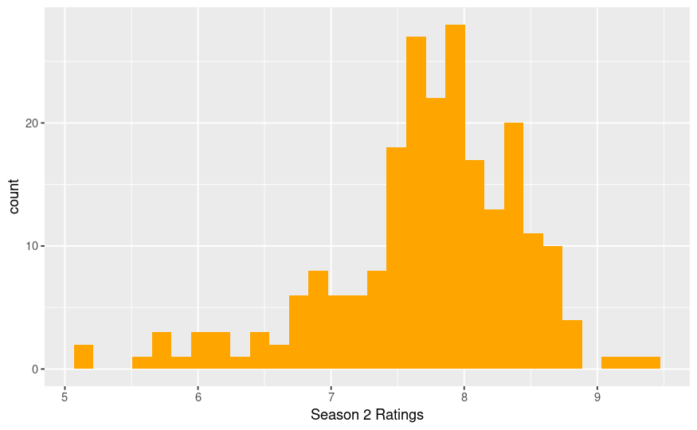
Exploratory Analysis

Slide 6
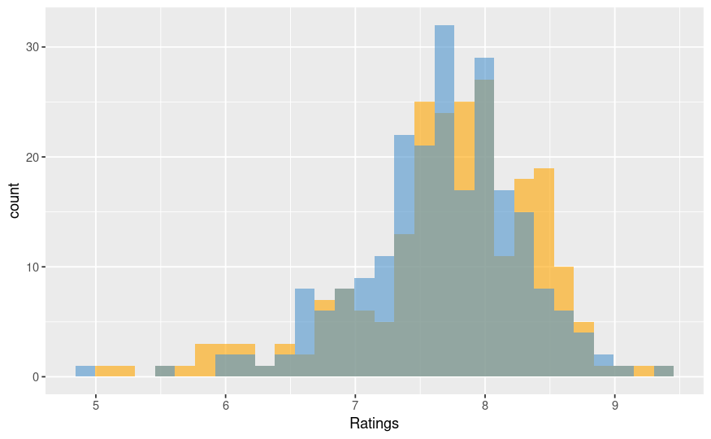
Exploratory Analysis Cont.
Season 1
Mean: 7.67
SD: .627
Season 2
Mean: 7.71
SD: .725

Slide 7
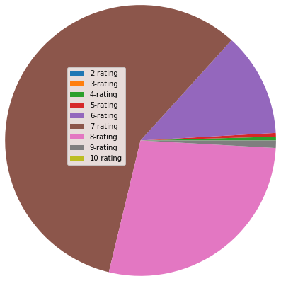
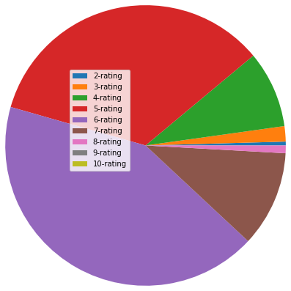
Exploratory Analysis Cont.
Season-1 Pie Chart for Avg ratings
Season-2 Pie Chart for Avg ratings

Slide 8
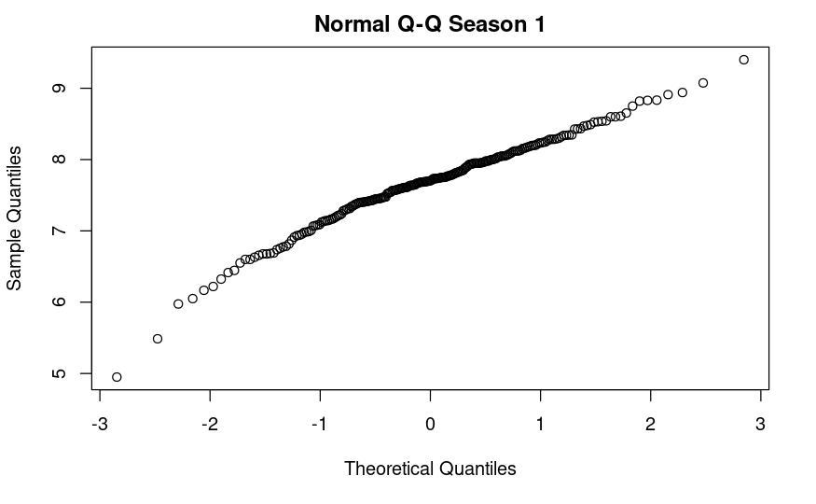
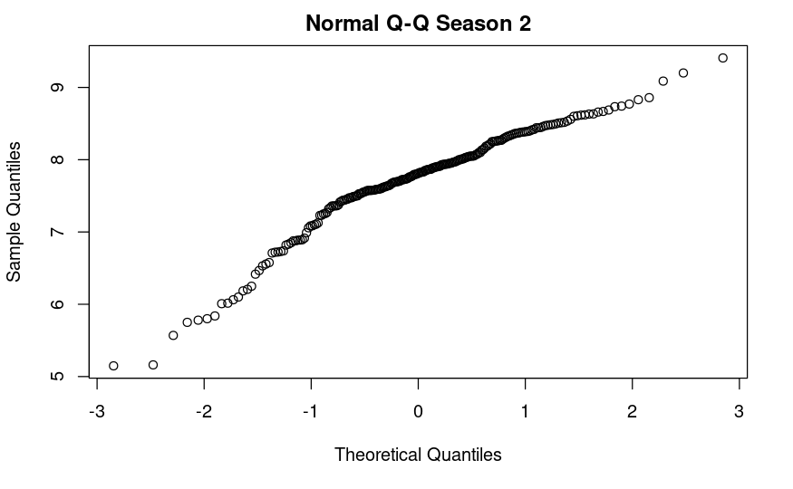
Exploratory Analysis Cont.
Normal Quantile-Quantile plots are not perfectly linear. It is probably acceptable for our data to vary from the normal
distribution to this extent, however we are still violating the normality assumption for two-sample T test somewhat.

Slide 9
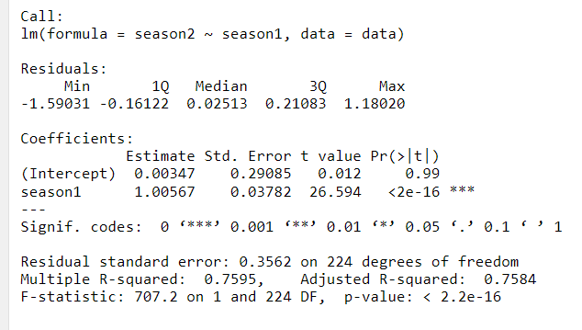
Exploratory Analysis Cont.
P val of < .001 confirms our expectation that season 1 values and season 2 values are not independent of
one another.

Slide 10
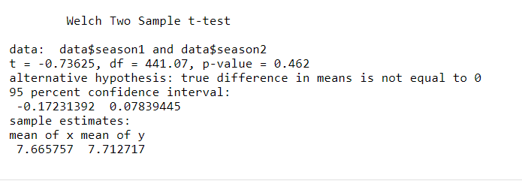
Two-Sample T Test Results
We do not find statistically Significant evidence of a difference in population mean rating between first and second seasons of tv shows.
It could be worth trying to run this analysis again in the future if we have a larger pool of data than 226 observations.

Slide 11
Bootstrap Sampling
Took 20000 Bootstrap samples of size 200 from our original sample of 226 shows for each season. Corresponding season 1 and season 2 values were not picked. i.e., they were not sampled in pairs. They were sampled separately with replacement. This means that the sample taken for season 1 is independent here from the sample taken for season 2.
Since the season 1 values in the boot strap samples were gathered independently from the season 2 values, we should no longer be in violation of the independence assumption for a two-sample t test.

Slide 12
Bootstrap Sampling Cont.
Mean p val from 20000 two-sample t-tests on bootstrap samples was .427 (.30). This seems substantially lower than our original calculated p val of .462.
Still no statistically significant evidence of difference in population means between season 1 and season 2, so our interpretation of the results does not change.

Slide 13
Bootstrap Sampling Cont.
Sampled 20000 bootstrap samples from original 226 shows data, but this time in pairs so now we should be violating the independence assumption again.
Mean p val sampling this way was .431 (.30). A bit greater than the Mean p val of .427(.30) when sampling independently.
The fact that there is a noticeable difference in mean p value despite such large sample sizes seems to indicate that sampling independently instead of in pairs has an impact on the analysis.
Difference in mean p vals isn’t huge, which could indicate that a paired samples t-test isn’t being impacted too much data due to failing the independence assumption in this case. This supports the viability of its use on the original data set.

Slide 14
Generate Raw Ratings for TV Shows
Season 1 :
rbinom(n, 10, p_season1)
Season 2 based on Season 1 ratings:
No assumptions - uniform probability
Cutoff point - Season 1 rating 3 or lower, assume not rate season 2
Quadratic – Extreme values more likely to rate season 2

Slide 15
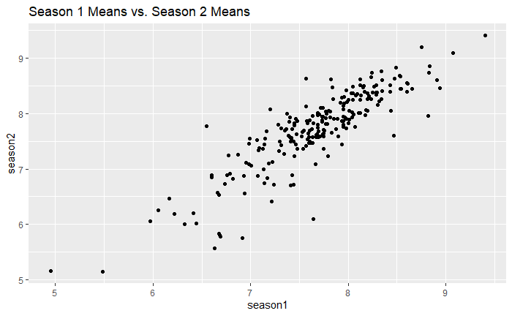
Season 1 vs. Season 2 Averages – Original Data

Slide 16
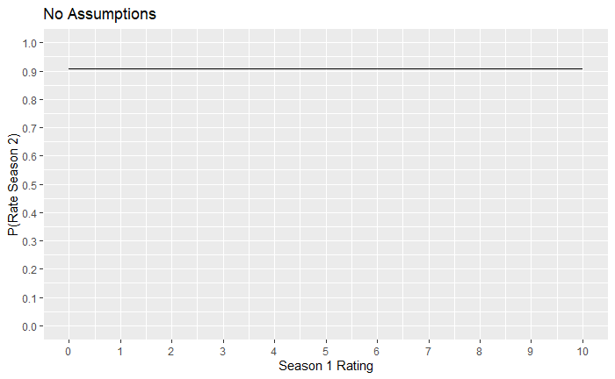
Method 1: No Assumptions

Slide 17
No Assumptions Transition Matrix
P(Season 2 Rating | Season 1 Rating)
0 1 2 3 4 5 6 7 8 9 10
Season1=0 0.091 0.091 0.091 0.091 0.091 0.091 0.091 0.091 0.091 0.091 0.091
Season1=1 0.091 0.091 0.091 0.091 0.091 0.091 0.091 0.091 0.091 0.091 0.091
Season1=2 0.091 0.091 0.091 0.091 0.091 0.091 0.091 0.091 0.091 0.091 0.091
Season1=3 0.091 0.091 0.091 0.091 0.091 0.091 0.091 0.091 0.091 0.091 0.091
Season1=4 0.091 0.091 0.091 0.091 0.091 0.091 0.091 0.091 0.091 0.091 0.091
Season1=5 0.091 0.091 0.091 0.091 0.091 0.091 0.091 0.091 0.091 0.091 0.091
Season1=6 0.091 0.091 0.091 0.091 0.091 0.091 0.091 0.091 0.091 0.091 0.091
Season1=7 0.091 0.091 0.091 0.091 0.091 0.091 0.091 0.091 0.091 0.091 0.091
Season1=8 0.091 0.091 0.091 0.091 0.091 0.091 0.091 0.091 0.091 0.091 0.091
Season1=9 0.091 0.091 0.091 0.091 0.091 0.091 0.091 0.091 0.091 0.091 0.091
Season1=10 0.091 0.091 0.091 0.091 0.091 0.091 0.091 0.091 0.091 0.091 0.091

Slide 18
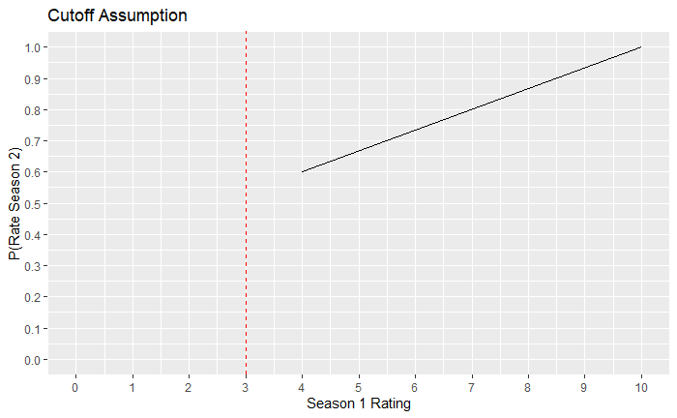
Method 2: Cutoff Point

Slide 19
Cutoff Point Transition Matrix
P(Season 2 Rating | Season 1 Rating)
0 1 2 3 4 5 6 7 8 9 10
Season1=0 0.75 0.025 0.025 0.025 0.025 0.025 0.025 0.025 0.025 0.025 0.025
Season1=1 1.00 0.000 0.000 0.000 0.000 0.000 0.000 0.000 0.000 0.000 0.000
Season1=2 1.00 0.000 0.000 0.000 0.000 0.000 0.000 0.000 0.000 0.000 0.000
Season1=3 1.00 0.000 0.000 0.000 0.000 0.000 0.000 0.000 0.000 0.000 0.000
Season1=4 0.60 0.000 0.000 0.133 0.133 0.133 0.000 0.000 0.000 0.000 0.000
Season1=5 0.50 0.000 0.000 0.000 0.167 0.167 0.167 0.000 0.000 0.000 0.000
Season1=6 0.40 0.000 0.000 0.000 0.000 0.200 0.200 0.200 0.000 0.000 0.000
Season1=7 0.30 0.000 0.000 0.000 0.000 0.000 0.233 0.233 0.233 0.000 0.000
Season1=8 0.20 0.000 0.000 0.000 0.000 0.000 0.000 0.267 0.267 0.267 0.000
Season1=9 0.10 0.000 0.000 0.000 0.000 0.000 0.000 0.000 0.300 0.300 0.300
Season1=10 0.00 0.000 0.000 0.000 0.000 0.000 0.000 0.000 0.000 0.500 0.500

Slide 20
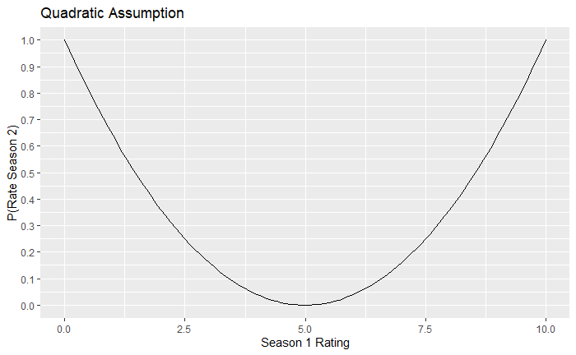
Method 3: Quadratic

Slide 21
Quadratic Transition Matrix
P(Season 2 Rating | Season 1 Rating)
0 1 2 3 4 5 6 7 8 9 10
Season1=0 0.75 0.025 0.025 0.025 0.025 0.025 0.025 0.025 0.025 0.025 0.025
Season1=1 0.00 0.500 0.500 0.000 0.000 0.000 0.000 0.000 0.000 0.000 0.000
Season1=2 0.10 0.300 0.300 0.300 0.000 0.000 0.000 0.000 0.000 0.000 0.000
Season1=3 0.20 0.000 0.267 0.267 0.267 0.000 0.000 0.000 0.000 0.000 0.000
Season1=4 0.40 0.000 0.000 0.200 0.200 0.200 0.000 0.000 0.000 0.000 0.000
Season1=5 0.90 0.000 0.000 0.000 0.033 0.033 0.033 0.000 0.000 0.000 0.000
Season1=6 0.90 0.000 0.000 0.000 0.000 0.033 0.033 0.033 0.000 0.000 0.000
Season1=7 0.40 0.000 0.000 0.000 0.000 0.000 0.200 0.200 0.200 0.000 0.000
Season1=8 0.20 0.000 0.000 0.000 0.000 0.000 0.000 0.267 0.267 0.267 0.000
Season1=9 0.10 0.000 0.000 0.000 0.000 0.000 0.000 0.000 0.300 0.300 0.300
Season1=10 0.00 0.000 0.000 0.000 0.000 0.000 0.000 0.000 0.000 0.500 0.500

Slide 22
Exploration of Generated Differences
Comparison of Original vs. Generated
Mean of Mean Differences SE of Mean Differences
Original Data -0.047 0.355
No Assumptions 2.666 0.631
Cutoff Assumption 1.621 0.273
Quadratic Assumption 2.217 0.521

Slide 23
Moving Forward
There was only one set of raw scores produced for 226 shows by 1000 people.
Repeat this process of generating data and calculating mean differences.
Explore more methods of comparing Season 1 and Season 2 mean ratings.

Slide 24
Conclusion

Slide 25
References
IMDb(2021). TV Series (Sorted by Popularity Ascending). https://www.imdb.com/search/title/?title_type=tv_series
R Core Team (2019). R: A language and environment for statistical computing. R Foundation for Statistical Computing, Vienna, Austria. URL https://www.R-project.org/.
RStudio Team (2020). RStudio: Integrated Development for R. RStudio, PBC, Boston, MA URL http://www.rstudio.com/.
Wickham et al., (2019). Welcome to the tidyverse. Journal of Open Source Software, 4(43), 1686, https://doi.org/10.21105/joss.01686
Xie Y (2021). knitr: A General-Purpose Package for Dynamic Report Generation in R. R package version 1.36, https://yihui.org/knitr/.

