Slide 1
COMPLETELY RANDOMIZED DESIGNS
Chapter 3

Slide 2
LEARNING OBJECTIVES
Explain what complete randomization means
Perform randomization in R (lab 7)
State assumptions that make this design appropriate
Define experimental and observational error
Give hypothetical examples for sources of variation contributing to the two types of error

Slide 3
COMPLETELY RANDOMIZED DESIGNS (CRD)
Every experimental design starts with a pre-randomized design plan
CRD plan is most basic:
List out all possible treatment levels (could come from one or more treatment factors)
Decide number of replicates per treatment level
Given CRD plan, assignment of treatments to EUs is done completely at random
Randomization is valid if it preserves the desired replication

Slide 4
BREAD RISING EXAMPLE RANDOMIZATION
Treatment factor: time to rise (3 levels)
Assign levels 1, 2, and 3 to r₁, r₂, and r₃ EUs (r₁+r₂+r₃=N)
Example: N=12 loaf pans with r₁ = r₂ = r₃ =4
Randomization procedure is valid is every permutation of treatment labels is equally likely
NOT THE SAME AS SAYING EVERY EU HAS SAME CHANCE TO BE ASSIGNED A GIVEN TREATMENT
EU | 1 | 2 | 3 | 4 | 5 | 6 | 7 | 8 | 9 | 10 | 11 | 12
Trt | 1 | 1 | 1 | 1 | 2 | 2 | 2 | 2 | 3 | 3 | 3 | 3
Trt | 1 | 2 | 3 | 3 | 3 | 2 | 2 | 1 | 1 | 3 | 2 | 1
Trt | 2 | 2 | 2 | 3 | 1 | 2 | 3 | 1 | 1 | 3 | 1 | 3

Slide 5
INCORRECT RANDOMIZATION SCHEMES
Examples of the wrong way to randomize:
For each EU, randomly generate number from {1,2,3}
Start with EU 1 and randomly generate number from {1,2,3}, continue to other EUs until desired replication is met
Possible designs under (1) and (2)
Randomize Scheme | EU | 1 | 2 | 3 | 4 | 5 | 6 | 7 | 8 | 9 | 10 | 11 | 12
1 | Trt | 1 | 2 | 2 | 1 | 1 | 3 | 3 | 3 | 2 | 2 | 1 | 1
1 | Trt | 1 | 1 | 1 | 1 | 1 | 1 | 1 | 1 | 1 | 1 | 1 | 1
2 | Trt | 1 | 2 | 3 | 3 | 2 | 1 | 1 | 2 | 3 | 3 | 2 | 1
2 | Trt | 1 | 1 | 1 | 1 | 2 | 2 | 2 | 2 | 3 | 3 | 3 | 3

Slide 6
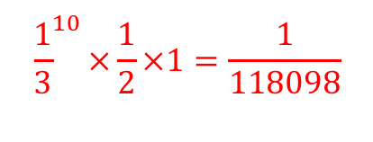
INCORRECT RANDOMIZATION SCHEMES
Scheme 2 is invalid because the two assignments have different probabilities of occurring
Randomize Scheme | EU | 1 | 2 | 3 | 4 | 5 | 6 | 7 | 8 | 9 | 10 | 11 | 12
2 | Trt | 1 | 2 | 3 | 3 | 2 | 1 | 1 | 2 | 3 | 3 | 2 | 1
Each have prob 1/3
Prob 1/2
Prob 1
Randomize Scheme | EU | 1 | 2 | 3 | 4 | 5 | 6 | 7 | 8 | 9 | 10 | 11 | 12
2 | Trt | 1 | 1 | 1 | 1 | 2 | 2 | 2 | 2 | 3 | 3 | 3 | 3

Slide 7
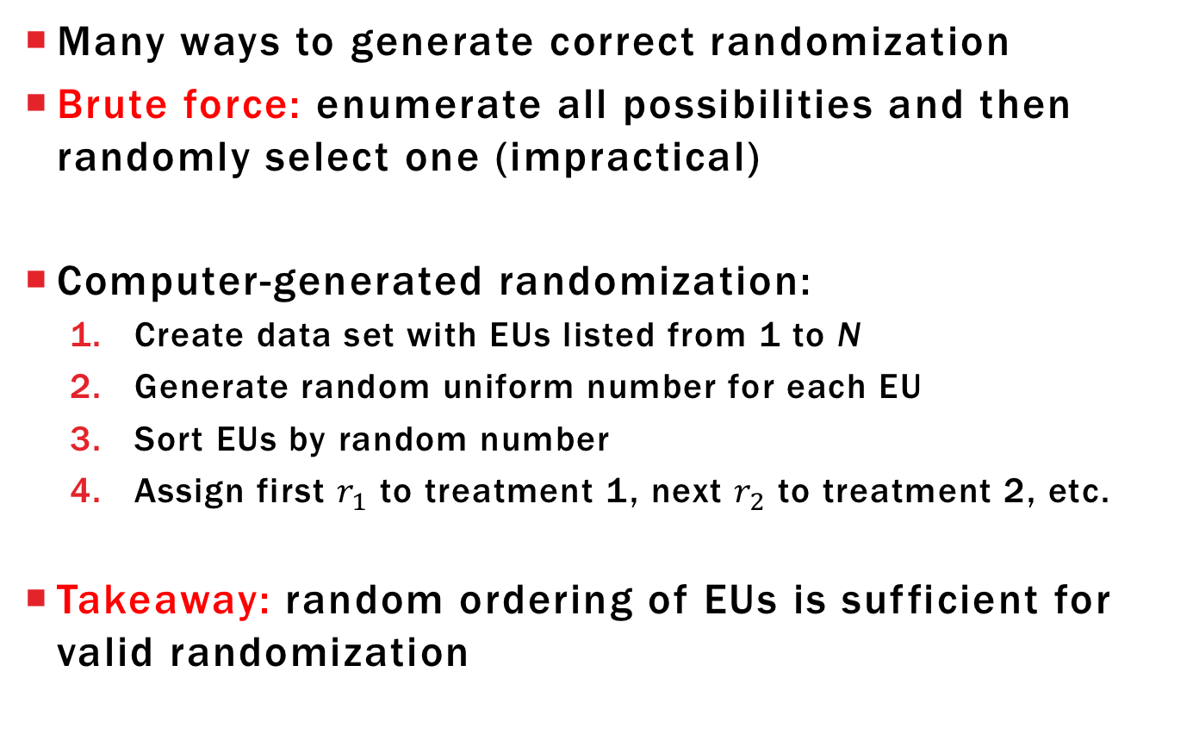
CORRECT RANDOMIZATION SCHEME

Slide 8
COMMENTS ABOUT CRDS
Treatments do not have to be equally replicated for a design to be called a CRD
Called a CRD because of randomization procedure
Recommended when EUs are fairly homogenous
Nuisance factors are either
Held constant
Measured and adjusted for with analysis of covariance

Slide 9
EXPERIMENTAL ERROR
Experimental error: variation between responses subjected to the same treatment
Sources of experimental error:
EU variability (present independently of treatment)
Treatment application error (inability to apply treatment exactly same)
EU state variability (changes in EU that occur during/after treatment separate from the treatment effect)
Environmental factors realized through state variability
Does not have OU variability = observational error

Slide 10
OBSERVATIONAL ERROR
Observational error: response variation between OUs within same EU
Sources of observational error:
OU variability (present independently of treatment)
Measurement error (inability to accurately measure a constant)
Inconsistent within-EU treatment application (inability to apply a treatment uniformly across EU)
Estimate experimental and observational variance separately only with multiple measurements per EU
Won’t consider these models right now, just average the multiple responses from same EU

Slide 11
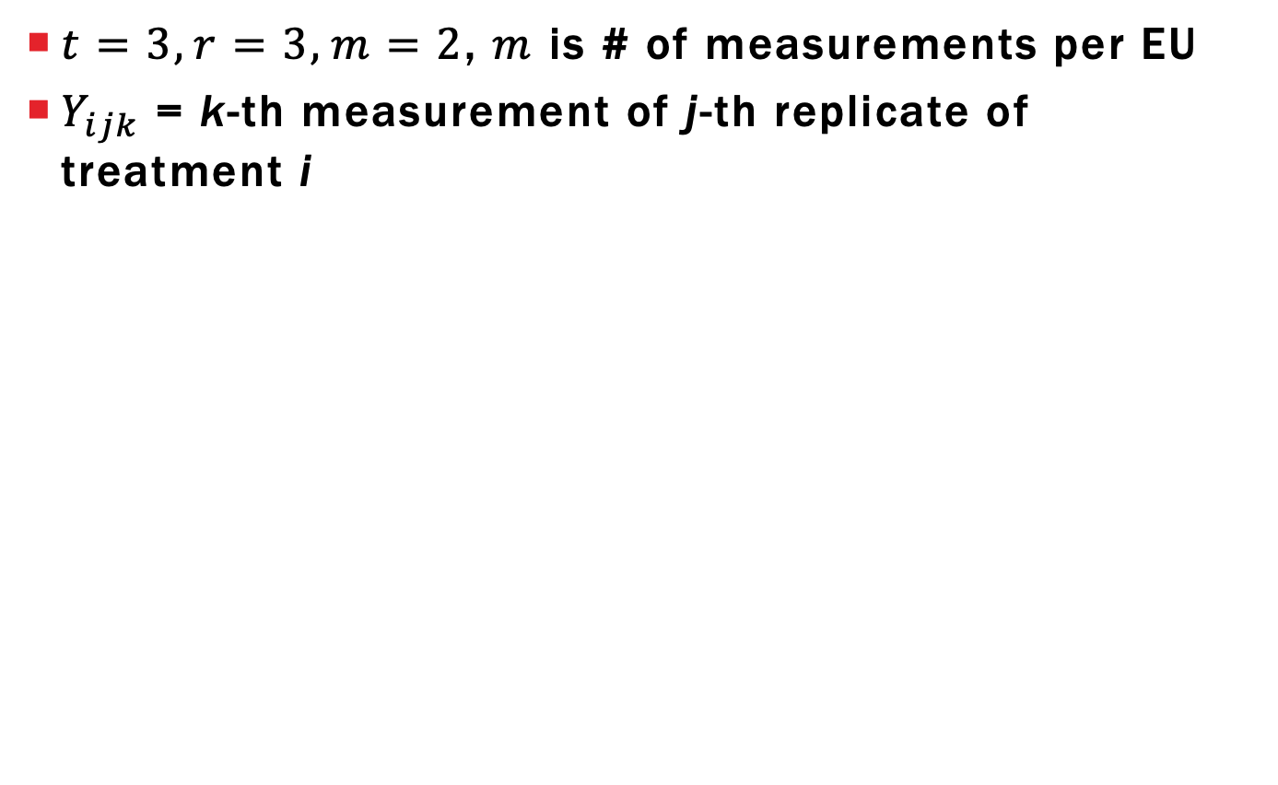
VISUALIZING OU VS EU VARIABILITY
i | 1 |  |  |  |  |  | 2 |  |  |  |  |  | 3
j | 1 |  | 2 |  | 3 |  | 1 |  | 2 |  | 3 |  | 1 |  | 2 |  | 3
k | 1 | 2 | 1 | 2 | 1 | 2 | 1 | 2 | 1 | 2 | 1 | 2 | 1 | 2 | 1 | 2 | 1 | 2
OU variability between measurements from same EU
(variability for fixed values i and j)

Slide 12
VISUALIZING OU VS EU VARIABILITY
i | 1 |  |  |  |  |  | 2 |  |  |  |  |  | 3
j | 1 |  | 2 |  | 3 |  | 1 |  | 2 |  | 3 |  | 1 |  | 2 |  | 3
k | 1 | 2 | 1 | 2 | 1 | 2 | 1 | 2 | 1 | 2 | 1 | 2 | 1 | 2 | 1 | 2 | 1 | 2
EU variability between average measurements across EU with same treatment
(variability for fixed value i)

Slide 13
FERTILIZER AND TOMATO PLANTS
Box et al (1978) describe experiment to determine whether a change in fertilizer mixture would change yield of tomato plants (# tomatoes from plant)
11 tomato plants were planted in a single row, fertilizer A or B was randomly assigned to each plant
Container | 1 | 2 | 3 | 4 | 5 | 6 | 7 | 8 | 9 | 10 | 11
Fertilizer | A | A | B | B | A | B | B | B | A | A | B

Slide 14
LEARNING OBJECTIVES
Explain what complete randomization means
Perform randomization in R (lab 7)
State assumptions that make this design appropriate
Define experimental and observational error
Give hypothetical examples for sources of variation contributing to the two types of error

