Slide 1
Analysis of Covariance
Chapter 9

Slide 2
Learning objectives
Explain differences between treatment factors and covariates
Explain usual assumptions between covariates, treatments, and responses
Write ANCOVA models for a single covariate
Perform ANCOVA in R (upcoming Lab)

Slide 3
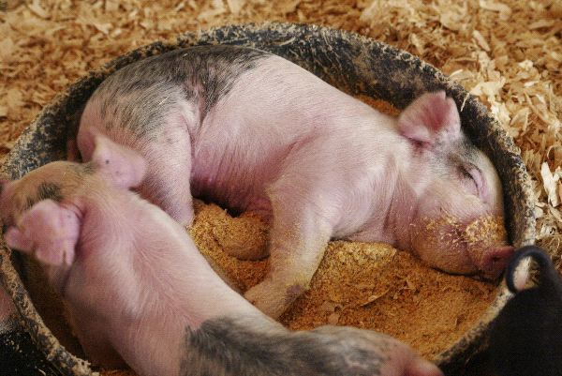
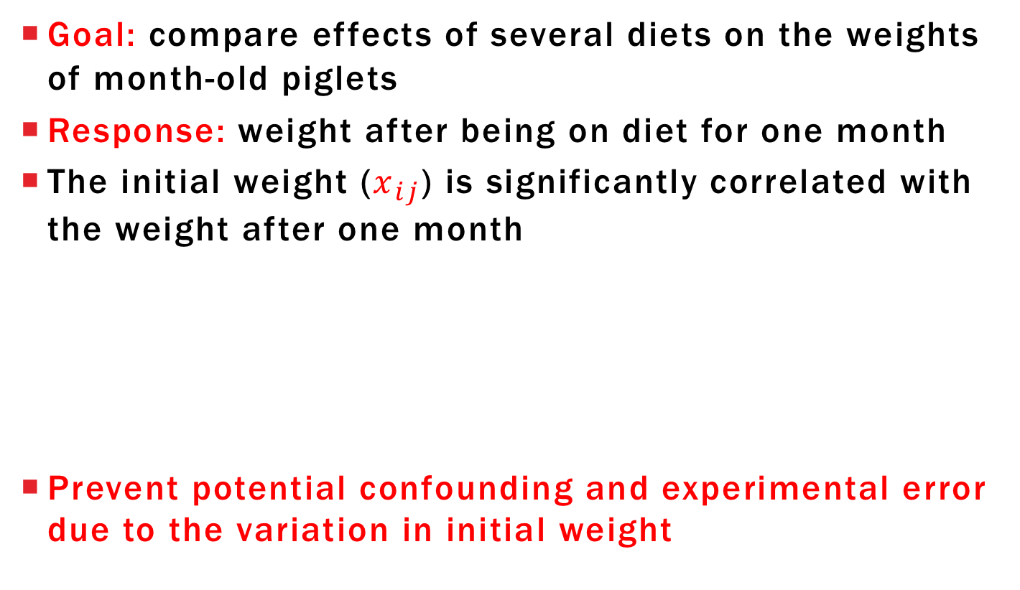
Motivating Example
Goal: compare effects of several diets on the weights of month-old piglets
Response: weight after being on diet for one month
The initial weight ($x_{ij}$) is significantly correlated with the weight after one month
Prevent potential confounding and experimental error due to the variation in initial weight

Slide 4
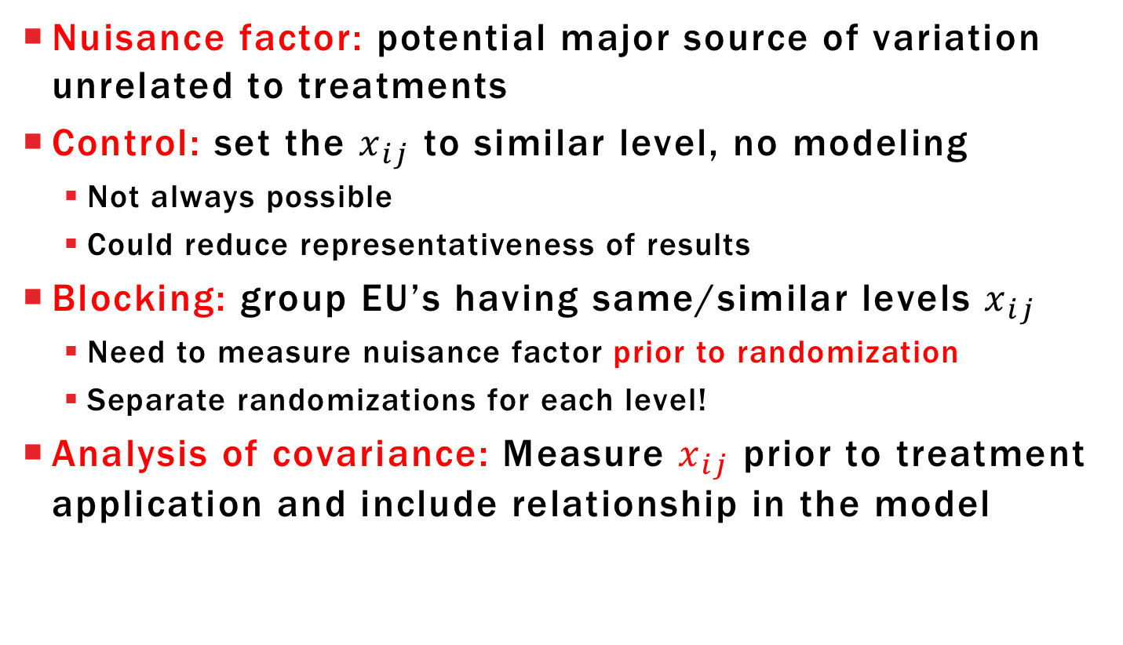
Covariates and nuisance factors
Nuisance factor: potential major source of variation unrelated to treatments
Control: set the $x_{ij}$ to similar level, no modeling
Not always possible
Could reduce representativeness of results
Blocking: group EU’s having same/similar levels $x_{ij}$
Need to measure nuisance factor prior to randomization
Separate randomizations for each level!
Analysis of covariance: Measure $x_{ij}$ prior to treatment application and include relationship in the model

Slide 5
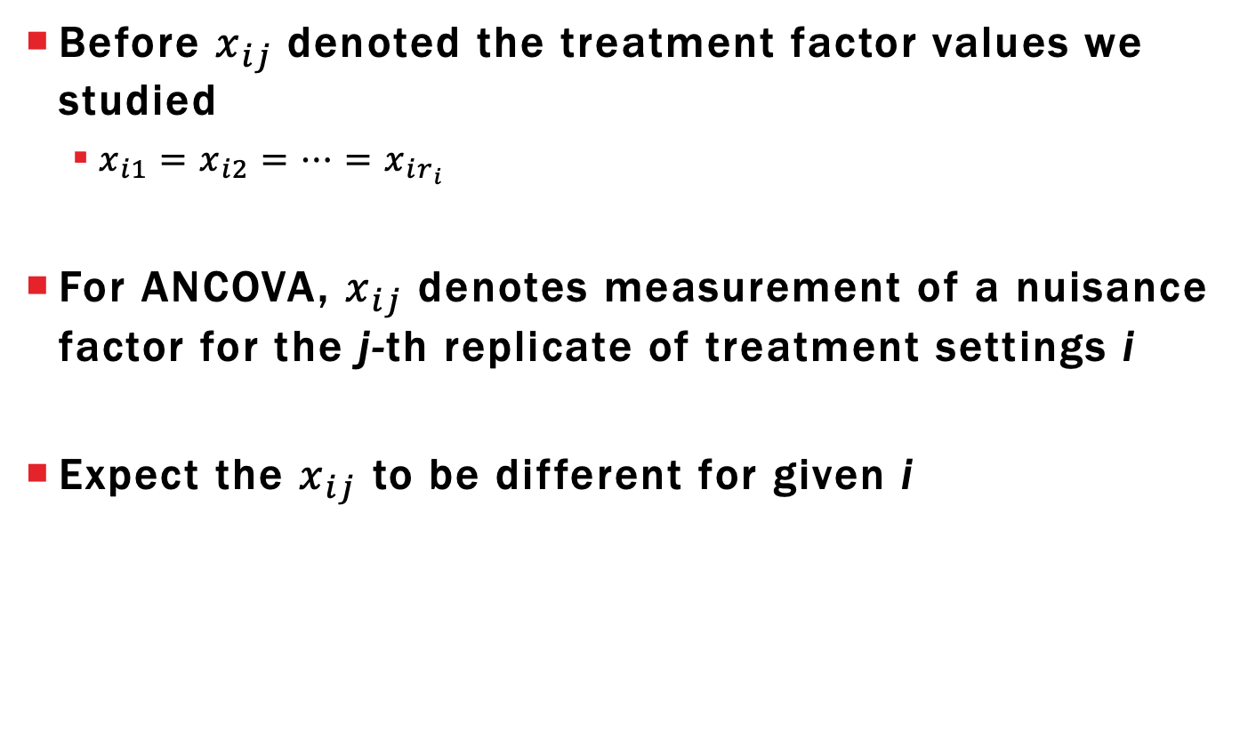
Notation Comments
Before $x_{ij}$denoted the treatment factor values we studied
$x_{i1}=x_{i2}=…=x_{ir_{i}}$
For ANCOVA, $x_{ij}$ denotes measurement of a nuisance factor for the j-th replicate of treatment settings i
Expect the $x_{ij}$ to be different for given i

Slide 6
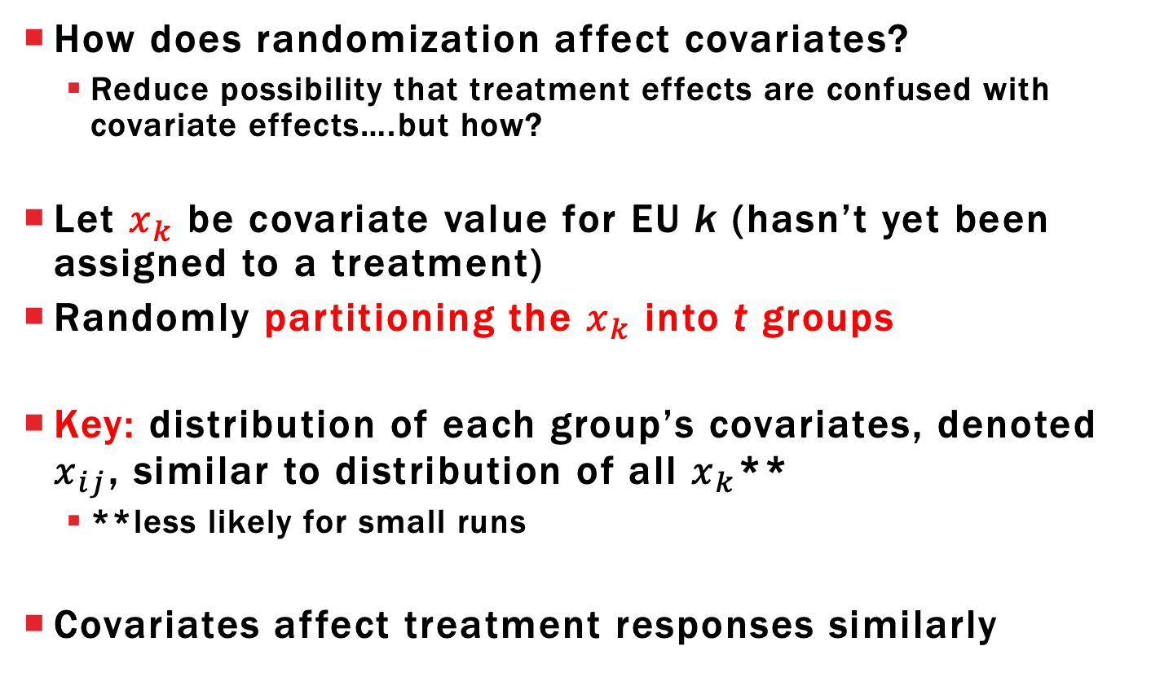
Randomization and Covariates
How does randomization affect covariates?
Reduce possibility that treatment effects are confused with covariate effects….but how?
Let $x_{k}$ be covariate value for EU k (hasn’t yet been assigned to a treatment)
Randomly partitioning the $x_{k}$ into t groups
Key: distribution of each group’s covariates, denoted $x_{ij}$, similar to distribution of all $x_{k}$**
**less likely for small runs
Covariates affect treatment responses similarly

Slide 7
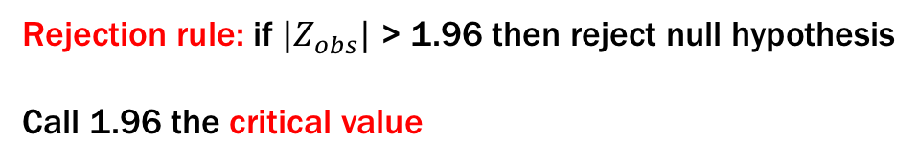
ANCOVA Assumptions
Covariates explain EU/OU variation
The $x_{k}$ are not influenced by treatment
Measure covariate before treatment application
If false, then you introduce potential confounding between covariate effects and treatment effects
Won’t be able to distinguish which is important

Slide 8
Why include Covariates?
Randomization only reduces bias (potential confounding) due to covariate effect on average
msE will be inflated estimate of $σ^{2}$ if we only fit the effects model → low power
Need to include covariate effect in model
What are some common models for covariates?
Add effects to the existing models we have already seen

Slide 9

ANCOVA with Quantitative Covariates Simple Linear Regression
Assume that covariate is quantitative and relationship with response is same for all treatments
SLR ANCOVA model visualized:
Different SLR model for each treatment
Same slope parameter
Different intercepts
Comparing treatments for fixed $x_{ij}$ value gives same difference $τ_{i}−τ_{i′}$

Slide 10
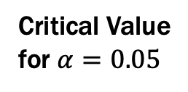
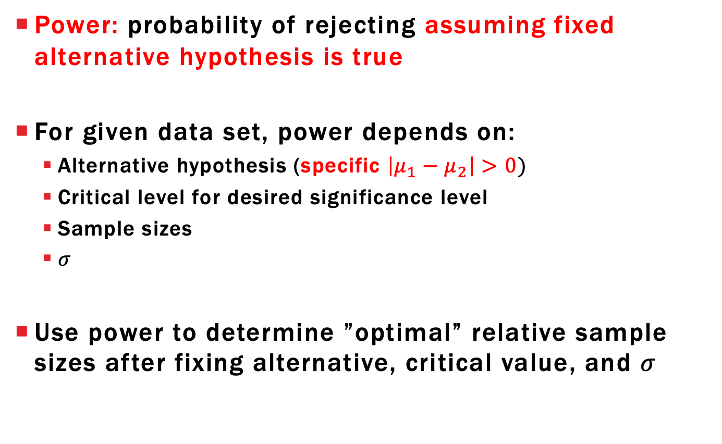
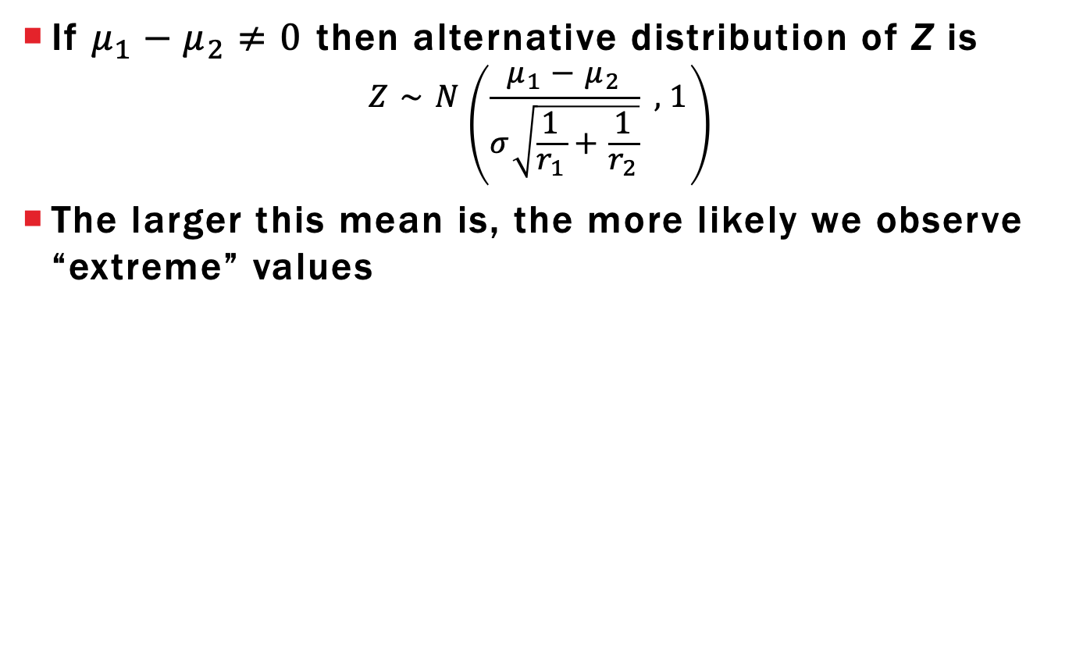


ANCOVA with Quantitative Covariates Simple Linear Regression
Write model mathematically as:
$$Y_{ij}=μ+τ_{i}+βx_{ij}+E_{ij}$$
$$μ+τ_{1}+βx_{1j}$$
$$μ+τ_{2}+βx_{2j}$$
Calculate ${E(Y}_{ij}−Y_{i^{′}j^{′}})$
Calculate ${E(\overline{Y}}_{i}.−{\overline{Y}}_{i^{′}}.)$

Slide 11
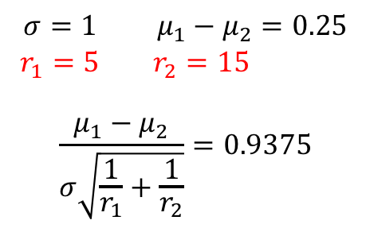
ANCOVA with Quantitative Covariates Polynomial Models
Polynomial ANCOVA model
$$Y_{ij}=μ+τ_{i}+β_{1}x_{ij}+β_{2}x_{ij}^{2}+…+β_{p}x_{ij}^{p}+E_{ij}$$
Treatment comparisons still assumed to be the same throughout the covariate values
Polynomial coefficients are estimable
Recommend backwards elimination
Lack-of-fit unlikely due to no control over $x_{ij}$ so unlikely to have replicates

Slide 12
Covariate-Treatment interaction
May find that the relationship between covariate and response changes with treatment
If treatment had no effect on the covariate value, then we need to assign a unique slope to each treatment
Treatment comparisons depend on covariate value

Slide 13
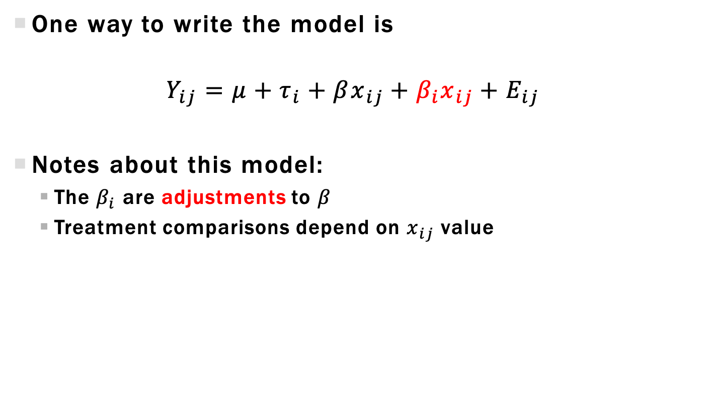
Model including Covariate-Treatment interaction
One way to write the model is
$$Y_{ij}=μ+τ_{i}+βx_{ij}+β_{i}x_{ij}+E_{ij}$$
Notes about this model:
The $β_{i}$ are adjustments to $β$
Treatment comparisons depend on $x_{ij}$ value

Slide 14
ANCOVA with Categorical Covariates
Suppose we don’t have piglet initial weight values but rather have 3 initial weight groups
Small (1), Medium (2), Large (3)
Distribution of categories:
How many small/medium/large assigned to each treatment group?
Random assignment means we EXPECT equal distribution
For a given experiment, the distribution will not be equal
Small | Medium | Large
11 | 9 | 10

Slide 15

ANCOVA with Categorical Covariates
Perform randomization and get following assignment
Let $θ_{1}, θ_{2},θ_{3}$ be effects for covariate group effect
Like treatment effects but we can’t randomize to EUs
What’s a useful model for this data?
 |  | Small | Medium | Large | Total:
Treatment | 1 | 3 | 3 | 4 | 10
 | 2 | 2 | 4 | 4 | 10
 | 3 | 6 | 2 | 2 | 10
 | Total: | 11 | 9 | 10

Slide 16

Categorical Covariate Model 1: Two-Factor Main effect Model
Want to combine two models together
Treatment model: $Y_{ij}=μ+τ_{i}+E_{ij}; i=1,2,3; j=1,…,10$
Initial group model: $Y_{kl}=μ+θ_{k}+E_{kl}; k=1,2,3; j=1,…,r_{k}$
$r_{1}=11, r_{2}=9; r_{3}=10$
Index individual observations using 3 subscripts:
i = treatment assigned
j = covariate group
k = replicate for paired (i,j)
Final model:
$$Y_{ijk}=μ+τ_{i}+θ_{j}+E_{ijk}$$
$i=1,2,3; j=1,2,3; k=1,…,r_{ij}; E_{ijk}∼^{iid}N\left(0,σ^{2}\right)$
$r_{11}=3,{ r}_{12}=3, r_{13}=4,…, r_{33}=2$

Slide 17


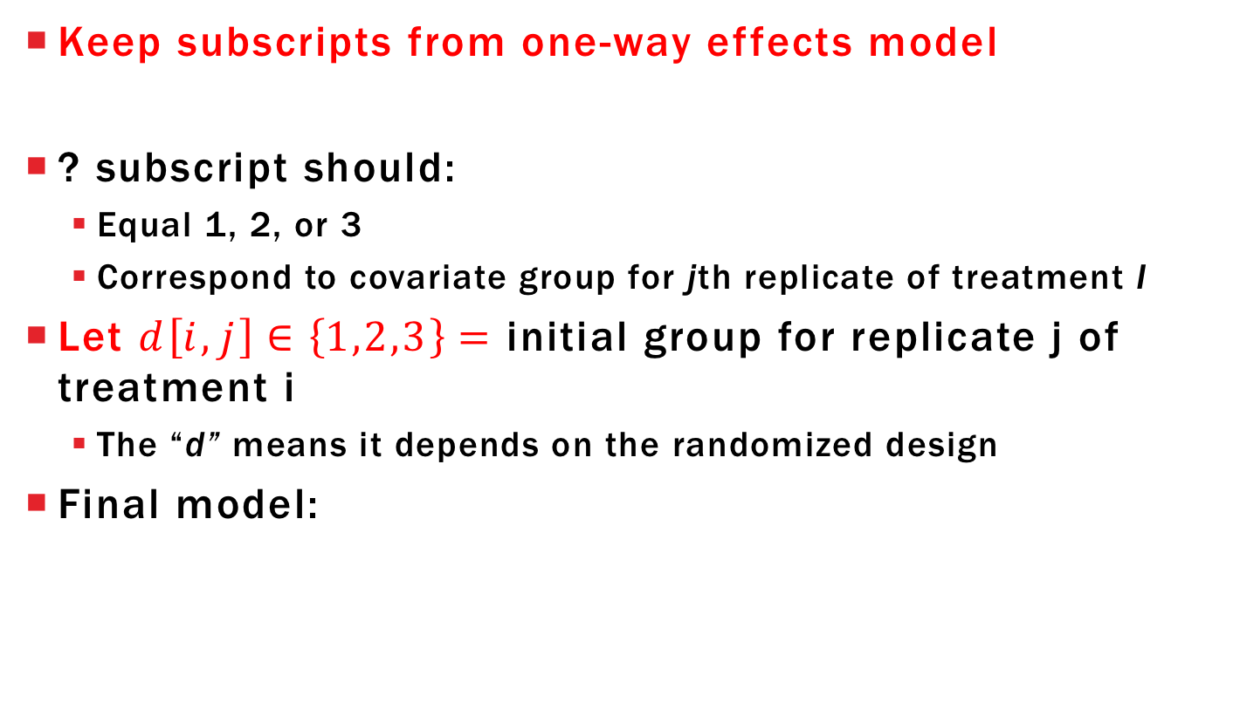
Categorical Covariate Model 2: Design-Dependent Subscripts
Keep subscripts from one-way effects model
? subscript should:
Equal 1, 2, or 3
Correspond to covariate group for jth replicate of treatment I
Let $d\left[i,j\right]∈\left\{1,2,3\right\}=$ initial group for replicate j of treatment i
The “d” means it depends on the randomized design
Final model:
$$Y_{ij}=μ+τ_{i}+θ_{?}+E_{ij}$$
$$Y_{ij}=μ+τ_{i}+θ_{d[i,j]}+E_{ij}$$
$$i=1,2,3; j=1,…,10; d\left[i,j\right]∈\left\{1,2,3\right\}; E_{ij}∼^{iid}N(0,σ^{2})$$

Slide 18
Learning objectives REVIEW
Explain differences between treatment factors and covariates
Explain usual assumptions between covariates, treatments, and responses
Write ANCOVA models for a single covariate
Perform ANCOVA in R (upcoming Lab)

