Slide 1
Intro to Incomplete block designs
Chapter 11

Slide 2
Learning objectives
Explain advantages and disadvantages of using an incomplete block design (IBD)
Describe how to properly randomize IBD’s
Define and check for connected-ness
Write the statistical model and explain why treatment means are not used for contrast estimators

Slide 3

Eye drop Example
There are 4 eye drop medications to compare
Randomly select 12 subjects to test
Can only test a person once (can’t flush out eye and apply different treatment)
Q1: How would you design this using a CRD? How many reps per treatment?
Q2: Describe a design that could take into account person-to-person variability.

Slide 4
Why use incomplete blocks
RCBD: apply and observe each treatment one time in each block
Requires the block size (k) to equal # treatments (t)
EUs in block should be homogeneous, otherwise blocking has minimal effect
Problem: The more EUs we put in a block, the less likely this will be true
Brought up this concern when discussing GRCBD
Incomplete block designs (IBD) used when the number of treatments is larger than block size (k < t)

Slide 5
Advantages and disadvantages
Advantages:
Reduces experimental error and increases representativeness
Better justification of homogeneity of EU’s for many treatments than RCBD or GRCBD
Accommodating when we can’t get large block sizes
Disadvantages:
IBDs are not equivalent in their analysis properties!
The “best” IBD’s are difficult to construct or may not exist
Analysis becomes even trickier and need to make assumptions

Slide 6
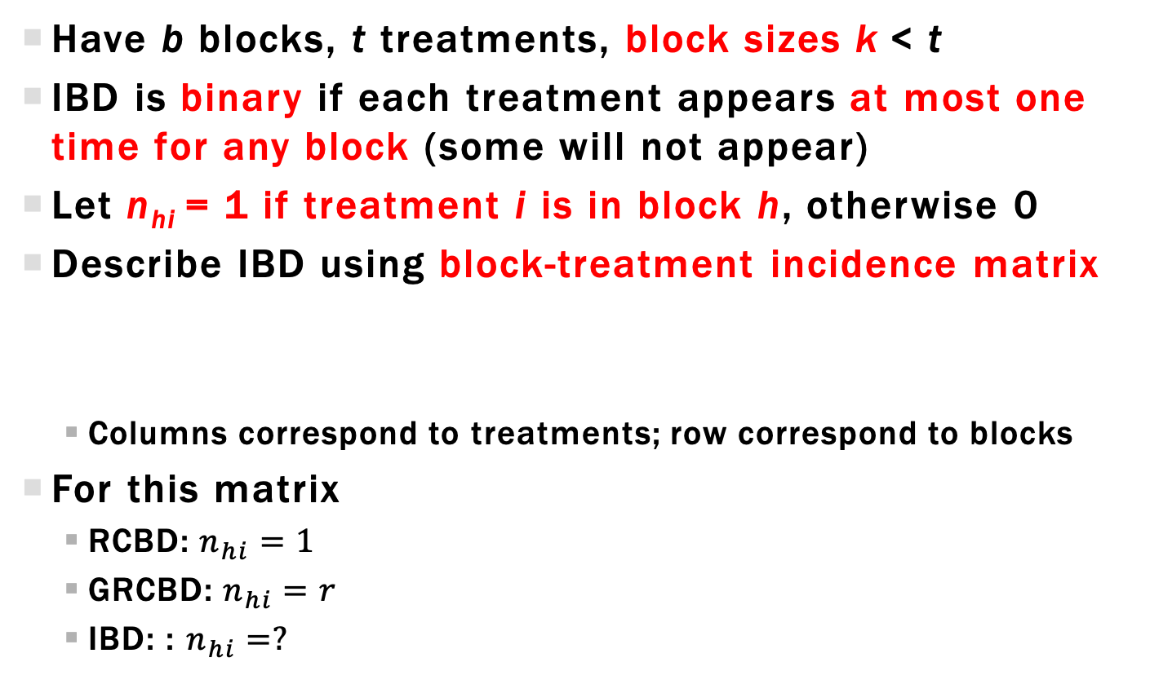
IBD set up and Incidence matrix
Have b blocks, t treatments, block sizes k < t
IBD is binary if each treatment appears at most one time for any block (some will not appear)
Let n_{hi} = 1 if treatment i is in block h, otherwise 0
Describe IBD using block-treatment incidence matrix
Columns correspond to treatments; row correspond to blocks
For this matrix
RCBD: $n_{hi}=1$
GRCBD: $n_{hi}=r$
IBD: : $n_{hi}=?$

Slide 7
IBD set up and Incidence matrix
Group: For the following IBD plan, write out the block/treatment incidence matrix
Block 1 2 3 4 5
1
2
3
4
5
2
3
4
5
1
3
4
5
1
2
4
5
1
2
3

Slide 8
Randomizing IBD
IBD plan determines the treatment sets that will be applied to EU’s in the blocks
Treatments obviously need to be randomly assigned to the EUs within the blocks
Also randomize treatment sets to the blocks
Why didn’t we care about the treatment set randomization for RCBDs?
Block 1 2 3 4 5
Randomize sets to blocks
1
2
3
4
5
2
3
4
5
1
3
4
5
1
2
4
5
1
2
3

Slide 9
Randomizing IBD
IBD plan determines the treatment sets that will be applied to EU’s in the blocks
Treatments obviously need to be randomly assigned to the EUs within the blocks
Also randomize treatment sets to the blocks
Block 1 2 3 4 5
Randomize sets to blocks
3
4
2
1
5
4
5
3
2
1
Randomize within blocks
5
1
4
3
2
1
2
5
4
3

Slide 10
Statistical model – ibd Oversimplified
Following model is used to analyze data
Remember the index issues we had with categorical ANCOVA? The same issues come up here
We do not observe every combination of h and i
Instead, let u = 1,…,k index the EU in block h
Define treatment assigned to EU u in block h (post randomization)

Slide 11
Statistical model – ibd Explicit
More explicit to write the model as
Again, Rwill make the appropriate adjustments so nothing explicit needs to be done on your end
This model does help to explicitly show that treatment contrasts are estimated differently than before

Slide 12
Connected designs
Basic requirement when choosing an IBD is that we can estimate all treatment contrasts
Such designs are said to be connected
Not every IBD is connected! Be careful!
A sufficient condition is that every treatment pair occurs in some block but not always necessary
Checking for connectedness using :
For treatment pair, find path between corresponding columns
Cannot move diagonally
Free to move across rows or columns only if the elements are 1

Slide 13
Treatment means and LSmeans
Expected value of treatment means depends on set of blocks a treatment appears in
When we ask JMP for LSmeans, it gives the BLUE for
Conclusion: Treatment mean does not equal Lsmean
Advice: be careful when using treatment means to summarize data, they may be biased!
=Block average for
treatment i
=Overall block average

Slide 14
Treatment means and Contrast BLUEs
This bias carries over if we use the treatment means to estimate contrasts
For CRDs, RCBDs, and LSDs, BLUEs for any contrast was same contrast of the treatment means, but now
Unequal block means will potentially bias estimates
Unbiased estimates exist, let R calculate BLUEs
Bias!

Slide 15
Learning objectives Review
Explain advantages and disadvantages of using an incomplete block design (IBD)
Describe how to properly randomize IBD’s
Define and check for connected-ness
Write the statistical model and explain why treatment means are not used for contrast estimators

