Slide 1
Intro to multiple blocking factors
Chapter 12

Slide 2
Learning objectives
Identify crossed/nested blocking factors
Describe Latin square design and relate it to an RCBD
Describe how to properly randomize a LSD
Write and explain statistical model for a LSD and perform analysis in R

Slide 3

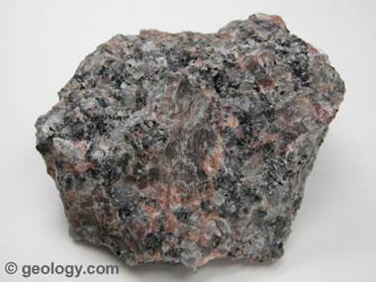
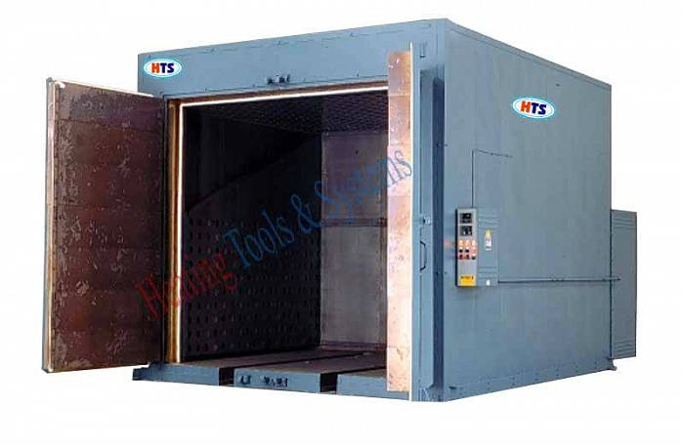
Production of ceramic cookware
Compare different production methods for ceramic cookware
Anticipate two nuisance sources of variation:
Batch of raw material to make cookware
Different ovens used for baking cookware
These make up two blocking factors
We have c batches of material and r different ovens
Every batch type is used with every oven type
Idea: Think of this as block design with c*r blocks

Slide 4
Crossed blocking factors
Have enough raw material in a batch/oven combo to do each production method one time
RCBD with b=cr blocks and t treatments
Group: What are the EUs? How many EUs would this experiment have?
 |  | Batch
 |  | 1 | 2 | ... | c
Oven | 1
 | 2
 | r
Each cell represents a
block

Slide 5
Crossed Blocking factors – Statistical model
Index blocking factors using i=1,…,r and j=1,…,c
Usual block model would be:
Some block/treatment interaction effects could also be considered

Slide 6
Nested blocking factors – Statistical model
Same label “Batch 1” across ovens but Batch 1 in Oven 1 doesn’t equal Batch 1 in Oven 2
Batch “main effect” no longer makes sense, comparisons of Batch must be done Oven-by-oven
Call batch a nested blocking factor (within oven)
Call oven a nesting blocking factor
Let i=1,…,r be nesting factor; j=1,…,c be nested factor
Won’t worry about these examples in this class

Slide 7
One EU per combination
Designs shown earlier require too many EUs
What if we have one EU per combination?
Another example of an unreplicated factorial experiment!
Assume that r=c=t
If row or column factor dropped, we’d want a RCBD
Goal: Find design that is RCBD with respect to both rows and columns
t=4
t=3
1 | 2 | 3 | 4
2 | 3 | 4 | 1
3 | 4 | 1 | 2
4 | 1 | 2 | 3
How can we randomize these
to maintain this structure?
1 | 2 | 3
2 | 3 | 1
3 | 1 | 2
How do we construct these
designs?

Slide 8
Latin Square Designs Cyclic Construction
Fortunately, these types of designs have been studied for a long time
Such designs are called Latin square designs (LSD)
A t x t array of t symbols such that each symbol appears exactly once in each row and column
Construct an LSD for any t using cyclic pattern
This is a design plan, we still need to randomize
1 | 2 | 3 | 4
2 | 3 | 4 | 1
3 | 4 | 1 | 2
4 | 1 | 2 | 3

Slide 9
Randomizing LSD’s
Properly randomized when all possible LSD’s are equally likely to be chosen
Generally difficult to guarantee this property, requires concept of transformation sets
In practice, usually start with the cyclic design plan
Fact 1: If we permute the rows we will maintain this structure (same with columns)
Fact 2: If we permute treatment labels we will also maintain this structure

Slide 10
Randomizing LSD’s
Step 1: Randomly permute labels of t treatments
Step 2: Randomly permute rows
Step 3: Randomly permute columns
Label Permutation
1 → 2
2 → 3
3 → 1
4 → 4
1 | 2 | 3 | 4
2 | 3 | 4 | 1
3 | 4 | 1 | 2
4 | 1 | 2 | 3

Slide 11
Randomizing LSD’s
Step 1: Randomly permute labels of t treatments
Step 2: Randomly permute rows
Step 3: Randomly permute columns
Row Permutation
1 → 1
2 → 4
3 → 2
4 → 3
2 | 3 | 1 | 4
3 | 1 | 4 | 2
1 | 4 | 2 | 3
4 | 2 | 3 | 1

Slide 12
Randomizing LSD’s
Step 1: Randomly permute labels of t treatments
Step 2: Randomly permute rows
Step 3: Randomly permute columns
Column Permutation
1 → 4
2 → 2
3 → 3
4 → 1
2 | 3 | 1 | 4
1 | 4 | 2 | 3
4 | 2 | 3 | 1
3 | 1 | 4 | 2

Slide 13
Randomizing LSD’s
Step 1: Randomly permute labels of t treatments
Step 2: Randomly permute rows
Step 3: Randomly permute columns
4 | 3 | 1 | 2
3 | 4 | 2 | 1
1 | 2 | 3 | 4
2 | 1 | 4 | 3
All done!

Slide 14
Latin Square Designs – Statistical model
Just like with RCBD, we fit main effect model
Gives us the following additive model:
For a given (i , j) we only have a single k
How can we write the model that reflects this dependency?
Wait, there’s only t² EUs

Slide 15
Latin Square Designs – Statistical model
Let be a function of i and j that produces the treatment label assigned to that cell
Change model to only use indices i and j
Fortunately, R doesn’t care about this
4 | 3 | 1 | 2
3 | 4 | 2 | 1
1 | 2 | 3 | 4
2 | 1 | 4 | 3
d[1,1]=4
d[1,4]=2
d[3,2]=2
d[4,2]=
d[4,4]=

Slide 16
Latin Squares – Advantages and disadvantages
Advantages
Accounts for two sources of heterogeneity simultaneously (just like any multiple block factor design)
Minimal resources compared to usual crossed block design since only 1 EU per cell
Straightforward analysis
Disadvantages
Requires number of row and column blocks to equal t
If t is small there aren’t many degrees-of-freedom left for error
For small t we’d rather have more EU’s

Slide 17
Learning objectives Review
Identify crossed/nested blocking factors
Describe Latin square design and relate it to an RCBD
Describe how to properly randomize a LSD
Write and explain statistical model for a LSD and perform analysis in R

