Slide 1
One-Factor Analysis: Part 2
Chapter 3-5, 8

Slide 2
Learning objectives
Define a sampling distribution for a statistic
Write null and alternative hypotheses for two-sample tests and simple linear regression
Understand relationship between null and alternative distributions
Explain how to calculate Type 1 error and power

Slide 3
Bread yeast and time to rise
Yeast is added to bread to make it “rise”
Contacts warm water and feeds on sugars in the flour
Releases carbon dioxide at some rate
Bread dough rests for a period of time to allow this process to happen
Compare two different rise times to see if there is a significant difference in dough height
35 and 45 minutes (quantitative or categorical?)
Large batch of dough partitioned into N loaf pans

Slide 4
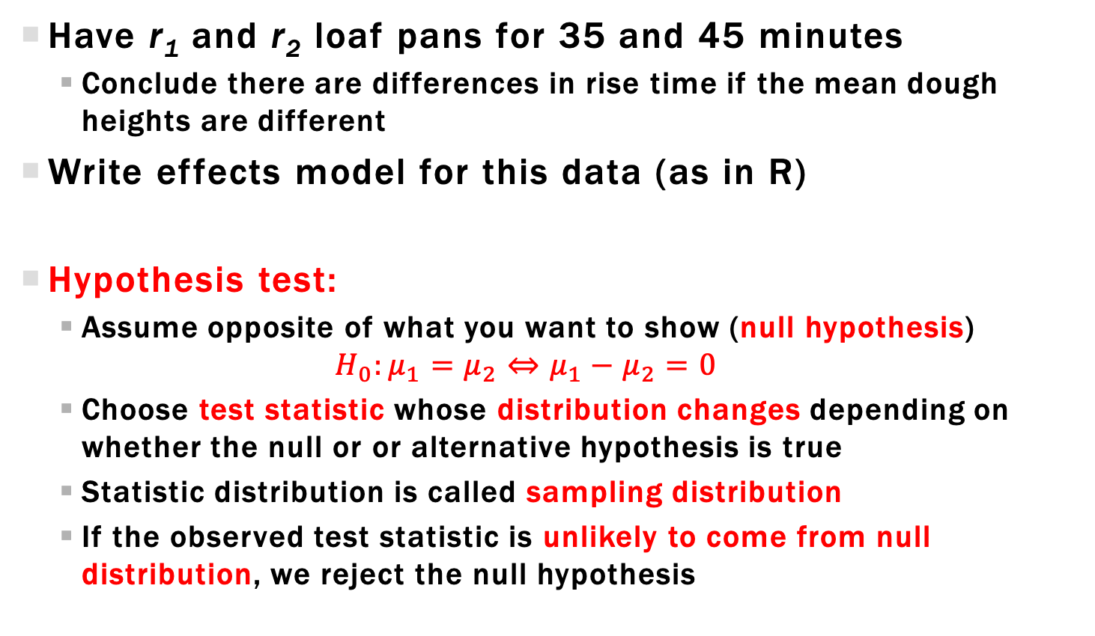
Two Sample Hypothesis testing
Have r₁ and r₂ loaf pans for 35 and 45 minutes
Conclude there are differences in rise time if the mean dough heights are different
Write effects model for this data (as in R)
Hypothesis test:
Assume opposite of what you want to show (null hypothesis)
$$H_{0}:μ_{1}=μ_{2}⇔μ_{1}−μ_{2}=0$$
Choose test statistic whose distribution changes depending on whether the null or or alternative hypothesis is true
Statistic distribution is called sampling distribution
If the observed test statistic is unlikely to come from null distribution, we reject the null hypothesis

Slide 5
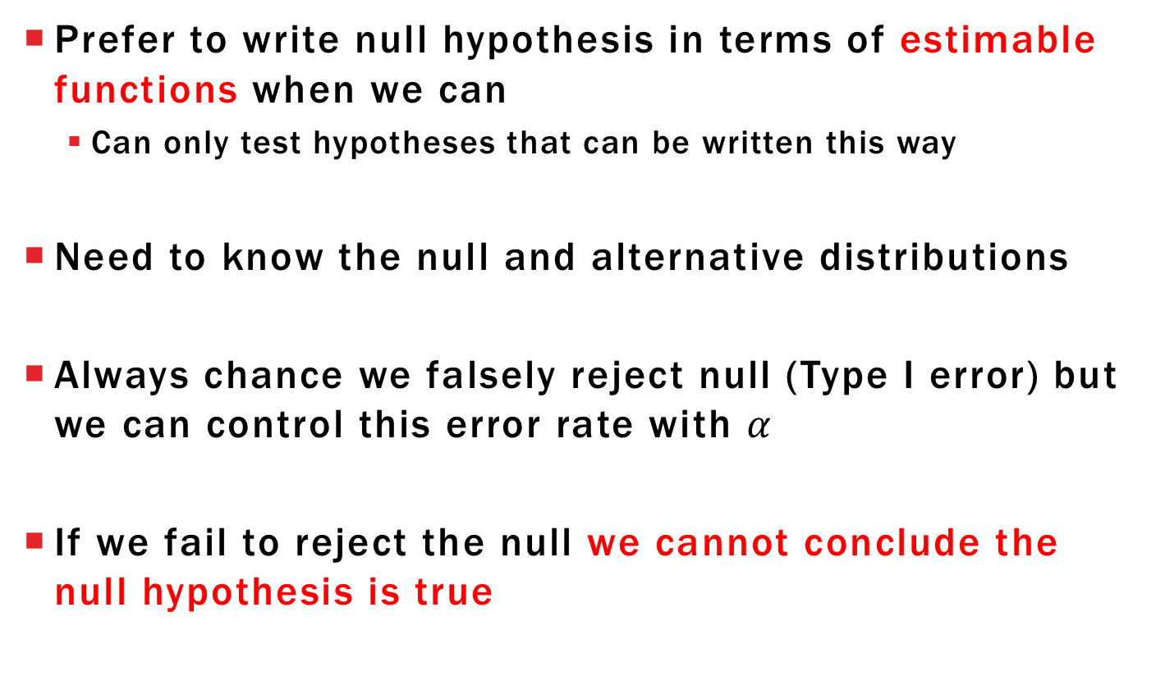
Comments about Hypothesis testing
Prefer to write null hypothesis in terms of estimable functions when we can
Can only test hypotheses that can be written this way
Need to know the null and alternative distributions
Always chance we falsely reject null (Type I error) but we can control this error rate with $α$
If we fail to reject the null we cannot conclude the null hypothesis is true

Slide 6
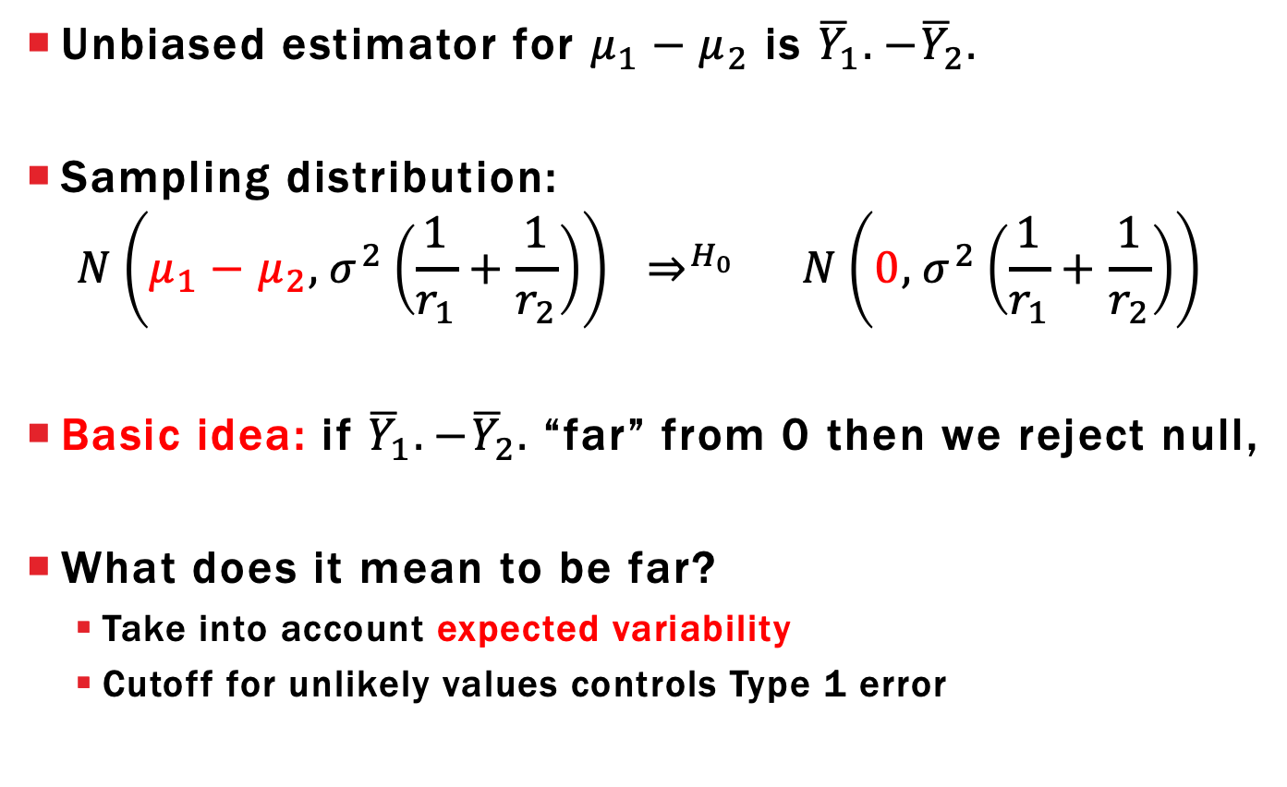
Two Sample Hypothesis testing
Unbiased estimator for $μ_{1}−μ_{2}$ is ${\overline{Y}}_{1}.−{\overline{Y}}_{2}.$
Sampling distribution:
$$N\left(μ_{1}−μ_{2}, σ^{2}\left(\frac{1}{r_{1}}+\frac{1}{r_{2}}\right)\right) ⇒^{H_{0}} N\left(0, σ^{2}\left(\frac{1}{r_{1}}+\frac{1}{r_{2}}\right)\right)$$
Basic idea: if ${\overline{Y}}_{1}.−{\overline{Y}}_{2}.$“far” from 0 then we reject null,
What does it mean to be far?
Take into account expected variability
Cutoff for unlikely values controls Type 1 error

Slide 7
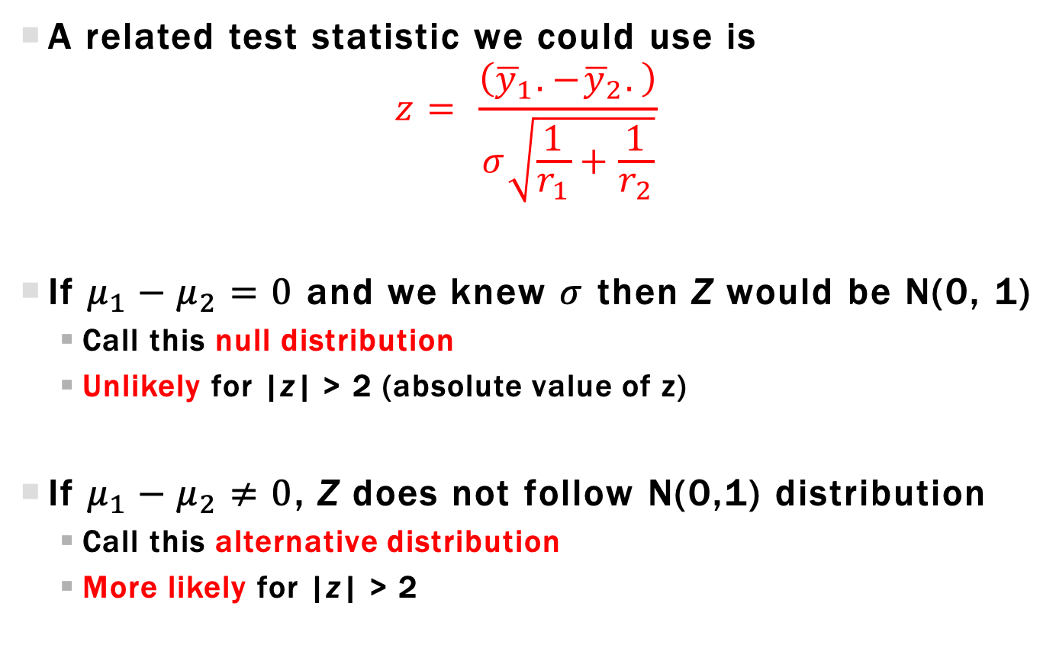
Two-sample Z-Statistic
A related test statistic we could use is
$$z= \frac{\left({\overline{y}}_{1}.−{\overline{y}}_{2}.\right)}{σ\sqrt{\frac{1}{r_{1}}+\frac{1}{r_{2}}}}$$
If $μ_{1}−μ_{2}=0$ and we knew $σ$ then Z would be N(0, 1)
Call this null distribution
Unlikely for |z| > 2 (absolute value of z)
If $μ_{1}−μ_{2}≠0$, Z does not follow N(0,1) distribution
Call this alternative distribution
More likely for |z| > 2

Slide 8
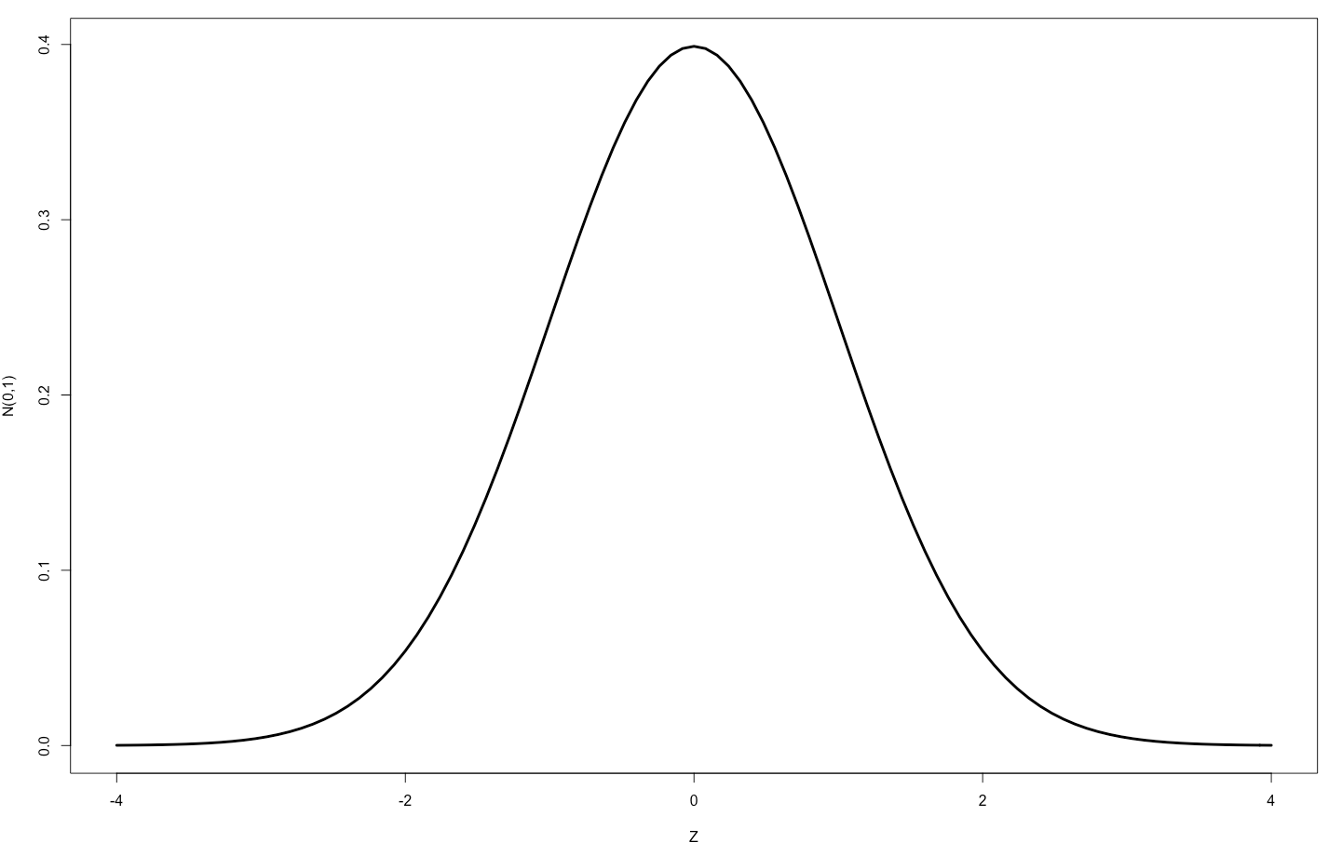
Two-sample Z-Statistic Null distribution
Plot of null distribution
If null true, then 95% chance observed Z is between -1.96 and 1.96
If observed Z is outside this range, makes sense to reject null

Slide 9
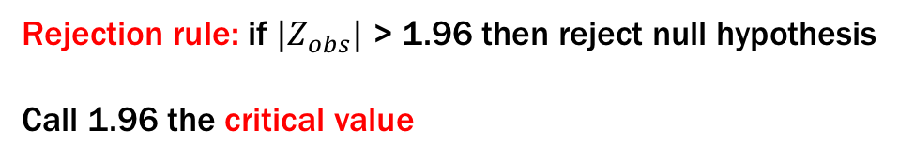
Two-Sample Z-Statistic Critical value Rejection
Plot of null distribution
Rejection rule: if ${|Z}_{obs}|$ > 1.96 then reject null hypothesis
Call 1.96 the critical value

Slide 10

Type 1 Error
Type 1 error: reject when null is true (false reject)
$$P\left(Type 1 error\right)=P_{H_{0}}\left(\left|Z\right|>1.96\right)=0.05=α$$
Assuming $H_{0}$ is true

Slide 11
Two-Sample Z-Statistic P-value Rejection
An alternative rejection rule
Calculate probability of observed statistic (z) or more extreme value
assuming the null is true

Slide 12

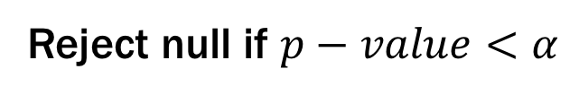
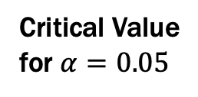
Two-Sample Z-Statistic P-value Rejection
An alternative rejection rule
|z|
Critical Value
for $α=0.05$
$$2 × P_{H_{0}}\left(Z>\left|z\right|\right)=p−value$$
Reject null if $p−value<α$

Slide 13
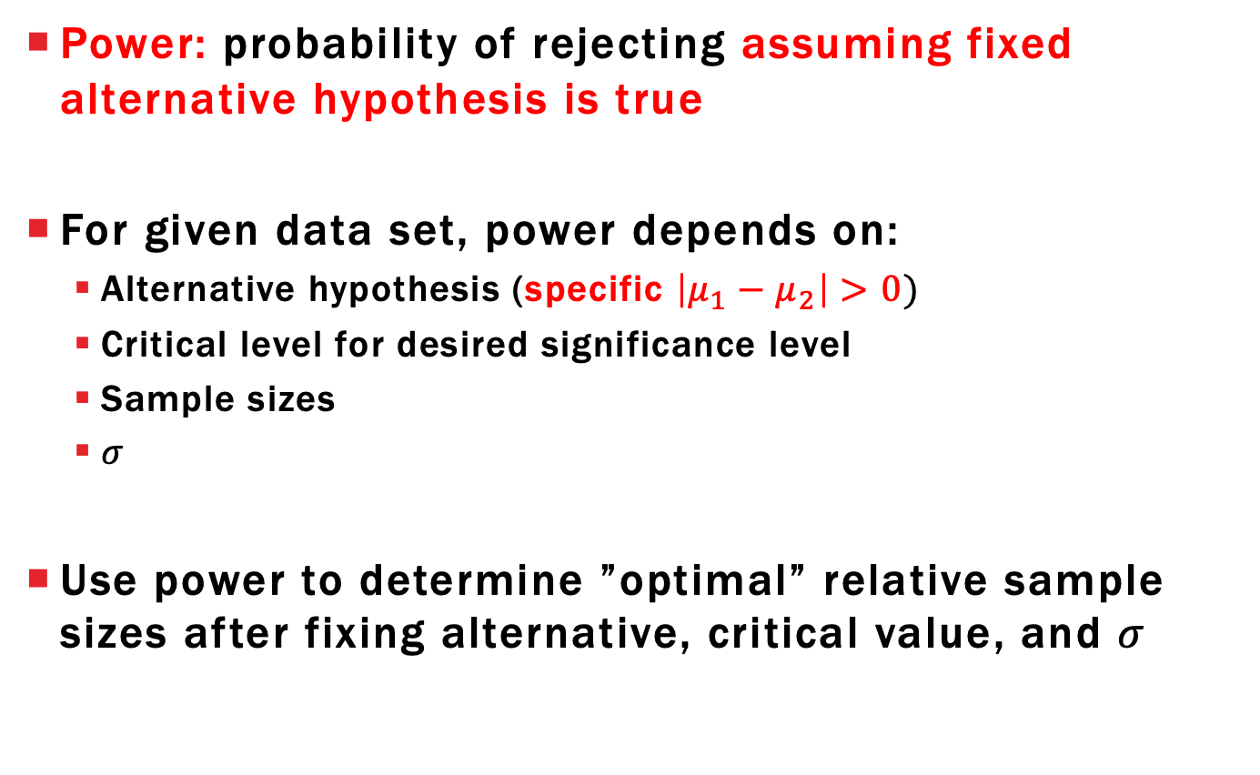
Power
Power: probability of rejecting assuming fixed alternative hypothesis is true
For given data set, power depends on:
Alternative hypothesis (specific $\left|μ_{1}−μ_{2}\right|>0)$
Critical level for desired significance level
Sample sizes
$σ$
Use power to determine ”optimal” relative sample sizes after fixing alternative, critical value, and $σ$

Slide 14
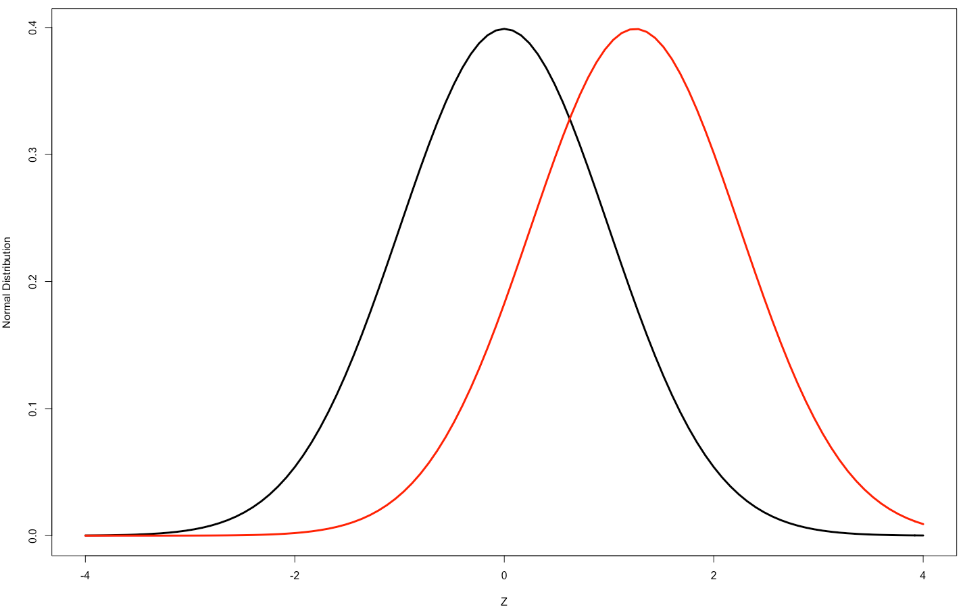



Two-Sample Z-Statistic Power
If $μ_{1}−μ_{2}≠0$ then alternative distribution of Z is
$$Z∼N\left(\frac{μ_{1}−μ_{2}}{σ\sqrt{\frac{1}{r_{1}}+\frac{1}{r_{2}}}} ,1\right)$$
The larger this mean is, the more likely we observe “extreme” values
Noncentrality
parameter
$$P_{H_{0}}\left(\left|Z\right|>1.96\right)=0.05=α$$
$$σ=1 μ_{1}−μ_{2}=0.25$$
$r_{1}=10 r_{2}=10$
$$\frac{μ_{1}−μ_{2}}{σ\sqrt{\frac{1}{r_{1}}+\frac{1}{r_{2}}}}=1.25$$

Slide 15



Two-Sample Z-Statistic Power
If $μ_{1}−μ_{2}≠0$ then true distribution of Z is
$$Z∼N\left(\frac{μ_{1}−μ_{2}}{σ\sqrt{\frac{1}{r_{1}}+\frac{1}{r_{2}}}} ,1\right)$$
The larger this mean is, the more likely we observe “extreme” values
$$P_{H_{A}}\left(\left|Z\right|>1.96\right)=0.2395>0.05$$
Assuming $H_{A}$ is true
$$σ=1 μ_{1}−μ_{2}=0.25$$
$r_{1}=10 r_{2}=10$
$$\frac{μ_{1}−μ_{2}}{σ\sqrt{\frac{1}{r_{1}}+\frac{1}{r_{2}}}}=1.25$$

Slide 16
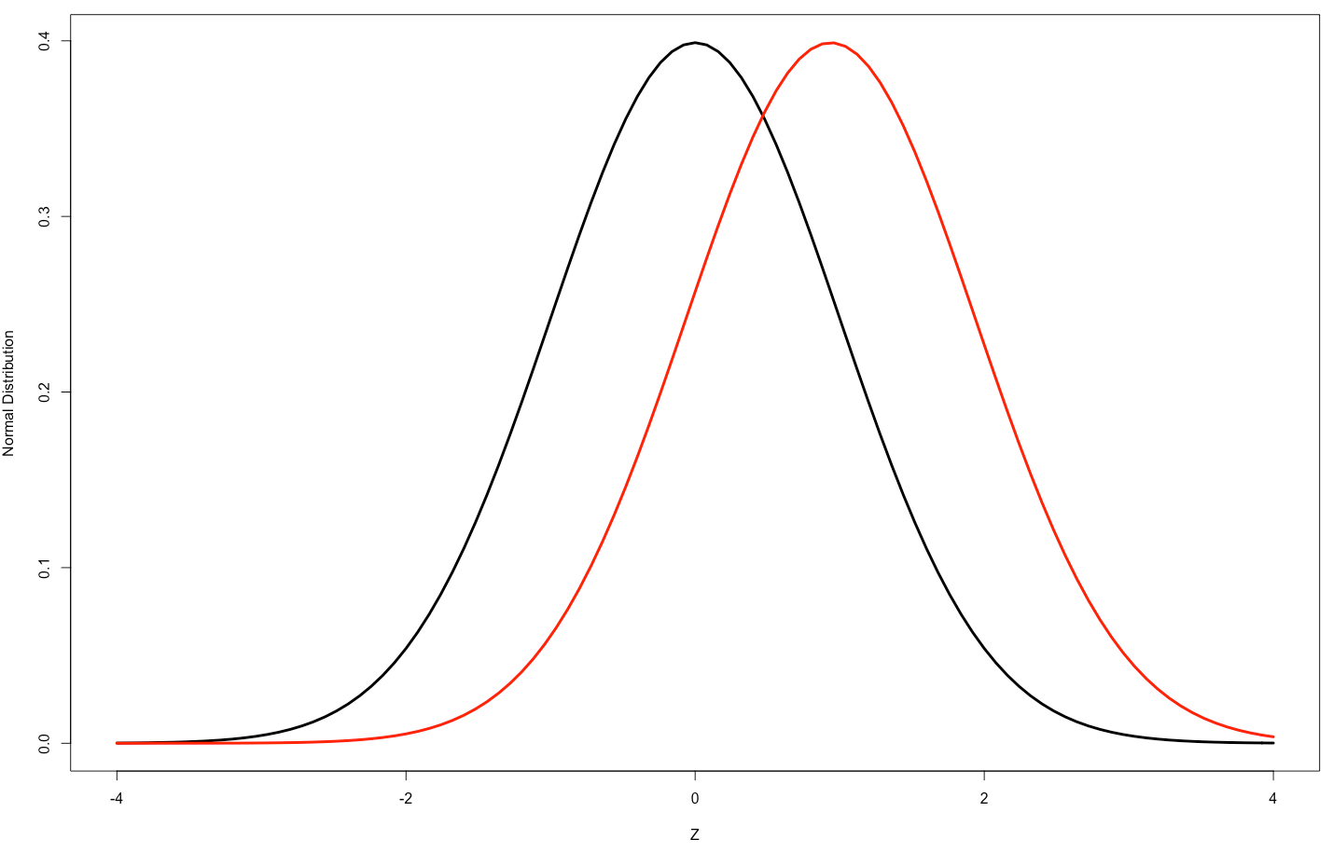


Two-Sample Z-Statistic Power
If $μ_{1}−μ_{2}≠0$ then true distribution of Z is
$$Z∼N\left(\frac{μ_{1}−μ_{2}}{σ\sqrt{\frac{1}{r_{1}}+\frac{1}{r_{2}}}} ,1\right)$$
The larger this mean is, the more likely we observe “extreme” values
$$P_{H_{A}}\left(\left|Z\right|>1.96\right)=0.1552>0.05$$
$$σ=1 μ_{1}−μ_{2}=0.25$$
$r_{1}=5 { r}_{2}=15$
$$\frac{μ_{1}−μ_{2}}{σ\sqrt{\frac{1}{r_{1}}+\frac{1}{r_{2}}}}=0.9375$$

Slide 17
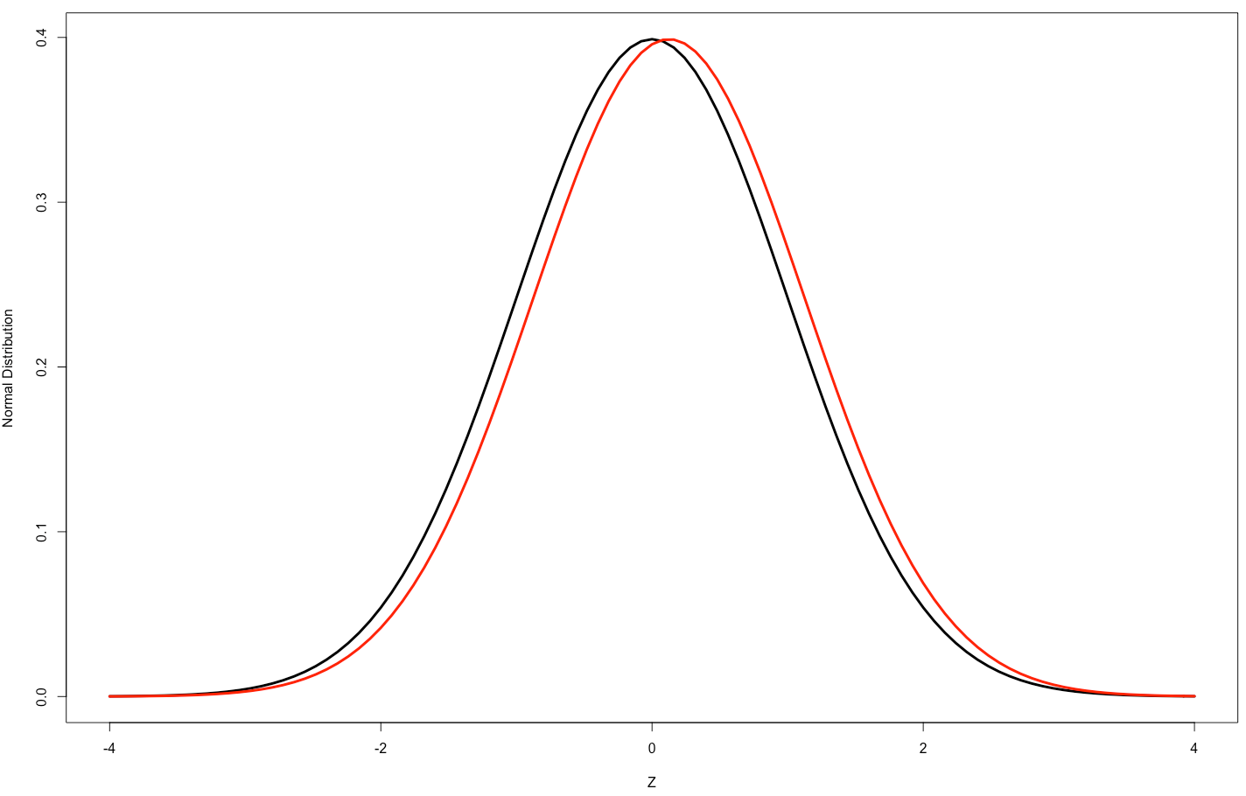


Two-Sample Z-Statistic Power
If $μ_{1}−μ_{2}≠0$ then true distribution of Z is
$$Z∼N\left(\frac{μ_{1}−μ_{2}}{σ\sqrt{\frac{1}{r_{1}}+\frac{1}{r_{2}}}} ,1\right)$$
The larger this mean is, the more likely we observe “extreme” values
$$P_{H_{A}}\left(\left|Z\right|>1.96\right)=0.0518>0.05$$
$$σ=10 μ_{1}−μ_{2}=0.25$$
$r_{1}=10 r_{2}=10$
$$\frac{μ_{1}−μ_{2}}{σ\sqrt{\frac{1}{r_{1}}+\frac{1}{r_{2}}}}=0.125$$

Slide 18
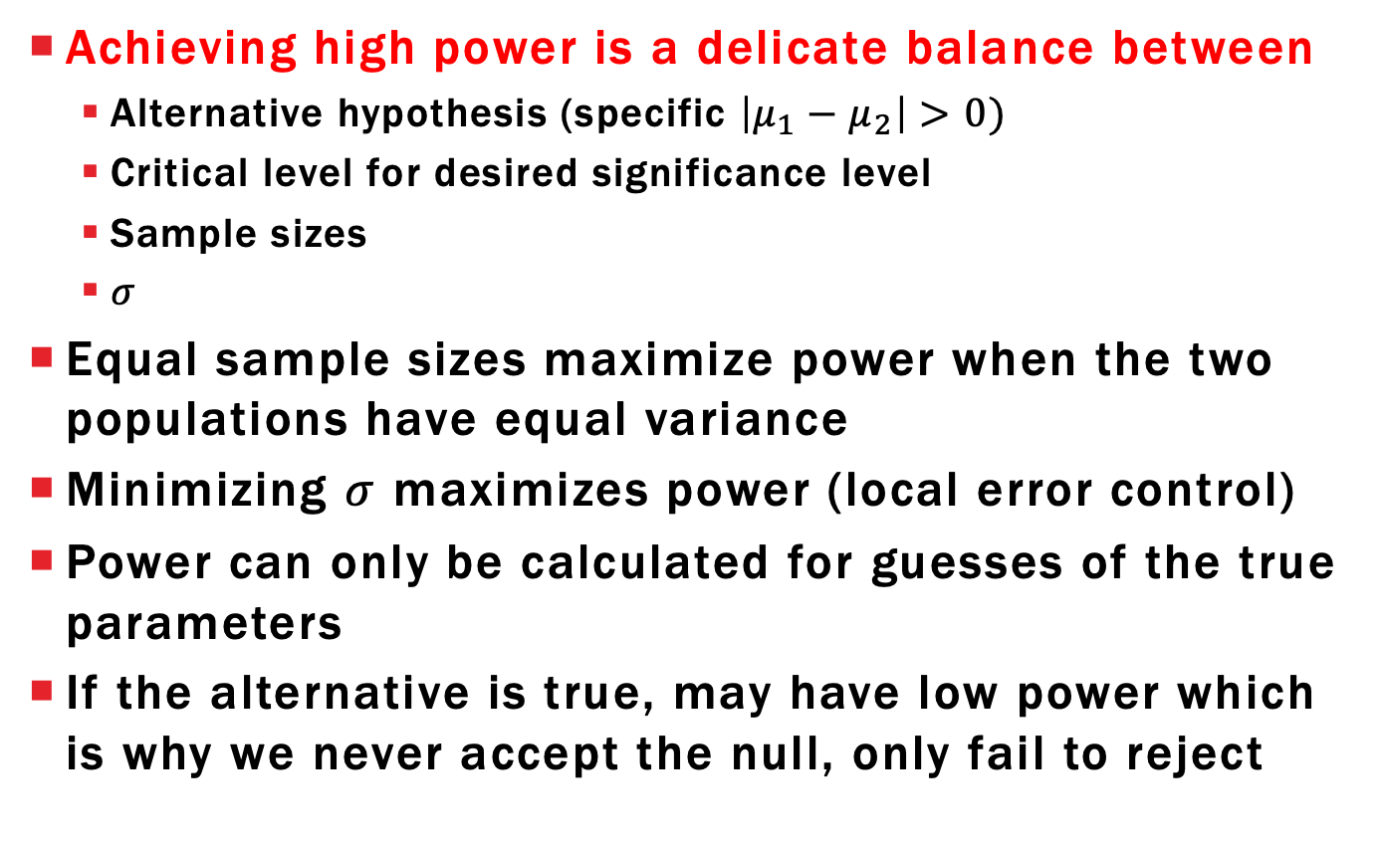
Lessons from Power
Achieving high power is a delicate balance between
Alternative hypothesis (specific $\left|μ_{1}−μ_{2}\right|>0)$
Critical level for desired significance level
Sample sizes
$σ$
Equal sample sizes maximize power when the two populations have equal variance
Minimizing $σ$ maximizes power (local error control)
Power can only be calculated for guesses of the true parameters
If the alternative is true, may have low power which is why we never accept the null, only fail to reject

Slide 19
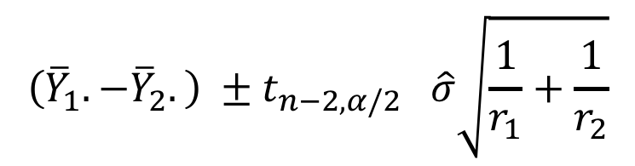
Two-Sample Confidence Intervals
If we reject the null we should provide estimate of what the difference truly is
Use a % confidence interval centered at estimate
Like “inverting” hypothesis test
$$\left({\overline{Y}}_{1}.−{\overline{Y}}_{2}.\right) ±t_{n−2,α/2} \hat{σ}\sqrt{\frac{1}{r_{1}}+\frac{1}{r_{2}}}$$
Estimator
Critical value from
T-distribution with df
Standard error of
estimate

Slide 20
Learning objectives Review
Define a sampling distribution for a statistic
Write null and alternative hypotheses for two-sample tests and simple linear regression
Understand relationship between null and alternative distributions
Explain how to calculate Type 1 error and power

