Slide 1
One-Factor Analysis: part 3
Chapter 3-5, 8

Slide 2
Learning objectives
Explain F-test for ANOVA using expected values of msT and msE
Explain difference between central and non-central F
Explain connection between F and T-statistic

Slide 3
Bread yeast and time to rise
Compare three different rise times to see if there is a significant difference in dough height
35, 40, and 45 minutes (quantitative or categorical?)
Large batch of dough partitioned into N loaf pans of equal size
Determine if any difference between treatment means
If there is a difference, which are different?

Slide 4
Test statistics
For t=2 used two-sample t-test
With t > 2? Multiple two-sample tests?
t=3 there would be 3 such tests
t=4, we’d have 6
t=5.... 20
t=10…45
Multiple hypothesis testing dramatically increases Type I error rate if we aren’t careful
Each test has its own Type 1 error rate
Goal: one test statistic that takes on certain values when the null is true and others when null is false

Slide 5
Testing for treatment differences Null Hypothesis
Write this as a testable hypothesis in terms of our model parameters and construct test statistics
Must involve estimable functions!
Cell Means

Slide 6

Partitioning Sources of Variance
If $H_{0}$ true, then variance estimator should be
If wrong then this will be an inflated estimator
Partition ssTotal with identity
Source of inflation!

Slide 7
Analysis of Variance SSE and SST
Look at expected values
Comments about
Equals 0 under null hypothesis
Use these statistics to create our test statistic

Slide 8
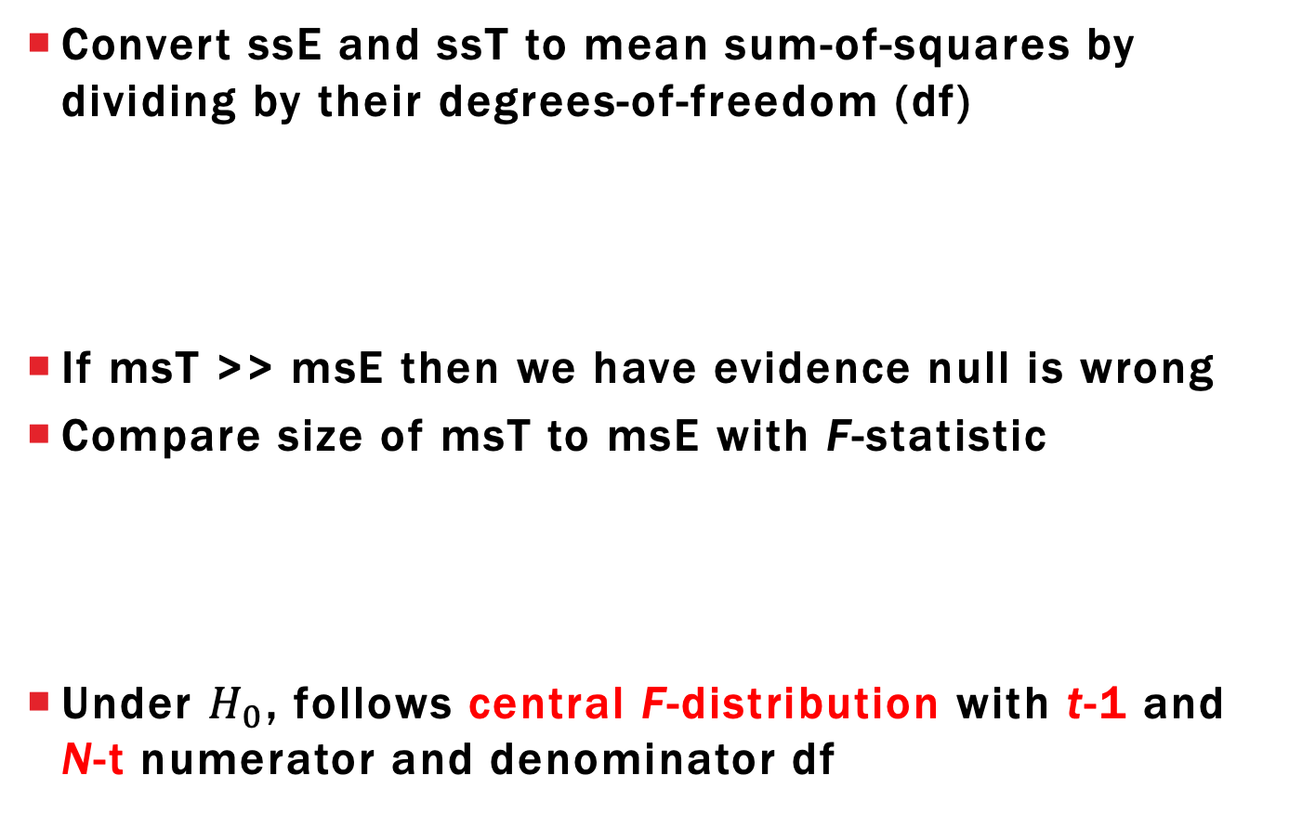
Analysis of Variance mean squares and F-statistic
Convert ssE and ssT to mean sum-of-squares by dividing by their degrees-of-freedom (df)
If msT >> msE then we have evidence null is wrong
Compare size of msT to msE with F-statistic
Under $H_{0}$, follows central F-distribution with t-1 and N-t numerator and denominator df

Slide 9
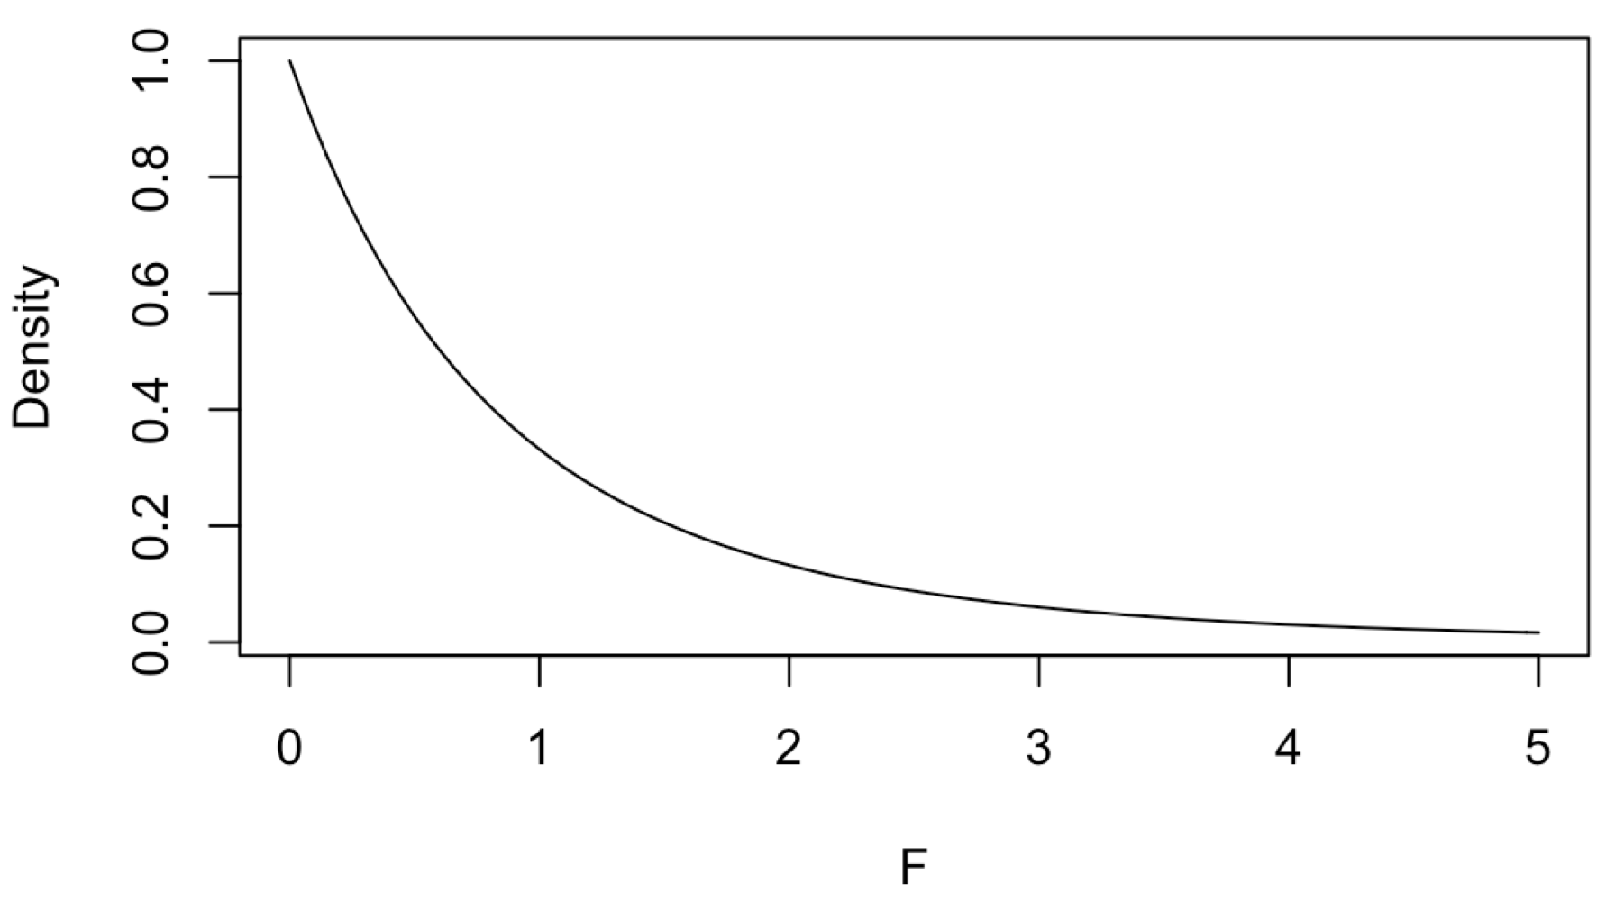
F-distribution under Null distribution
Bread example has t=3, r=4 (N=12)
F-distribution with 2 num df and 9 denom df
0.05 critical value = 4.26
P-value expression: (one-sided test)

Slide 10
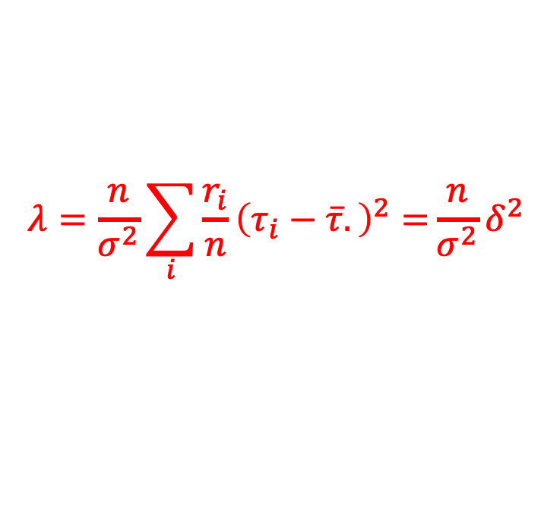
Non-central F-distribution
F statistic follows central F-distribution under null
If alternative is true then it follows non-central F-distribution with noncentrality parameter
Shifts probability density to larger values, meaning larger F value are more likely
Use to calculate power and sample size
$$λ=\frac{n}{σ^{2}}\sum_{i}{\frac{r_{i}}{n}{\left(τ_{i}−\overline{τ}.\right)}^{2}=}\frac{n}{σ^{2}}δ^{2}$$

Slide 11
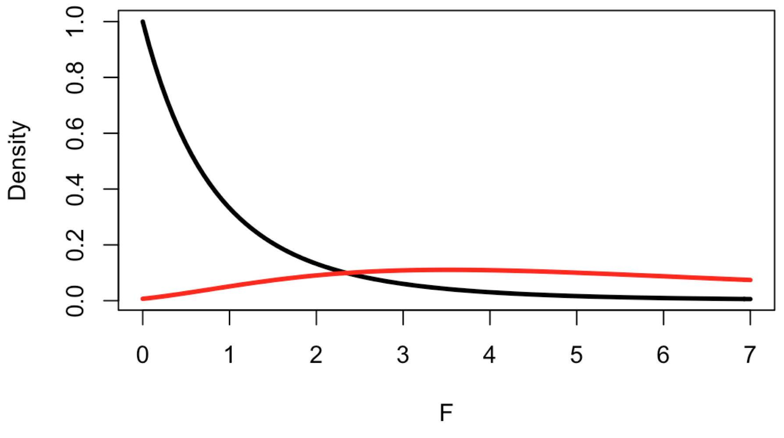
Non-central F-distribution
Bread example has 2, 9 df
Say
Critical value to reject at 0.05 level = 4.26
Noncentral F

Slide 12

Power calculation
To calculate power, we have to specify a single alternative hypothesis through
Replicate numbers
Treatment effect parameters**
Variance
**Need to relax this unrealistic requirement
$$λ=\frac{n}{σ^{2}}\sum_{i}{\frac{r_{i}}{n}{\left(τ_{i}−\overline{τ}.\right)}^{2}=}\frac{n}{σ^{2}}δ^{2}$$

Slide 13
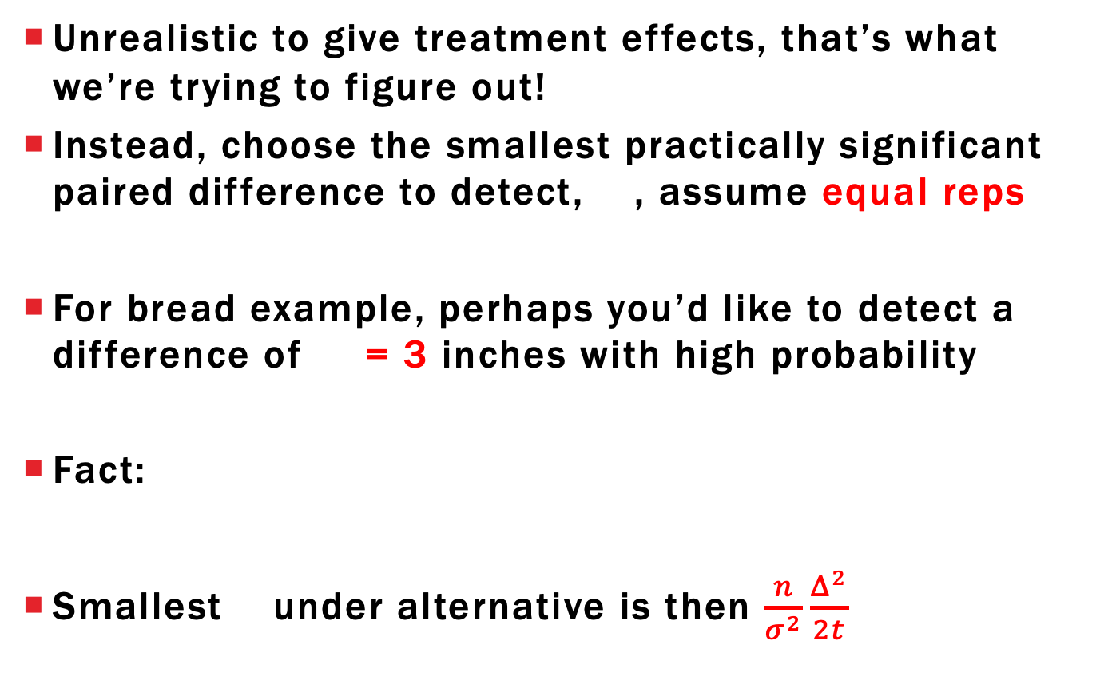
Power conservative approach
Unrealistic to give treatment effects, that’s what we’re trying to figure out!
Instead, choose the smallest practically significant paired difference to detect, , assume equal reps
For bread example, perhaps you’d like to detect a difference of = 3 inches with high probability
Fact:
Smallest under alternative is then $\frac{n}{σ^{2}}\frac{Δ^{2}}{2t}$

Slide 14
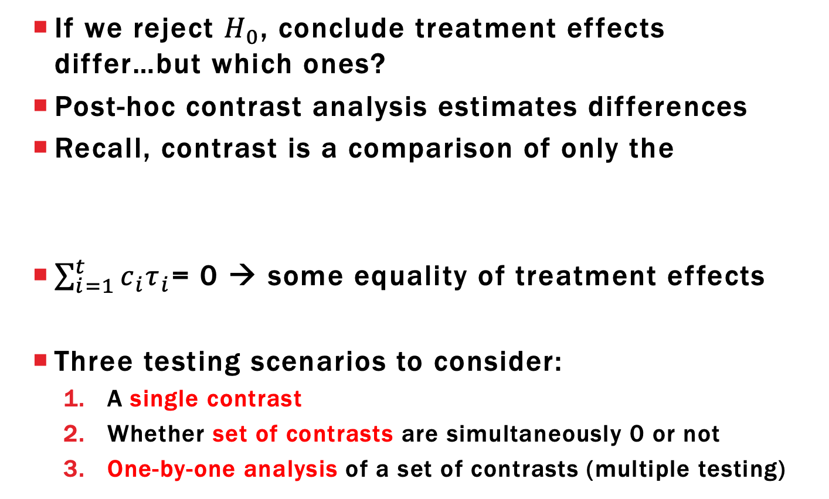
Post-Hoc Contrast Analysis
If we reject $H_{0}$, conclude treatment effects differ…but which ones?
Post-hoc contrast analysis estimates differences
Recall, contrast is a comparison of only the
$\sum_{i=1}^{t}{c_{i}τ_{i}}$= 0 → some equality of treatment effects
Three testing scenarios to consider:
A single contrast
Whether set of contrasts are simultaneously 0 or not
One-by-one analysis of a set of contrasts (multiple testing)

Slide 15
Single Contrast Sampling distribution
For the sampling distribution is
Don’t know so we use the T-statistic
Degrees-of-freedom
from MSE
Standard error

Slide 16

Single Contrast Hypothesis testing
Don’t know , so we test it
If $H_{0}$ true then test statistic is
P-value (two-sided):

Slide 17
Testing with Full and Reduced models
Null and alternative distributions implicitly assume all remaining contrasts are potentially nonzero
Didn’t have to think about this for two-sample problem
Referred to as full vs reduced model approach
Full model: all contrasts are significant (model DF = t-1)
Reduced model: one contrast is insignificant (model DF = t-2)
Important when simultaneously testing multiple contrasts and testing polynomial regression models
Also comes up with analysis of factorial experiments

Slide 18
Single Contrast Confidence interval
All a hypothesis tells us is what contrast isn’t
Common to use a confidence interval
Similar to the two-sample confidence interval

Slide 19
Single Contrast Sum-of-squares
Alternative test statistic for contrasts is based on the F-distribution with 1 numerator df
Under the null hypothesis
This test statistic follows central F-distribution with 1 and N-t degrees-of-freedom
Referred to as contrast sum-of-squares (SS)

Slide 20
ANOVA and contrasts
Recall the null hypothesis for ANOVA
Subtract from each part of equality and we get
Conclusion: ANOVA is simultaneously testing whether t-1 contrasts all equal 0
Full model: all possible contrasts are significant
Reduced model: no contrast significant

Slide 21
ANOVA and contrasts Linear Independence
Many equivalent expressions for null hypothesis but all of them involve t-1 linearly independent contrasts
Concept from linear algebra but we can get the gist with an example
Have three contrasts with coefficients in bread example
Write contrast coefficients as a list (or vector)

Slide 22
ANOVA and contrasts Linear Independence
The last vector can be derived from the first two
Called a linearly dependent set of contrasts
Can write one vector as a linear combination of others
Set of contrasts is linearly independent if no contrast coefficient vector can be written as a linear combination of the others
--
--
--
=
d – c = e

Slide 23
Testing Multiple contrasts
Fact 1: Largest set of linearly independent contrasts has t-1 contrasts
Fact 2: ANOVA test is equivalent to simultaneous test of t-1 linearly independent contrasts
Takeaway: We can use F-tests to simultaneously test a set of linearly independent contrasts
Works for linearly independent sets with less than t-1 contrasts as well!

Slide 24
General Linear Hypothesis Test
Have k < t-1 linearly independent contrasts and want to test whether all simultaneously equal 0
Defines the reduced model
Software generates required F-statistic and calculates p-value based on F-distribution with k and N-t degrees-of-freedom
F-statistic in general requires matrix computations but can be calculated by hand in special situations

Slide 25
One-at-a-time testing of Contrasts Multiple comparisons
Even with these general contrast hypotheses, still left without knowledge of which individual effects are truly different from 0
Naïve Approach: Confidence intervals for each
Issue: Proposed confidence level only applies to a single interval
We want to be confident that all proposed intervals simultaneously have the proposed confidence level

Slide 26
Multiple comparisons
Suppose we want k>1 confidence intervals
Then the probability of all confidence intervals capturing the true contrasts simultaneously could be as low as
Example: k=5 and would give lower bound of 0.75
Idea: make intervals larger to prevent this…
…can’t make them too large or they won’t be useful

Slide 27
Multiple comparison adjustments
Tukey’s HSD (Honestly significant difference):
Only works for paired differences
Adjusts critical value to be from studentized range distribution
Dunnett Adjustment:
Specific pairwise comparisons to reference treatment
Usually control or the “best” treatment

Slide 28
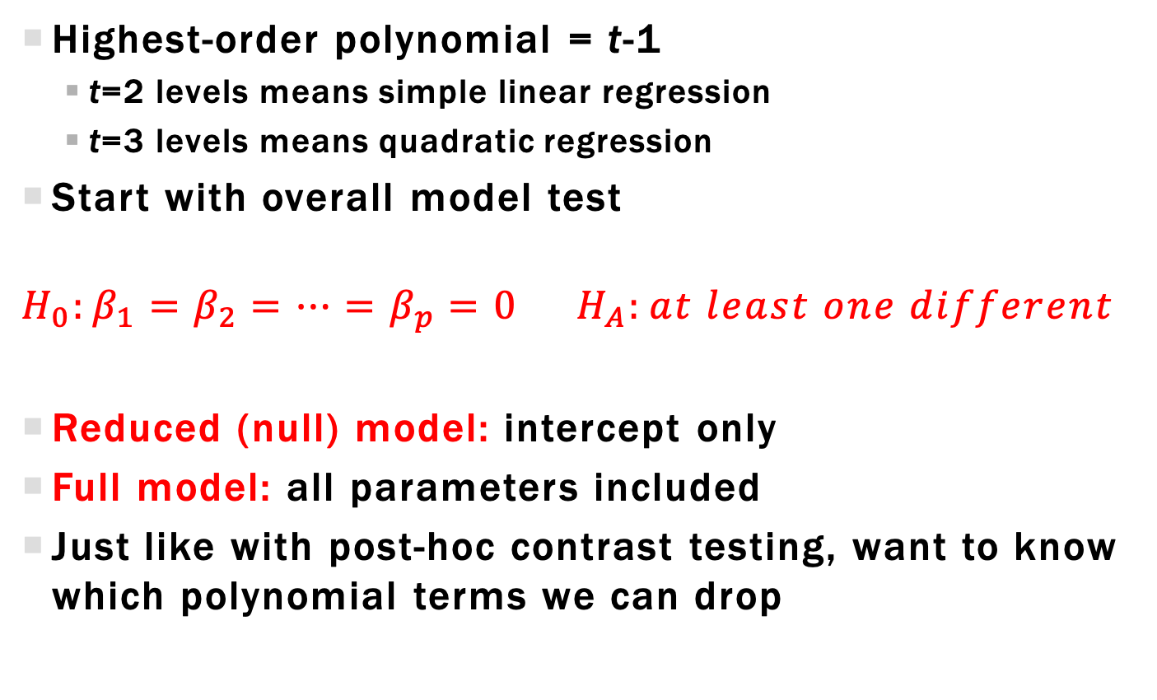
Polynomial Regression Inference: Overall Model
Highest-order polynomial = t-1
t=2 levels means simple linear regression
t=3 levels means quadratic regression
Start with overall model test
$$H_{0}:β_{1}=β_{2}=…=β_{p}=0 H_{A}:at least one different$$
Reduced (null) model: intercept only
Full model: all parameters included
Just like with post-hoc contrast testing, want to know which polynomial terms we can drop

Slide 29
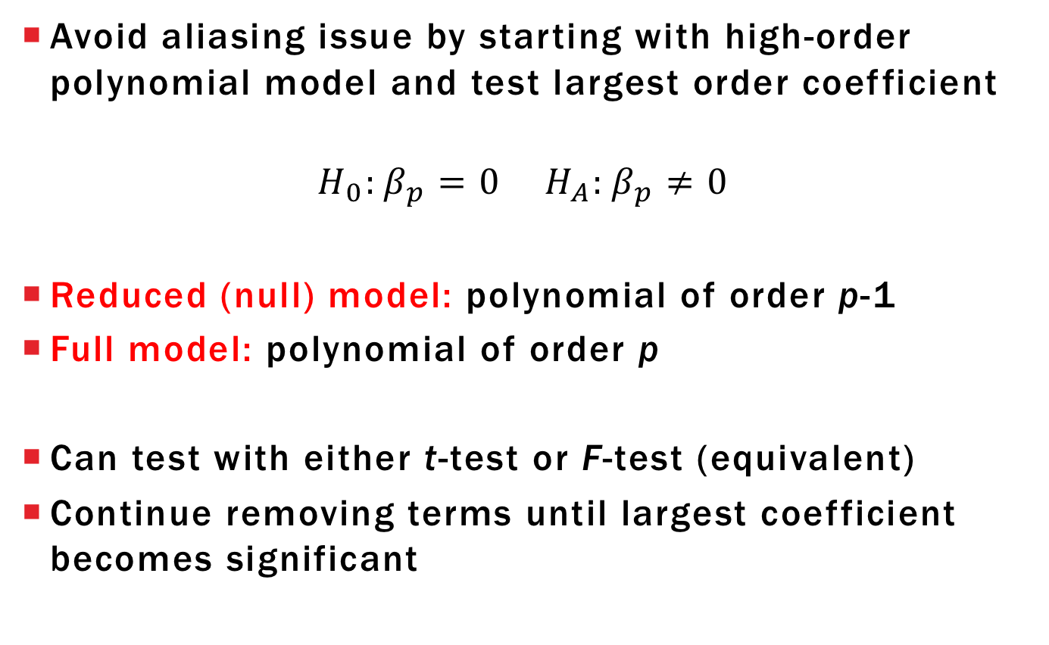
Backwards Elimination
Avoid aliasing issue by starting with high-order polynomial model and test largest order coefficient
$$H_{0}:β_{p}=0 H_{A}:β_{p}≠0$$
Reduced (null) model: polynomial of order p-1
Full model: polynomial of order p
Can test with either t-test or F-test (equivalent)
Continue removing terms until largest coefficient becomes significant

Slide 30
Learning objectives Review
Explain F-test for ANOVA using expected values of msT and msE
Explain difference between central and non-central F
Explain connection between F and T-statistic

