Slide 1

ggplot in with Gelman&Hill data
Kedar Patil
Stat 4701 – Spring 2015

Slide 2
Agenda
Project overview
Findings
Required packages
Useful resources
Code Demo

Slide 3
Overview
Research objective
To understand if there is a relation between child’s IQ and mother’s education or age
Data
Gelman & Hill – child.iq.dta
400 observations of Child IQ, Mother’s education, Mother’ age
Findings
Positive relationship observed between mom’s education and Child’s IQ
Mom’s age is also correlated with Mom’s education
No apparent relation between Mom’s age and Child’s IQ

Slide 4
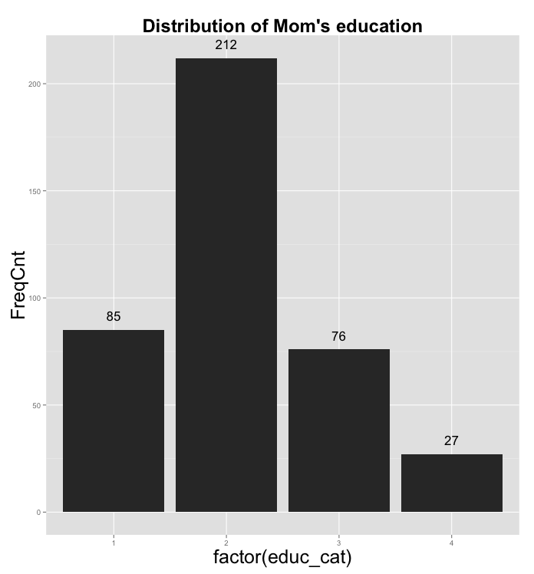
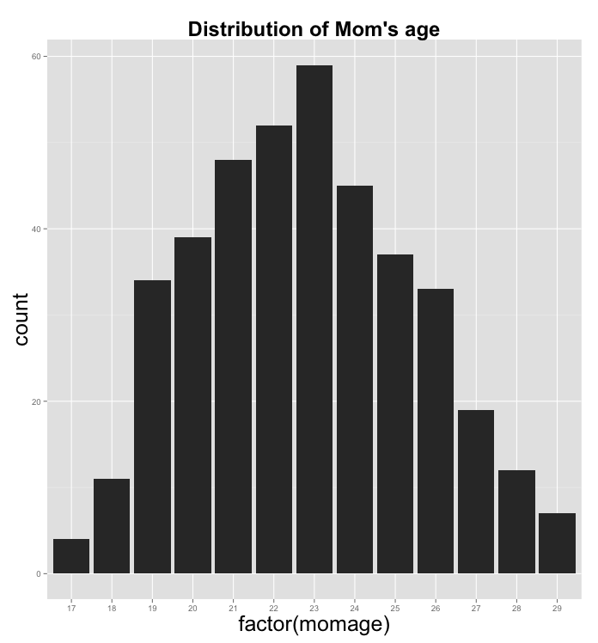
Frequency Distribution
Education category 2 has highest representation, and category 4 has the least
Age distribution is fairly symmetric, with peak at ~23 years

Slide 5
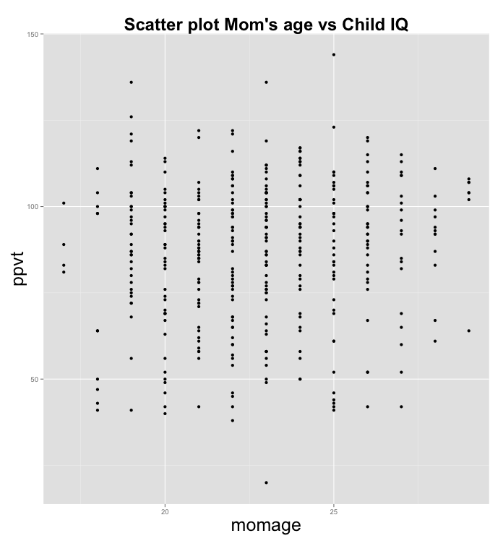
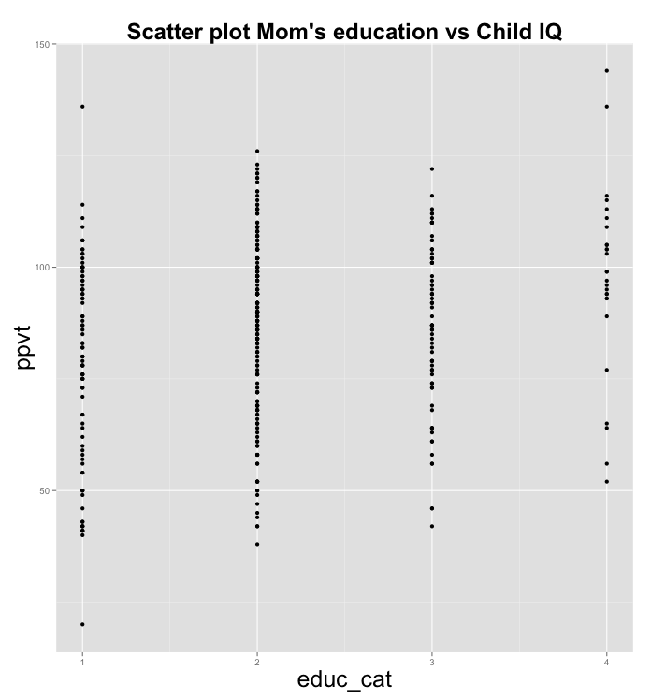
Scatter Plots
Not much is apparent from scatter plots
All points fall in buckets, indicating Age and Education are both categorical variables

Slide 6
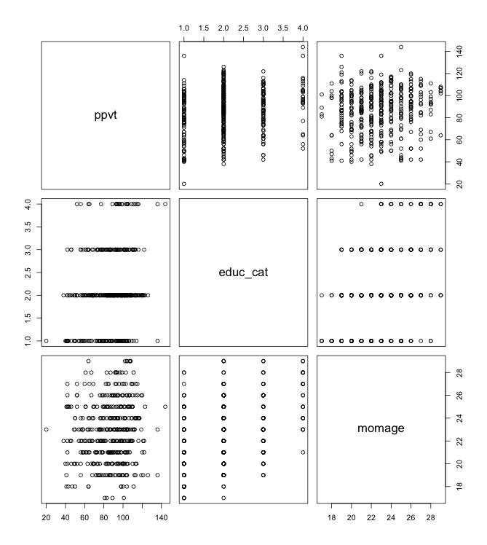
Matrix Scatter Plots
Matrix scatter plots give the ability to view pairwise relationship between multiple variables at a time
ggplot does not have this functionality, so pair() function in base R package is used

Slide 7
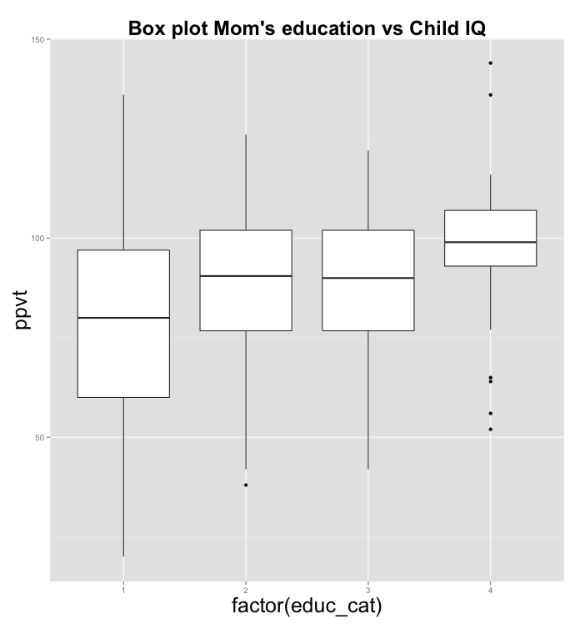
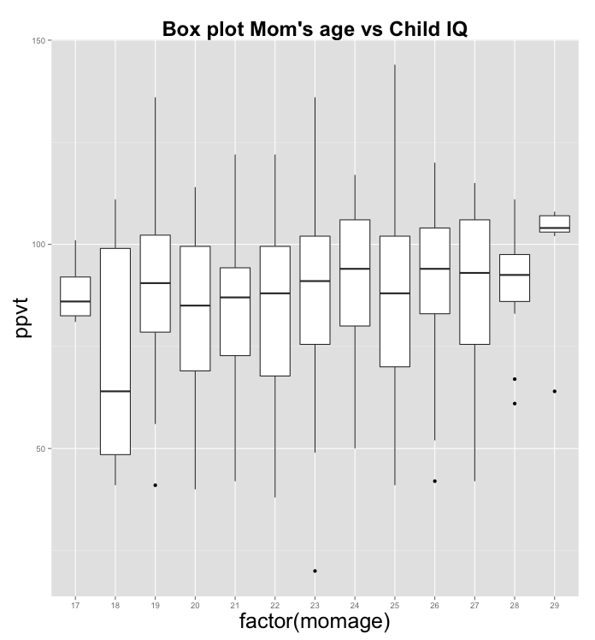
Box Plots
Positive relationship between education and Child’s IQ
No apparent relation between Age and Child’s IQ

Slide 8
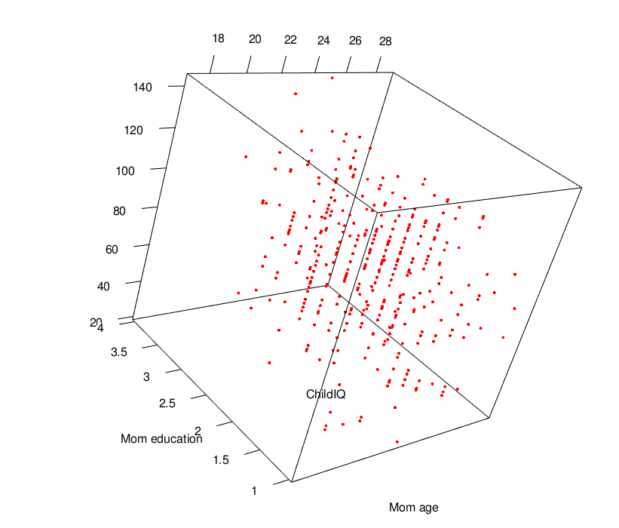
3D Rotating Plots
3D Rotating Plot gives ability to visualize the interaction of all 3 variables together

Slide 9
Required Packages
ggplot2
MASS and plyr – for bar plot with summary statistics
rgl and RColorBrewer – for 3D rotating plots
Install x11 for Mac – for 3D rotating plots

Slide 10
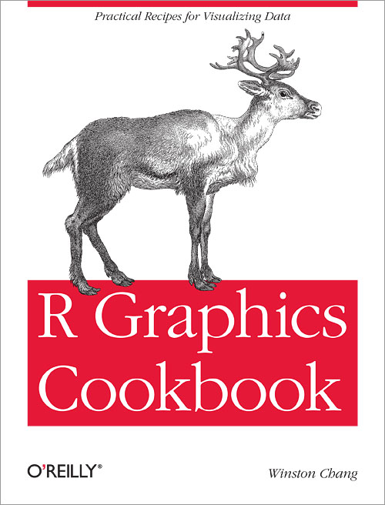
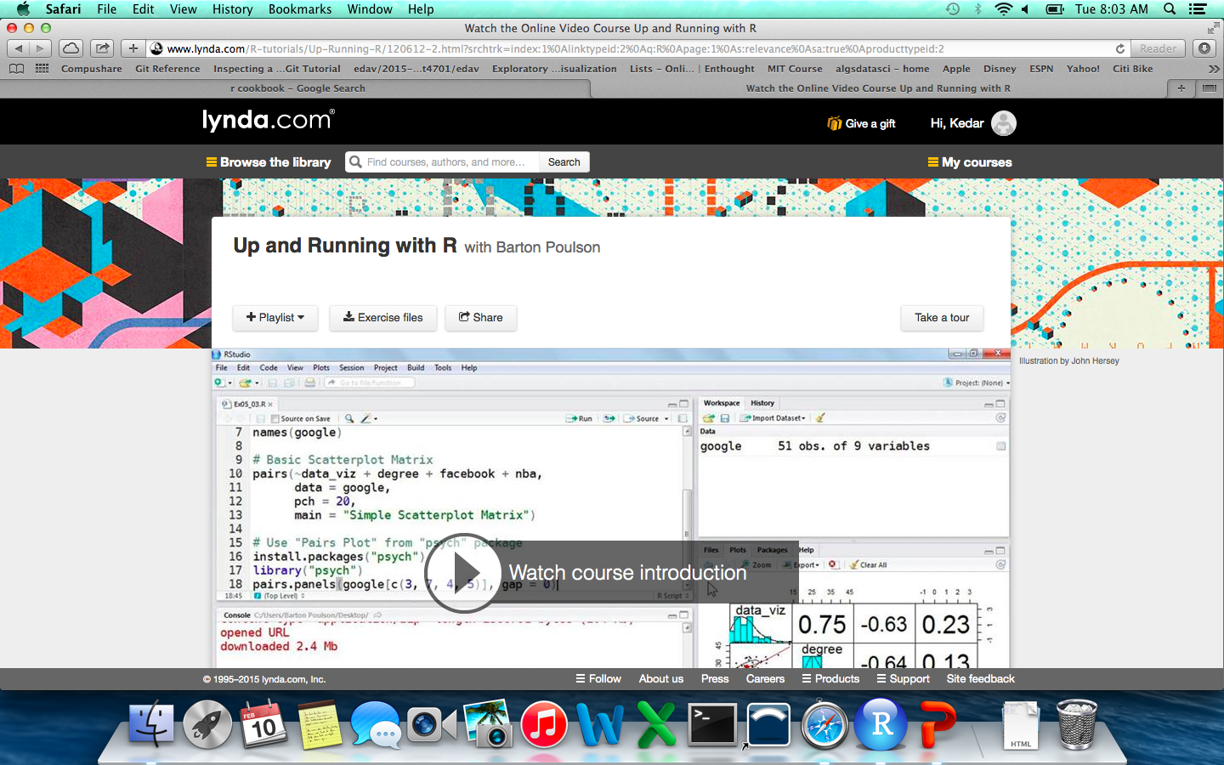
Useful Resources
R Graphics Cookbook, by Winston Chang
Lynda.com – Up and Running with R

