Slide 1
STAT 605 Project
Nan Yan
Yun Mo
Chen Hu
Qiaochu Yu

Slide 2
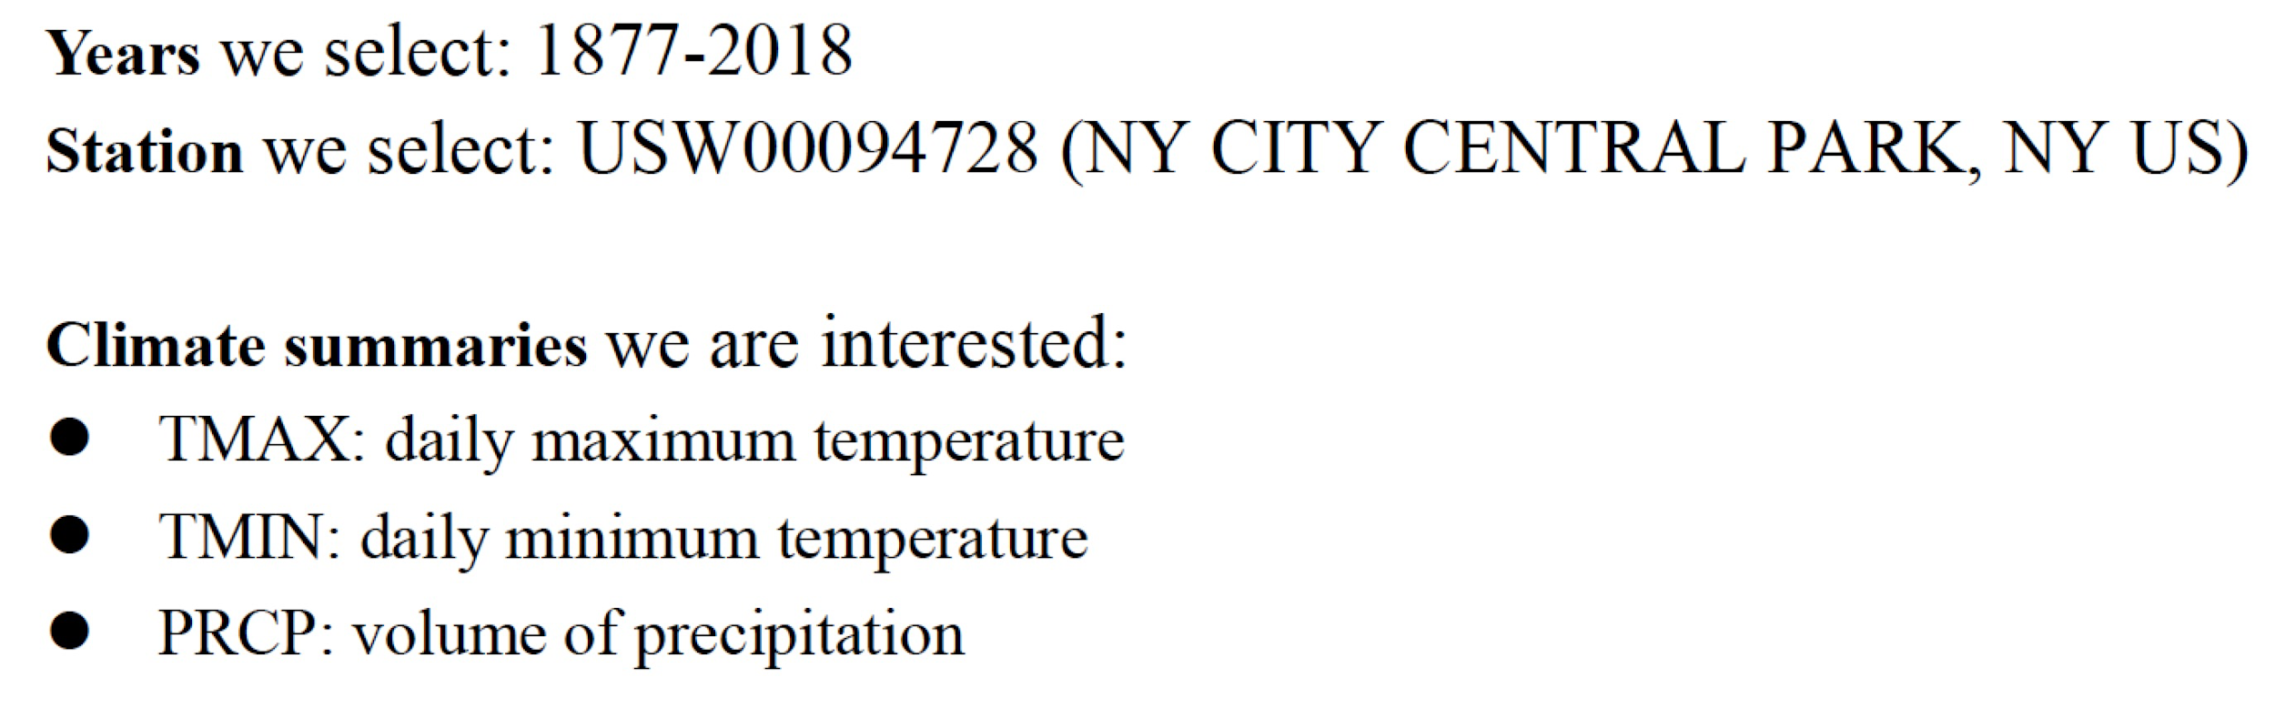
Data description
An integrated database of daily climate summaries from land surface stations across the globe cover year 1763-2019.

Slide 3
Goal
Plot time series plots for monthly mean, maximum and minimum statistics of TMAX, TMIN and PRCP.
Figure out which year the maximum, minimum temperature and precipitation occurred in for every month.
See if temperature or precipitation has certain trend through 1877 to 2018.

Slide 4
Data structure
1877.zip
1877.csv
(7.8 MB)
.
.
.
.
All_year.zip
(14GB)
2018.zip
2018.csv
(1.2GB)

Slide 5
Download data
Process each year as one job in CHTC.
Upload csv files to google drive
Download by share link of each csv file
Simple idea while hard practice

Slide 6
Data clean
Choose target station
Extract interested variables
Calculate monthly data based on daily data
Merge into 3 csv files
(TMAX.csv TMIN.csv PRCP.csv)

Slide 7
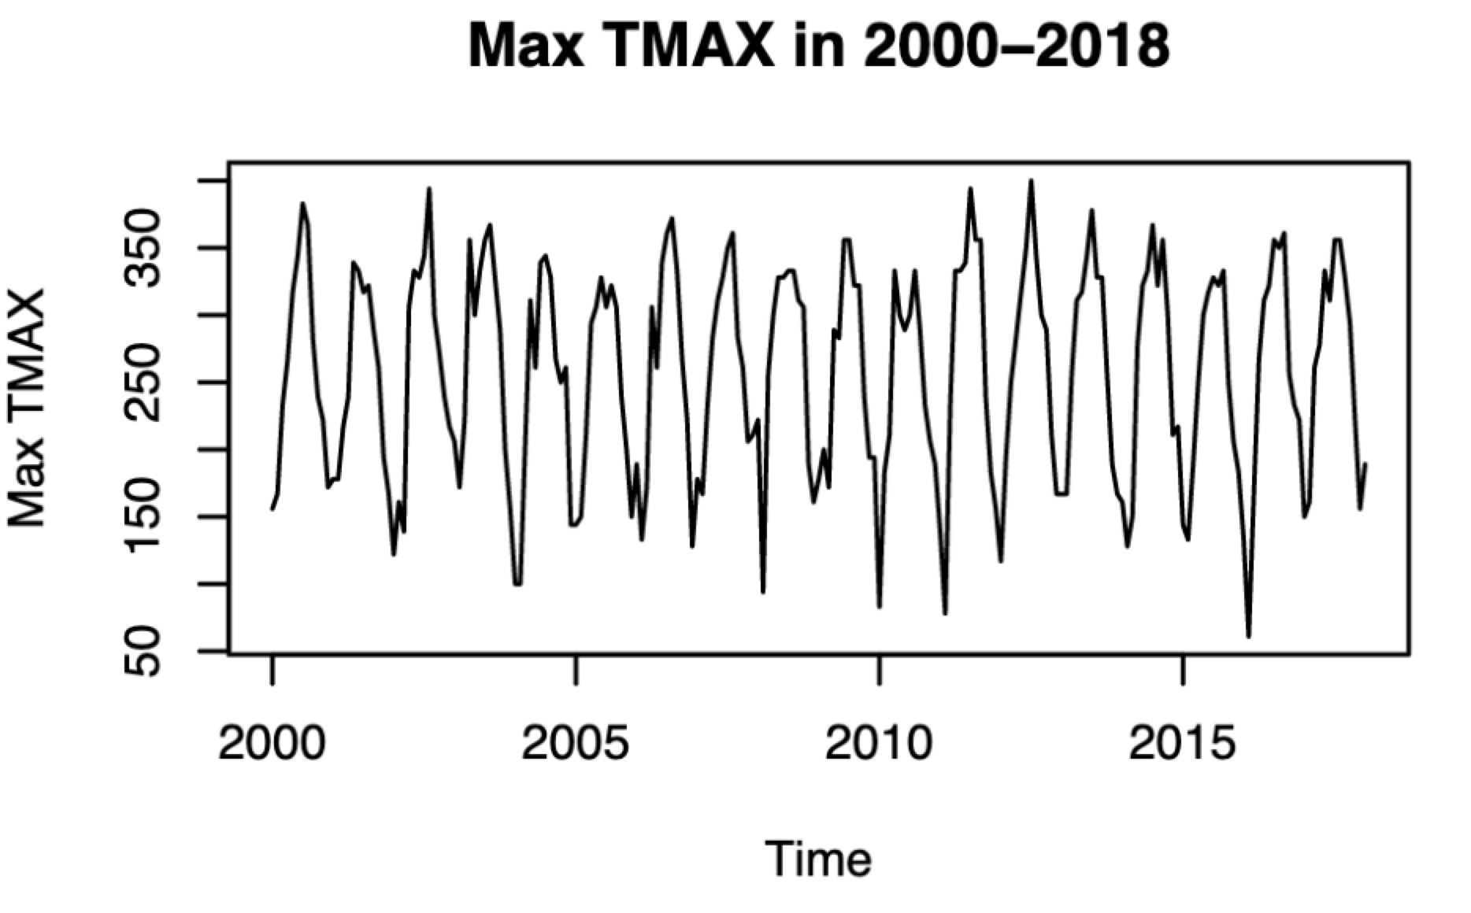
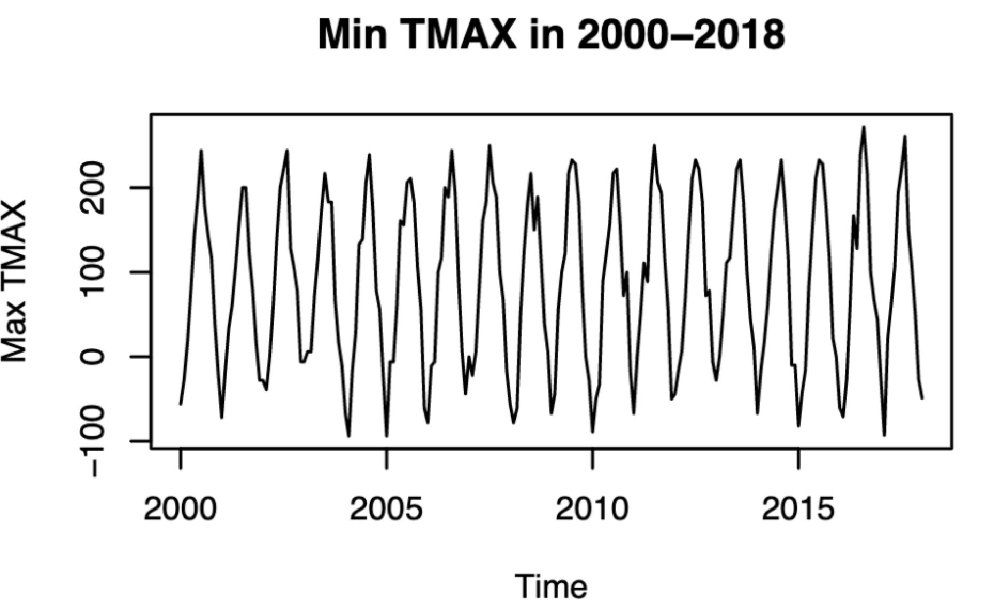
Time series plots (TMAX)

Slide 8
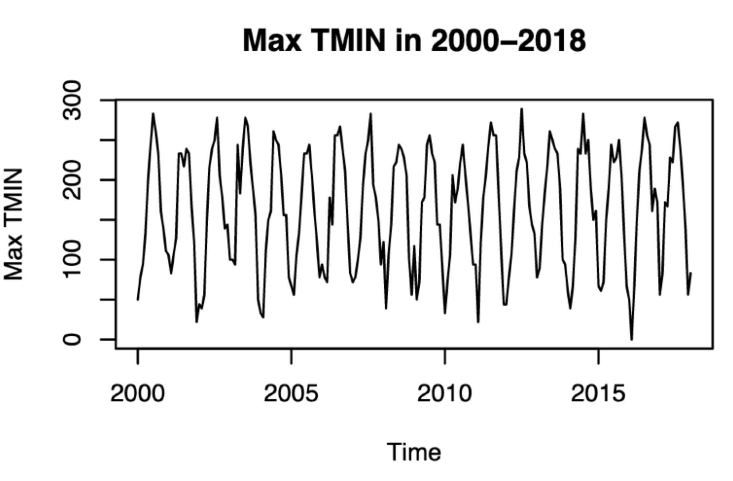
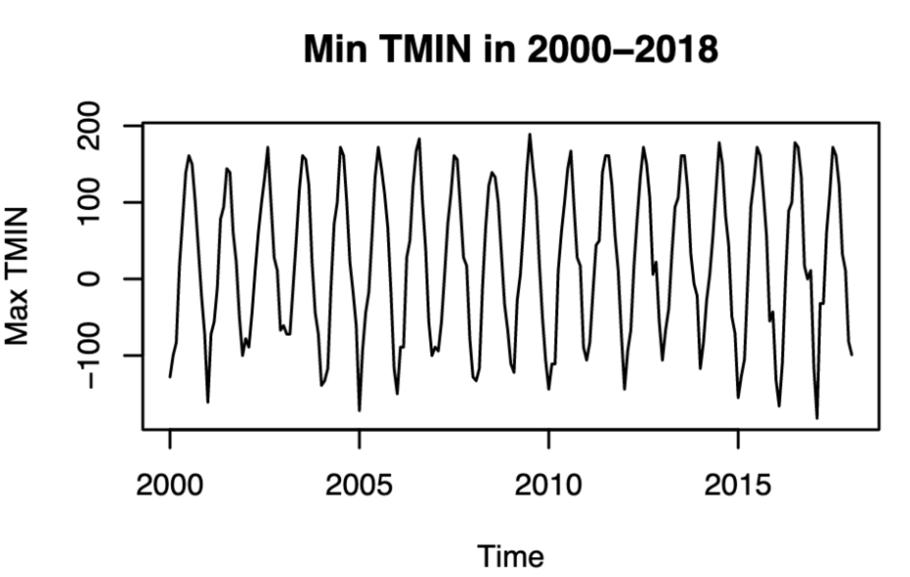
Time series plots (TMIN)

Slide 9
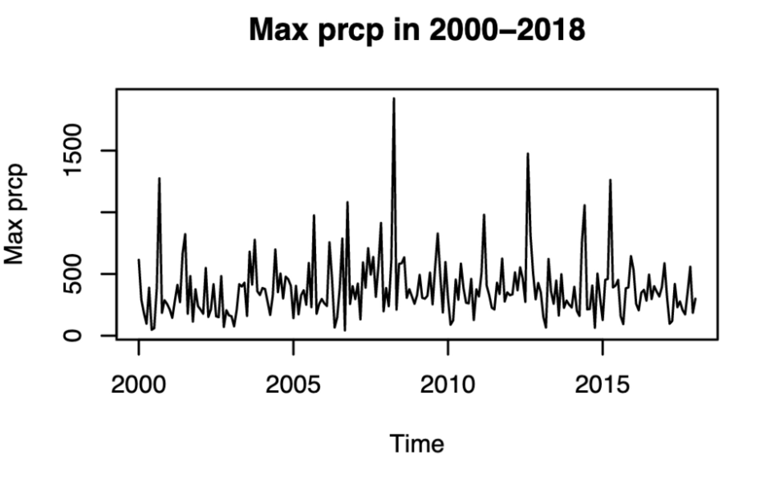
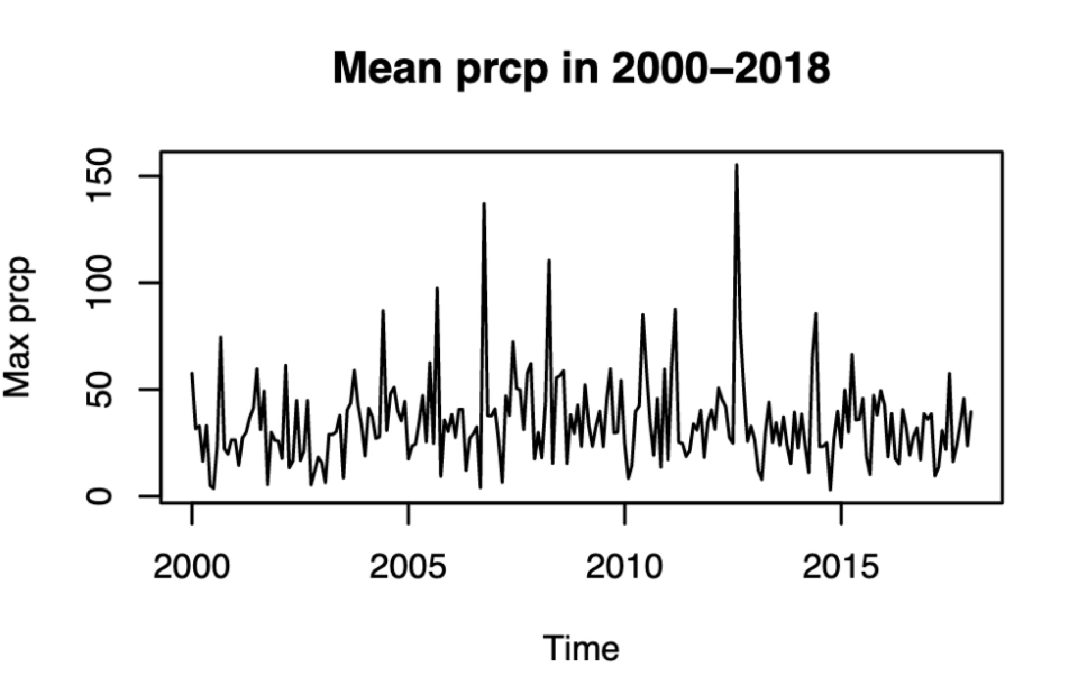
Time series plots (PRCP)

Slide 10
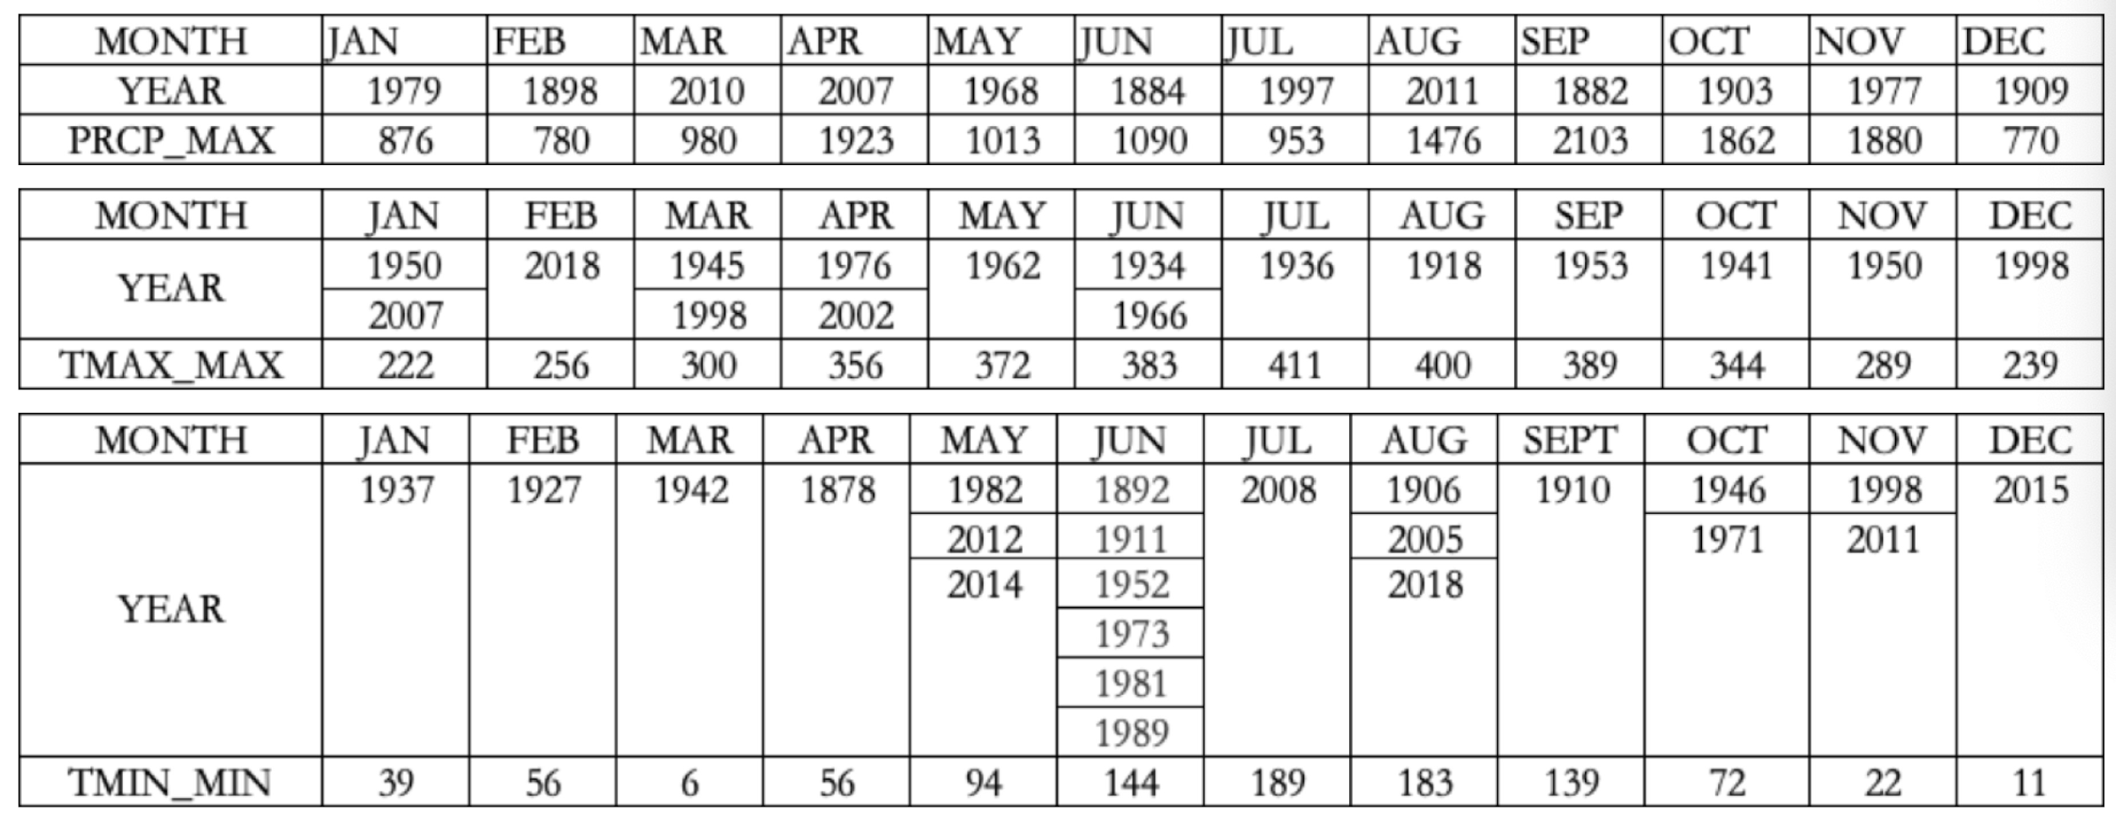
When did extreme value occur

Slide 11
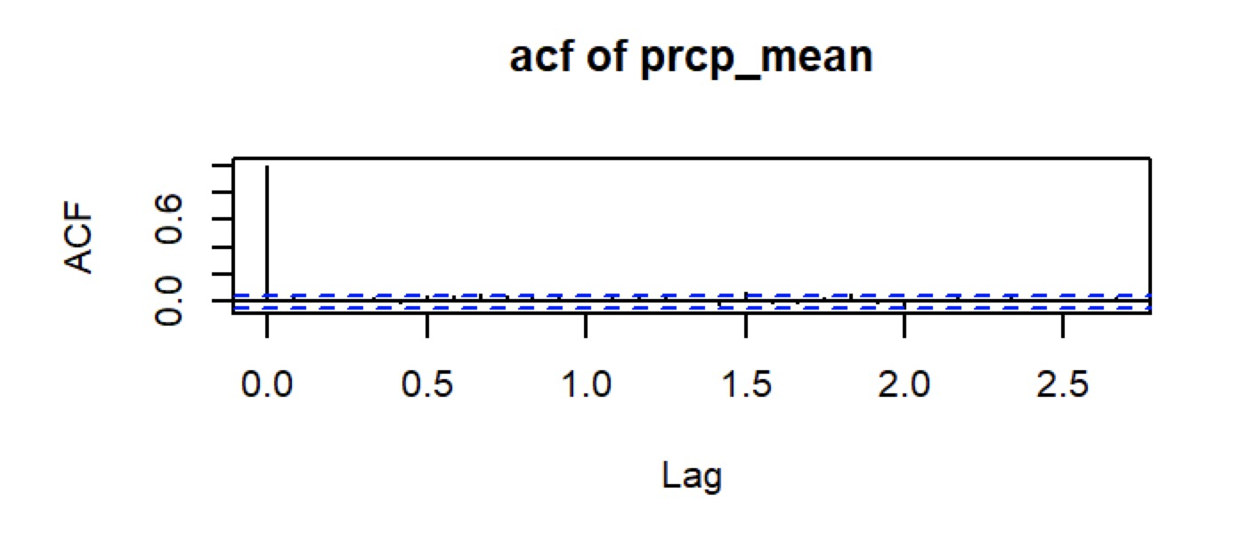
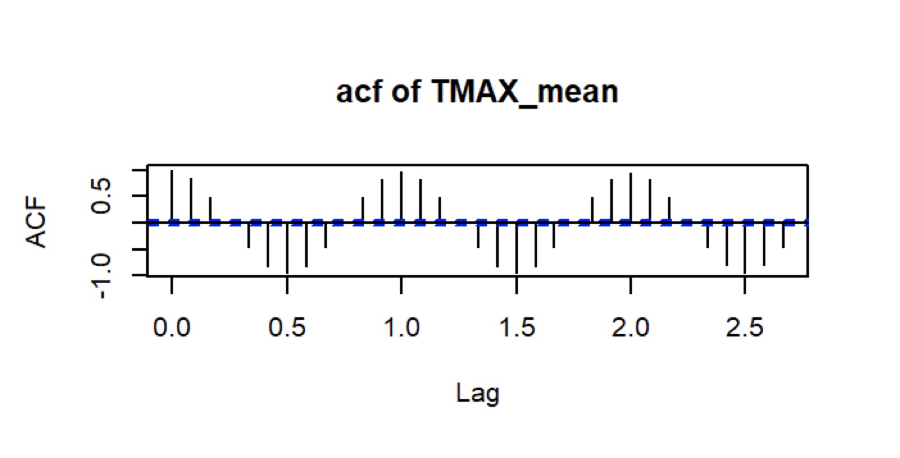
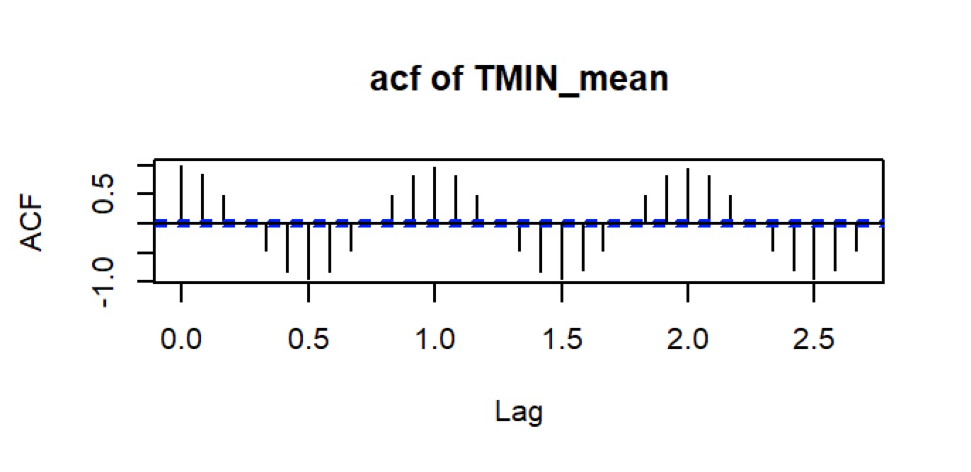
Discover trend
Mean for PRCP shows no trend
Mean for TMAX and TMIN show a strong seasonal trend

Slide 12
THANK YOU

