Slide 1
Artists In The U.S.
Mahyar Madarshahain & Jing Wang

Slide 2
Number of Obseravations | Number of Variables | Number of Rows having missing values | Number of rows after data cleaning
3381 | 6 | 1472 | 1909
##Introduction
The Arts Data Profile provides national and state-level estimates of artists in the workforce, sourced from 2015-2019 American Community Survey (ACS) data conducted by the U.S. Census Bureau. State-level estimates cover the total number of artists and individual counts for 13 specific artist occupations. An interactive map displays counts and location quotients for total artists and selected occupations, including architects, arts directors, fine artists, animators, designers, dancers, musicians, actors, entertainers, writers, authors, and photographers for each U.S. state.
Artists:
Architects (except landscape and naval); landscape architects; art directors, fine artists, and animators; designers; actors; producers and directors; dancers and choreographers; music directors and composers; musicians; disk jockeys, except radio; entertainers; broadcast announcers and radio disk jockeys; other media and communication workers; writers and authors; and photographers.
Location Quotients
The location quotient (LQ) measures the concentration of a particular occupation within a state’s labor force, relative to that occupation’s concentration in the U.S. labor force. For example, an LQ of 1.2 indicates that the occupation clusters in a state at a level 20 percent greater than within the nation’s workforce at large. An LQ of 0.8 indicates that the occupation clusters in a state at a level 20 percent below the occupation’s concentration in the U.S. labor force.
Objective
Are there any states with a location quotient significantly below 1.0 for artists?
What is the overall distribution of artist types across different states or territories?
The top 10 state /territory has the highest number of artists, as indicated by the location quotient.
Is there a correlation between the percentage of artists in a state (artists_share) and the state’s number of workers?
How does the racial diversity of artists vary across different states or territories? Are there states with a more diverse artist population than others?
The top 10 states which has the most number of Asian artists, and the related population percentage.
Delving into dataset intricacies, addressing anomalies, exploring trends, and presenting visualizations Seeking patterns, correlations, and distinctive features to enhance understanding of the artistic workforce in the U.S. An analytical journey unfolding across different states and territories
Dataset Description

Slide 3
variable | class | description
state | character | This variable represents the U.S. state where the data was collected
race | character | This variable specifies the racial or ethnic category of the workforce being analyzed
type | character | This variable indicates the type of profession or occupation for which the data is recorded
all_workers_n | double | This numeric variable represents the total number of workers in the specified state and occupation
artists_n | double | This numeric variable signifies the number of artists within the same state and occupation
artists_share | double | This numeric variable expresses the share or proportion of artists among all workers in the occupation within the particular state
location_quotient | double | Location quotient is a numerical measure used to assess the concentration of a particular occupation in a specific geographical area
Variables Description

Slide 4
state | location quotient
Alabama | 0.678499
Alaska | 0.703285
Arizona | 0.889886
Arkansas | 0.624634
Delaware | 0.718172
Idaho | 0.756616
Illinois | 0.937109
Indiana | 0.718303
Iowa | 0.670376
Kentucky | 0.694958
Michigan | 0.863056
Minnesota | 0.925676
Mississippi | 0.524682
Missouri | 0.810909
Montana | 0.789532
Nebraska | 0.861959
New Hampshire | 0.664936
New Mexico | 0.984415
North Carolina | 0.671117
North Dakota | 0.581610
Ohio | 0.924914
Pennsylvania | 0.905970
South Carolina | 0.716638
South Dakota | 0.636614
Tennessee | 0.994544
Texas | 0.854910
Utah | 0.875502
Virginia | 0.918024
Washington | 0.944148
West Virginia | 0.512631
Wisconsin | 0.707132
Wyoming | 0.880094
Result for question 1
Are there any states with a location quotient significantly below 1.0 for artists?
The states having average location quotient less than one

Slide 5
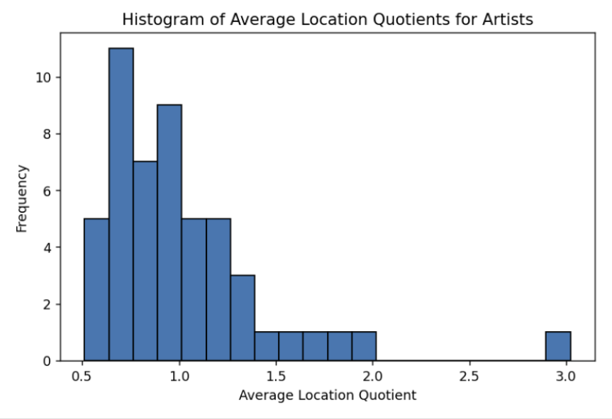
The histogram of location quotient for all states
Histogram

Slide 6
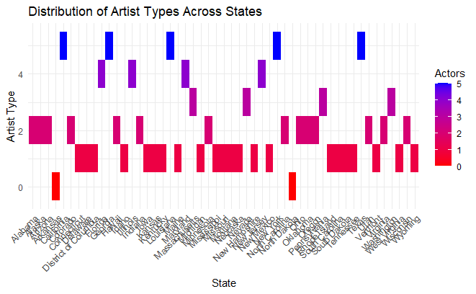
<<<<<<< HEAD
Question 2: What is the overall distribution of artist types across different states or territories?
The overall distribution of all artist types across different states or territories

Slide 7
Visualization Considerations for Question 2
Heatmaps are powerful but come with limitations.
Challenges include color misinterpretation and difficulty in distinguishing similar shades.
Difficulty in interpreting shades.
Lack of granularity for specific data points, especially in individual states.
Concerns about color scale effectiveness based on data variations. Shiny App Solution
Leveraging Shiny to address heatmap limitations.
Interactive visualization for detailed analysis.
Better navigation for exploring specific states and artist types.
Shiny App for Question 2

Slide 8
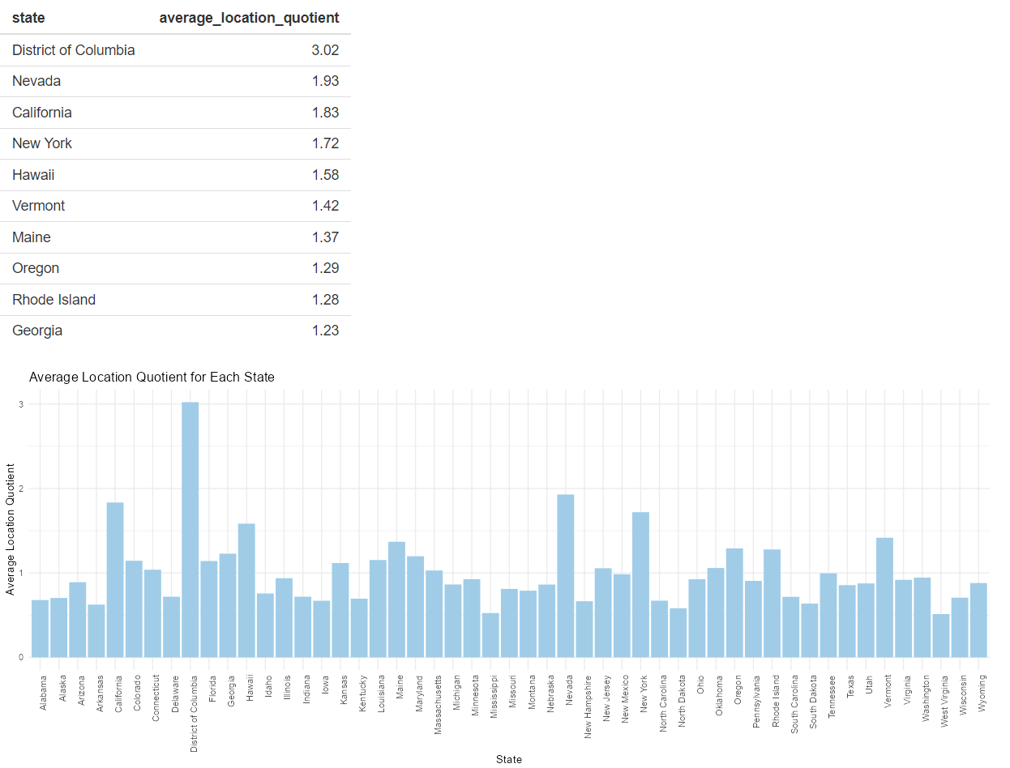
The overall distribution of all artist types across different states or territories
Result for question 3
The top 10 state /territory has the highest number of artists, as indicated by the location quotient.
The top 10

Slide 9
Question 4: Is there a correlation between the percentage of artists in a state (artists_share) and the state’s number of workers?
The correlation between two variables, x and Y, is calculated using the Pearson correlation coefficient (r), which is defined by the following formula: X: the percentage of artists in a state (artists_share) Y: the state’s number of workers (all_workers_n) The correlation coefficient (r) ranges from -1 to 1:
Question 4: Is there a correlation between the percentage of artists in a state (artists_share) and the state’s number of workers?

Slide 10
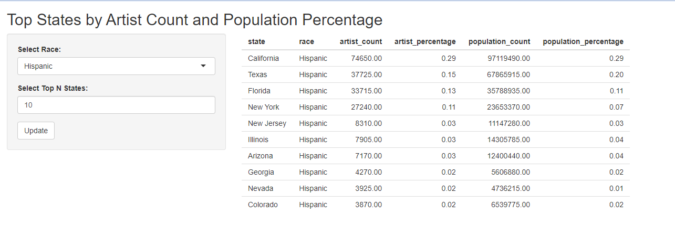
Correlation Coefficient: -0.0315 (Very Weak Negative Correlation)
Interpretations: 1. The negative sign suggests that, on average, as the percentage of artists increases, the state’s number of workers tends to decrease slightly. 2. Percentage of artists is not a strong predictor of the overall workforce size. 3. Economic, demographic, or industry-specific factors may contribute to the overall workforce size. ## Result for question 5 <<<<<<< HEAD Racial Diversity ## Question 6: The top 10 states which has the most number of Asian artists, and the related population percentage | state | artist_count | population_percentage | |—————-|————–|————————| | California | 61210 | 0.386956806 | | New York | 22820 | 0.111216828 | | Texas | 8830 | 0.091643248 | | New Jersey | 7420 | 0.044556437 | | Washington | 5305 | 0.038646725 | | Illinois | 5165 | 0.04114094 | | Massachusetts | 3645 | 0.02719804 | | Florida | 3615 | 0.031865987 | | Virginia | 3445 | 0.027151296 | | Hawaii | 3305 | 0.031579239 | ======= Racial Diversity
Shiny app fpr question 6

Slide 11
## Conclusion
Thank you

