Slide 1
ppt
Jose Cesario Pinto

Slide 2
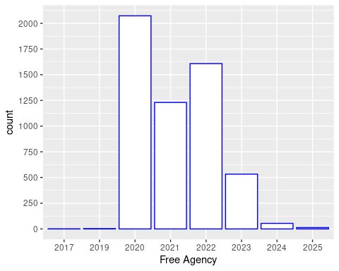
Number of free agency players by year

Slide 3
There will be 2208 free agency players by 2022

Slide 4
20 MVP players
## player position team ## 1 Matt Ryan quarterback Falcons ## 2 Russell Wilson quarterback Seahawks ## 3 Aaron Rodgers quarterback Packers ## 4 Kirk Cousins quarterback Vikings ## 5 Matt Stafford quarterback Lions ## 6 Khalil Mack 4-3-outside-linebacker Bears ## 7 Aaron Donald defensive-line Rams ## 8 Andrew Luck quarterback Colts ## 9 Jimmy Garoppolo quarterback 49ers ## 10 Alex Smith quarterback Redskins ## 11 Derek Carr quarterback Raiders ## 12 Demarcus Lawrence defensive-line Cowboys ## 13 Von Miller 4-3-outside-linebacker Broncos ## 14 Joe Flacco quarterback Broncos ## 15 Frank Clark defensive-line Chiefs ## 16 Trey Flowers defensive-line Lions ## 17 Odell Beckham, Jr. wide-receiver Browns ## 18 Philip Rivers quarterback Chargers ## 19 Eli Manning quarterback Giants ## 20 Cam Newton quarterback Panthers

Slide 5
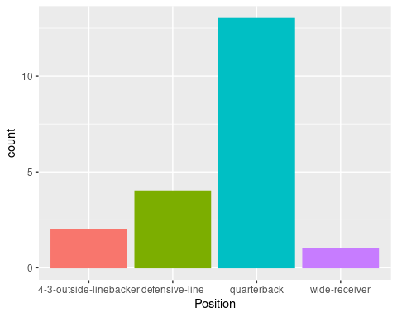
Position relationship with MVP’s

Slide 6
The position that shows more MVP’s is the quarterback.

Slide 7
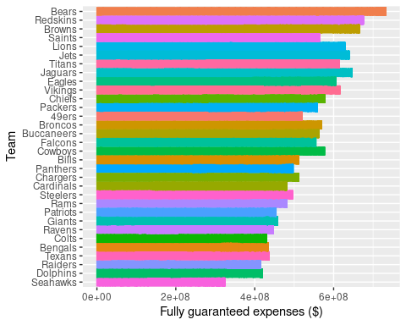
Teams with highest fully guaranteed expenses

Slide 8
The Bears team has the highest fully guaranteed expenses (~4,2 M dollars), followed by Red Skins (~4,1 M dollars) and Browns (~3,8 M dollars).

Slide 9
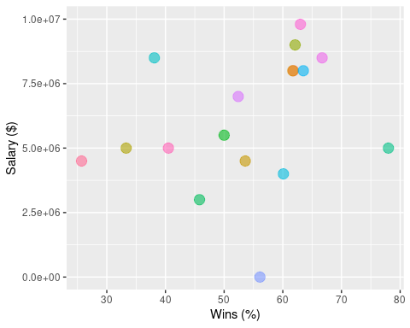
Relationship between coach records and their salaries

