Slide 1
My Introduction
Nannan Wang November 29, 2021

Slide 2
1. Background
I am from Beijing, China.
I enrolled in the university of Nebraska Lincoln in 2018 Summer.
I am currently working on two master’s degrees in Education
and Statistics.
I expect to graduate in 2022!

Slide 3
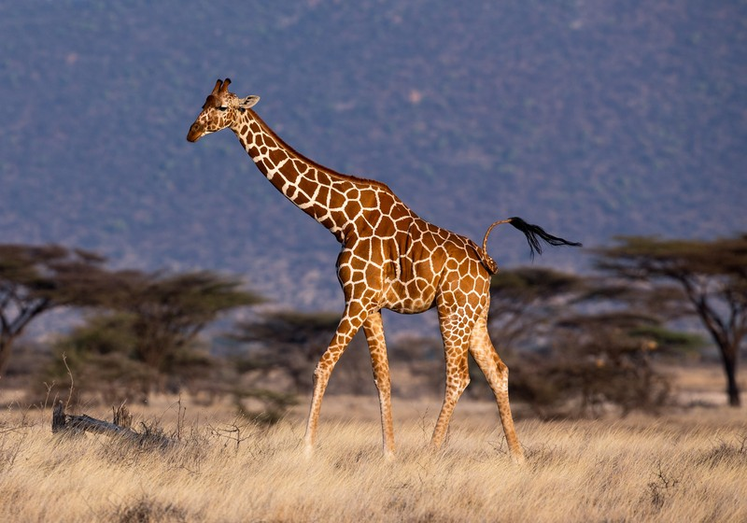
My favorite animal
Figure: A Giraffe.

Slide 4
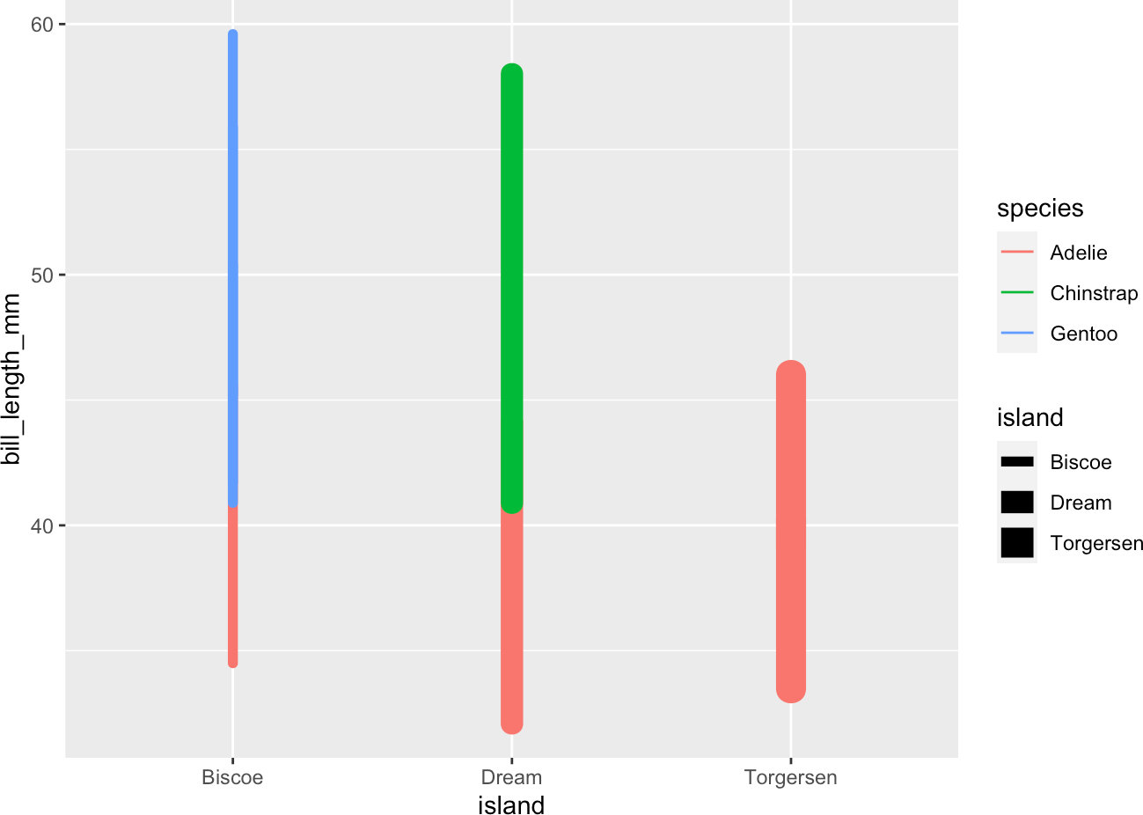
My favorite graph from STAT-850
Figure: A favorite graph

Slide 5
Nannan Wang CV

