Slide 1
850 Final Project Presentation
Yutong Liu, Lin Zhao

Slide 2
Outline
Yutong

Slide 3
Introduction
Yutong

Slide 4
Introduction
Yutong

Slide 5
Objective
Yutong

Slide 6
Dataset description
Lin

Slide 7
Result - Refuse food component
Lin
summary(cars)
## speed dist ## Min. : 4.0 Min. : 2.00 ## 1st Qu.:12.0 1st Qu.: 26.00 ## Median :15.0 Median : 36.00 ## Mean :15.4 Mean : 42.98 ## 3rd Qu.:19.0 3rd Qu.: 56.00 ## Max. :25.0 Max. :120.00

Slide 8
Result - Adjust units of nutrition amount
Lin

Slide 9
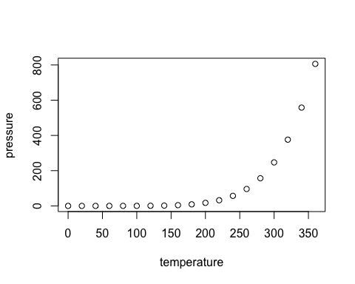

Slide 10
Result - Interactive graphics
< ADD HYPERLINK HERE>
Yutong

Slide 11
Result - Potential recyclable refuse
Lin

Slide 12
Conclusion
Bullet 1
Bullet 2
Bullet 3

Slide 13
References

Slide 14
THANK YOU

