Slide 1
Brief Intro to Python for Statistics
By Ryan Cole

Slide 2
What is Python?
Python is a popular object-oriented programming language
Scripting language, so is compiled in real time
Major features:
Ease of access
elegant syntax
large standard library, including interfacing with multiple software layers
Disadvantages:
Code base is fractured somewhat (two major versions are currently 3.6 and 2.7)
Not intended for high performance

Slide 3
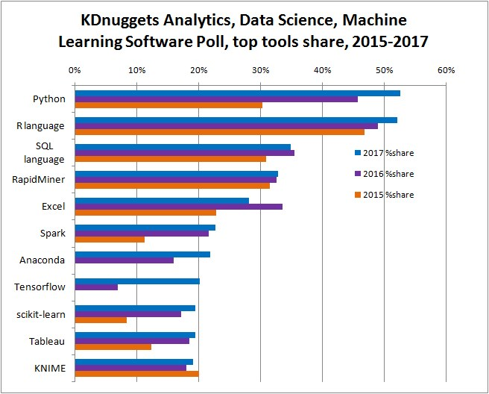
How popular is ‘popular’?

Slide 4
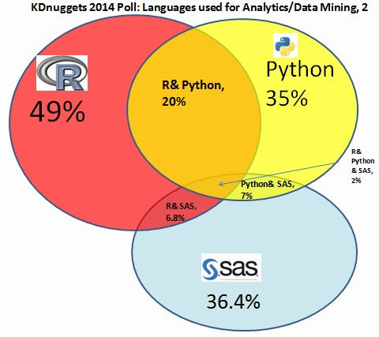
Compare to 2014

Slide 5
Where do I get it?
Recommended:
Install Python 3 using Anaconda
https://www.anaconda.com/download/
Platform for data science
Includes virtual environments
Includes Spyder IDE

Slide 6
Great, how do I learn?
Lots of resources online
General Python:
www.codeacademy.com
Free interactive python tutorial (also basic SQL)
Geared towards web development but great for basic structure
Data Science with Python:
Python Data Science Handbook, by Jake VanderPlas

Slide 7
Notable Packages for Python
SciPy
open-source software for mathematics, science, and engineering that includes:
Pandas uses data frames similar to R, particularly tidyverse package in R
NumPy array package useful for computation
Matplotlib for visualization – include Seaborn for quick boost to quality
StatsModels
Classes and functions to estimate statistical models and conduct tests
Tested for correctness
Graphics output is less than optimal
Scikit learn
Popular machine learning suite
with a number of procedures implemented

