Slide 1

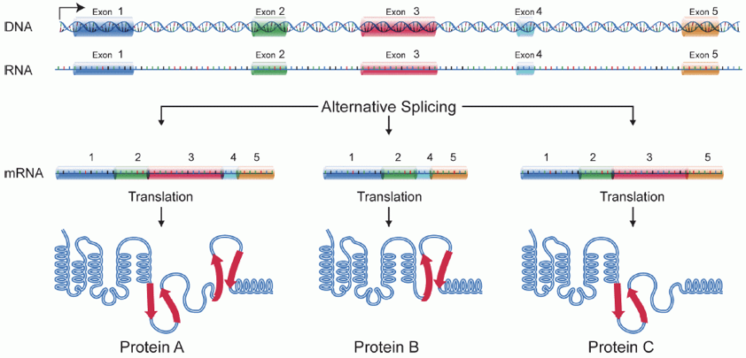
Project 1: Trajectory-based differential transcript usage analysis
We introduced trajectory-based DE (on the gene level) and differential transcript usage analysis (on the transcript level) today.
Can we leverage our expertise on both these topics, and assess DTU analysis along a trajectory?

Slide 2
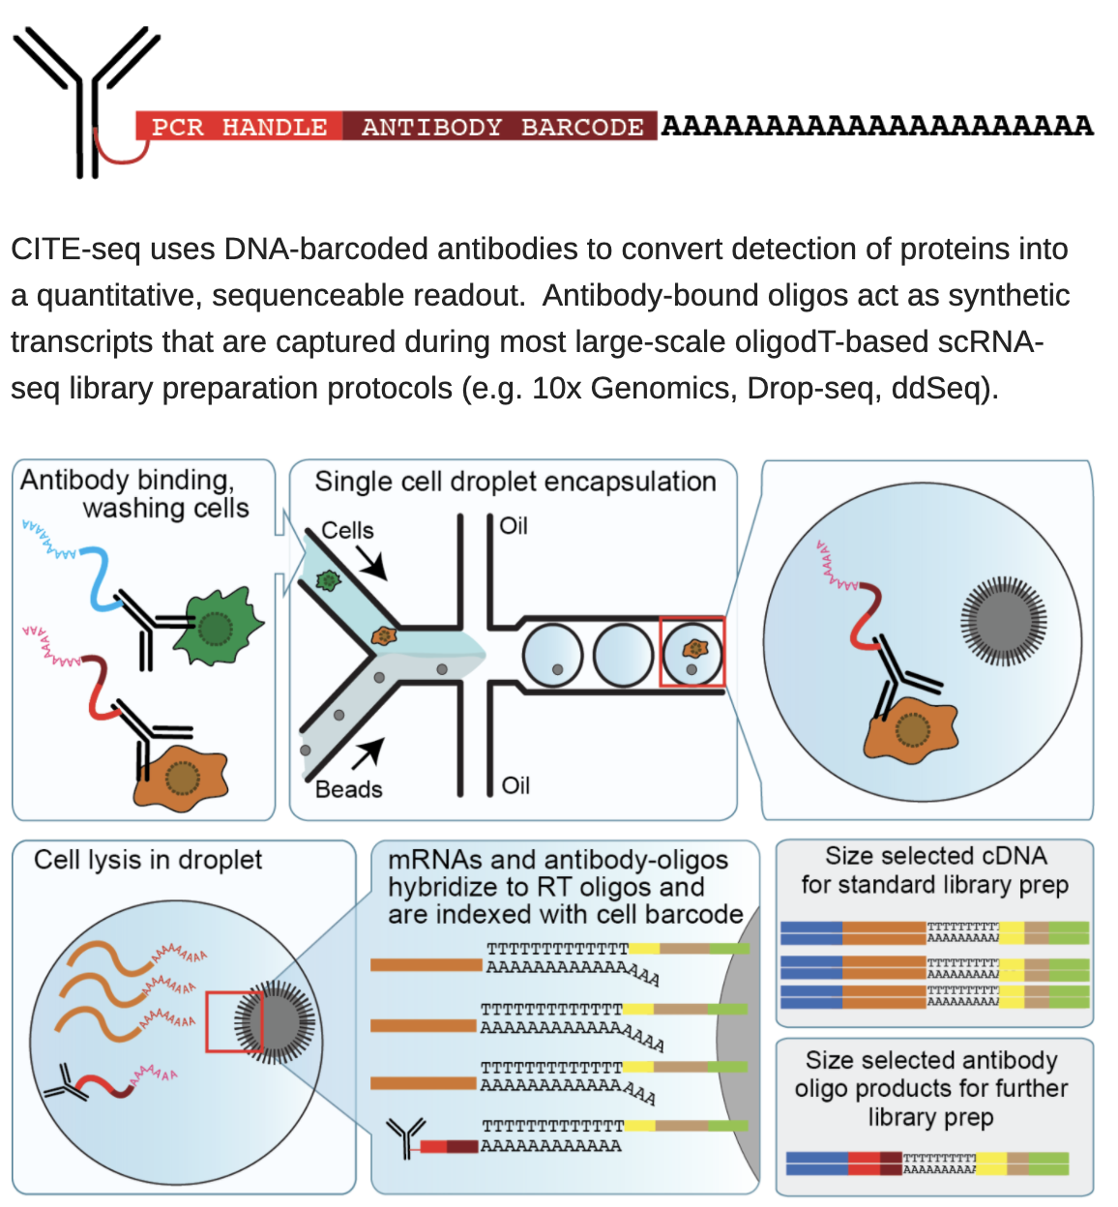
Project 2: Parametric DE analysis for CITE-seq data
The CITE-seq protocol allows for quantifying both cell-surface proteins and transcritpomics data.

Slide 3
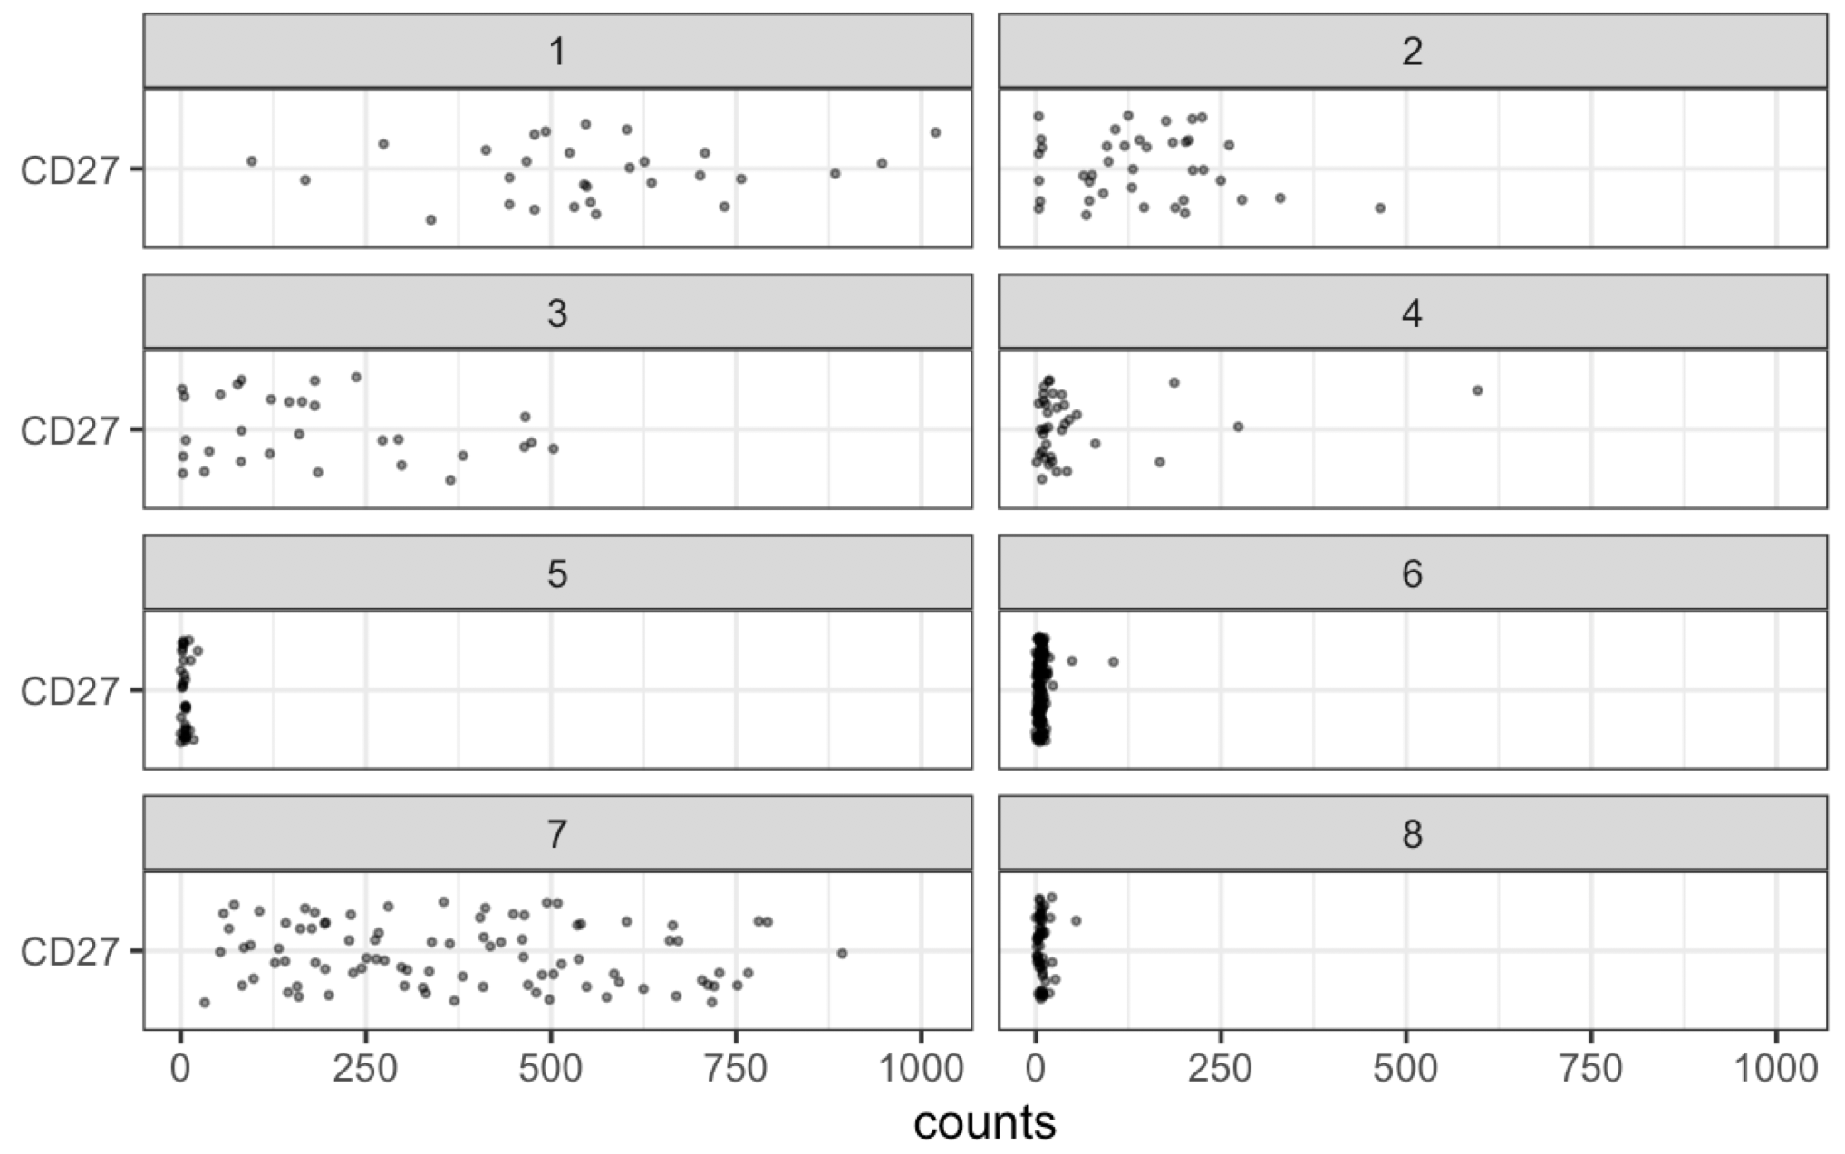
Project 2: Parametric DE analysis for CITE-seq data
The CITE-seq protocol allows for quantifying both cell-surface proteins and transcritpomics data.
Currently, DE analyses rely on Wilcoxon rank sum tests and focus only on marker gene discovery
Goal: assess if we can make parametric assumptions for modeling cell-surface protein abundance
This would allow us to make use of more powerfull tests and go beyond marker discovery
Data: expression of CD27 in 8 different cell types

