Slide 1
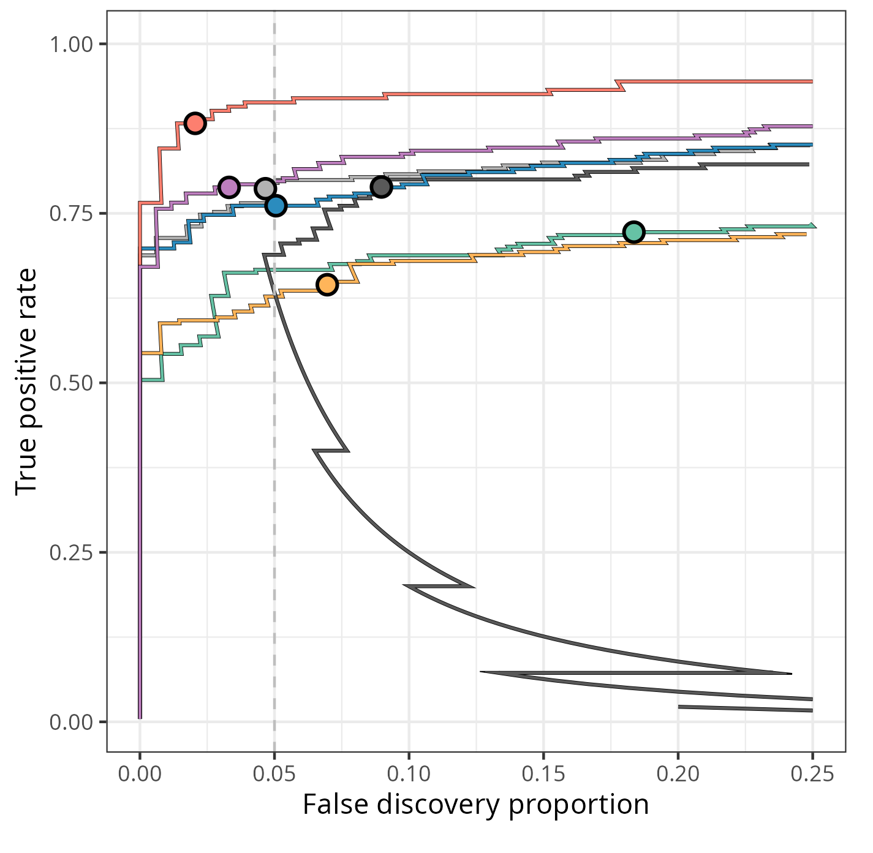
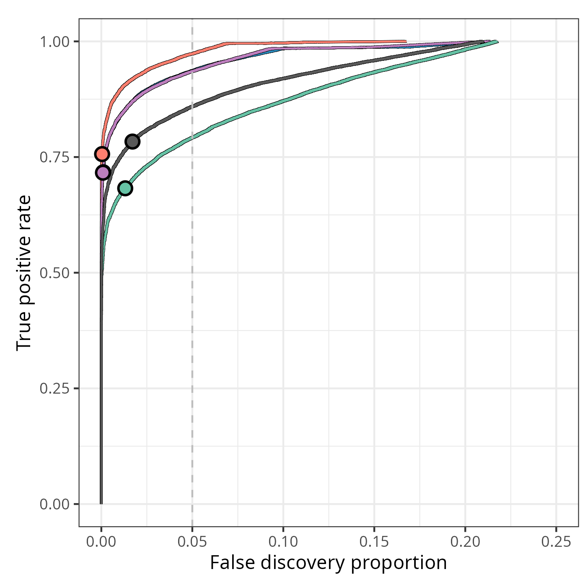
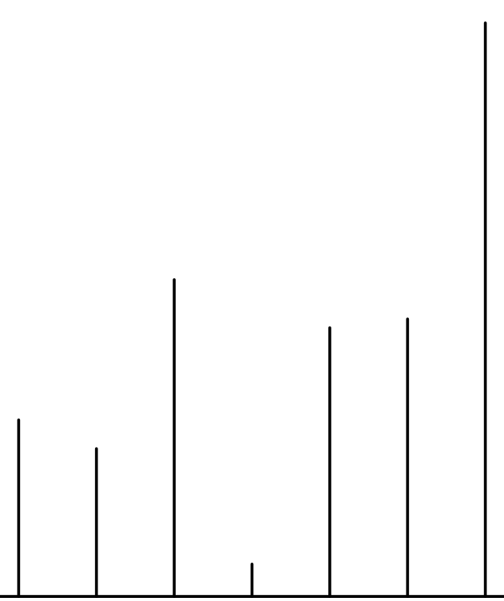

Improved performance
MSstatTMT Spike-in
msTrawler Spike-in
PSM-level dataset
Custom preprocessing
msqrob2_psm_rrilmm
msqrob2_psm_refit
msqrob2_rrilmm
msTrawler
DEqMS
MSstats
Robust Modeling
msqrob2TMT
Reporter Region
Mouse case-study
Diet + Time + Diet x Time +
(1|spectrum) + (1|sample) + (1|run) + (1|bio-repeat) + (1|mixture)
Treatment
Correlation
Fat | Time
High | early
Low | early
High | late
Low | late
Custom hypotheses
Early Diet
Late Diet
Average Diet

