Slide 1
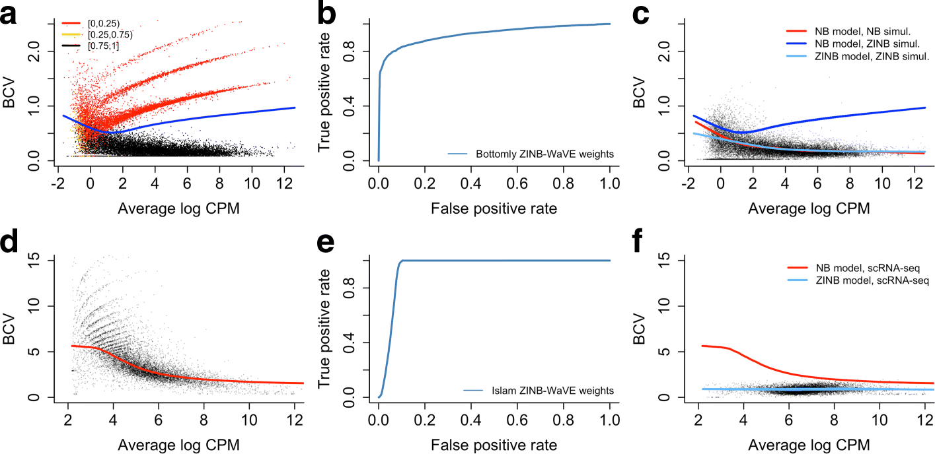
Observation weights unlock bulk RNA-seq tools for zero inflation and single-cell applications.
Genome Biology 2018 19(1):24

