Slide 1
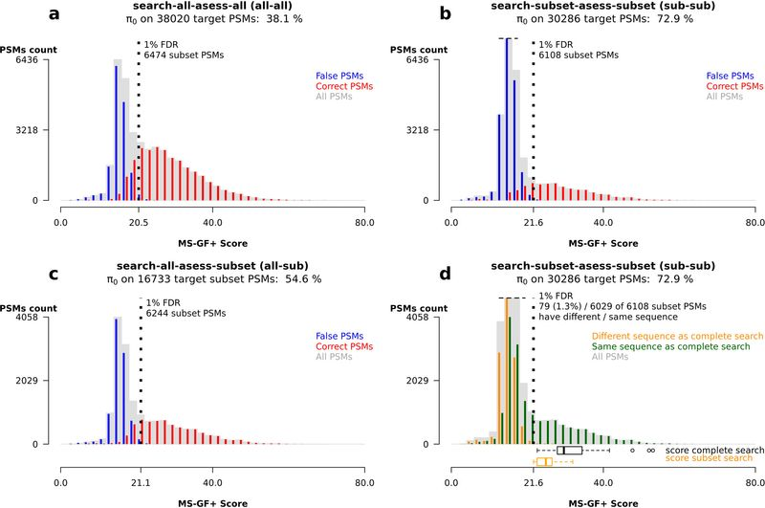
Mass spectrometrists should search for all peptides, but assess only the ones they care about.
Nature Methods 2017 14(7):643-644
Search against DB
with all expected peptides:
Search all
Remove irrelevant PSMs:
Subset
FDR calculation on subset:
Assess Subset

