Slide 1
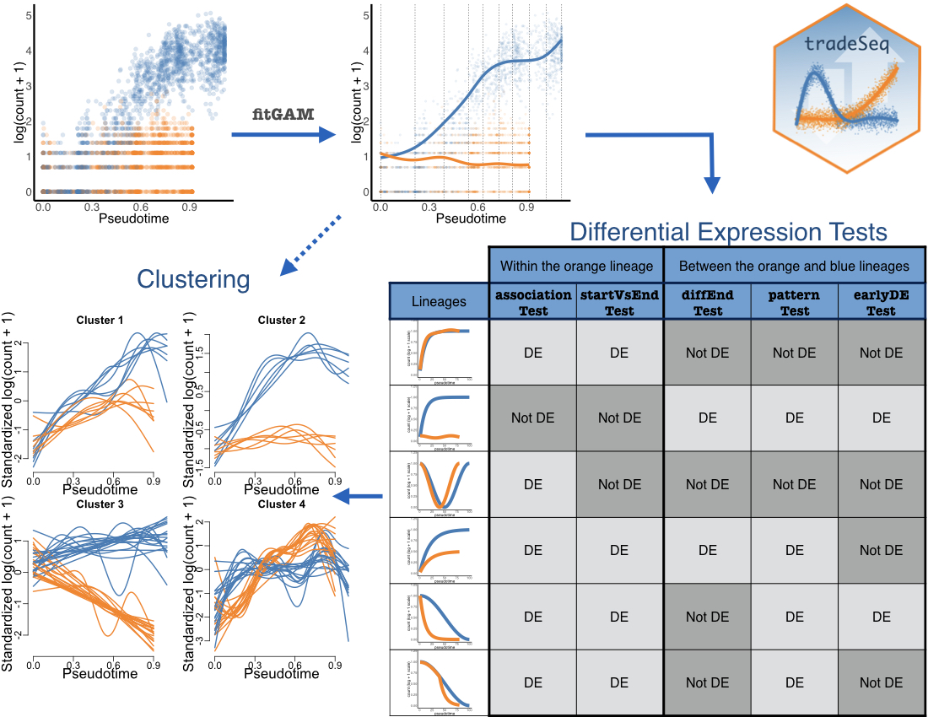
Trajectory-based differential expression analysis for single-cell sequencing data. Bioarvix 2019

