Slide 1
Introduction to Neural Network
An Artificial Neural Network (ANN) is a computational model that is inspired by the way biological neural networks in the human brain process information.
Artificial Neural Networks have generated a lot of excitement in Machine Learning research and industry, thanks to many breakthrough results in speech recognition, computer vision and text processing.

Slide 2
Basic unit of Neural Network
The basic unit of computation in a neural network is the neuron. It receives input from some other nodes, or from an external source and computes an output.
Each input has an associated weight (w), which is assigned on the basis of its relative importance to other inputs.

Slide 3
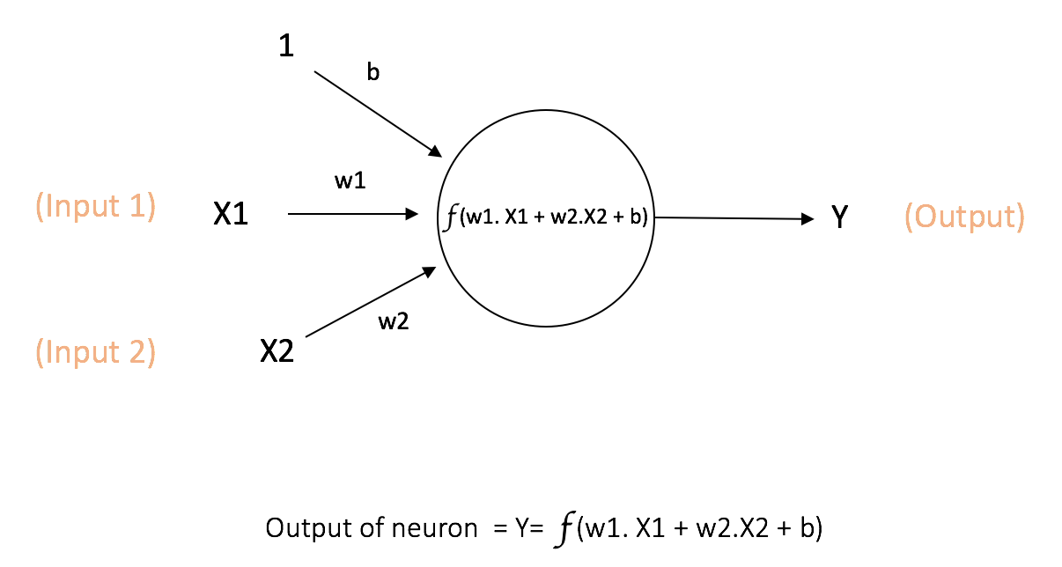
An example of neuron
The node applies a function f to the weighted sum of its inputs
The network on the right takes numerical inputs X1 and X2 and has weights w1 and w2 associated with those inputs. Additionally, there is another input 1 with weight b (called the Bias) associated with it.
The output Y from the neuron is computed as shown in the figure. The function f is non-linear and is called the Activation Function.

Slide 4
Activation Function
Sigmoid: takes a real-valued input and squashes it to range between 0 and 1
σ(x) = 1 / (1 + exp(−x))
tanh: takes a real-valued input and squashes it to the range [-1, 1]
tanh(x) = 2σ(2x) − 1
ReLU: ReLU stands for Rectified Linear Unit. It takes a real-valued input and thresholds it at zero (replaces negative values with zero)
f(x) = max(0, x)
The purpose of the activation function is to introduce non-linearity into the output of a neuron.

Slide 5
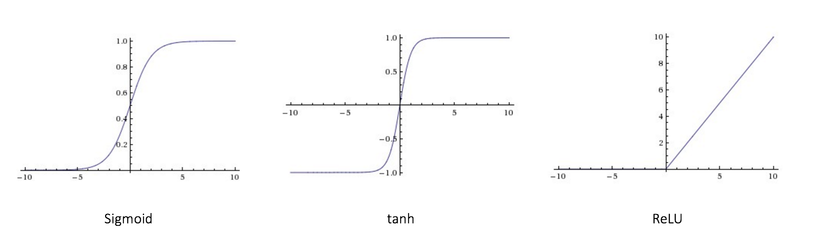
Activation Function
The purpose of the activation function is to introduce non-linearity into the output of a neuron.

Slide 6
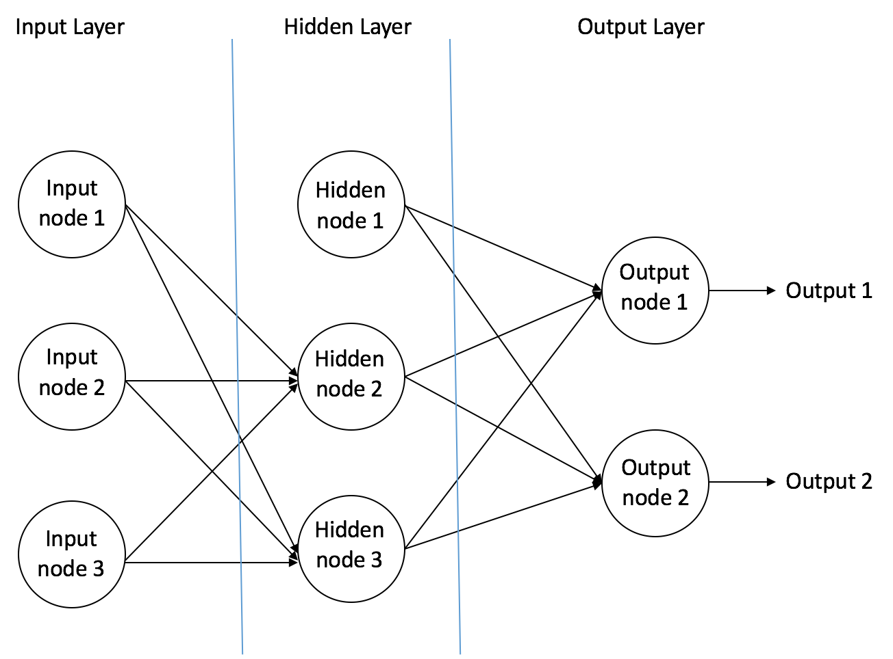
Feedforward Neural Network
The feedforward neural network was the first and simplest type of artificial neural network.
It contains multiple neurons arranged in layers.
Nodes from adjacent layers have connections or edges between them.
All these connections have weights associated with them.

Slide 7
Neural Network in Python
TensorFlow
TensorFlow is an end-to-end open source platform for machine learning. It has a comprehensive, flexible ecosystem of tools, libraries and community resources that lets researchers push the state-of-the-art in ML and developers easily build and deploy ML powered applications.
https://www.tensorflow.org/

Slide 8
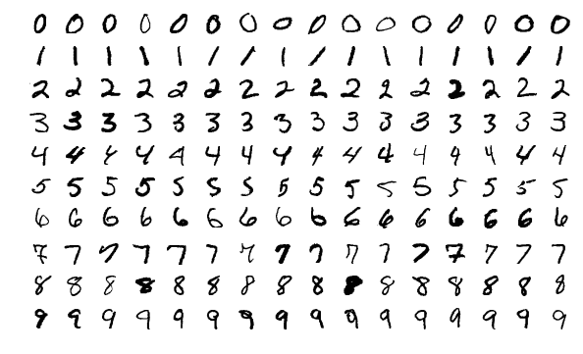
Training a neural network on MNIST with Keras Network
MNIST dataset: Modified National Institute of Standards and Technology database
It is a large database of handwritten digits that is commonly used for training various image processing systems.
The MNIST database contains 60,000 training images and 10,000 testing images.

Slide 9
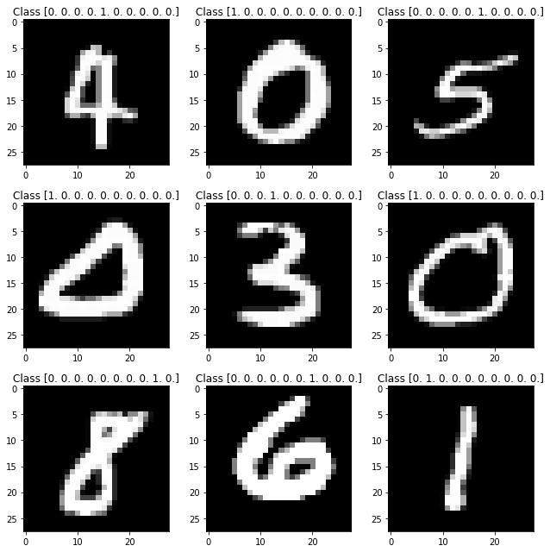
Training a neural network on MNIST with Keras Network
The figure on the right, with title “class”, which is the label of the number.

Slide 10
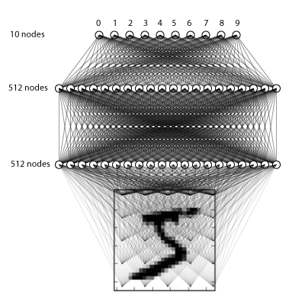
Building a 3-layer fully connected network (FCN)

Slide 11
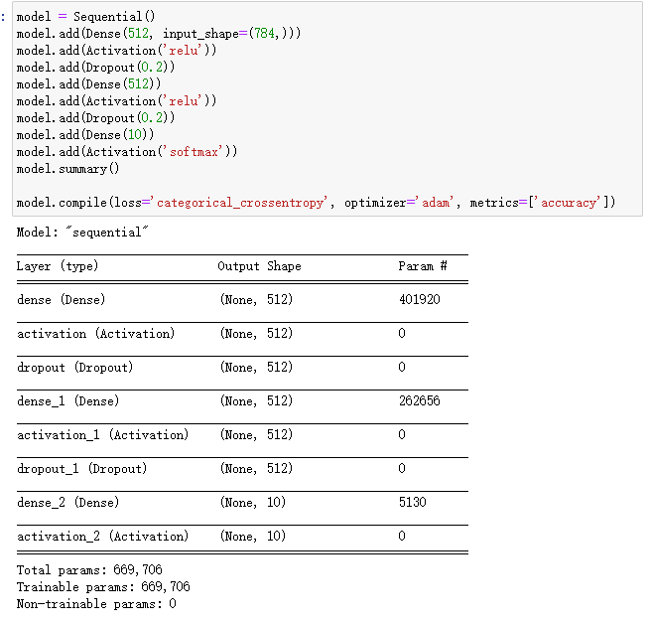
keras
The coding logic of keras is very simple, we can add the layer as we want

Slide 12
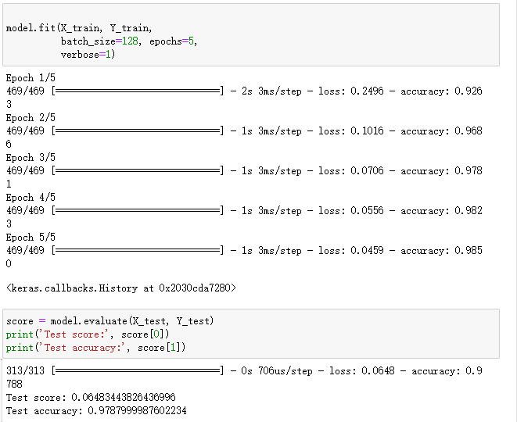
Training and predict
After 5 epoch of training, the accuracy in test set is 97.9%.

Slide 13
Further: Convolution
Before, we built a network that accepts the normalized pixel values of each value and operates soley on those values. What if we could instead feed different features of each image into a network, and have the network learn which features are important for classifying an image?
This possible through convolution! Convolution applies kernels (filters) that traverse through each image and generate feature maps.

Slide 14
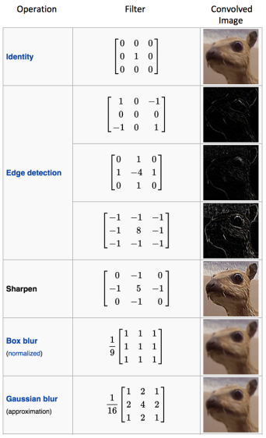
Convolution Neuro Network
In the above example, the image is a 5 x 5 matrix and the kernel going over it is a 3 x 3 matrix. A dot product operation takes place between the image and the kernel and the convolved feature is generated. Each kernel in a CNN learns a different characteristic of an image.

Slide 15
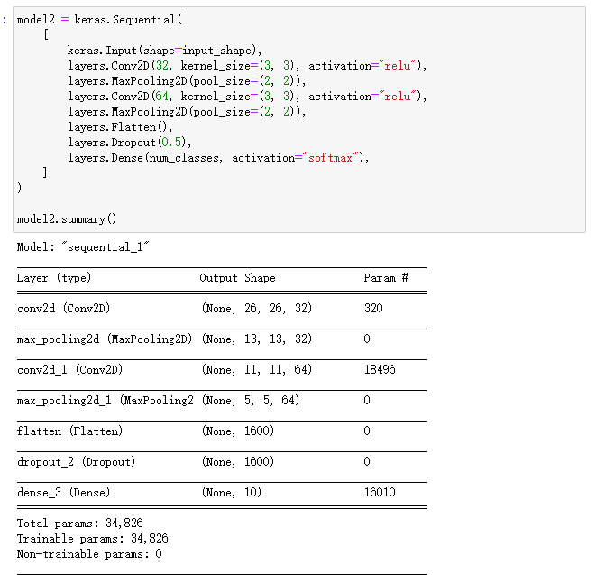
Convolution Neuro Network
The convolution NN takes much time to run, but has higher accuracy.

Slide 16
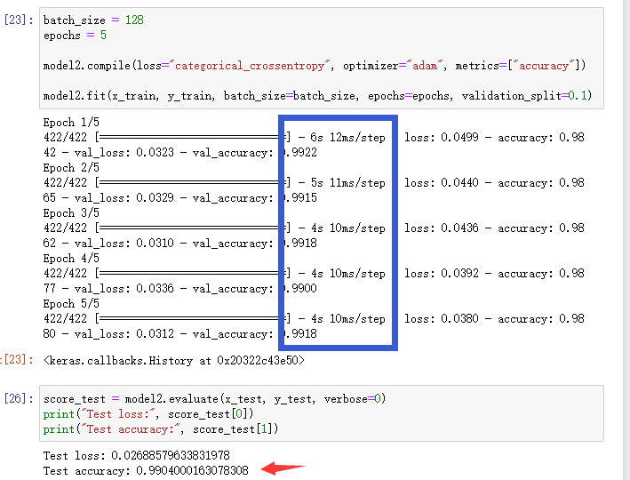
Convolution Neuro Network
The convolution NN takes much time to run, but has higher accuracy.
We can see that the training time is much longer, but the test accuracy is also higher.

