Slide 1
Use R in Python
In the first section, we will introduce how to use R in python
The package we use is “rpy2”.
Official document: https://rpy2.github.io/
We will focus on comparing drawing figure in R and Python.

Slide 2
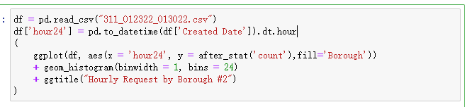
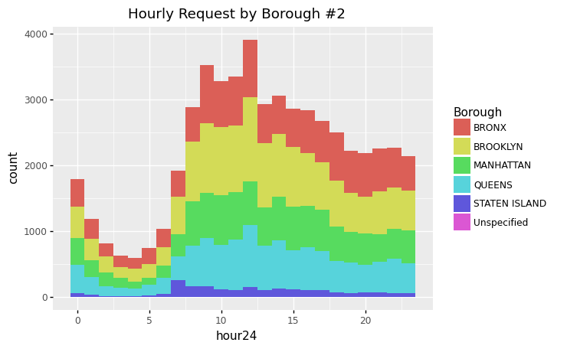
Plotnine in Python
In the midterm project, we have a task that using “plotnine” to plot the frequencies of the requests versus the hours they were created by borough. Here is the code and result:

Slide 3
GGplot2 in Python
ggplot2 is a famous packages in R, and plotnine is actually based on it.
To use ggplot2 in python, we must install “ggplot2” in R first.
To plot graph in python using r and ggplot2, we also have to convert pandas dataframe into R dataframe.
To show image in jupyter notebook, we need to import IPython.

Slide 4
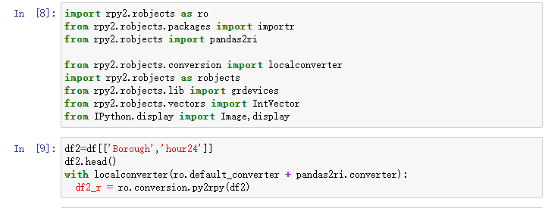
GGplot2 in Python
The code above imported the needed package, and convert python dataframe to R dataframe (py2rpy).

Slide 5
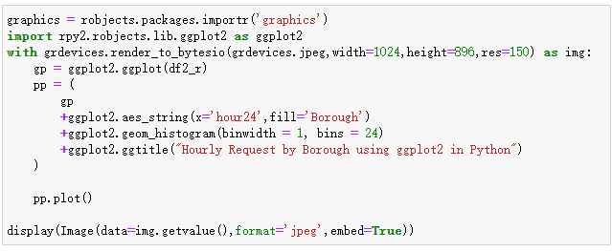
GGplot2 in Python
Then we called ggplot2 to draw a histogram in jupyter notebook

Slide 6
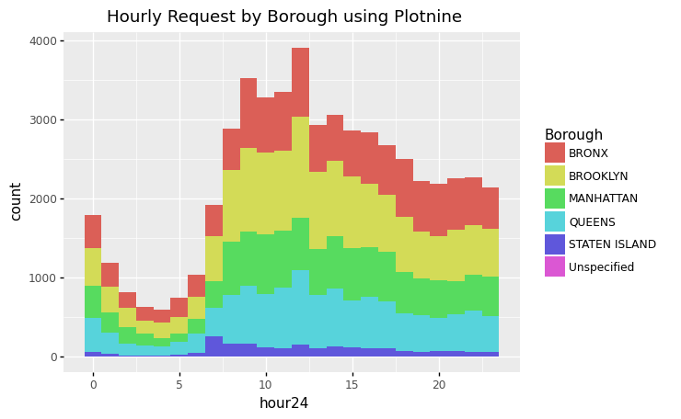
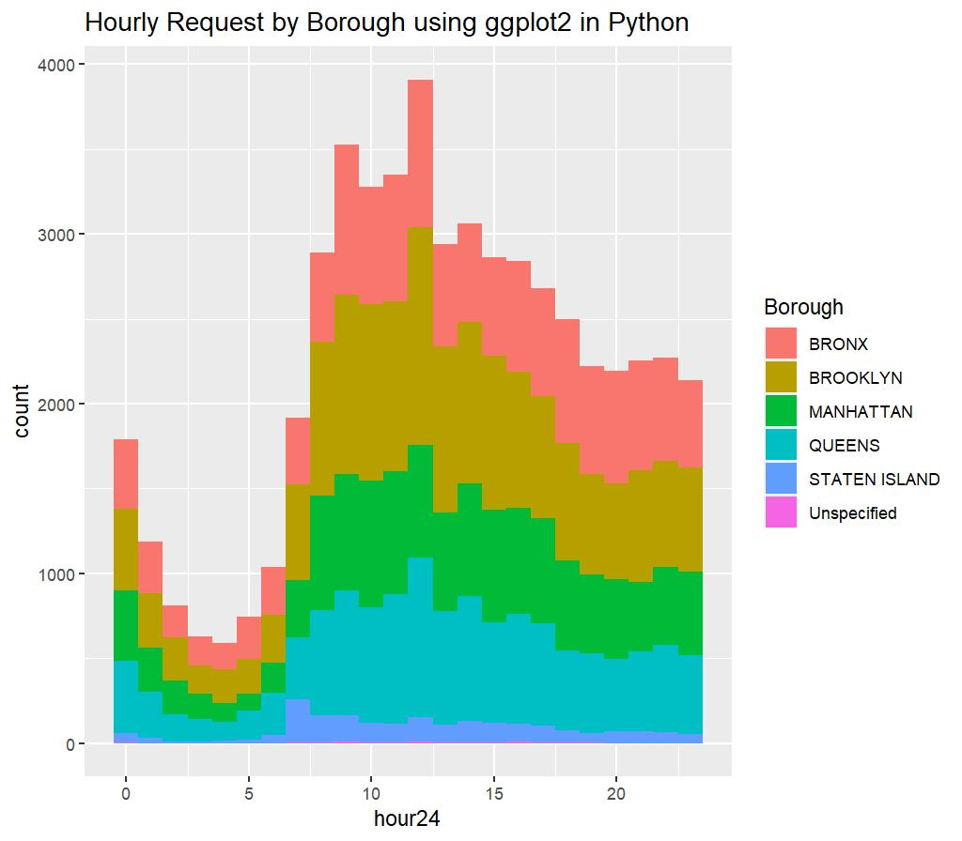
Comparison of plotnine and ggplot2 in python
plotnine
ggplot2

Slide 7
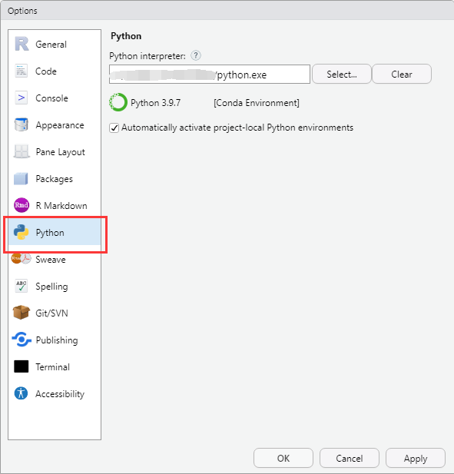
Use Python in Rstudio
Install related package in R: reticulate
Just use the command ‘install.package’
Select tools -> options and choose python

Slide 8

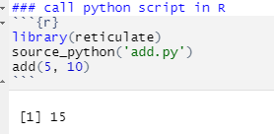
Use Python in Rstudio
We can write a python script, and read it in R
Python function:
And use this function in R:

Slide 9
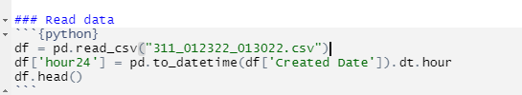

Read csv as pandas in R
In Rmarkdown, we can use python directly
And we can use function in R to convert it as dataframe in R

Slide 10

ggplot2 in R
In Rmarkdown, we can use python directly
And we can use function in R to convert it as dataframe in R
Then we just use ggplot2 in R:

Slide 11
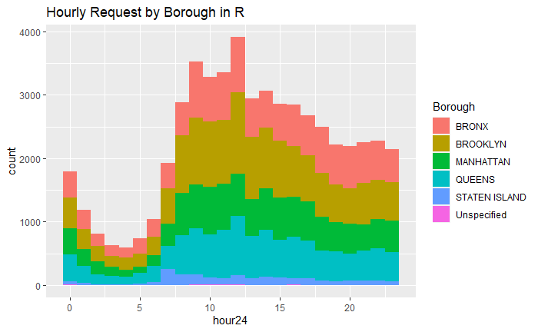
Comparison of plotnine in python and ggplot2 in R
Plotnine in python
ggplot2 in R

Slide 12
Summary: What have we done?
In the first part:
we run program in jupyter notebook, firstly we read the csv file using pandas and plot histogram using plotnine.
Then we convert the dataframe using rpy2, and run R code in python to plot histogram using ggplot2

Slide 13
Summary: What have we done?
In the second part:
We run python code in Rstudio, and using pandas to read csv file.
Then we convert pandas dataframe into R dataframe, and using ggplot2 in R to plot the histogram

Slide 14
Summary: Why we need to do this
Even though the data table in R is also called “dataframe”, it is actually a different thing with the dataframe in pandas
Therefore, the “plotnine” in pandas doesn’t recognize the dataframe in R, and ggplot2 in R also doesn’t recognize the dataframe of pandas in python, we have to find method to convert them into each other.

Slide 15
Summary: What can be done further
We can use the statistics function in R to do data analysis in Python since R is a professional data analysis language.
We can also run neural network in R to build model.

