Slide 1
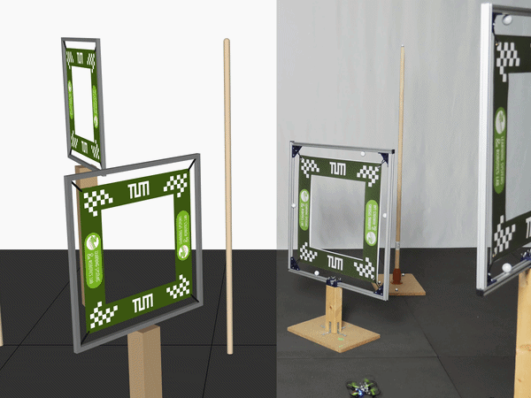
Robust Level-2 Drone Racing with Direct PPO
Progress Presentation | SS26
Xiaochen Miao
04 June 2026
CURRENT: LEVEL-2 POLICY
Notes:
Timing: 20 seconds.
We are building a direct PPO controller for randomized Level-2 drone racing. The focus of this progress update is the method, the measured reliability gap, and the concrete plan to close it.

Slide 2
One policy closes the Level-2 loop
METHODOLOGY / 1 OF 3
OBSERVE
Drone state Gates + obstacles
ENCODE
Body-frame geometry 2-step state history
DECIDE
PPO actor 2 x 64 tanh MLP
COMMAND
Roll, pitch, yaw and thrust
EXECUTE
Crazyflow / Crazyflie 50 Hz closed loop
NEW OBSERVATION EVERY 20 ms
Why direct PPO
One low-cost forward pass at runtime
Reacts to newly observed geometry and dynamics
Learns planning and control trade-offs jointly
Selected for the randomized Level-2 task
Why not rely only on MPCC
Spline + OCP is interpretable and structured
But randomized scenes require replanning and constraint tuning
PPO limitation: reward-sensitive, with no hard collision guarantee
Xiaochen Miao | Progress Presentation SS26 | 1/5
Notes:
Timing: 50 seconds.
The controller uses a direct closed loop. Every 20 milliseconds it receives the current state and visible track geometry, converts it to body-frame features with short history, and produces attitude plus thrust. We selected PPO because online execution is just one network pass and it can react to randomization. Compared with the MPCC baseline, the cost is weaker guarantees and stronger dependence on reward design.

Slide 3
Observation and reward design make racing learnable
METHODOLOGY / 2 OF 3
103-D body-frame observation
Shaped reward follows a gate-passing sequence
17
36
20
30
APPROACH
axis progress
CENTER
gate stage
PASS
pass bonus
EXIT
back-gate bonus
State + progress (17D)
height, body velocity, angular velocity, rotation, target progress
Positive signals
Gate-axis / stage progress
Gate pass + finish bonus
Fast completion
Safety + smoothness costs
Crash / obstacle proximity
Tilt and command tilt
Action changes + time
Gate geometry (36D)
previous, current and next gate corners in the drone frame
Obstacles + visits (20D)
relative obstacle positions plus visited gate/obstacle flags
Action + history (30D)
previous normalized action plus two 13-D state-history samples
4-D normalized action
roll | pitch | yaw | thrust -> scaled to the attitude controller limits
BODY-FRAME GEOMETRY REDUCES GLOBAL-COORDINATE DEPENDENCE
Xiaochen Miao | Progress Presentation SS26 | 2/5
Notes:
Timing: 55 seconds.
The policy receives 103 features. The important choice is to express gate and obstacle geometry in the drone body frame and include previous, current, and next gates plus short state history. Sparse race completion alone was not enough, so the reward decomposes gate passing into approach, centering, crossing, and exiting. Safety, tilt, smoothness, and time penalties create the speed-versus-robustness trade-off.

Slide 4
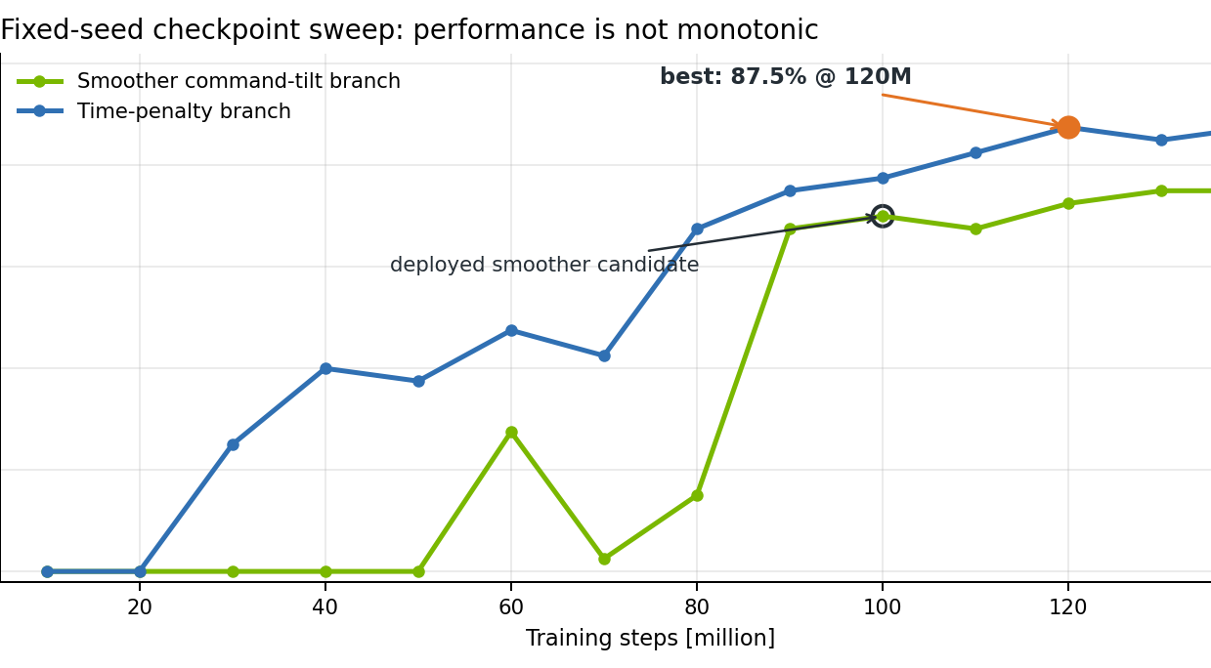
Training is paired with reproducible diagnosis
METHODOLOGY / 3 OF 3
1 Parallel simulation
1,024 Crazyflow environments on GPU
2 PPO update
32-step rollouts, GAE, actor-critic optimization
3 Checkpoint sweep
Save every 10M steps; evaluate deterministic policy
4 Failure diagnosis
Fixed seeds + crash-object and hotspot analysis
150M
2h 26m
training steps
GPU training time
Xiaochen Miao | Progress Presentation SS26 | 3/5
Notes:
Timing: 55 seconds.
Training uses 1,024 parallel environments, 32-step rollouts, and regular checkpoints. A 150-million-step run took about two hours and 26 minutes on GPU. We do not select a policy from training reward alone. Each checkpoint is evaluated deterministically on fixed seeds, then crashes are classified by target gate, object, and location. The curve shows why this matters: success is not monotonic with more training.

Slide 5
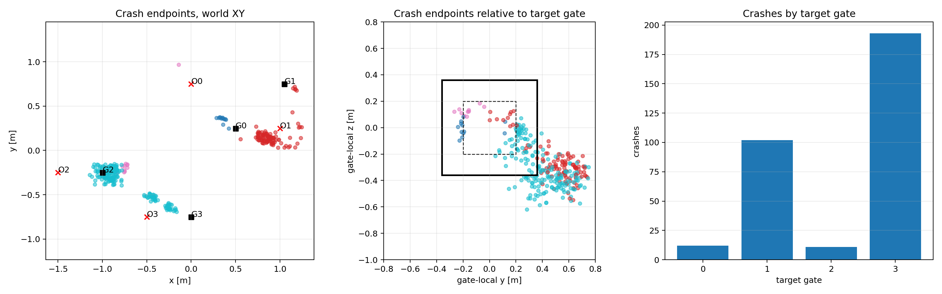
Fast policy achieved; reliability is the remaining gap
PROGRESS TO DATE
87.5%
5.80 s
0%
72.5%
best success rate 40 fixed-seed episodes
mean successful time best 120M checkpoint
position safety-limit violations across the 40-seed sweep
smoother deployed candidate 200 single-env episodes
Crash hotspots from 1,024 randomized vector worlds
What did not work as expected
Success regresses after some checkpoints; more training is not automatically better.
318 / 1,024 crashes: Gate 3 top = 132; Obstacle 2 = 96.
Faster policies produce more aggressive tilt commands.
Response: targeted hotspot diagnosis + checkpoint selection.
NEXT: FIX TWO DOMINANT HOTSPOTS
Xiaochen Miao | Progress Presentation SS26 | 4/5
Notes:
Timing: 70 seconds.
The best checkpoint currently reaches 87.5 percent success over 40 fixed seeds with a 5.80-second mean successful race and no position-limit violations. For deployment we are currently using a smoother 100-million-step policy, which reaches 72.5 percent over 200 single-environment episodes. The remaining gap is concentrated: in a 1,024-world test, Gate 3 top and Obstacle 2 account for 228 of 318 crashes. More training is not monotonic, so the next iteration targets those failure modes instead of simply increasing steps.

Slide 6
Plan for the remainder of the semester
MILESTONES AND SMART GOALS
OBJECTIVE BY 02 JULY: RELIABLE LEVEL-2 POLICY, VALIDATED AND DEPLOYMENT-READY
11 JUN
18 JUN
25 JUN
02 JUL
Hotspot fix
Change reward / observation around Gate 3 top and Obstacle 2. Acceptance: 1,024-episode test; reduce these two crash counts by >=30%.
Policy freeze
Compare candidate checkpoints on the same randomized worlds. Acceptance: >=85% success, <=6.0 s mean successful time, 0 position-limit violations.
Sim-to-real validation
Run the frozen policy through the deployment pipeline and lab track. Acceptance: at least 18 / 20 completed runs and 0 safety-stop events.
Final package
Freeze checkpoint, config, evaluation outputs, and final report material. Acceptance: one-command reproducible evaluation and deployment-ready controller.
OWNER: XIAOCHEN MIAO
OWNER: XIAOCHEN MIAO
OWNER: XIAOCHEN MIAO
OWNER: XIAOCHEN MIAO
Risk buffer: retain the 120M time-penalty checkpoint as the fallback if hotspot tuning or hardware validation regresses.
Xiaochen Miao | Progress Presentation SS26 | 5/5
Notes:
Timing: 50 seconds.
The remaining work is split into four measurable milestones. First, reduce the two dominant hotspot crash counts by at least 30 percent in a 1,024-episode test. Second, freeze a policy that reaches at least 85 percent success, stays below six seconds, and has no position-limit violations. Third, complete at least 18 of 20 lab runs without a safety stop. Finally, freeze the reproducible evaluation and deployment package. Xiaochen Miao owns each task in the current repository workflow.

