Slide 1
NAKUJA 4 SOLID PROPULSION TEAM
WEEK 6 PROGRESS report

Slide 2
6th WEEK OBJECTIVES
Category | Tasks
Simulations | - 5-Grain KNSB simulation (tail core comparison) - 1-Grain motor simulation - Igniter simulation
Fabrication | - Mandrel (pipe) - Bulkhead ×2 - Nozzle ×1
Testing | - Ignition system test - Test stand repair
Procurement | - Materials & electronics
UI/Software | - Data dashboard UI (Sensor streaming)
3D Printing | - Casting tool parts

Slide 3
Grain simulations
5-grain simulation;
[set up A] Core Diameters: 33, 33, 33, 33, 34 mm
burn time:3.39s
impulse:8271.35Ns
peak mass flux:2.40 lb(in^2*s)(G:5)
[set up B] Core Diameters: 33, 33, 33, 33, 38 mm
burn time:3.39s
impulse:8214.66Ns
peak mass flux:2.01 lb(in^2*s)(G:5)
Key observations
Moderate thrust boost with 34 mm
Stable pressure profile (no overshoot)

Slide 4
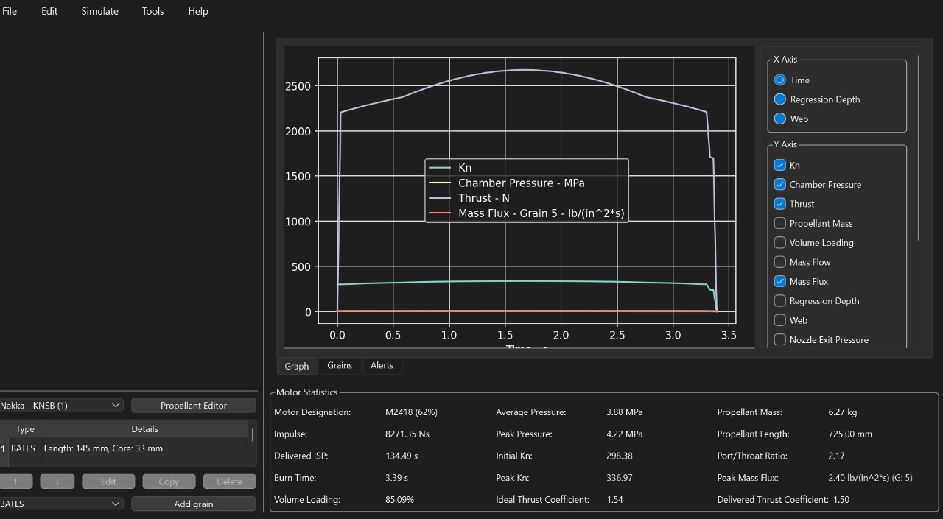
5- Grain simulation for set up A

Slide 5
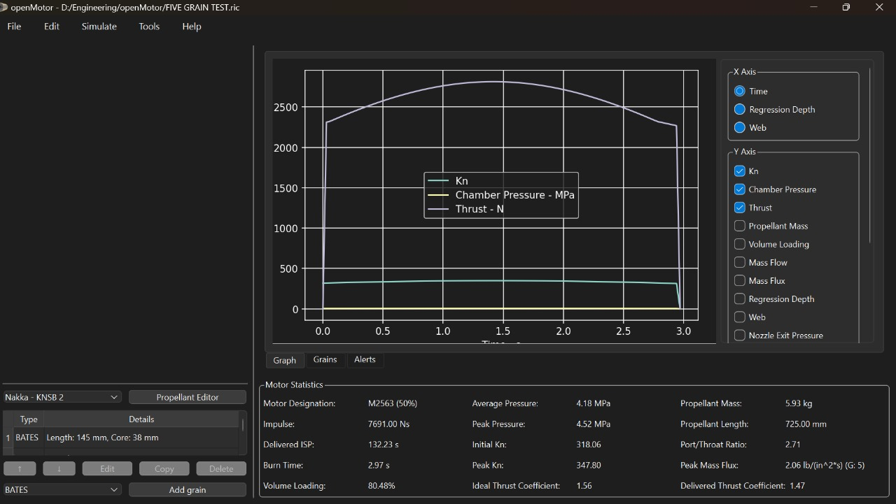
5- Grain simulation for set up B

Slide 6
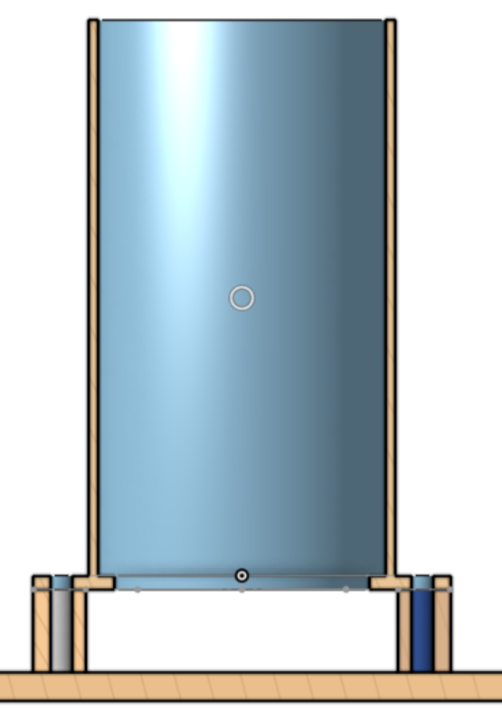
Motor holder modification
This was done due to the requirement to fit the pressure fitting equipment.

Slide 7
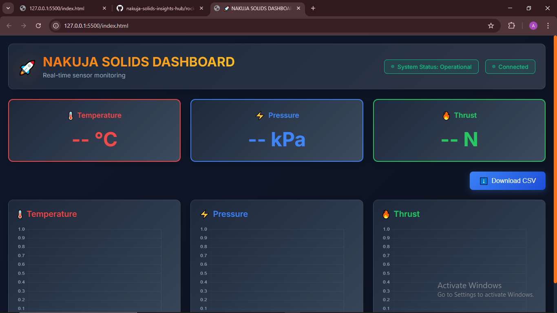
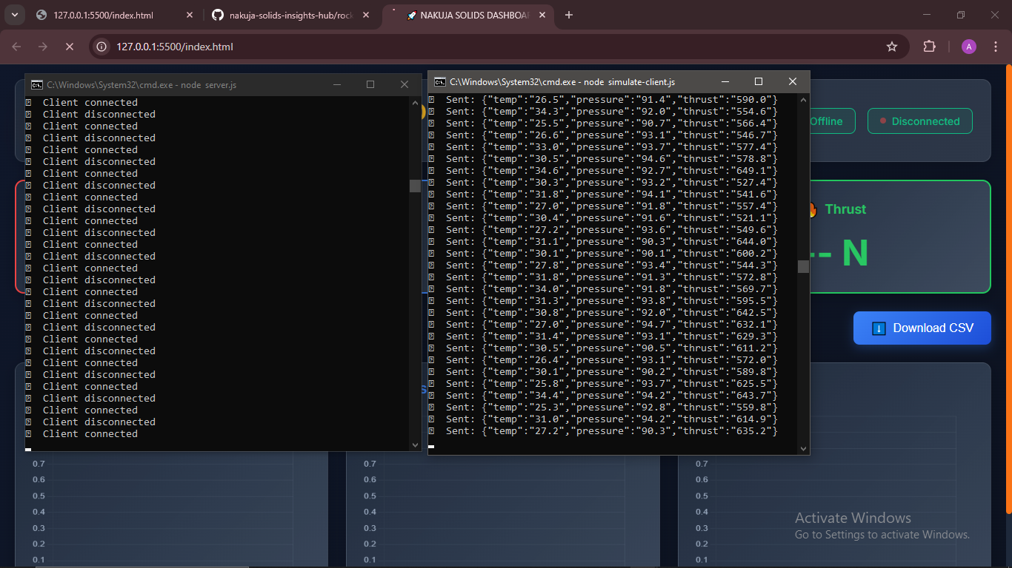
Sensor Data UI – HTML + JS + Node.js

Slide 8
Ui workability
Frontend Built with HTML & JavaScript
Custom-designed dashboard interface for displaying sensor data
Node.js Server Handles Data Streaming
Uses WebSocket to push data to the frontend continuously
Simulated Client Feeds Real-Time Data
Mimics sensor values (pressure, thrust, temperature) for testing
The current simulated setup can be easily replaced with live data from ESP32

Slide 9
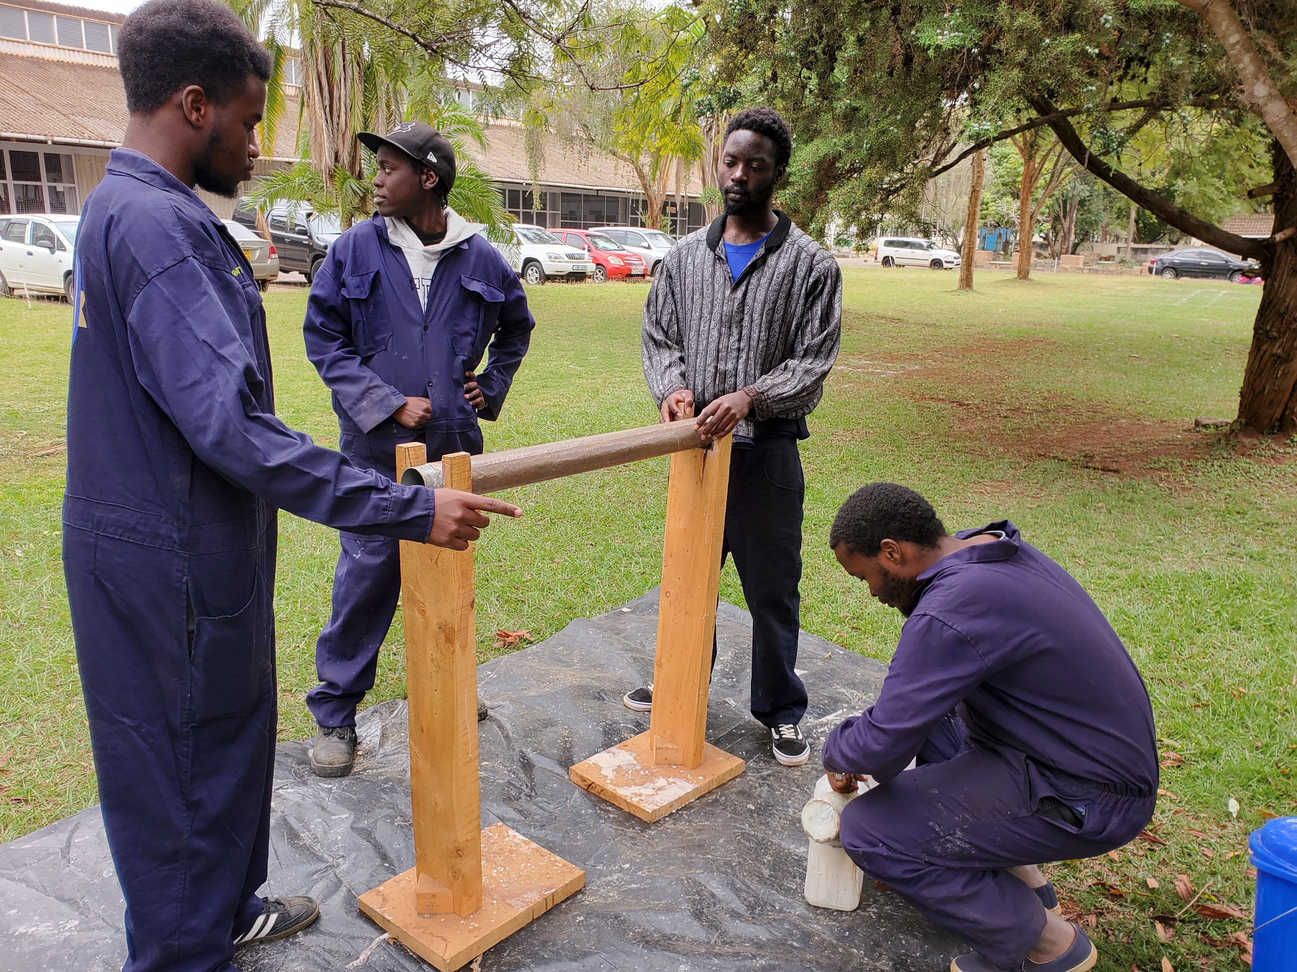
Mandrel fabrication
Mandrel fabrication is currently in progress but has been temporarily halted due to the depletion of epoxy and hardener. Procurement for the required materials has been initiated to resume the process.

Slide 10
procurement
A comprehensive procurement list was prepared to support ongoing fabrication, testing, and system integration tasks. While some items have already been requested, others remain pending due to budget or access constraints. Timely acquisition of these materials is essential to resume halted processes such as mandrel fabrication and test stand repair.
https://docs.google.com/spreadsheets/d/14YRcJAnbKLYfZXIksleHOWmt7rT3NkBsljoMaEVurcI/edit?gid=1712813840#gid=1712813840

Slide 11
HAVE A GREAT WEEKEND
THANK YOU

