Slide 1
NAKUJA 4 SOLID PROPULSION TEAM
WEEK 7 PROGRESS report

Slide 2
7th WEEK OBJECTIVES
Category | Task
Fabrication | - Completion of bulkheads - Nozzle fabrication - Core rod fabrication
Assembly | - Curing setup
Testing | - Test cooking (propellant process validation)
 | Task

Slide 3
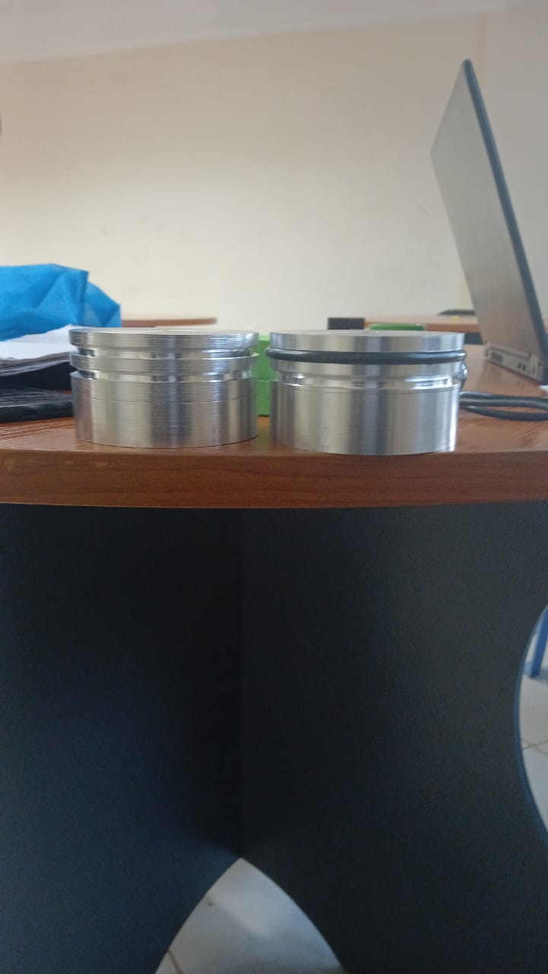
Completion of bulkheads
Bulkheads were completed and drilling is in progress to required specs

Slide 4
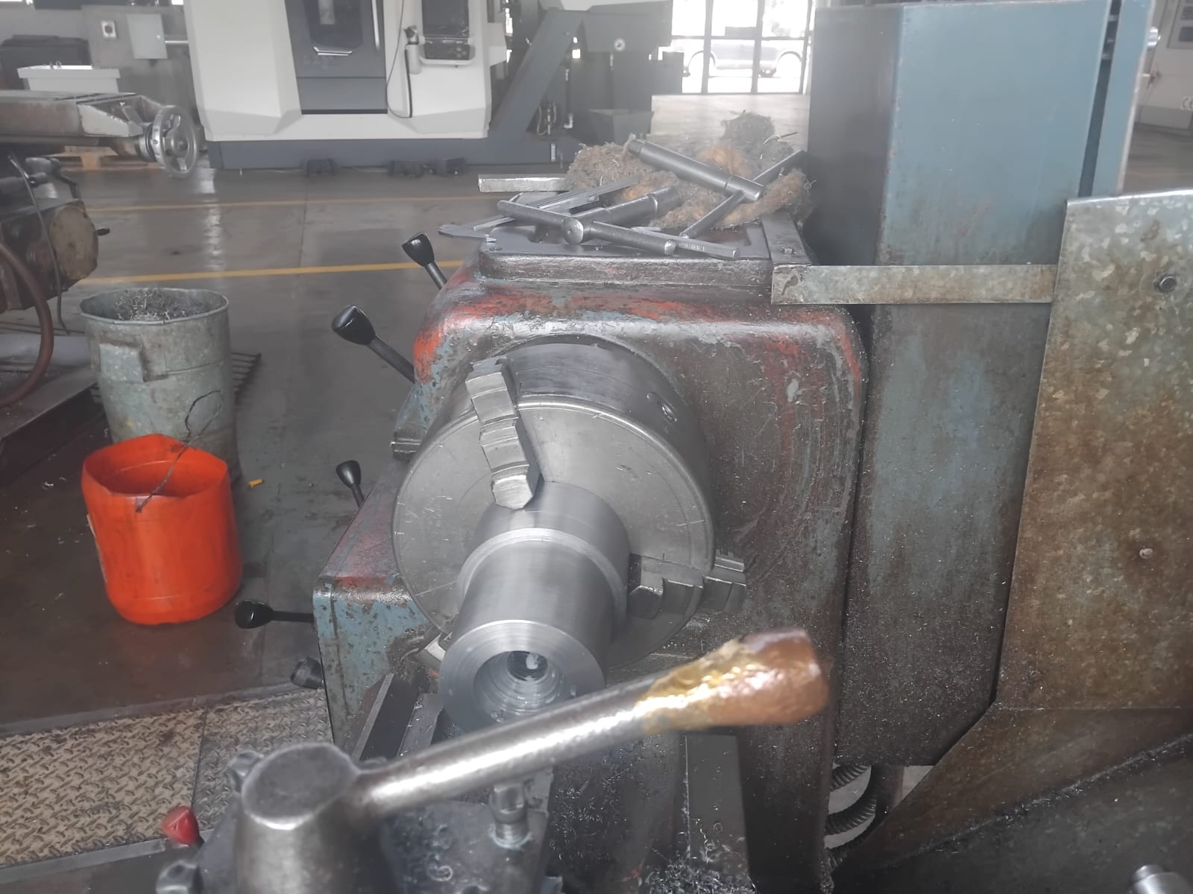
Nozzle fabrication
Nozzle fabrication is in the final stages
Machining of the outer profile is done
Throat shaping and finishing are still pending
On track for completion early next week

Slide 5
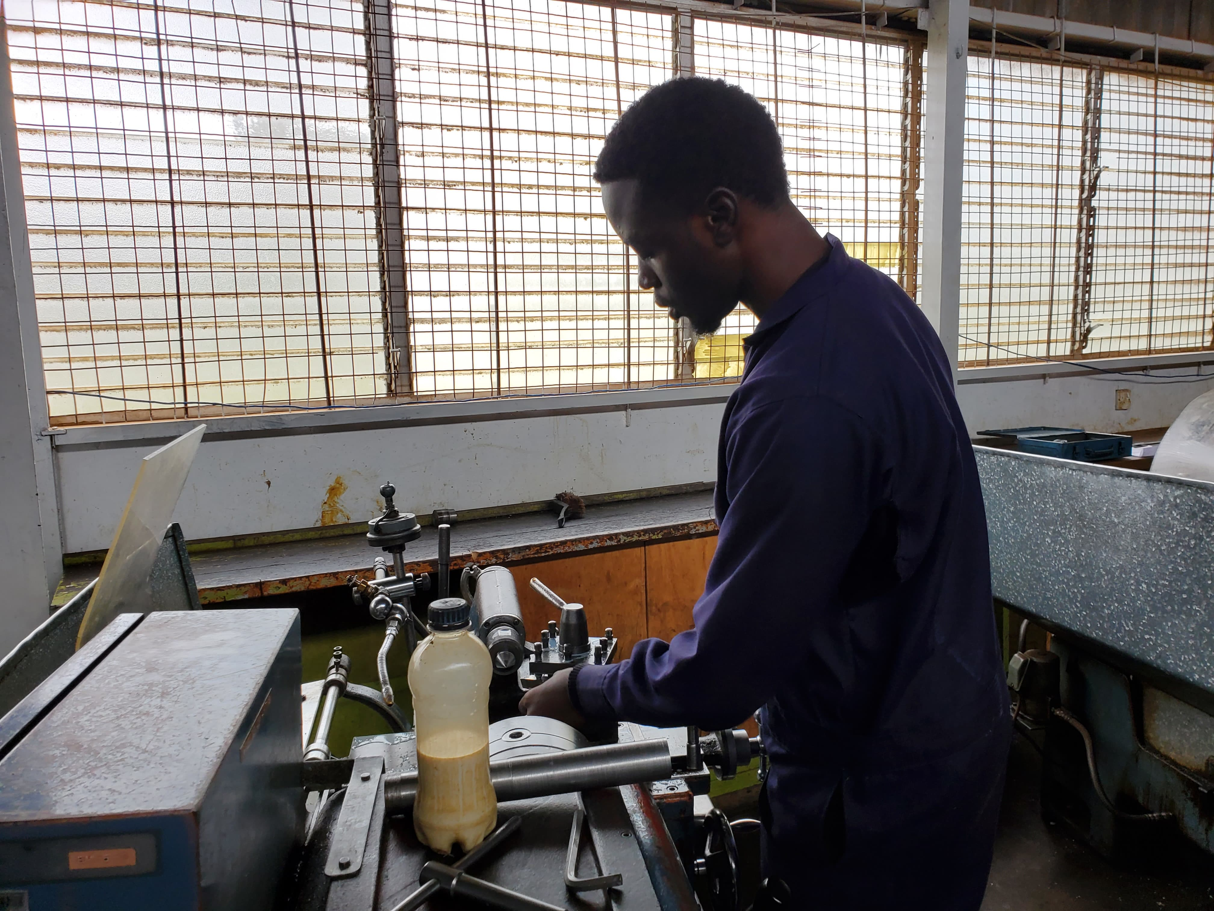
Core rod fabrication
Core rods were cut to the correct diameter and length
Designed to create central grain cavity during casting
Threading is pending, which currently prevents casting trials
Once threaded, rods will allow secure and repeatable alignment during pour

Slide 6
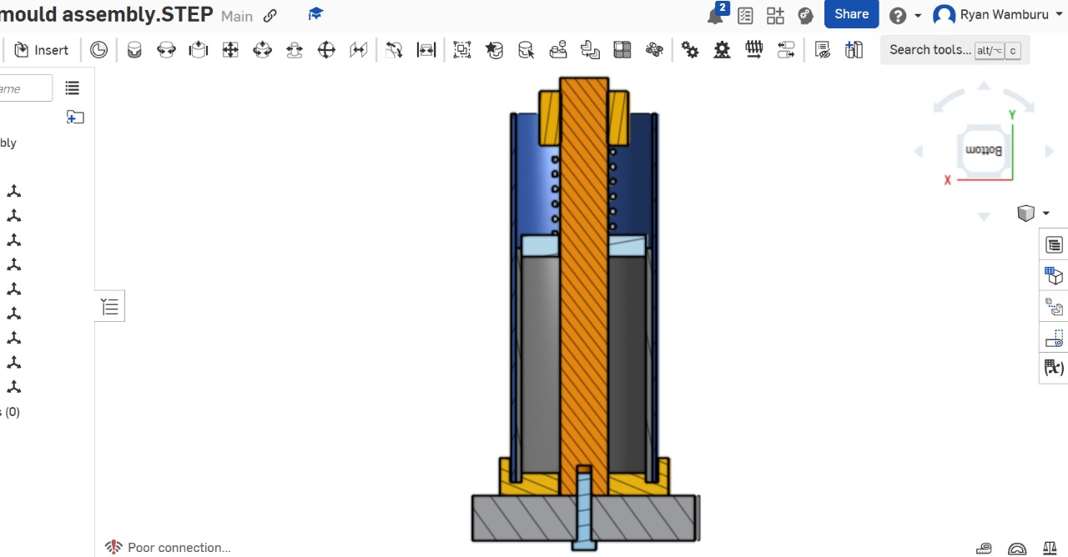
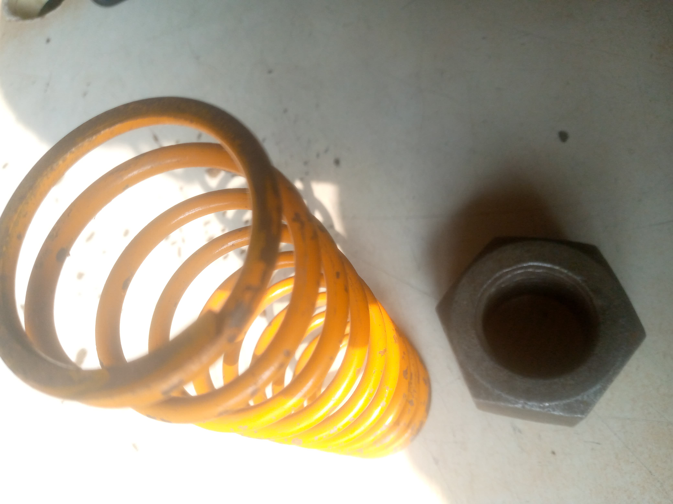
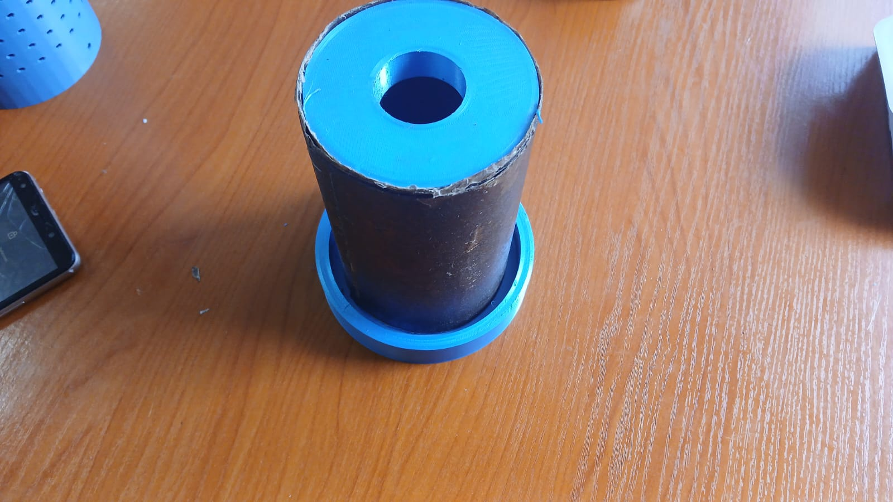
Curing setup
Simple curing fixtures were 3D printed and procured to align the casing and liner and hasten curing process.

Slide 7
Bulk head - drilling
Drilling was performed after machining to ensure accurate bolt hole positioning
Hole layout matched motor casing and nozzle bolt pattern
Verified concentric alignment for sealing and structural integrity

Slide 9
HAVE A GREAT WEEKEND
THANK YOU

