Slide 1
TECH MAVERICKS
EMPLOYEE EXPENSE MANAGEMENT SYSTEM
TATHARI SURESH KUMAR
THALAKAPALLI PRANAY KUMAR
PONUGOTI SURAJ

Slide 2
FEATURES:
Web-based, easy-to-use environment, reducing tour costs and increasing employee usage.
Screen for entering expense vouchers for any reimbursable expenses borne by the employee.
Monitoring, managing and enforcing corporate policies and improve the accuracy of expenses records.
Workflow for routing reports, from employees to approving managers to receipt and payment approval, ensuring stakeholders prompted for action actively.
Receipt verification approval, ensuring payment is only made when receipts provided are va
Real-time tracking and enquiry of expenses records, reducing time spent by accounting people dealing with enquiries.
At any point in the workflow, managers have the option of rejecting any voucher stating appropriate reasons.

Slide 3
The entire process involved in the expense management system is clearly described in the form of documentation which can be read through our main site .

Slide 4
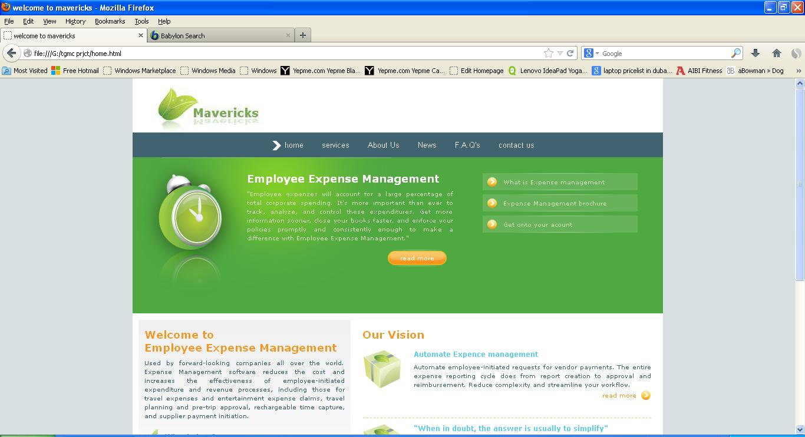
HOME PAGE

Slide 5
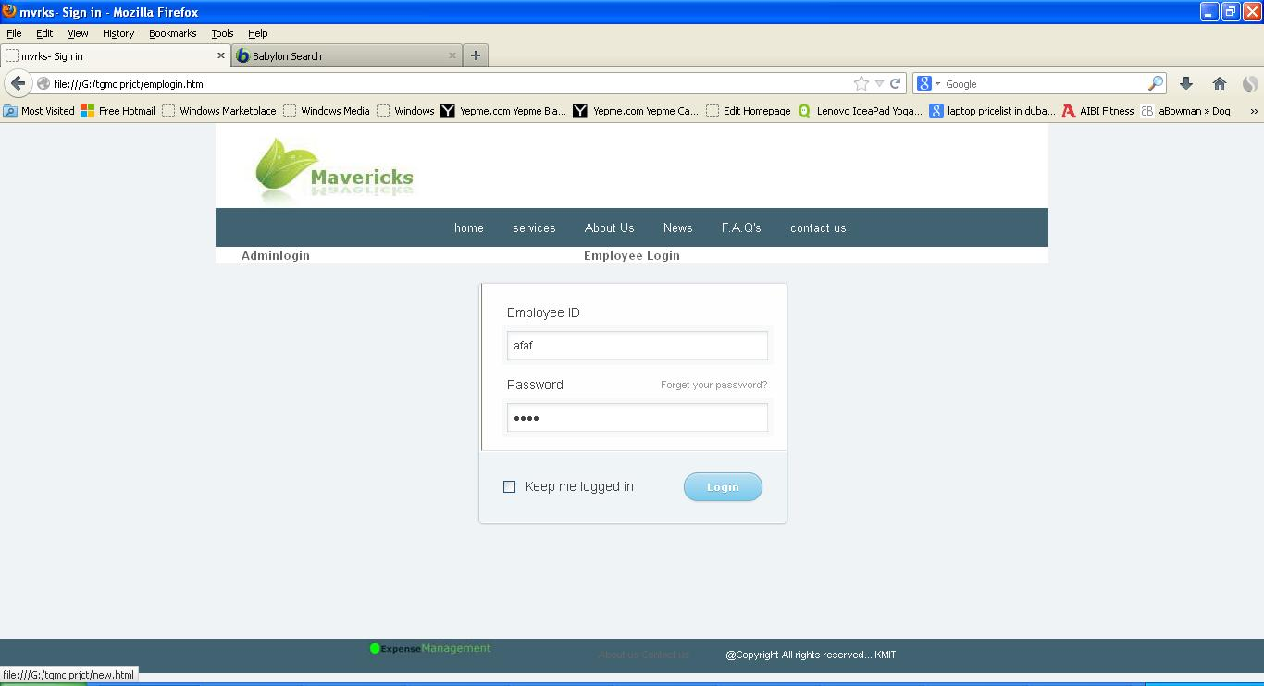
LOGIN PAGE

Slide 6
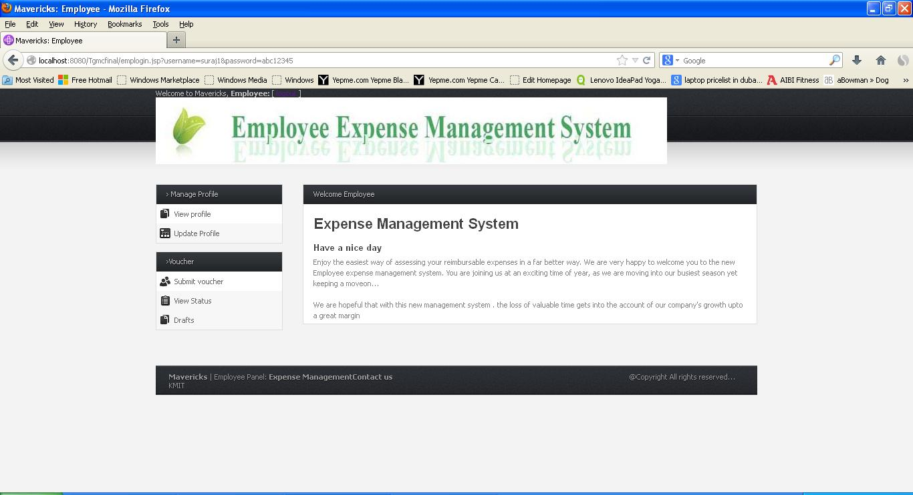
EMPLOYEE WELCOME PAGE
In the welcome page of employee , Employee can view and update his profile.

Slide 7
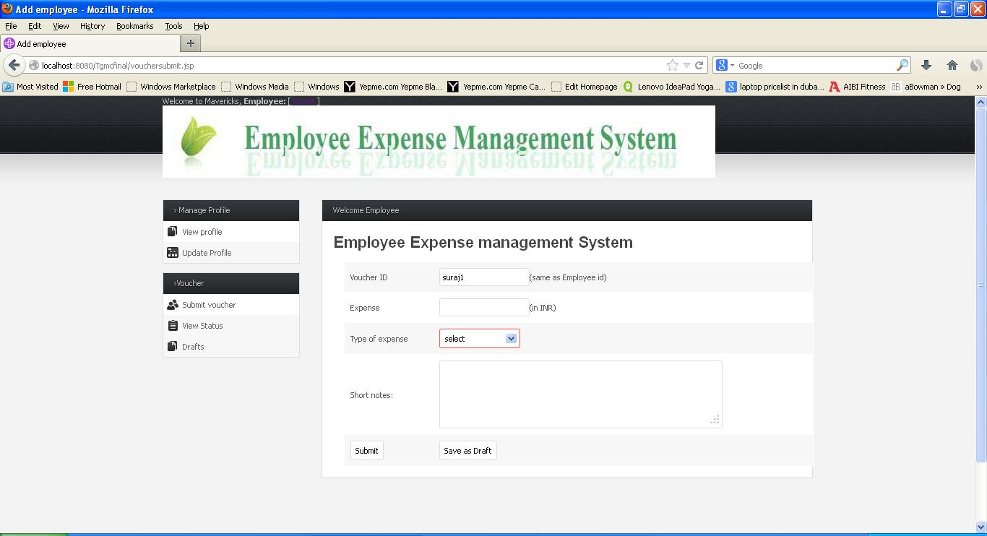
Employee submits vouchers to higher officials regarding on expenses he spent for approval.

Slide 8
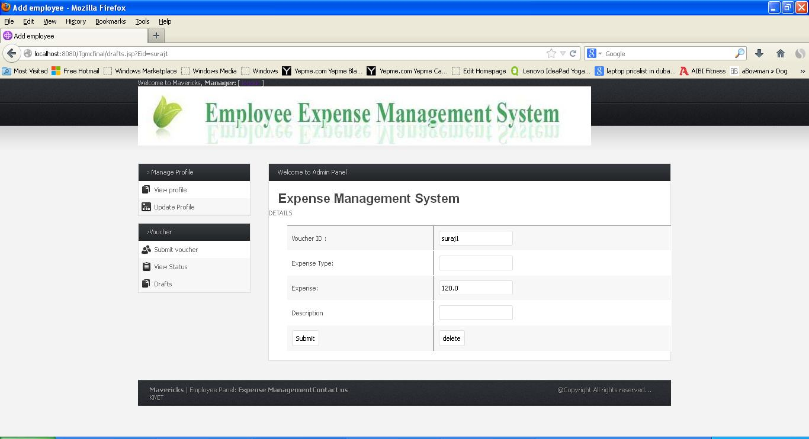
Employee can also save his unsent vouchers in drafts and use them in future.

Slide 9
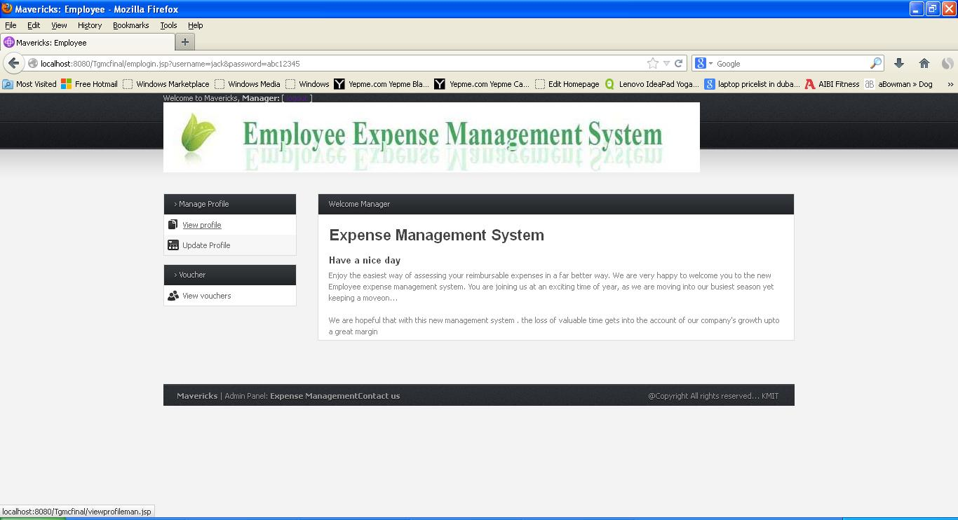
MANAGER
Manager can view and update his profile.
He views vouchers of his employees which are waiting for his approval.

Slide 10
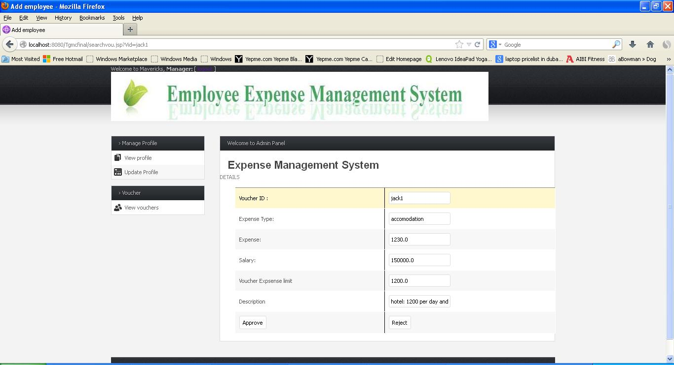
Manager based on details sent by his employee he may approve or reject voucher.

Slide 11
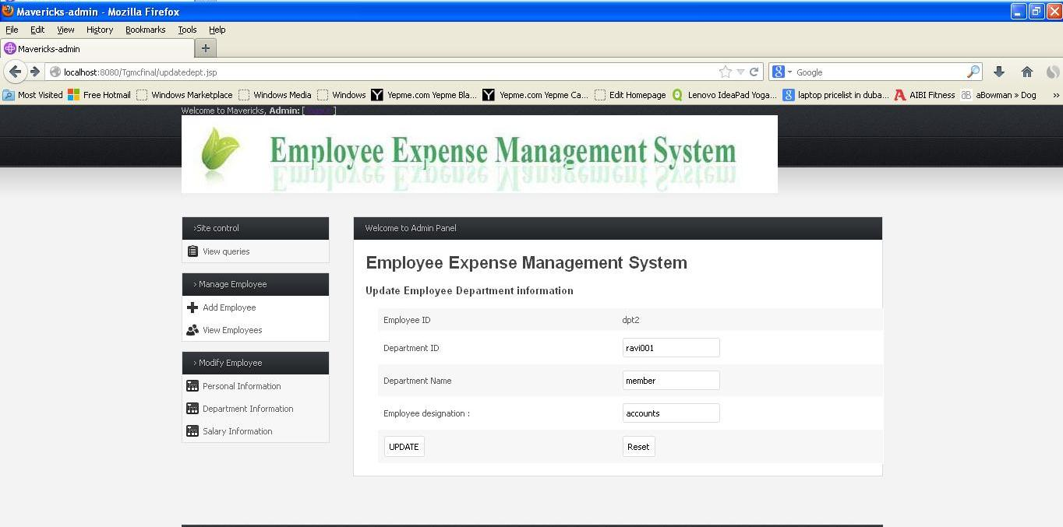
ADMIN
In the admin page of admin , Admin can add , delete and update details of employees.
Deletion of employees can be done during updating employee details by selecting update employee.

Slide 12
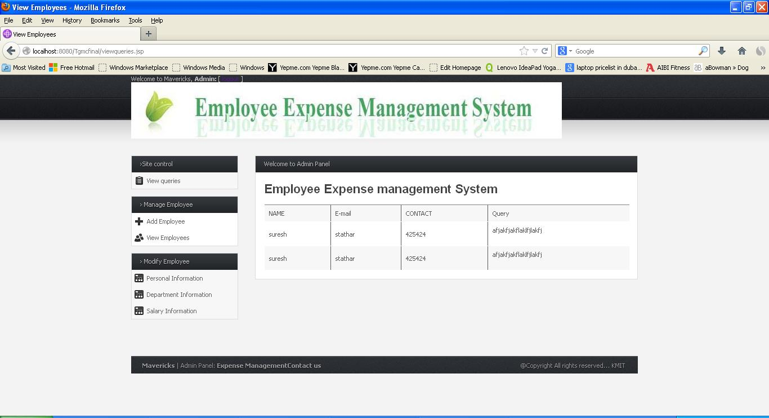
Admin can also see queries written by users .

Slide 13

ACCOUNTANT
Accountant can view and update his profile.
Accountant checks the approved voucher and mark it as paid if the voucher has all the details regarding expenses of the employee.

Slide 14
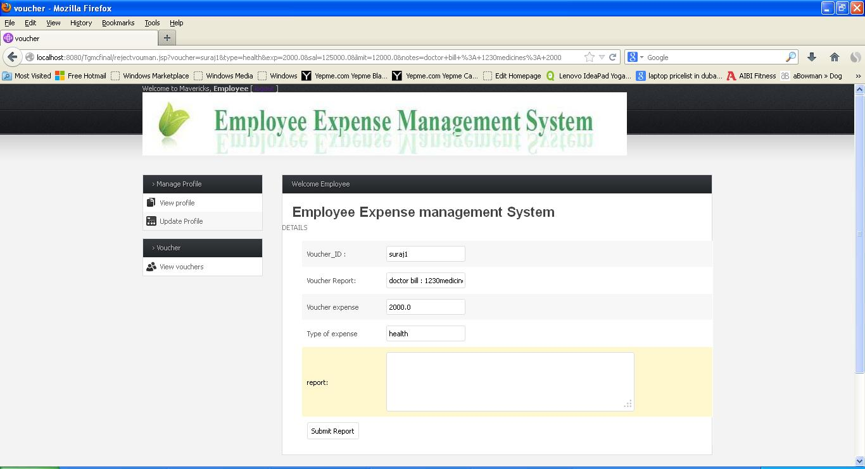
If Accountant needs any additional information ,he sends a report to the employee asking for additional information.

Slide 15
THANK YOU
TECH MAVERICKS

