Slide 1
Where the rain goes
Modelling the Al-Masar Al-Akhdar green corridor, Beirut
A 0.5 m rain-on-grid shallow-water model built from airborne LiDAR

Slide 2
HOW THE SIMULATOR WORKS

Slide 3
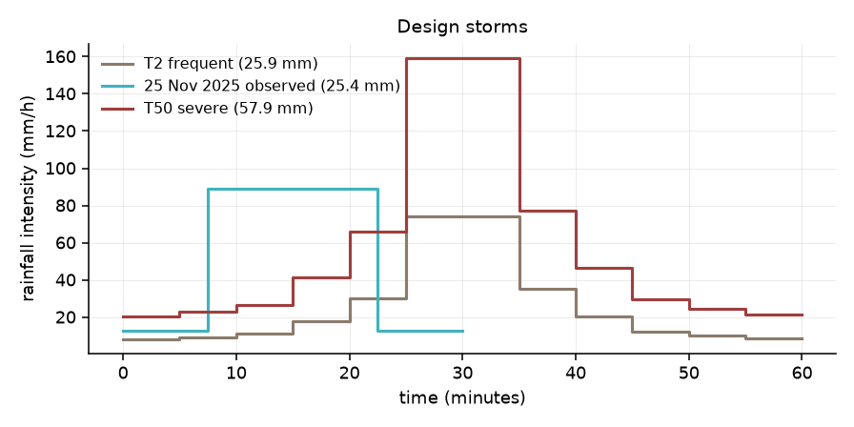
Rain falls on every cell. Nothing is routed by hand.
2-D shallow-water equations, 2.3 million cells at 0.5 m
Rain applied directly to every cell — the flood pattern is an output, not an assumption
No drainage network drawn in advance, no sub-catchments
Per-cell infiltration, roughness and detention from a 9-class land-cover classification
Buildings block flow; roof and courtyard rain is rerouted to the nearest street
Mass balance closes to 3 × 10⁻⁵ every run

Slide 4
What makes it different
The physics other packages leave out
Per-cell infiltration with a wetting front (Green–Ampt), surface detention, and gullies whose capture depends on the head over the grate
None of the 19 packages in the UK EA benchmark models infiltration or green infrastructure at all — they are hydraulics only
A solver you can differentiate
Gradients of flooded area with respect to every cell of the design, verified to 2 × 10⁻⁸
Turns the model from a predictor into a designer
Built for this problem
Two schemes in one code — fast inertial and shock-capturing HLLC — so scheme error is measured, not assumed
Sub-metre on a real city: 2.3 M cells, and we show resolution decides the answer
PyTorch on GPU — what makes the adjoint and ensembles affordable
Opt-in erosion sub-model for the soft landscape
What it does not do: no coupled 1-D sewer or river model; shock capturing costs ~3.5× the fast scheme

Slide 5
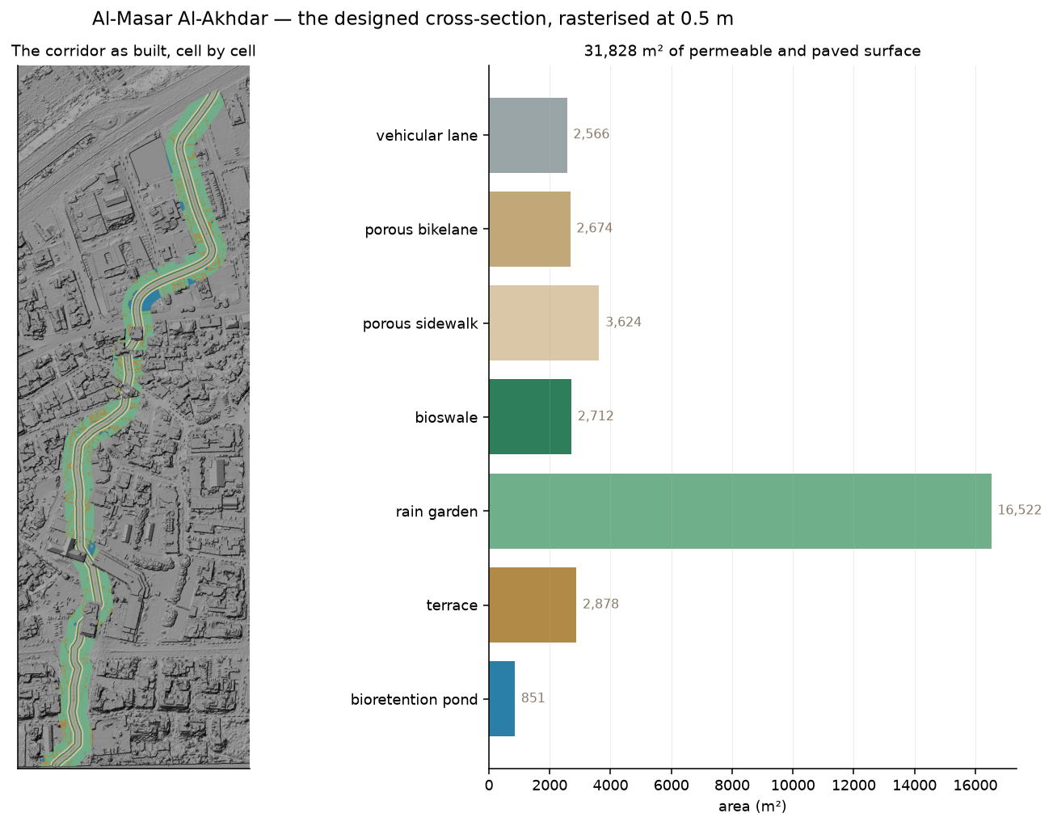
The corridor is built into the terrain, surface by surface
Geometry from the AUB Beirut Urban Lab dataset
Seven surface types, each with its own infiltration, roughness and surface depression
Rain garden is 52 % of the corridor; the engineered bioswales and ponds are under 4,000 m²
Buildings the scheme demolishes are cleared from the terrain first
31,828 m² of corridor in total
Our reading of the design. The cross-section is interpreted from the published drawings and what seemed hydraulically sensible — not a construction specification.

Slide 6
CAN IT BE TRUSTED?

Slide 7
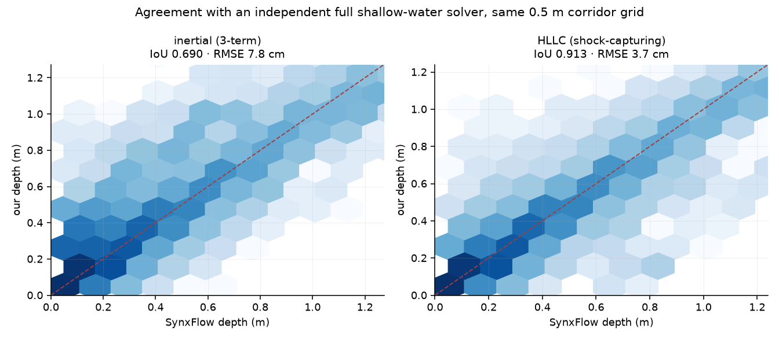
Against an independent solver, on the same grid
SynxFlow — an independently written full shallow-water Godunov solver
Our shock-capturing scheme: IoU 0.913 · correlation 0.985 · RMSE 3.7 cm
Our fast scheme: IoU 0.690 · RMSE 7.8 cm · spreads water over 27 % more area
LISFLOOD-FP: unusable here — fabricated six times the input volume and failed its own mass balance

Slide 8
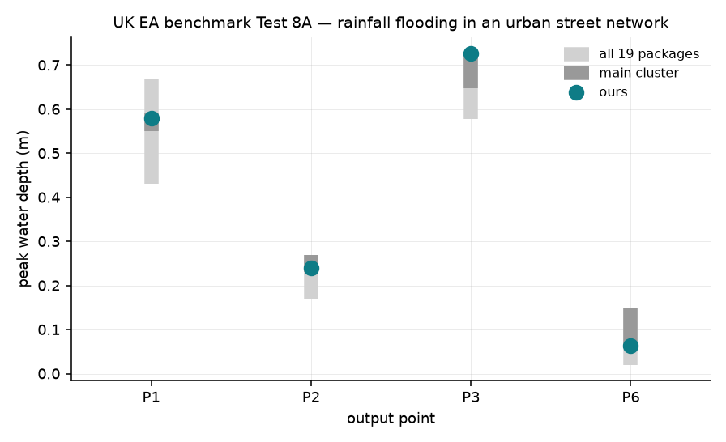
UK EA benchmark, Test 8A: rainfall in an urban street network
The closest published benchmark to what we model: direct rainfall on a real dense street network in Glasgow
In cluster at all four gauges with published curves
P1 0.579 m · P2 0.239 m · P3 0.726 m · P6 0.064 m
Compared against 19 commercial and research packages
Mass balance closed to −0.000 % on the benchmark run

Slide 9
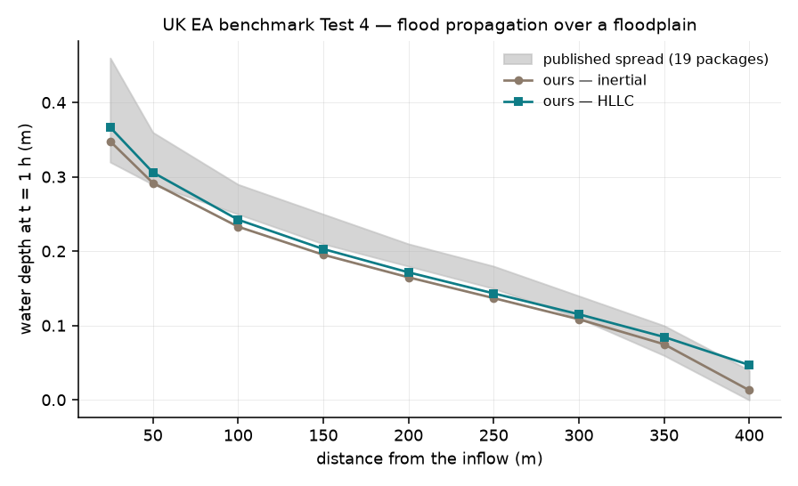
UK EA benchmark, Test 4: flood propagation over a floodplain
Tests the speed of an advancing flood front and the depths behind it
In cluster at all nine cross-section points, on both schemes
Built from the specification in the EA report — no data files required for this case
Behind these: 5 of 5 analytic tests pass — conservation, Manning normal depth, well-balancedness, reference-port equivalence

Slide 10
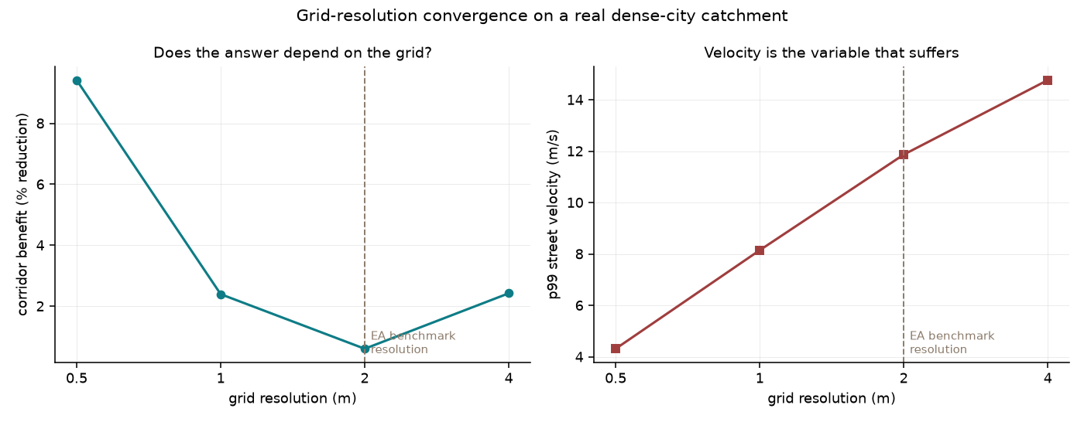
Does the half-metre grid earn its cost?
The EA benchmark report leaves this open: “it is not currently clear that grid resolutions finer than 2 m will improve…”
Same terrain, coarsened step by step — only the grid changes
At 2 m the corridor's measured benefit collapses from 9.4 % to 0.6 %
Peak street velocity climbs the wrong way, 4.3 → 14.8 m/s, as kerbs and narrow streets are averaged away
For this kind of appraisal, sub-metre resolution is the difference between measuring the effect and missing it

Slide 11
BEIRUT: THE GREEN CORRIDOR

Slide 12
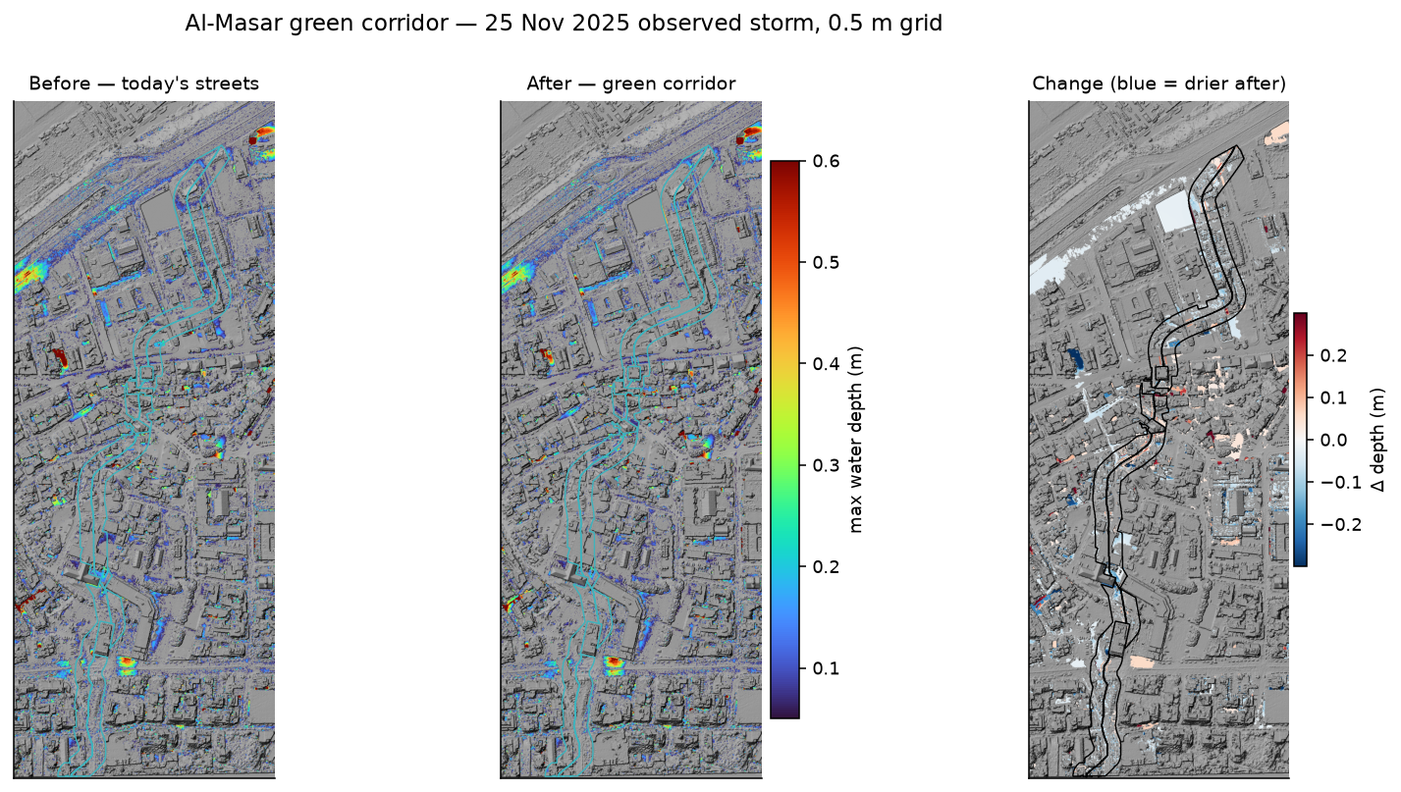
Before and after, 25 November 2025 storm
Peak water depth. Teal outline = the right-of-way ribbon. Right panel: blue is drier after the corridor is built.

Slide 13
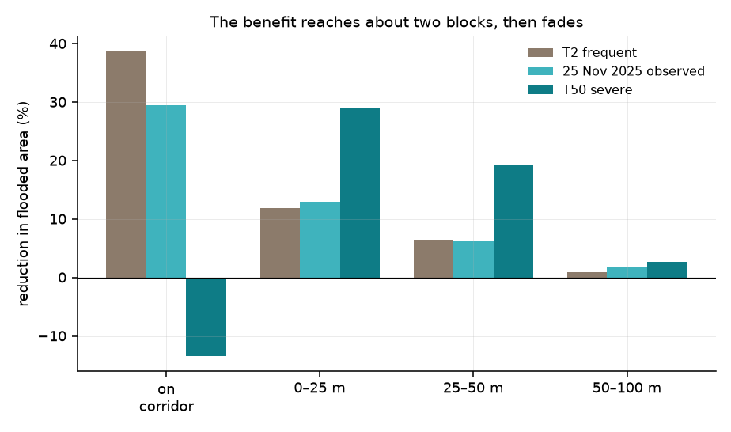
The benefit is real, and it reaches about two blocks
Frequent storm (T2) −58 % flooding underfoot
Observed 25 Nov 2025 −52 %
Severe storm (T50) -1 %
+919 m³ extra water absorbed in the observed storm
−17 % less water sent toward the port
Measured on walkable surfaces — the fifth of the corridor dug out as swales and ponds holds water by design

Slide 14
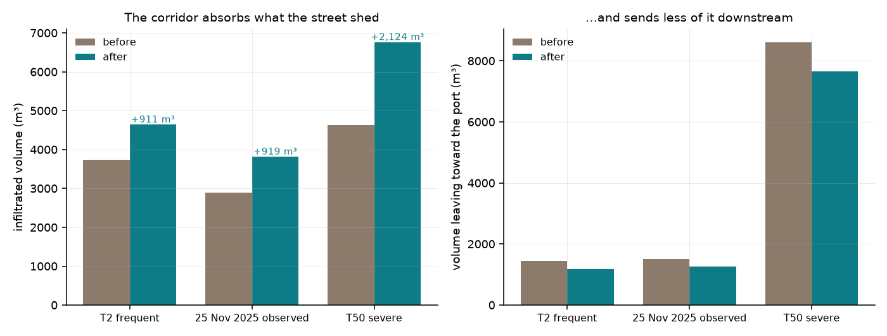
In a severe storm it stops keeping itself dry — and protects everywhere else
T50: flooded area on the corridor barely moves (-0.7 %)
…yet it absorbs 2,124 m³ more water and cuts flow toward the port by 11 %
Its swales and ponds fill and hold — the water is on the corridor by design, not running down the streets
Correction to the earlier study: the corridor does not triple infiltration. The multiple is 1.32× — ordinary Beirut ground already absorbs far more than a constant rate implied.

Slide 15
What would make this a validated model
The model is verified. It is not yet validated.
It reproduces analytic solutions, passes two international benchmarks, and agrees with an independent solver to 3.7 cm.
Every one of those compares it to other models — never to a flood that was measured in Beirut.
The proposal
A modest, well-targeted field campaign in Beirut would close this — and nothing else can.
What it would take
Water-mark surveys after the next significant storm — photographs and levelled marks at a few dozen street locations
A handful of low-cost depth loggers at known ponding points
Timing of when key streets became impassable
What it would buy
A measured error, not an inter-model one — and results that can carry planning decisions with confidence

