Slide 1
How the flood model works
A physics simulation of rain running through a city, at half-metre resolution
What it computes · how it is tested · what it says about the Beirut green corridor
Notes:
No hydraulics background assumed. Three questions: what does it actually compute, how do we know it is right, and what did it tell us. Stop me on any of the maths — none of it is deep, it is just unfamiliar.

Slide 2
The idea in one paragraph
Cut the city into half-metre squares. Put rain on all of them. Let physics move the water.
2.3 million squares, each holding three numbers: how deep the water is, and how fast it is moving in x and y.
Every timestep, work out how much water crosses between neighbouring squares, add the rain, subtract what soaks into the ground and what the drains take, and repeat — about 75,000 times for one hour of storm.
It runs on a GPU because every square updates independently, which is exactly what a GPU is for.
Why this rather than a drainage model
The usual approach divides the city into catchments, guesses what fraction of rain runs off each, and routes the result through a pipe network you have drawn.
That requires you to decide in advance where the water goes.
Here nothing is routed by hand. Where the flooding shows up is an output. That is the property that lets the model say something useful about a design that has never been built.
Notes:
This slide is the whole talk in miniature. If someone takes only one thing, it should be that the flood pattern is computed, not assumed.

Slide 3
WHAT IT COMPUTES

Slide 4
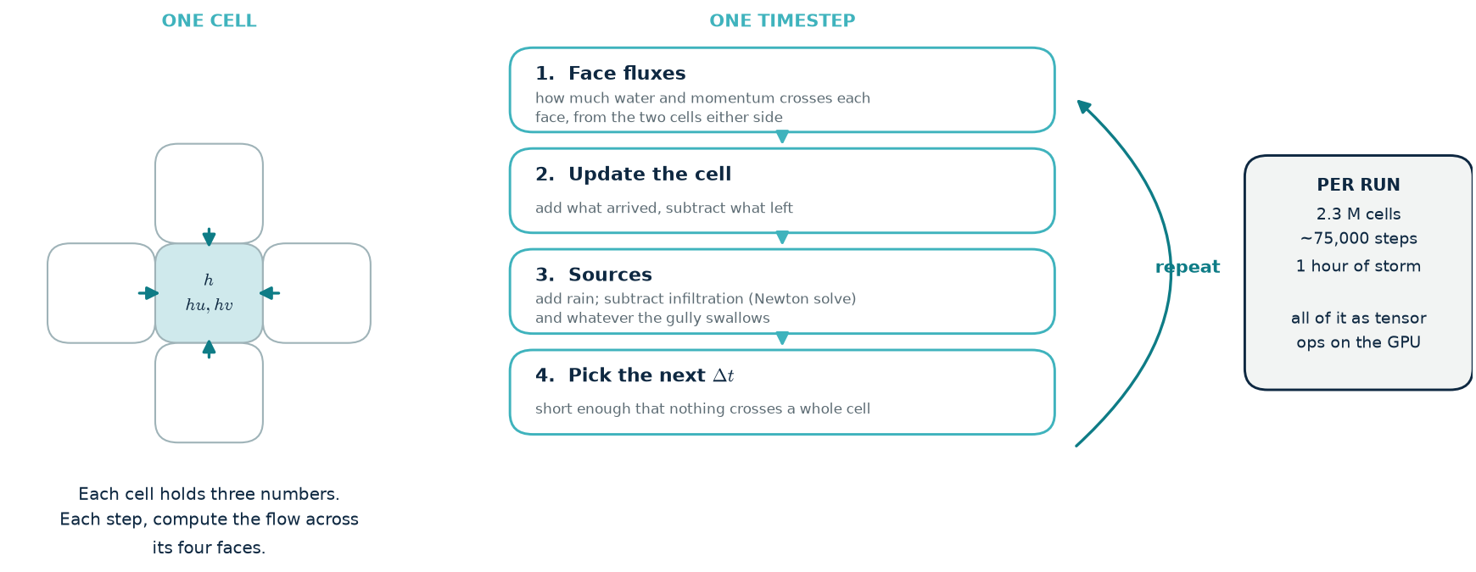
The main loop
Nothing exotic: a stencil over a regular grid, a state update, source terms, and a stability-limited timestep. The whole thing is tensor operations — there is no per-cell Python anywhere in the hot path.
Notes:
Deliberately familiar territory for anyone who has written numerical code. The only two non-obvious parts are step 1, which is the next slide, and step 3's infiltration, which needs an iterative solve because the law cannot be rearranged.

Slide 5
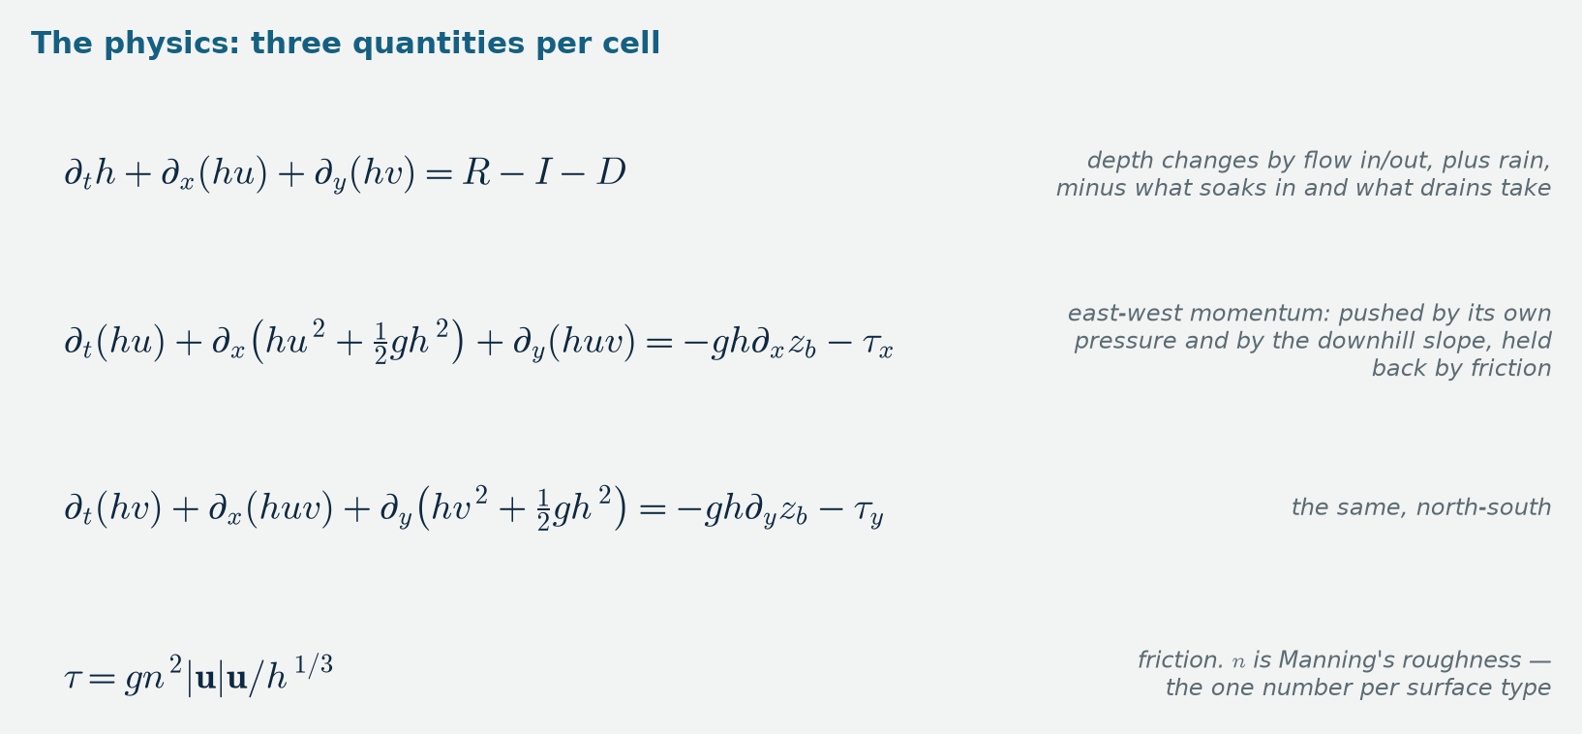
The equations being stepped
Conservation of water and of momentum, averaged over depth
The first line is bookkeeping: a square's water level changes by what flows in and out, plus rain, minus what soaks in and what the gullies take.
The next two are Newton's second law for the water: it accelerates under its own pressure and under gravity pulling it downhill, and friction with the ground slows it.
That is the entire physics. Everything else in this talk is about computing it accurately, and checking that we did.
Notes:
Do not linger. The point is that the physics is short and standard — which is exactly why the model can be compared against other packages. The interesting engineering is downstream of here.

Slide 6
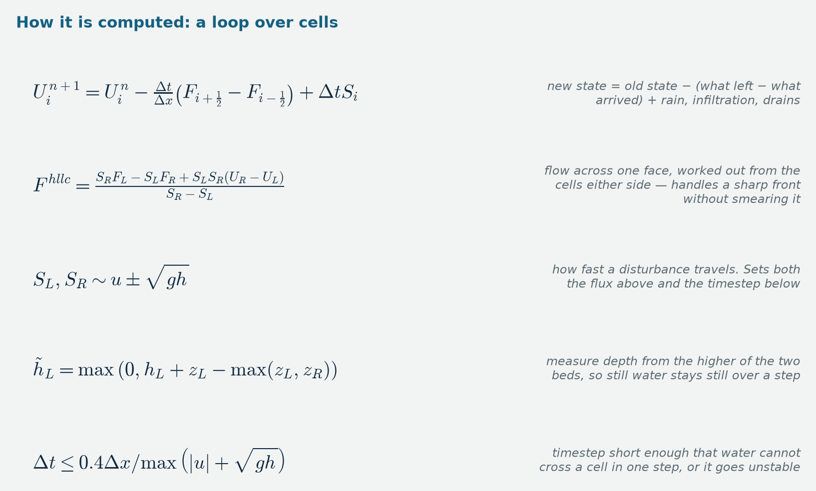
Two ways to compute the flow between squares
The cheap way ("inertial") drops one term — the momentum the water carries with it as it moves. What is left can be solved almost directly. This is what most flood models in production use, including LISFLOOD-FP.
The full way ("shock-capturing") keeps every term and solves a small problem at each face: given the water either side, what actually flows across? It costs about 3.5× more and needs a timestep about half as long.
We implemented both, in one code. Same terrain, same rain, same everything else — so the difference between two runs is the method and nothing else. Most studies cannot measure that, because they only have one solver.
Notes:
If asked what the dropped term does: it is the difference between water that simply spreads and water that has momentum and keeps going. It matters when flow is fast — which in Beirut it is, 6 to 8 m/s on a 6 % street grade. Next slide shows how much it matters.

Slide 7
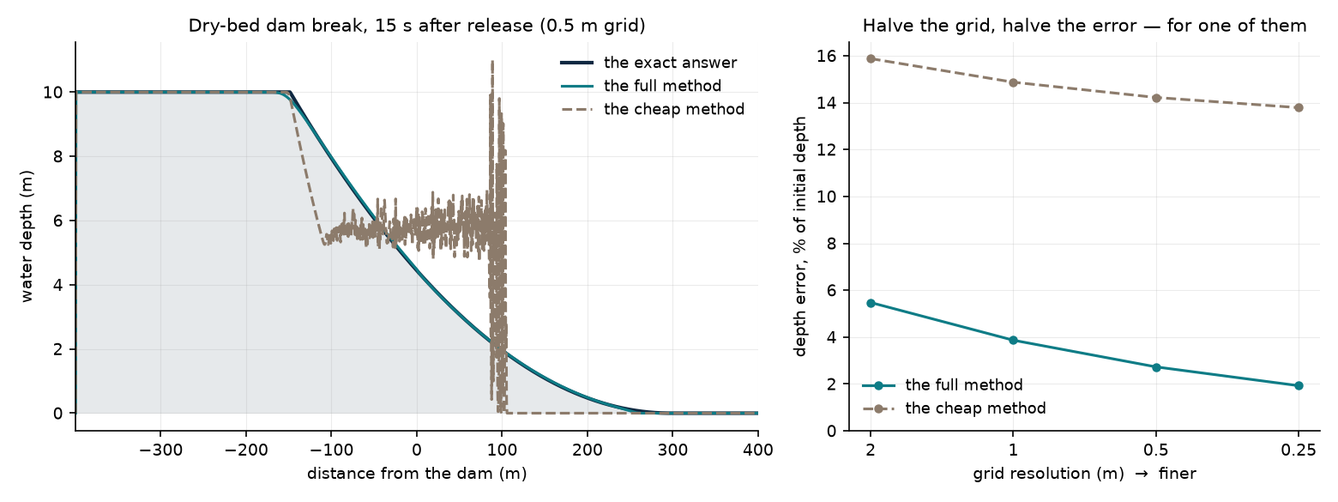
The test that separates them: a dam break with a known answer
Release a wall of water onto dry ground. This problem has an exact solution you can write down on paper, so there is no argument about what the right answer is. Left: both methods against it. Right: the same test on progressively finer grids.
Notes:
The single most useful slide for a sceptical engineer. Three things to point at. One: the full method sits on the exact curve. Two: the cheap method oscillates and its front is 60 % too slow — it does not just lose accuracy, it converges to the wrong answer, which is the thing you always want to catch. Three: the right panel is a convergence test — halve the grid, error should fall. It does for one method and flatlines for the other. This is why we pay 3.5× for the full solver.

Slide 8
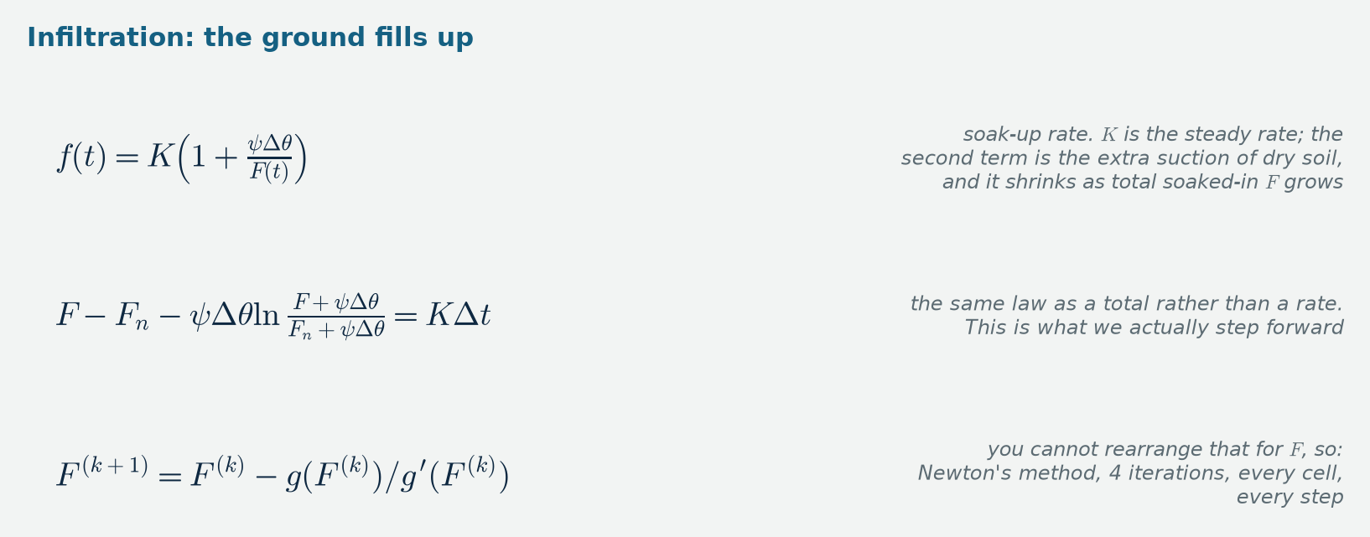
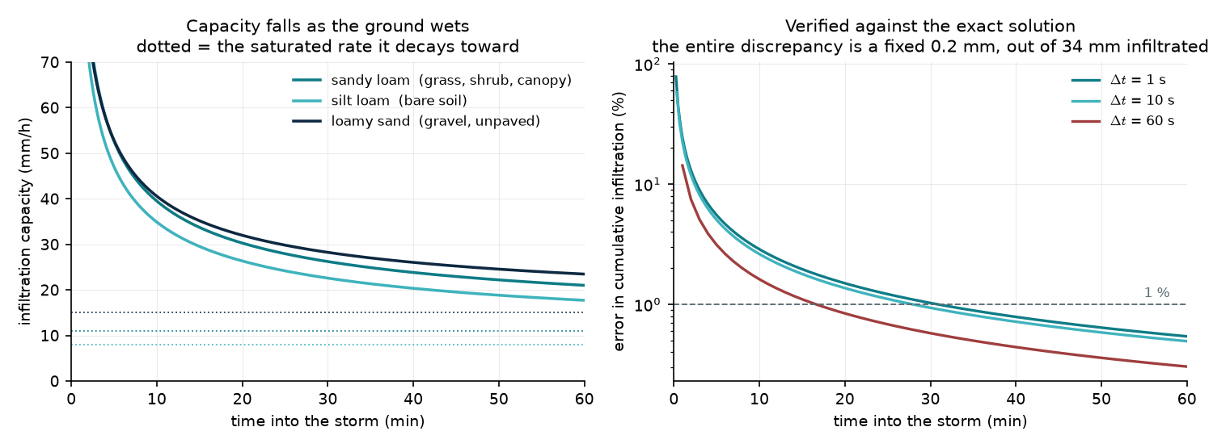
Where the water goes when it is not on the street
Notes:
The green corridor works by soaking water up, so this term is not a detail — it is the mechanism under test. A constant soak-up rate is wrong in a way that matters: ground absorbs fast when dry and slows as it fills, like a sponge. Left panel shows that decay; the dotted lines are the constant rate a simpler model would have used throughout. Right panel is the verification — our solver against the exact answer. Switching to this is what dropped the corridor's claimed infiltration gain from 3× to 1.3×.

Slide 9
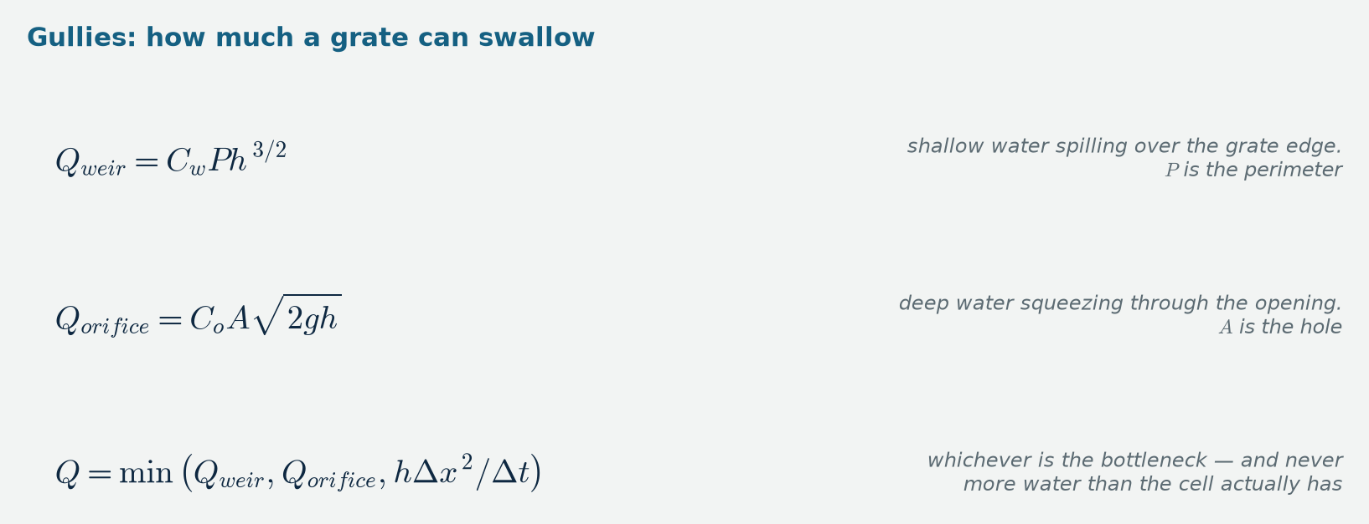
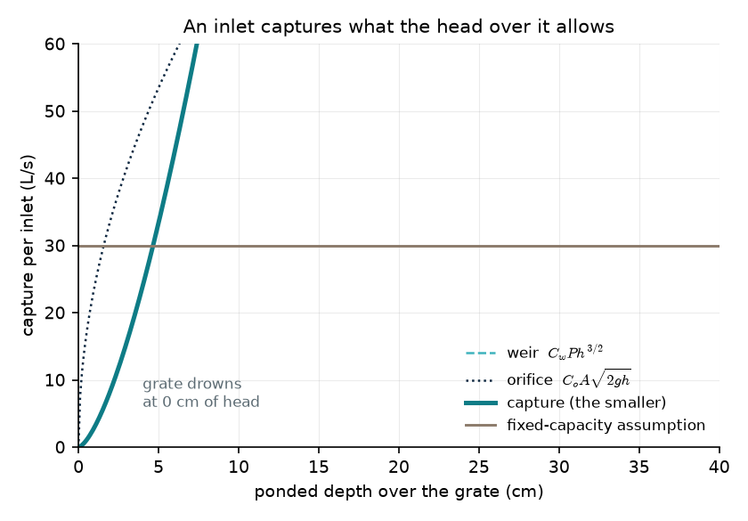
Storm drains that fill up
A gully grate has two regimes. Shallow water spills over its edge; deep water is forced through the opening. Which one limits the flow depends on how much water is standing on top of it.
Why not just give each drain a fixed capacity: because then a design that reduces ponding gets no penalty for also reducing what the drains capture. Making capture depend on depth closes that loop, so the corridor is not credited twice.
Honest caveat: nobody has data on Beirut's actual inlets. We report differences rather than absolutes, which is robust to getting this uniformly wrong.
Notes:
Small piece of physics, but a good example of the general principle: model the mechanism, not the outcome, and the feedbacks come for free.

Slide 10
HOW WE KNOW IT IS RIGHT

Slide 11
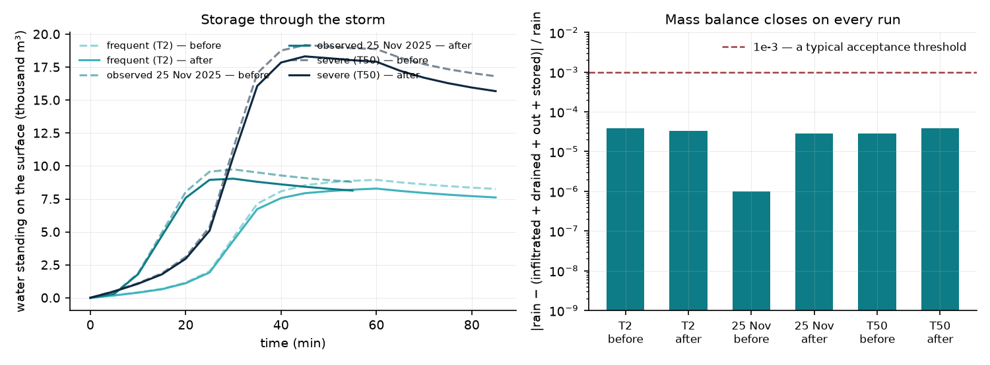
A test suite, and an assertion on every run
Five problems with answers known in advance
Sealed box — put rain in, check nothing leaks out: exact
Water running down a slope — check the steady depth matches the textbook formula: 14.1 vs 14.7 mm
A still pond on bumpy ground — check the model does not invent currents: 6 × 10⁻⁵ m/s
Same problem through an independent implementation: agrees to 0.027 mm
Erosion off — check the code path is bit-identical to before it existed
And an invariant checked on every production run: rain in = soaked up + drained + flowed out + still standing. It closes to better than 3 parts in 100,000, every time.
Notes:
Frame this as unit tests plus a runtime assertion, because that is what it is. The still-pond test is the one worth calling out: many methods fail it, and this terrain is full of retaining walls, so a model that fails it would generate flow out of nothing. On the right — one of the three engines we compared against failed exactly this mass check on this terrain, at six times the input volume.

Slide 12
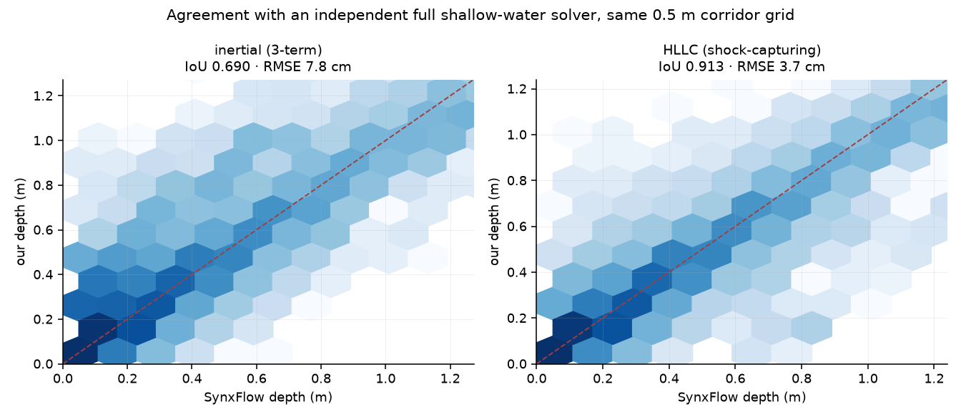
Run against a solver somebody else wrote
SynxFlow — a separate flood simulator, different team, different code, same job
Same terrain, same grid, same storm. Then compare the depth in every cell.
Our full method: agrees on 91 % of the flooded footprint, 3.7 cm typical difference
Our cheap method: 69 % overlap, 7.8 cm, and it spreads water over 27 % more area — the same bias the dam break predicted
A third engine, LISFLOOD-FP, could not be used at all: it produced six times the water that went in and failed its own conservation check on this terrain. Its output is void, not merely different.
Notes:
This is the strongest evidence available short of measuring a real flood. Two codes written independently, agreeing to under 4 cm across a whole catchment. Note it also confirms the dam-break finding on the real problem — same sign, same cause.

Slide 13
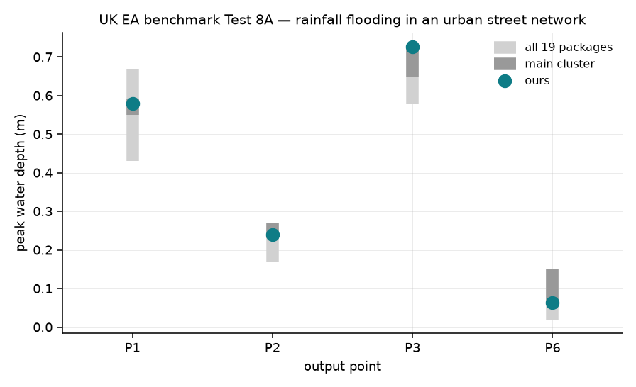
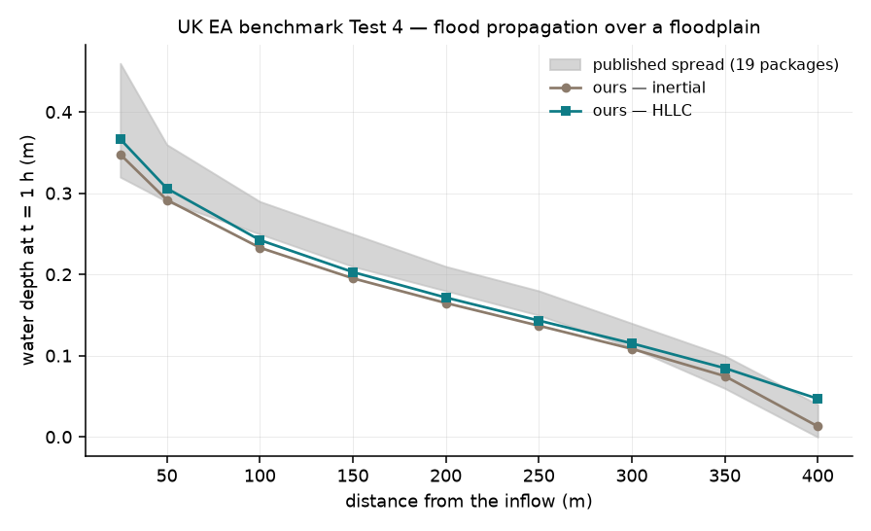
Two standard benchmark cases used to compare flood models
Rain on a real, dense street network — the closest published case to what we do. Our answer sits inside the range of published results at all four measurement points.
How fast a flood front travels and how deep the water is behind it. Inside the published range at all nine points, on both methods.
Notes:
The UK Environment Agency publishes a benchmark suite with results from 19 commercial and research packages, so 'in cluster' means we land where the established tools land. Of the other six cases, four need data files we do not have and two need a coupled sewer model we have not built.

Slide 14
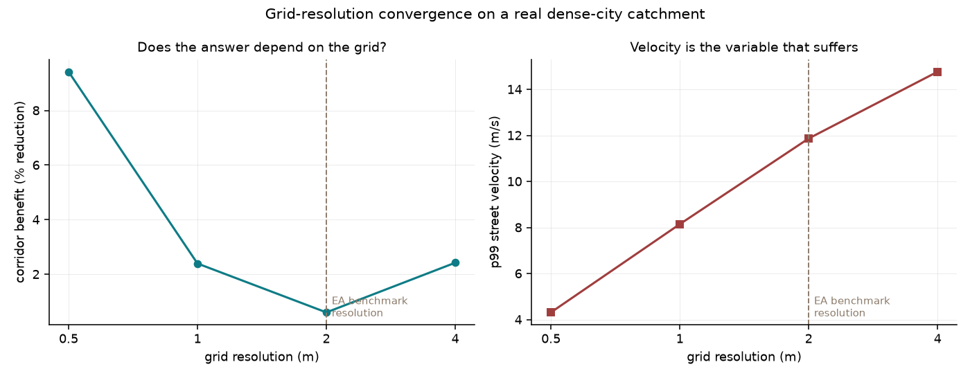
Does the half-metre grid earn its cost?
Coarsen the same terrain step by step and re-run. Only the grid changes — same rain, same everything.
At 0.5 m the corridor removes 9.4 % of the flooding. At 2 m: 0.6 %.
A study done at 2 m would conclude the intervention does essentially nothing.
Peak street velocity goes the wrong way — 4.3 up to 14.8 m/s as the grid gets coarser. Averaging blocks of cells together erases the kerbs and narrow streets that actually carry the water, while inventing steep steps between the big cells that remain.
Caveat: coarsening an existing model is not identical to building one natively at 2 m with retuned roughness. The size and direction of the effect are not in doubt.
Notes:
Worth stressing that the benchmark report itself lists this as an open question and asks somebody to test it at 0.5 m. We are unusually well placed to answer it, and the answer is that resolution decides the conclusion.

Slide 15
BEIRUT, AND WHAT COMES NEXT

Slide 16
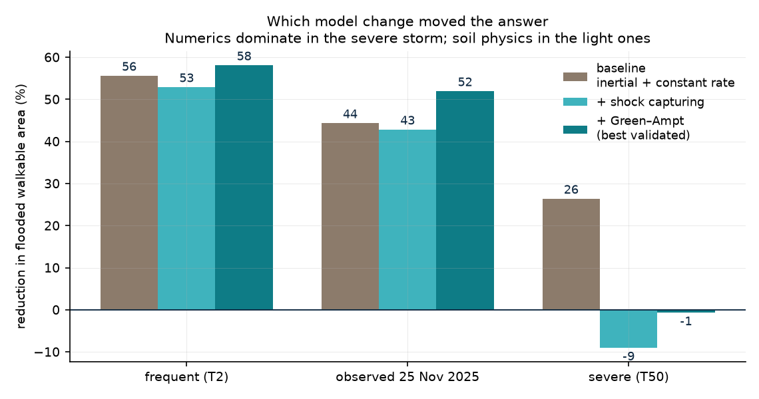
Which change to the model moved the answer
Same corridor, same storms, three versions of the model
Frequent storm: 55.6 → 52.9 → 58.1 % reduction in flooded walkable area
Observed 25 Nov: 44.3 → 42.8 → 52.0 %
Severe 50-year: 26.4 → −9.0 → -0.7 %
The severe storm is the interesting one. Switching to the accurate flow method alone moved it by 35 percentage points — the cheap method had been over-spreading water in the do-nothing case, where flow is fastest, and inflating the apparent benefit. Better soil physics then gave 8 points back.
This is why we built the second solver. Without it the headline would still read +26 %, and it would be wrong.
Notes:
A good slide to dwell on with an engineering audience: it is a worked example of a numerical artefact masquerading as a physical result, caught by having two implementations.

Slide 17
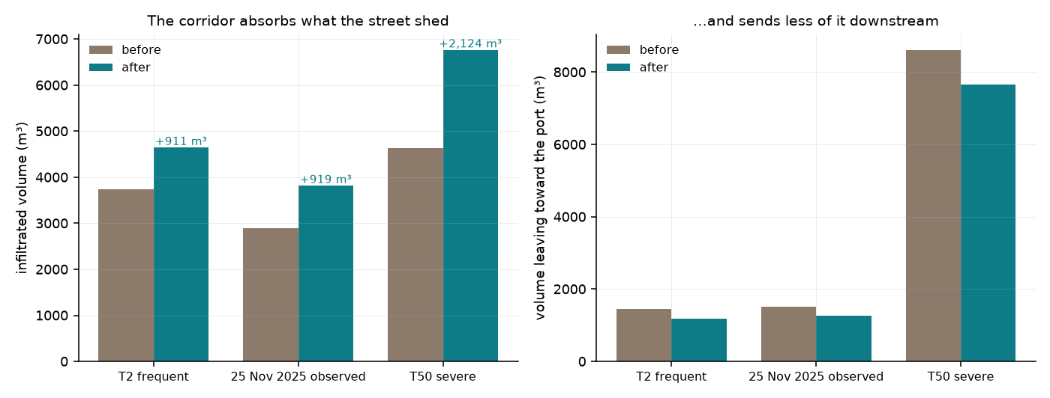
What the corridor actually does
Water balance, best-validated configuration
Frequent storm: +911 m³ soaked up · 18 % less water sent toward the port
Observed 25 Nov: +919 m³ · 17 %
Severe 50-year: +2,124 m³ · 11 %
In a 50-year storm it stops reducing its own flooded area but absorbs more than ever. The swales and ponds fill and hold. Two different jobs — keeping its own surface usable, and protecting what is downstream — and only the second survives an extreme event.
Correction to the earlier study: infiltration goes up 1.32×, not the 3× previously claimed. Ordinary Beirut ground absorbs far more than a constant-rate model implied.
Notes:
Say the correction plainly. The absolute gain held; the ratio did not, because the baseline was wrong. Better physics, smaller claim — that is how it should go.

Slide 18
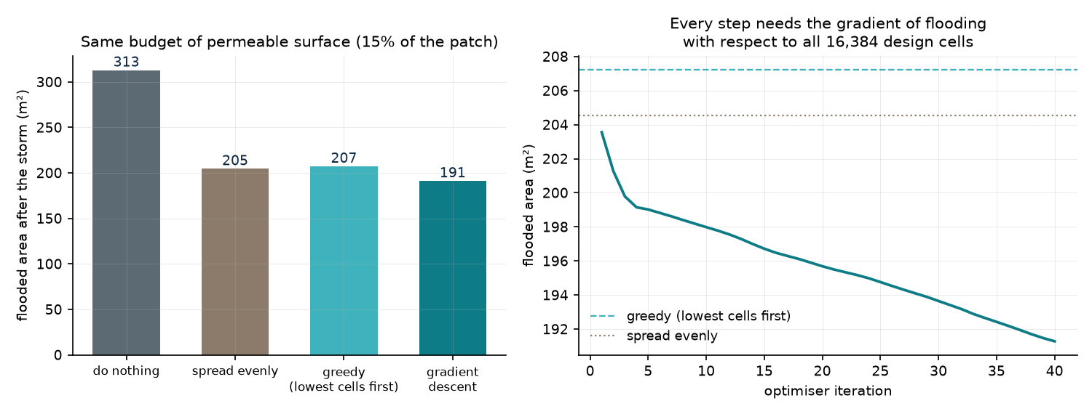
The model can be differentiated
It is written in PyTorch, so autograd works through the whole simulation.
Backpropagate through 75,000 timesteps and you get the derivative of flooded area with respect to every cell of the design — the same machinery that trains a neural network, applied to a physics solver.
Checked against finite differences to 2 × 10⁻⁸. Gradient checkpointing trades compute for memory so full storms fit.
So you can optimise a design instead of guessing at a few:
do nothing 313 m² · spread evenly 205 · greedy 207 · gradient descent 191 m²
Not a finished claim. Forced to a buildable yes/no layout the advantage disappears. The relaxation needs more work before this stands up.
Notes:
The part with publication potential. None of the 19 benchmark packages is differentiable, and none models infiltration or green infrastructure at all — they are hydraulics only. Be straight about the gap: the continuous optimum is real, the buildable one is not there yet, and the objective is still instantaneous rather than peak-over-time.

Slide 19
Where it stands, and what is missing
Solid
Passes five tests with known answers, on both methods
Agrees with an independently written solver to 3.7 cm across a whole catchment
Lands inside the published range on two standard benchmark cases
Conserves water to 3 parts in 100,000 on every run
Sub-metre resolution demonstrably changes the conclusion — we can show it rather than assert it
Gradients verified to 2 × 10⁻⁸
Missing
Nobody has measured a real flood in Beirut. Everything above compares the model to other models or to textbook problems. That is real evidence, and it is not the same as being right about this city.
Soil and paving absorption rates come from published tables, not site measurements
Drain inlet capacity assumed — no per-inlet data exists
The corridor cross-section is our reading of the published drawings
Erosion model is illustrative, and switched off in everything shown here
No coupled sewer or river model, which puts two benchmark cases out of scope
Notes:
Lead with the right column if the audience is sceptical. The honest summary is that the numerics are in good shape and the input parameters are not, and only field measurement fixes the second.

