Slide 1
Where the rain goes
What a green corridor would do to flooding in Beirut
A model of the Al-Masar Al-Akhdar right-of-way, built from a laser survey of the city
Notes:
No equations in this talk. What the model is told, what it works out, and what it says about the corridor.

Slide 2
The problem is not extreme rain
25 November 2025
25 mm of rain fell in half an hour.
Sassine Square and the Ring flooded. Traffic stopped. Basements filled.
By Lebanon's own stormwater code that burst is a 2-to-5 year event — the kind of rain the city should expect several times a decade.
So why does it flood?
The ground is sealed. Rain that would once have soaked into soil now runs straight off asphalt and concrete.
The slopes are steep. Water arriving from Achrafieh reaches the lower streets fast and deep.
The drains take what they can and the rest stays on the street.
A green corridor is an attempt to give some of that water somewhere to go.
Notes:
Set the frame: this is not about a freak storm, it is about ordinary rain on a surface that cannot absorb it. That is what makes it fixable.

Slide 3
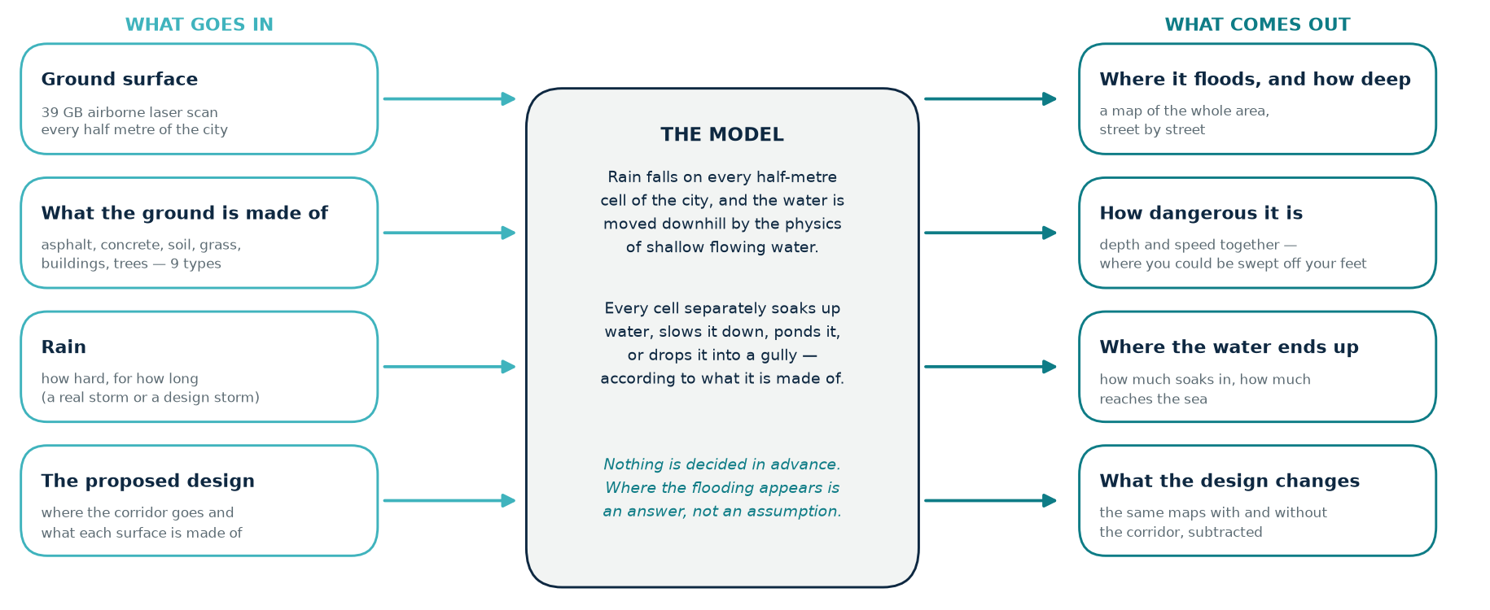
What the model is, in one picture
The model is told four things and works out the rest. It is not given a drainage plan or a list of places that flood.
Notes:
THE slide of this talk. The point to land: nothing about where the flooding happens is put in by hand. Rain is placed on every half-metre square of the city and the physics moves it. That is why the model can be trusted to say something about a design that has never been built.

Slide 4
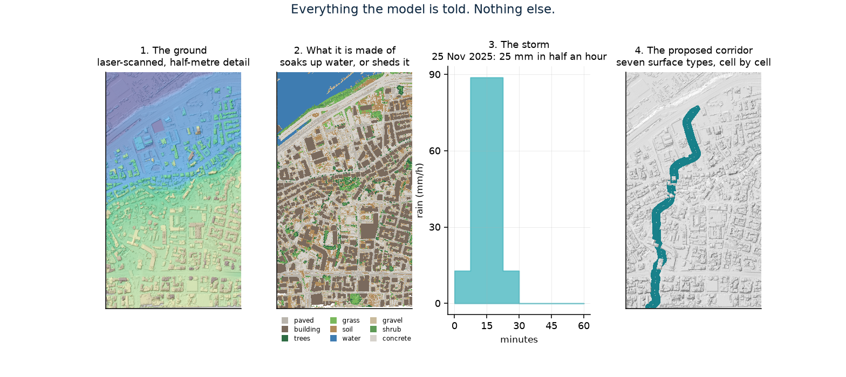
What goes in
A laser survey of the ground surface; what each patch of ground is made of; a storm; and the proposed design. Nothing else.
Notes:
39 GB of airborne laser data, gridded to half a metre — about 2.3 million squares. The land-cover map is what decides whether a square soaks water up or sheds it. The storm is a real recorded one. If the design team gives us their real drawings, that is a data swap and a re-run, not a rebuild.

Slide 5
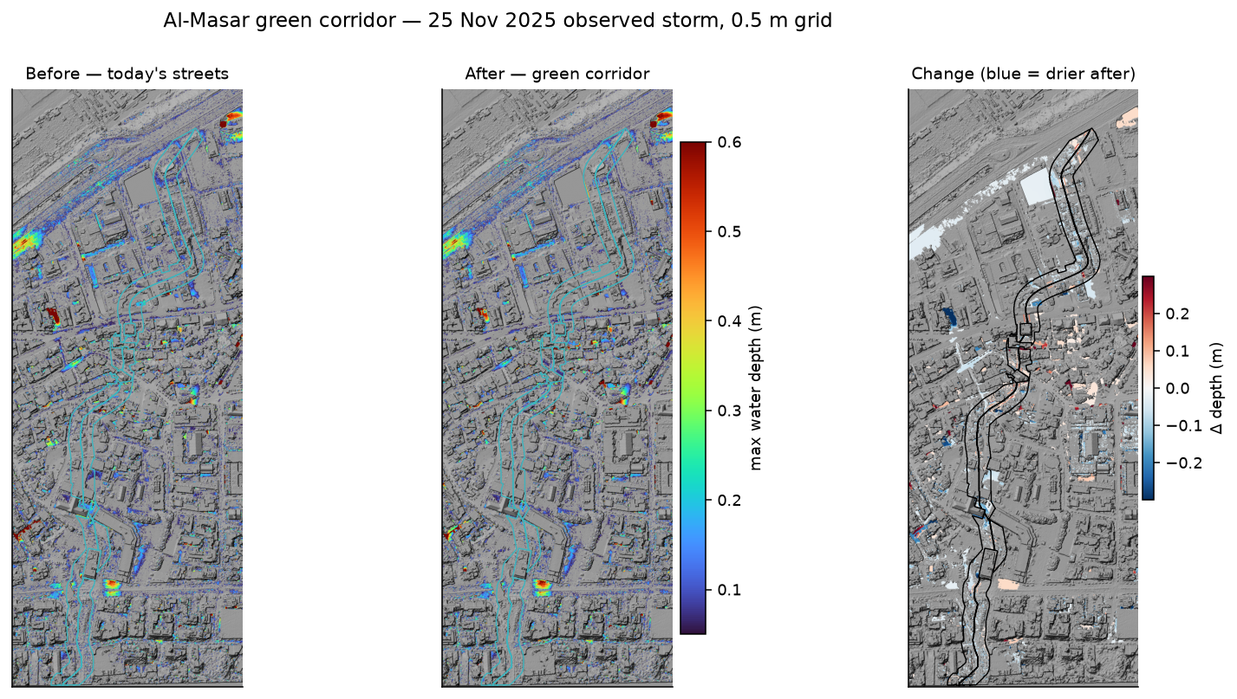
What comes out
Peak water depth during the observed storm — as things are today, with the corridor built, and the difference. Blue on the right-hand map means drier.
Notes:
Note the effect reaches beyond the corridor itself into the surrounding streets — the corridor sits on a natural drainage line, so it intercepts water coming down from Achrafieh. The large square at top left is a real deep construction excavation, surveyed by the laser and modelled as a basin. Genuine terrain, not an error.

Slide 6
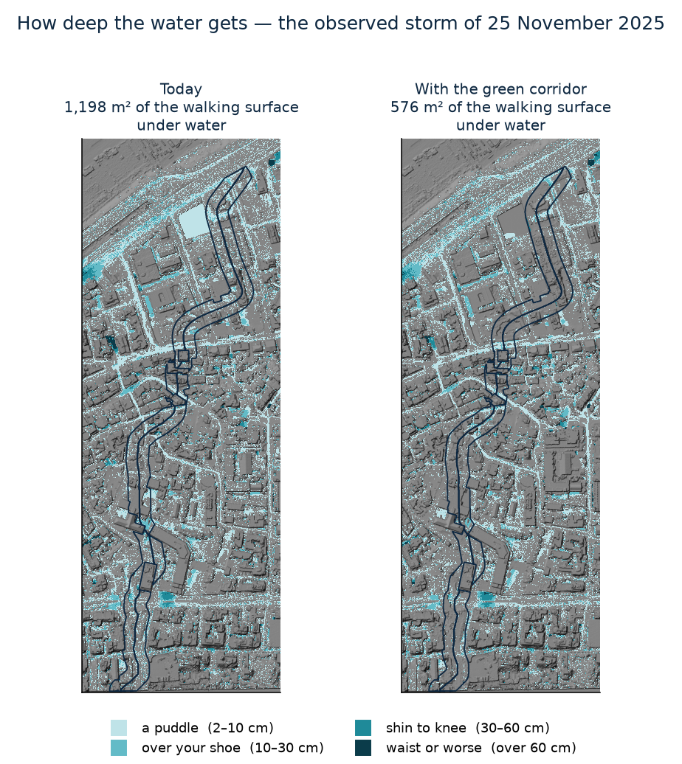
How deep, in terms you can picture
The model reports depth everywhere, every few seconds. Translated into what it means for a person on foot:
Today: 1,198 m² of the corridor's walking surface goes under water in the observed storm.
With the corridor: 576 m² — 52 % of it removed.
The dark outline is the corridor. Water that still shows inside it is mostly in the rain gardens and ponds, which are dug out to hold water on purpose.
Notes:
Depth in centimetres means little to most people; 'over your shoe' and 'shin to knee' mean a lot. If asked why water remains inside the corridor: that is the design working, not failing.

Slide 7
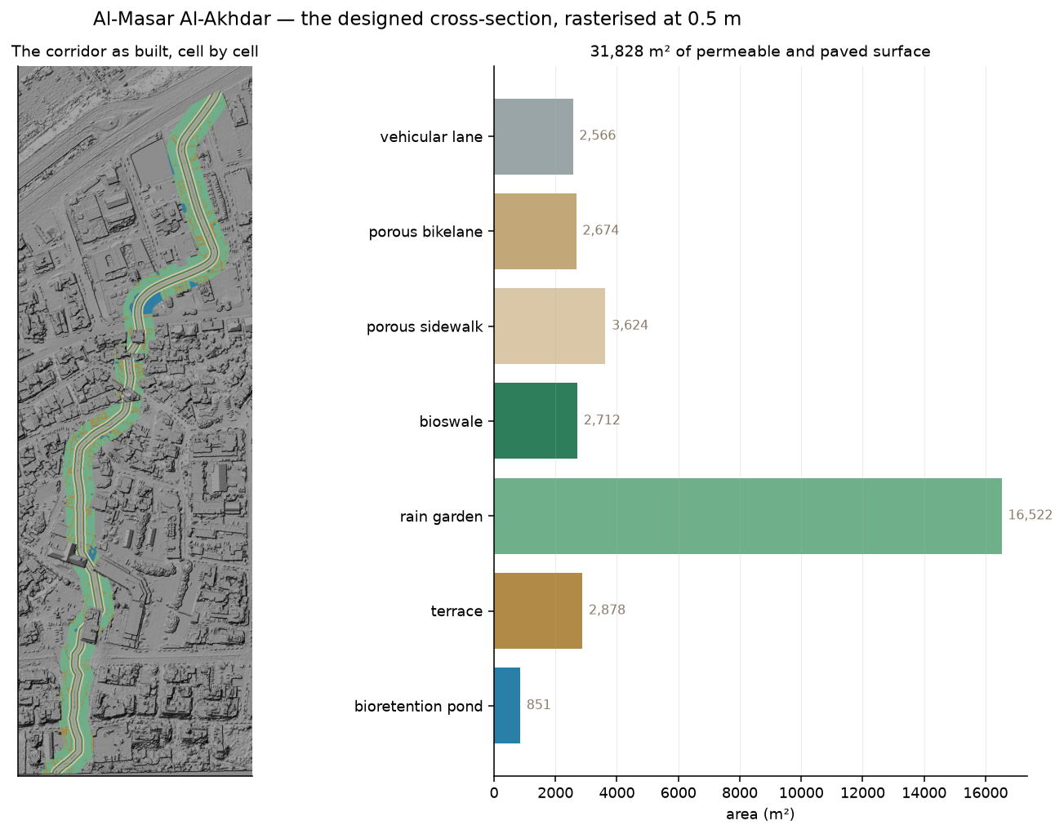
The corridor, as the model builds it
31,828 m² in total, laid down half a metre at a time
Seven different surfaces — rain garden, bioswale, bioretention pond, terrace, porous sidewalk and bikelane, vehicular lane — each with its own ability to absorb, slow and hold water
Rain garden is just over half of it; the engineered bioswales and ponds together are under 4,000 m²
Buildings in the corridor's path are removed from the terrain first, so the comparison is genuinely before-and-after
This is our reading of the design. The route and the zone come from the published dataset. The cross-section — how wide each band is, where the swales and ponds sit — is what we could make out from the drawings and what seemed sensible to us. Real dimensions would be a straight swap.
Notes:
Say the caveat unprompted — it costs nothing and it is the first thing a designer in the room will want to know. Frame it as an invitation: give us the real numbers and we re-run in a day.

Slide 8
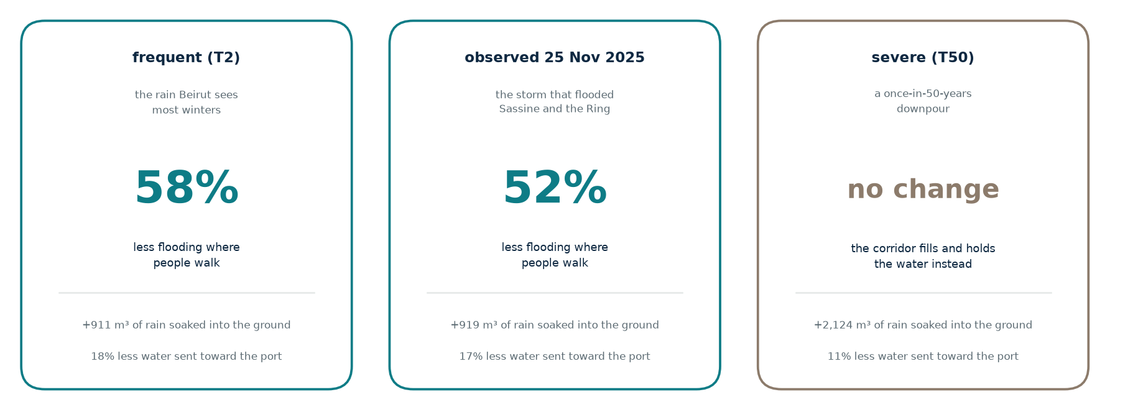
What it says
Measured on the surfaces people walk on. The fifth of the corridor dug out as swales and ponds is excluded — it holds water by design, and counting that as flooding would penalise the design for working.
Notes:
Three storms, three answers. The honest headline is that it works well for the rain Beirut actually gets most years, and that in a genuine 50-year storm it stops keeping its own surface dry and instead fills up and protects everywhere downstream. Two different jobs. Do not oversell the third card.

Slide 9
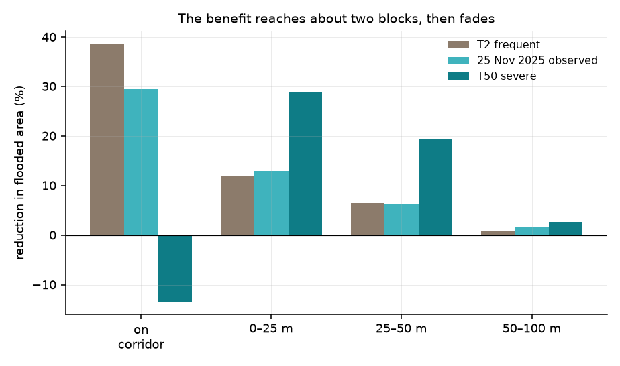
The benefit reaches about two blocks
The corridor is a thin ribbon, but the water it takes in would otherwise have run through the streets around it.
Measured by distance from the corridor edge, the improvement is strong on the corridor itself, clear within 25 m, still visible at 50 m, and gone by about 100 m.
This is a useful planning number. It says which streets a corridor helps and which it does not — and that a single corridor is a local remedy, not a city-wide one.
Notes:
Useful for managing expectations. Someone will ask whether this fixes flooding in Beirut. It does not — it fixes flooding along this axis, and the model can say exactly how far.

Slide 10
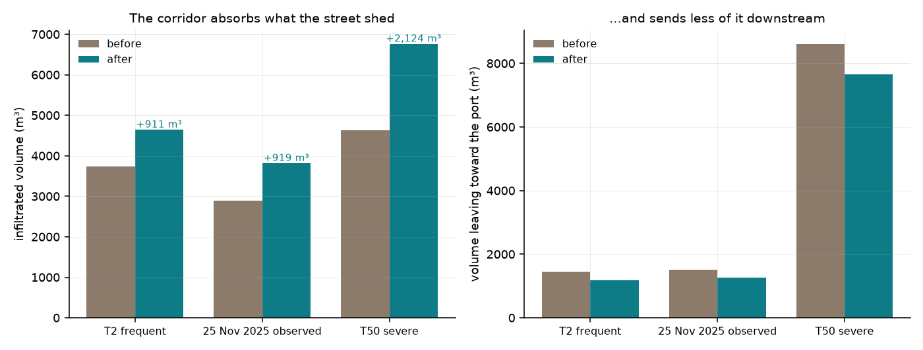
Where the water ends up
Two things happen to rain that the corridor catches
It soaks into the ground: an extra 919 m³ in the observed storm — roughly 368 bathtubs' worth that used to run down the street.
It stops flowing toward the port: 17 % less water reaches the sea outlet, which is where the city's drainage is under most strain.
In the 50-year storm the corridor absorbs the most of all — +2,124 m³ — even though its own surface stays wet. It is doing its job for everyone downstream.
Notes:
The bathtub comparison is only there to make cubic metres imaginable — use it or drop it. The serious point is the second one: less water reaching the port outlet is a benefit that does not show up on a flood map at all.

Slide 11
How much should you believe it?
What has been checked
It gets the textbook problems right — cases where the correct answer can be worked out on paper, all five of them.
It was run against a flood simulator written by a different team, on the same streets and the same storm. The two agree to within about 4 cm of water depth.
It was run against two international benchmark tests used to compare flood models, and sits inside the range of the nineteen commercial packages in that comparison.
It accounts for every drop: rain in equals water soaked up, drained, flowed away, or still standing — to five decimal places, every run.
What has not
Nobody has measured a flood in Beirut to compare it against.
Everything above compares the model to other models, or to problems with known answers. That is real evidence, and it is not the same as being right about this city.
The absorption rates of soils and paving are taken from published engineering tables, not measured on site.
So: use the comparisons with confidence — before versus after, which streets, roughly how much. Treat the absolute depths with more caution.
Notes:
Do not skip the right-hand column. Volunteering the limitation is what makes the left-hand column credible, and it sets up the ask on the next slide.

Slide 12
What would settle it
A modest field campaign, and nothing else, closes the gap
After the next significant storm: photographs and levelled marks where the water reached, at a few dozen street locations.
A handful of low-cost depth loggers at points that pond reliably.
A note of when key streets became impassable, and when they cleared.
No specialist equipment. No large team.
What it would buy
A measured error instead of a model-to-model one — the difference between a study that is defensible and one that can carry a planning decision.
We can help make it efficient. The model already predicts where flooding concentrates, so it can site the loggers and the survey points where they will be most informative. We would be glad to do that work alongside the project.
Notes:
Land this politely and concretely. It is an offer, not a complaint: we bring the model, they bring the city, and the measurement is cheap. Do not leave it as a vague 'more data would be nice'.

