Slide 1
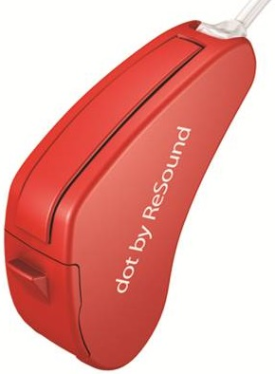


repeat
audio
in
try
audio
out
engineer
evaluate

