Slide 1


Slide 2
About Kotsovolos
Kotsovolos (Greek: Κωτσόβολος) is one of the leading electrical and electronics retailers in Greece. It started in a small neighborhood store downtown Athens in 1950 and today has a network of over 90 stores, in Greece and Cyprus, both corporate and franchise, as well as two online stores, kotsovolos.gr and kotsovolos.cy.
It has been a member of Dixons British company of electrical goods since 2005. In addition to retail, it provides after-sales support, installation, warranty and repair services, together with business-to-business services. The company's headquarters are located in New Heraklion, Attica.

Slide 3
Introduction
The purpose of this document is to describe the analysis and design of the Kotsovolos Order Management System (OMS), using Microsoft Azure services.
Kotsovolos uses the title KTP (“Keep The Promise”), in a general effort to fuse information from different systems (UNIXFOR, SAP, ORTEC, ABERON, CRM, etc), in order to achieve a guaranteed way of providing quality services to its customers. The architecture of the system and the basic OMS flow are described as well.

Slide 4
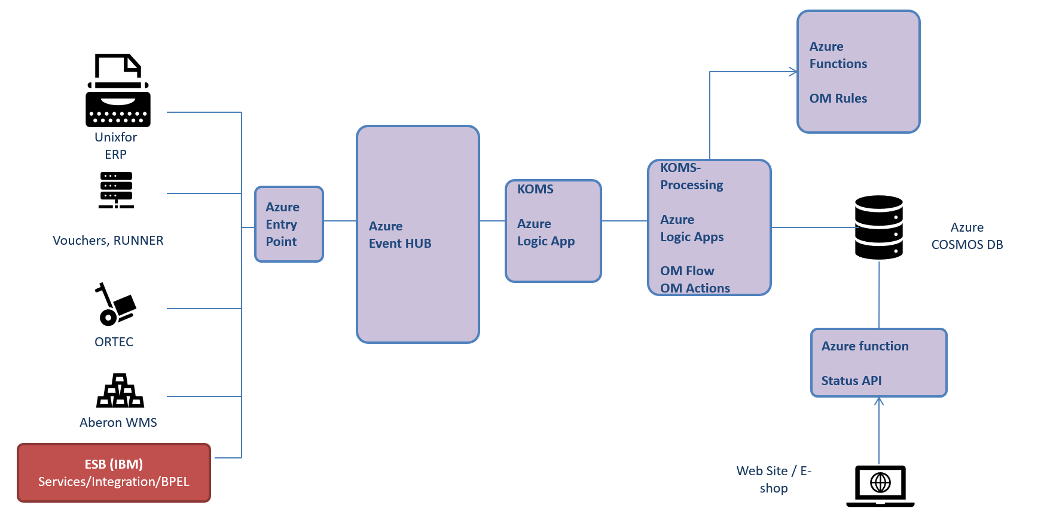
Solution Architecture

Slide 5
The main information element of KTP is in a JSON form. Different systems produce different JSON forms which are sent into an Azure Event Hub as input. A special entry point Azure Logic App (KOMSEntry) collects all events corresponding to Orders and redirects them into 10 Event Hub partitions according to the last digit of every Order key (OrderTransSeq).
Because it is possible to cancel an order with a view to reuse its receiver, delivery and line items information, it is expected to receive events based on a new OrderTransSeq but with the same aggregated data. For keeping the old information, especially when vouchers have been issued, the KTPkey is considered as an internal key which is used to avoid reiterations on existing vouchers. KTPkey is produced based on WCSOrderID.
A special central Logic App (KOMS) proceeds with the processing of all incoming events, applying business rules (by changing its JSON attributes) and producing a final JSON with all necessary changes depicting the current status of every order. The payload of every event is stored in a CosmosDB multi-model NoSQL Azure database (using its core-sql model API).

Slide 6
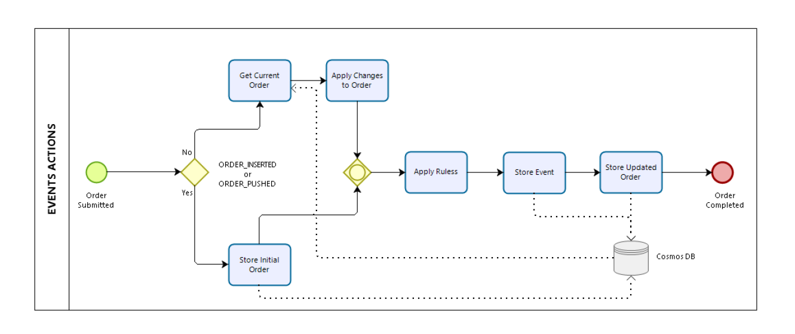
Event Actions

Slide 7
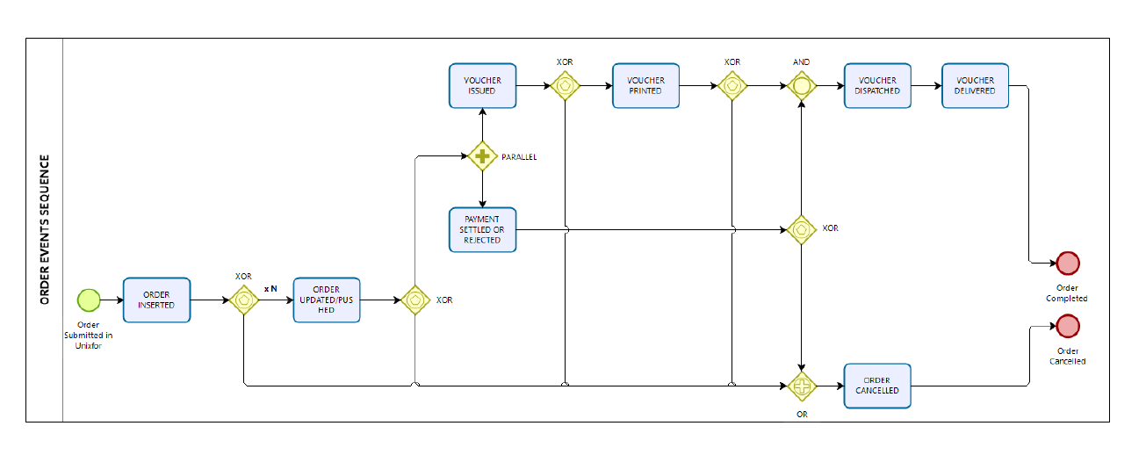
Order Events Sequence

Slide 8
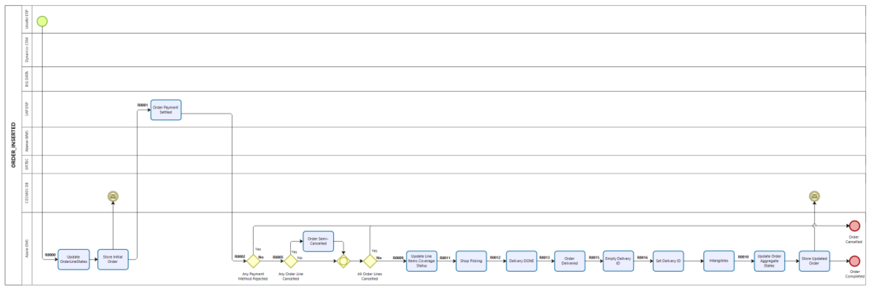
Order Inserted

Slide 9
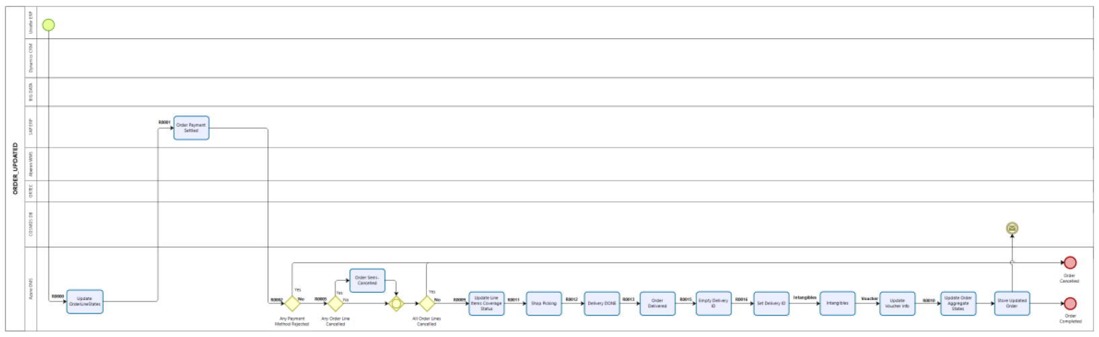
Order Updated

Slide 10
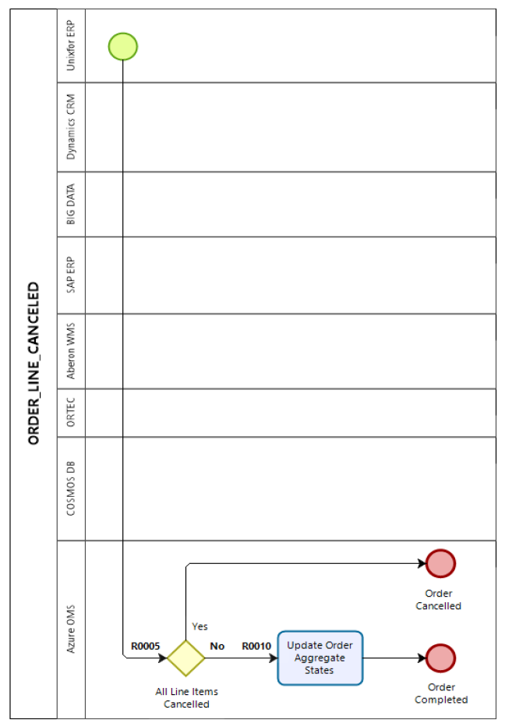
Order Canceled

Slide 11
The end

